Slide 1



L’évolution de la Grille
Maxime Lefrançois - MINES Saint-Etienne
http://maxime-lefrancois.info

Slide 2
Acteurs (historiques) de la grille
Producteur – EDF, …
Transporteur – RTE
Distributeur – ERDF, GrDF, + entreprises locales
Client – nous
Autorité de régulation – CRE

Slide 3
Sources d’énergie électrique pour la grille
Nucléaire
À flamme (gaz, fioul, charbon, incinérateurs,…)
Transformation d’énergie thermique
  Géothermie
  Centrales solaires
Transformation d’énergie mécanique
  Centrales marémotrices
  Centrales éoliennes
Sources d’énergie distribuées
Qu'est-ce qui change la donne ?

Slide 4





Change la donne - Véhicules Electriques
Recharge
  Prise domestique – 3kW
  T1 – 3 à 7kW
  T2 (Type 2) - 3 à 43kW
  T3 – 3 à 22kW
  CHADEMO – 50kW, DC
+ communication
+ limites du réseau
+ priorités
+ stockage
+ restitution ?

Slide 5
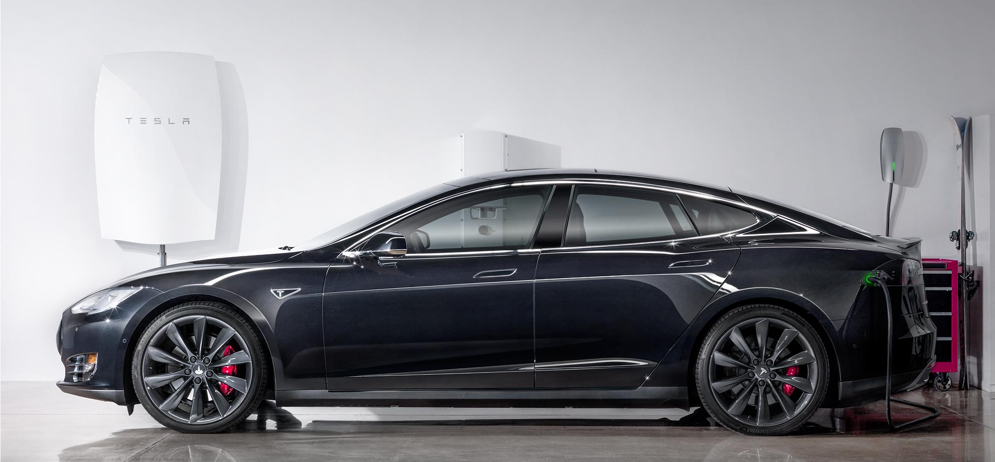
Change la donne - batteries
Exemple: Tesla Powerwall
  Puissance 3,3 kW, énergie 7 kWh

Slide 6
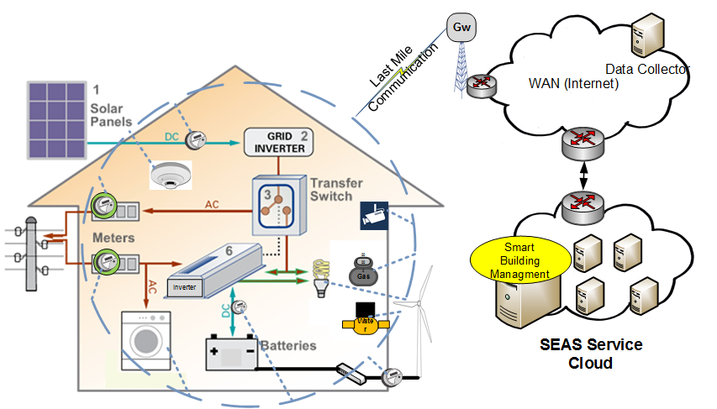
Change la donne -
Temps-réel

Slide 7
Nouveaux acteurs
Producteur – EDF, CNR,…
Transporteur – RTE
Distributeur – ERDF, GrDF, + entreprises locales
Client – nous
Autorité de régulation – CRE
Marché
Gestionnaires de microgrilles
Agrégateur
Opérateurs de charge pour véhicules électriques
Opérateurs de charge intelligente
…

Slide 8
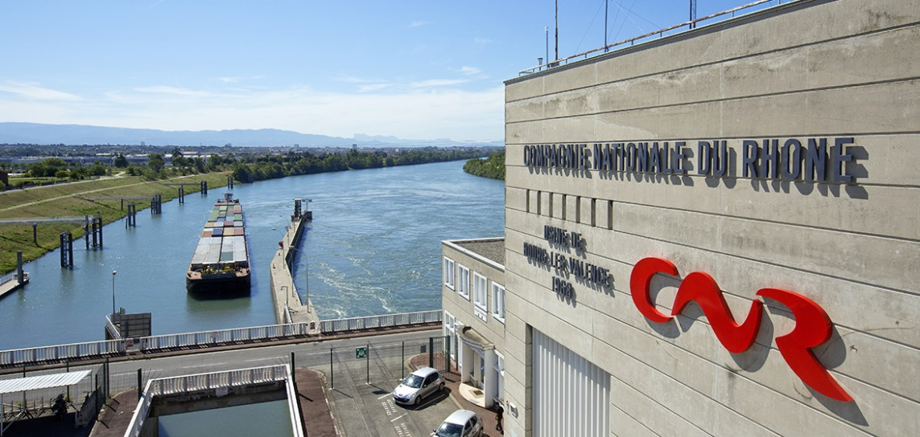
La CNR
Produit en moyenne 15 TWh par an
Produit le long du Rhône
Achète/vend de l'énergie sur "notre" marché international
Gère des flottes de véhicules électriques

Slide 9
Marché de l’énergie
Exemple Europe: EPEX, la bourse Européenne de l’électricité
-> Allemagne, Autriche, France, Luxembourg, Suisse
Prix de l’électricité : European Electricity Index (ELIX) (prix moyen 35 €/MWh)
1- Chacun s’engage en terme d’ achat/vente jusqu’à midi le jour i-1
par heure
ou par bloc
off-peak 1: 00-07
peakload: 08-19
sunpeak: 10-15
off-peak 2: 20-23

Slide 10
Marché de l’énergie
Exemple Europe: EPEX, la bourse Européenne de l’électricité
-> Allemagne, Autriche, France, Luxembourg, Suisse
Prix de l’électricité : European Electricity Index (ELIX) (prix moyen 35 €/MWh)
1- Chacun s’engage en terme d’ achat/vente jusqu’à midi le jour i-1
2- Ils font tourner leur algo, et calculent le ELIX du jour i

Slide 11
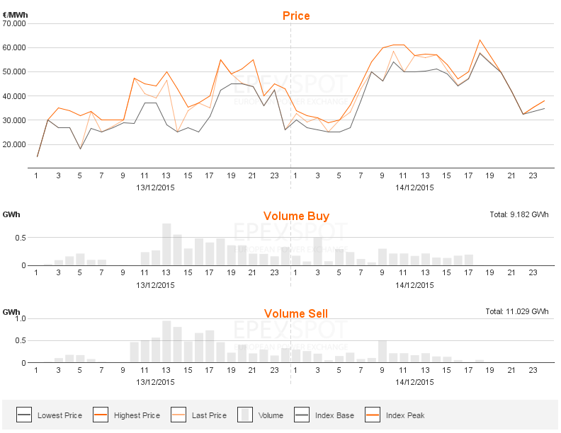
Marché de l’énergie

Slide 12
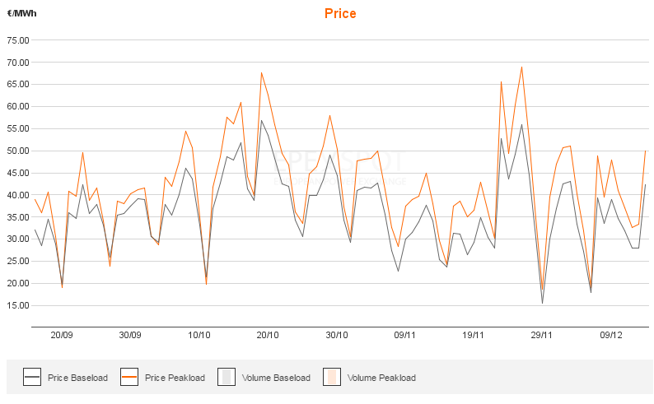
Marché de l’énergie

Slide 13
Marché de l’énergie
Exemple Europe: EPEX, la bourse Européenne de l’électricité
-> Allemagne, Autriche, France, Luxembourg, Suisse
Prix de l’électricité : European Electricity Index (ELIX) (prix moyen 35 €/MWh)
1- Chacun s’engage en terme d’ achat/vente jusqu’à midi le jour i-1
2- Ils font tourner leur algo, et calculent le ELIX du jour i
3- Grosses pénalités en cas de non respect de l’engagement

Slide 14
Marché de l’énergie
Marché
à plus ou moins long terme (mois, année, jour, heure)
plus ou moins gros volumes
plus ou moins cher
plus ou moins prédictible
dépend de l’heure,
des jours (évènements, ...),
des saisons (météo, …).
Que se passe-t-il si déséquilibre dans la production et la consommation ?

Slide 15
Nouveaux marchés de l’énergie
Demand/Response
Capacité de production
Capacité de non-production
Déplacement (shift)
Ecrasement (erase)

Slide 16
Nouveaux acteurs - Agrégateur
Un nouveau métier,
Contractent un ensemble de clients, et agissent comment une centrale virtuelle
Répondent aux appels du marché
Demand/Response
Capacité de production
Capacité de non-production
Déplacement (shift)
Ecrasement (erase)
Des Business Models à inventer
Problème du « Opt out » frénétique

Slide 17
Nouveaux acteurs
Producteur – EDF, CNR,…
Transporteur – RTE
Distributeur – ERDF, GrDF, + entreprises locales
Client – nous
Autorité de régulation – CRE
Marché
Gestionnaires de microgrilles
Agrégateur
Opérateurs de charge pour véhicules électriques
Opérateurs de charge intelligente
…

Slide 18
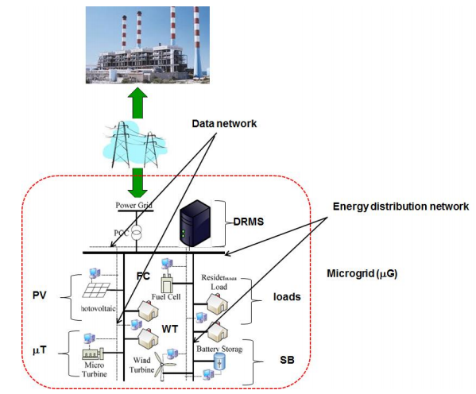
Exemple de la microgrille
Plus ou moins dépendant de la grille
  Jusqu’au fonctionnement en îlot
  ex simple: bateaux
Génération d’énergie
Stockage d’énergie
Charges

Slide 19
Sources d’énergie pour la Microgrille
Grille publique
Distributed Energy Resources
  Générateurs contrôlables
    ex. Micro-turbines (cogénération)
    ex. Pile à combustible (Fuel cell)
    …
  Générateurs non-contrôlables
    ex. Panneaux photovoltaïques
    ex. Eoliennes (wind turbines)
    …

Slide 20
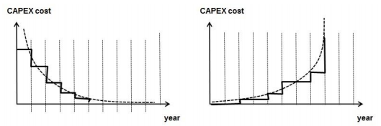
Prix de l’électricité pour une source
en €/kWh, peut être différent pour chaque source
Souvent, prise en compte d’une grille CAPEX - OPEX
  CAPEX - Dépenses d’investissement – (Capital Expanses)
  -> amortissement de l’achat
  OPEX - Dépenses d’exploitation (Operational Expanses)
  -> prix de maintenance
Pour la grille publique
  différents marchés, différentes formules

Slide 21
Microgrid Management Systems
Génération d’énergie
Stockage d’énergie
Charges
Demand/Response Management System (DRMS), = IA
objectif:
minimiser le prix de l’énergie nécessaire
pour satisfaire toutes les charges sur une période

Slide 22
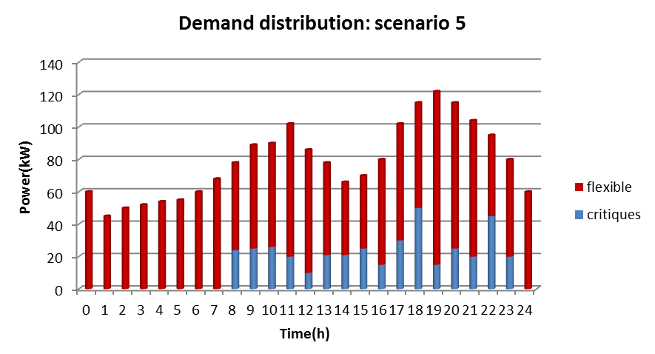
Caractéristiques générales Microgrille
Génération d’énergie
Stockage d’énergie
Charges
Demand/Response Management System (DRMS), = IA
objectif:
minimiser le prix de l’énergie nécessaire
pour satisfaire toutes les charges sur une période

Slide 23
Caractéristiques générales Microgrille
Génération d’énergie
Stockage d’énergie
Charges
Demand/Response Management System (DRMS), = IA
objectif:
minimiser le prix de l’énergie nécessaire
pour satisfaire toutes les charges sur une période
+ prédictions
  prix de l’électricité
  besoins
  ensoleillement -> génération par les PV
  vent -> génération par les éoliennes

Slide 24

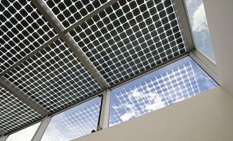

CONTEXT
A NEW WORLD FOR THE ENERGY
NEW BEHAVIOURS
DISTRIBUTED
dIGITAL
more open,
more collaborative,
more aware of the environment
An energy mix less centralized
makes electric system management more complex
A growing connectivity,
generates a common playground for IT and Utilities sectors
A PLETHORA OF INITIATIVES
Smart Meters, batteries, Smart Home, Micro Grid, Smart Grids, Smart Cities, Smart EV Charging, new services, etc.
ISSUE : CONNECT AND AND HELP THESE PROJECTS

Slide 25






















The ITEA 3 SEAS project
3 years, 6 countries, 35 partners, 230 person-year
Design and develop a global ecosystem of distributed
services that all target energy efficiency.
WP 1 - use cases, business models, requirements, architecture
WP 2 - knowledge model, knowledge based services
WP 3 - Smart Building
WP 4 - Microgrids, and Electric Vehicles
WP 5 - Simulations
WP 6 - Prototypes and Pilots
WP 7 - Standardization

Slide 26
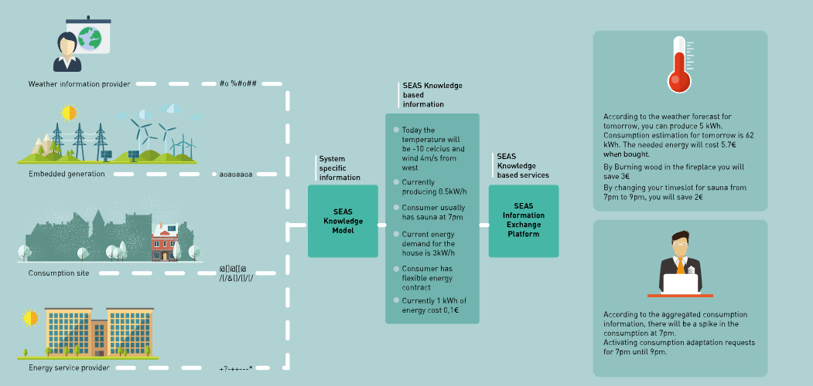
CONTEXT
THE potentiAL of REAL time energy management

Slide 27

Market vision
Competitive activities
Customer
Unregulated data provider
Energy retailer
Resource
provider
Provides
Prosumer
Consumer
Manages
Manages
Manages
Metering data,
other data
Resource object
1,2…n
owns
owns
Energy supply
Object
1,2…n
Object
1,2…n
Flexibility
BRP
Energy
producer
Manages
Manages
market access
Relationship 1,2…n
Power plant
Markets
Regulated activities
Wholesale market
Retail market
Long-term markets
Intraday market
Ancillary services
TSO
DSO
Manages
Manages
Day-Ahead market (DAM)
Balancing markets
Flexibility market
Capacity market
MV/LV Grid,
regulated
metering data
HV Grid, load balance

Slide 28
Algorithmes - Exemples
Notes:
Home area networking (HAN) provides inter-connection between sensors, actuators, home appliances and meters at home level. This network via a proxy connects to NAN. The NAN provides the last mile connection between proxy and the data concentrator and the data concentrator connects to the HES via Wide Area Network (WAN). The requirements for the design of HAN and NAN vary from environment to environment. For examples, the design of data network for a high-rise buildings in very dense metropolitan area is completely different from a building in a suburb residential area. Moreover the regulatory rules and policies change from a country to another for RF technologies and ISM bands . All these mean that there is no one all fit solution to satisfy different requirements for data network solutions.
In SEAS we proposed a hybrid solution. The solution may be based on long range communication technologies with a star topology or a meshed topology using short range communication solutions.
In the second solution all the end-points (sensors and smart meters) are directly joined the NAN meshed network.
The third solution again follows the HAN/NAN architecture; the difference is that the NAN relies on long range RF solutions to create a star topology and all the NAN end-points connect directly to the NAN gateway.
The fourth solution push all the end-points into the NAN; then the NAN is organized using RF long range technology similar to the third solution.
The fifth solution shows a solution in which HAN via a Home level Gateway connects the end-points directly to the WAN (Internet).

Slide 29

Algorithmes de prédiction de charge:
réseaux de neurones (CEA LITEN)
Architecture choice
Analyze
Input Parameters
Number of layer
Number of neurons
Activation function
Learning to determine system structure
Historical data
(P, Tmax, Tmin, Tmoy…)
Training
Evaluation criteria
Application
…
…
Variable Inputs
Determined Architecture
Load forecasting
(ex: J-1)
…
…
…
…
…
…
…
…
…
…
Hidden layers
Input layer
Output layer
Notes:
29

Slide 30
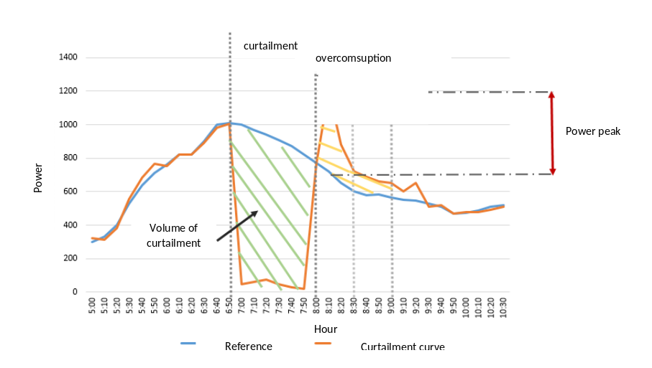
Technical Progress
LOAD SHIFTING ON THE HOUSEHOLD DEPOSIT (ECOMETERING)
Context and objectives:
In France, almost 30% of households use electric heaters. It is a consumption of about 43 TWh of electricity per year, allowing load shedding during winter peaks (gradient: 2 GW/°C). In order to assess real flexibility potential, we used data from another ENGIE project regarding households DSM services.
The objectives in the SEAS are :
- Specify DSM product for microgrid energy management: duration, schedule, interval between two curtailments
- Understand and model the deformation of the load curve based on different technologies and curtailment formats
- Analyze the impact on the indoor temperature and thus on client comfort
- Estimate the customer acceptance
Results:
Deformation profile :
  Curtailment between 60% and 100% of the deposit depending on the steering method,
  Power peak of 50% after the curtailment,
  Average of overconsumption of 50% one hour after the curtailment.
Low impact on the comfort, with less than 1°C of drop in temperature, and about 5% of derogation
These results could be extended to the air conditioning systems of tertiary sites. The deformation profile between air conditioning and heating could be close enough

Slide 31

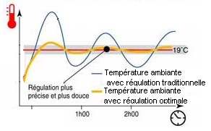


Technical Progress
MANAGEMENT STRATEGIES FOR RADIATORS (CEA LITEN)
Constraints
Minimize peak consumption
Puissance
Power
1
P_{total}≤ P_{permissible}
Temps
Time
Optimize comfort
METHODS
Controlable load (direct)
Charges pilotables (directes)
2
u₁
u₁
u₂
u₂
u_{k}
u_{k}
u_{n}
u_{n}
Radiators
Minimize costs
P
Radiateur
3
P
P
P
P
P
n
2
n
1
2
1
u: Start/stop (1/0)
u:marche/arrêt (1/0)

Slide 32
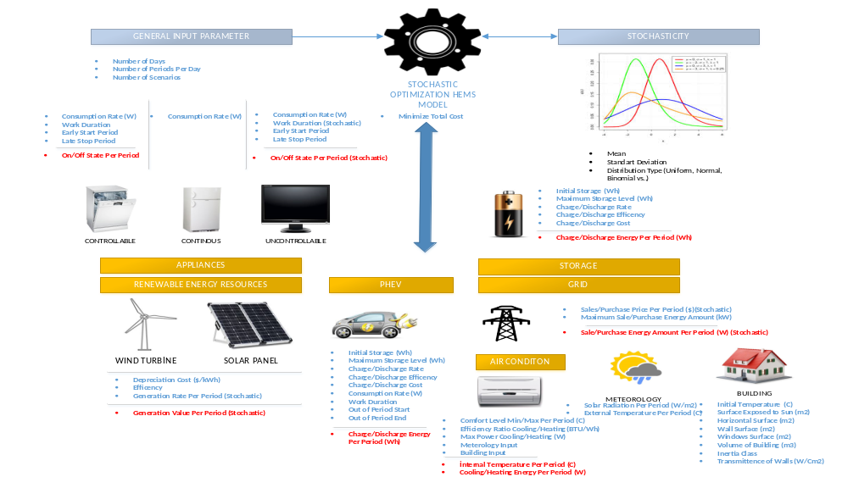
Technical Progress
Technical Progress
A Stochastic Approach for Smart Home Energy Management (UC12) (INNOVA)

Slide 33
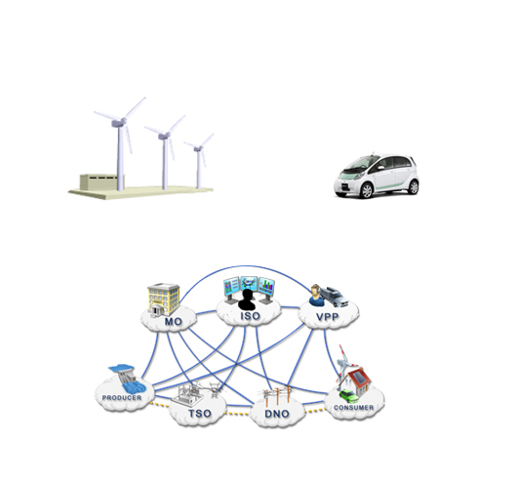
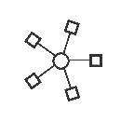

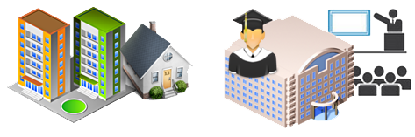
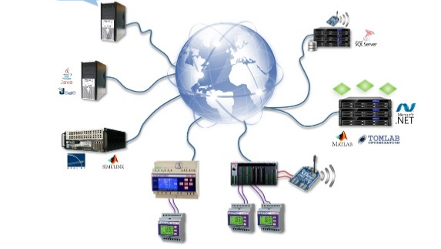

Expose algorithmes => services
Optimization
Forecasting
EVs
Algorithms, Tools &Business Models
Tools
WP4
Residential Microgrid
University Campus Microgrid
Case Studies & Data Sets
Shared Intelligence Platform
Microgrids Multiagent platform
(GECAD academic pilot)
Platforms
Case Studies repository
Notes:
.

Slide 34
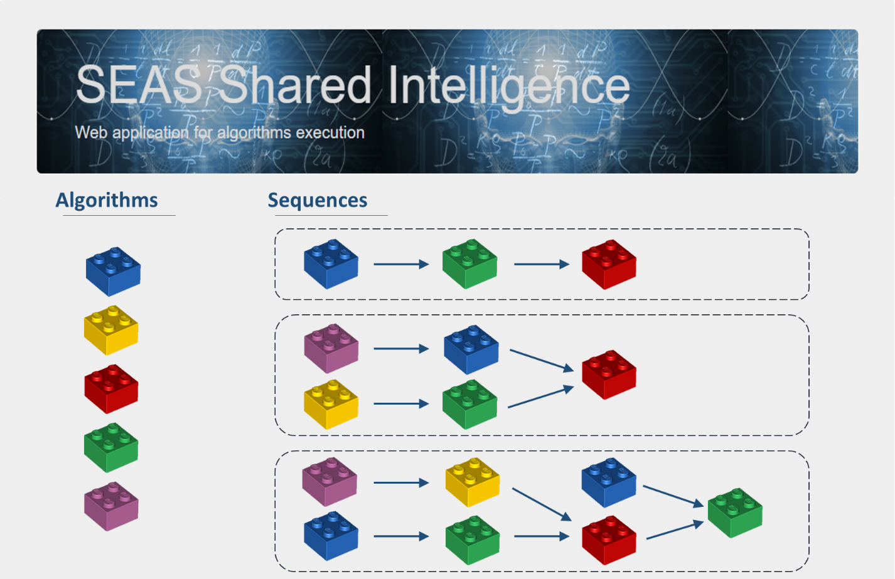
Composition des services
Notes:
.

Slide 35
Architecture
IoT strengh
  Cross information collected from different domains in order to realize better analysis and provide more meaningful information
  Difficult to set up if data collection happen in closed platforms using different data representation and technology
  Necessity to have common grounds
Several architectures/platforms/standards exist to collect data
  But, most of them, work only for specific domains and often in contained environment
Distributed SEAS Core Services (meta services)
  Data not centrally stored, understandable and valid for years (Ontology)
  Possibility to search and find data/services (Registration)
  Pricing done on a transactionally basis (Transaction)
  Ensuring privacy and data protection (Security)
  Distributed SEAS Core Services (meta services)

Slide 36
Architecture
SRAM
  Enable any existing IoT platforms (even closed) to participate in SEAS Architecture (Share information / Provide services)
  Ensure that only trusted entities can access data
  Applicable to all UCs
  Extensible to new businesses

Slide 37
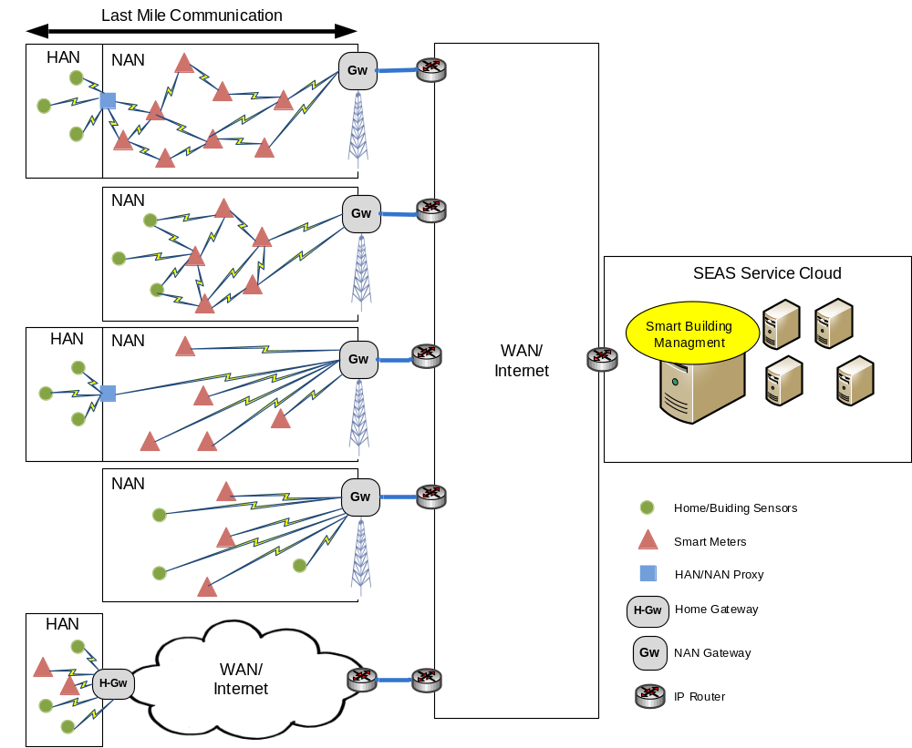
Architecture - Internet of Things
Notes:
Home area networking (HAN) provides inter-connection between sensors, actuators, home appliances and meters at home level. This network via a proxy connects to NAN. The NAN provides the last mile connection between proxy and the data concentrator and the data concentrator connects to the HES via Wide Area Network (WAN). The requirements for the design of HAN and NAN vary from environment to environment. For examples, the design of data network for a high-rise buildings in very dense metropolitan area is completely different from a building in a suburb residential area. Moreover the regulatory rules and policies change from a country to another for RF technologies and ISM bands . All these mean that there is no one all fit solution to satisfy different requirements for data network solutions.
In SEAS we proposed a hybrid solution. The solution may be based on long range communication technologies with a star topology or a meshed topology using short range communication solutions.
In the second solution all the end-points (sensors and smart meters) are directly joined the NAN meshed network.
The third solution again follows the HAN/NAN architecture; the difference is that the NAN relies on long range RF solutions to create a star topology and all the NAN end-points connect directly to the NAN gateway.
The fourth solution push all the end-points into the NAN; then the NAN is organized using RF long range technology similar to the third solution.
The fifth solution shows a solution in which HAN via a Home level Gateway connects the end-points directly to the WAN (Internet).

Slide 38

The ITEA 3 SEAS project
3 years, 6 countries, 35 partners, 230 person-year
Design and develop a global ecosystem of distributed
services that all target energy efficiency.
1- what the commercial expected from this task

Slide 39


The ITEA 3 SEAS project
3 years, 6 countries, 35 partners, 230 person-year
What is the universal language that will answer the need for message routing, trust, security, privacy ?
2- what partners expected from this task

Slide 40

The ITEA 3 SEAS project
3 years, 6 countries, 35 partners, 230 person-year
Design and develop a global ecosystem of distributed
services that all target energy efficiency.
Task:
Ground the Knowledge Model on Semantic Web formalisms
T 2.2 - knowledge model - domains to be covered
Energy market: demands, offers, transactions
Contracts: demand-response, aggregators, Data privacy, access control
The grid itself: architecture, characteristics, limitations
Energy generation/load/storage/transfer
Smart Building: architecture, environmental factors
Smart Building: its interaction with the environment
The environment, weather information
Electric vehicles and charging equipments
Time series: history, observations, forecasts
Controllable and non-controllable appliances / loads
Energy generators / batteries
SEAS service and their interfaces (registration and discovery)
3- how I felt when I first found out

Slide 41
The ITEA 3 SEAS project
3 years, 6 countries, 35 partners, 230 person-year
Design and develop a global ecosystem of distributed
services that all target energy efficiency.
challenge in Knowledge Representation
numerous domains, specialized or not
challenge in Knowledge Engineering
collaboration with scattered partners
challenge in vulgarisation
no knowledge of Semantic Web formalisms
challenge for pilots
semantic interoperability at low cost
for services and constrained devices

Slide 42
Knowledge Representation challenges
multiple, different domains
there exists many many ontologies
  sometimes they are pushed forward by politics
  but their quality is not there (ex: QUDT, SAREF)
  sometimes they reuse different, incompatible ontologies for the same domain (e.g., quantities - QUDT vs OM vs UCUM)
  sometimes they evolved, became deprecaded, or disappeared
more are currently being standardized
  W3C OWL Time, Semantic Sensor Networks ontology, ...
  oneM2M Base Ontology, W3C WoT Things Description ontology, ...

Slide 43
Knowledge Engineering challenges
Many partners, distributed all around Europe
How to capture their representation needs ?
How to get them to contribute on an ontology ?
(the ontology is meant to be used)
  who needs to understand Semantic Web formalisms ?
  how to teach them ?
  where will it be implemented ?

Slide 44
Proposals 1/2: Knowledge Engineering
make interviews with partners that are close
focus on available data of some partner
ask partners to document their algorithms inputs/outputs
develop and use a MediaWiki extension to collaboratively edit, and publish linked vocabularies
Organize a 3-days workshop with 45 ppl & 6 KnEng
→ Focus on
  what they all need
  has not been addressed already
  not currently being standardized
(Gomez et.al., PSC'16)
(Lefrançois & Zimmermann, IC'15)
http://data.the-smart-energy.com/workshop/2015/12
http://videolectures.net/SEASworkshop2015_paris/

Slide 45
Ingénierie de la connaissances
http://data.the-smart-energy.com/workshop/2015/12/
vidéos sur videolectures.net, ex.,
Flexibility Operation in Nordic Demand Response Markets,
Jan Segerstam, Empower
http://videolectures.net/SEASworkshop2015_segerstam_response_markets/
+ Initier les participants au Web Sémantique
+ Capturer les besoins pour le modèle de connaissances (RDF)
-> Ingénierie de la connaissance
Demands, offers, transactions
Contracts for demand-response or aggregators
The infrastructures characteristics and limitations
Energy generation/load/storage/transfer
Smart Building zones and environmental factors
Smart Building and its interaction with the environment
Controllable and non-controllable appliances / loads
Controllable and non-controllable energy generators
electric vehicles and charging equipments
Characteristics specific to batteries
Time series: history, observations, forecast
Data privacy and access control – contracts
Describing very light messages sent to/from sensor/actuators
Describing SEAS service and their interfaces to ease their registration and discovery

Slide 46
Description sémantique
Les ontologies SEAS
https://w3id.org/seas/

