Slide 1
Predicting a 10% loss in the S&P 500
Michal Bem, Flynn Kelleher, Qianying Ma, Karel Moryoussef, Pir Mujtaba, Connor O’Neil, Maria Ryabova, Rafa Salama, Maxime Vallot, Samantha Vun, Olivia Yuan
Harvard Management Company
MIT Sloan 15.451 Investment Management Lab
October 22, 2026

Slide 2
01 | The question and the baseline
02 | Predictors and methods
03 | Results
04 | RBP in three sell-offs
05 | Conclusions

Slide 3
The question
What is the probability that the S&P 500 loses 10% or more over the next three months?
10%
1930–1990
1991–2025
loss in the S&P 500 Total Return Index
723 rolling 3-month training periods containing 22 drawdown episodes
420 rolling 3-month test periods containing 12 drawdown episodes

Slide 4
Normal distribution vs. actual RESULTS
Let’s suppose annual returns are distributed
1928–2026 (11.7% mean, 19.9% volatility a year)
9.0% Chance of a three-month window ending down 10%
What Happened?
6.9%
81 of 1,182 rolling three-month windows,
~0.8x the normal
1976–2026 (12.5% mean, 14.7% volatility a year)
3.1% Chance of a three-month window ending down 10%
What Happened?
4.5%
27 of 606 rolling three-month windows,
~1.5x the normal
Notes:
In the first part of our analysis, we set a baseline: a normal distribution with the historical mean and volatility of total return. Over 1928–2026, the normal gives a 9.0% chance that a three-month window ends down 10% or more (about 106 of 1,182 windows). In fact, 6.9% did, 81 windows, so over the full sample the normal overstates losses. That’s because of the Great Depression, a period of very high volatility, which pushes the full-sample volatility up. If we leave it out and look at the period since 1976, the picture reverses: the normal gives only a 3.1% chance, about 19 of 606 windows, against the 4.5%, or 27 windows, that actually happened. Since 1976, losses came about one and a half times as often as the normal allows, because real returns have fatter tails than a normal curve.
----
Why the normal overpredicts over 1928–2026 but underpredicts since 1976. The Depression era, 1928–1945, had about 35% volatility a year, with swings both ways (three-month returns from −45% to +93%). It pulls the full-sample volatility up to 19.9%, so the normal expects more 10% losses (9.0%) than happened (6.9%). Outside it, volatility is about 14–15% a year and the normal underpredicts in every period (1946–1975: 3.1% against 4.4%; since 1976: 3.1% against 4.5%), because real returns have fatter tails than a normal curve: crashes such as 1987, 2008 and 2020 come more often than it allows. 1973–74 adds only 5 of the 81 windows.

Slide 5
Rolling 3-Month Returns Since 1928
81
three-month windows ended 10% or more down, out of 1,182
21
of them in our 1991–2025 test window, in 12 separate episodes
S&P 500 total return, month-end rolling three-month windows, 1928–2026
Notes:
This chart shows what actually happened: every rolling three-month window since 1928, with the −10% line. 81 windows ended below it, and they’re far from evenly spread. Almost half, 38, are in the Depression era, 1928 to 1945, which is why the full-sample normal overstates losses. From 1991 to 2025, the period we test our models on, 21 windows ended down 10% or more. The windows overlap, so those 21 come from 12 separate episodes: the dot-com bust, the financial crisis, COVID, and the 2022 sell-off among them. That’s 21 of 420 month-ends, a 5% base rate: one month in twenty. That’s the bar every model has to beat.
-- QnA
Backup: the full-sample normal expects 38 losses in the test window, but only because it includes the Depression. A normal fitted to 1991–2025 alone expects about 12, so about 1.7 times as many losses happened as it allows.
- 21 loss windows start in: 1998, 2000–02, the dot-com bust, 2007–08, the financial crisis, 2010, 2011, 2018, December 2019, which runs into COVID, 2022
For 1991–2025, 11.5% historical mean and 14.3% historical volatility a year.
The 1991–2025 test window has 420 month-ends, and 21 of them (5.0%) were followed by a 10% loss. The full-sample normal (9.0% a window) expects 38 there, so over the test window it overpredicts, as over 1928–2026. But a normal fitted to 1991–2025 alone (11.5% mean, 14.3% volatility a year) gives 2.9% a window and expects only 12, so about 1.7 times as many losses happened as it allows: the same fat tails as since 1976, on the period we test on.

Slide 6
Chosen Predictors
Group | Predictor | From | Known at the forecast date as
Market | Past 3-month return | 1928 | Through month-end
 | Trailing volatility (63 days) | 1928 | Second-to-last trading day
 | Credit spread (Baa − Aaa) | 1928 | Previous month's average
 | GARCH volatility forecast | 1938 | Second-to-last trading day
Composite | Absorption-ratio shift | 1929 | Second-to-last trading day
 | Turbulence | 1930 | Second-to-last trading day
Monetary | Yield-curve slope (10y − 3m) | 1934 | Previous month's average
Valuation | CAPE | 1928 | Earnings lagged 6 months
 | Concentration (HHI) | 1957 | Month's last close
Macro | Industrial production, 12m | 1928 | First release
 | Inflation (CPI), 12m | 1949 | First release
 | Unemployment change, 12m | 1960 | First release
Sentiment | Consumer sentiment (Michigan) | 1952 | Previous month's final

Slide 7
Two predictors that see danger differently
ABSORPTION RATIO
GARCH VOLATILITY
Are markets moving as one?
Is the market getting rougher?
How much of 17 industries’ moves come from a few common forces (PCA)
When everything moves together, a shock spreads further: the market is fragile
Meant to flag that fragility before a fall
Forecasts next quarter’s volatility from how calm and rough periods cluster
Forecasts better than simply looking at past volatility
Sees a crisis once it has begun
52%
27%
of 10% losses had a spike
of other months
But 9 in 10 spikes were false alarms: it flags fragility, not timing · 1991–2025
Two different signals, correlated at only 0.27: one looks for fragility before a fall, the other measures stress during it. Each brings new information to every model.
Notes:
We built two predictors ourselves. The absorption ratio asks whether all industries are moving as one: that is fragility, and it tends to show before a fall, though with many false alarms (no spike before losses that began in calm markets, such as Dec 2019 and Mar 2022). GARCH measures how rough the market is getting, so it sees a crisis once it has started. Correlation 0.27 (absorption-ratio shift against GARCH volatility, monthly to 2025, as on the next slide), against 0.78 between GARCH and trailing volatility. Payoff: the absorption-ratio shift is in RBP's top two almost everywhere.

Slide 8
Most predictors carry their own information
 | 1 | 2 | 3 | 4 | 5 | 6 | 7 | 8 | 9 | 10 | 11 | 12 | 13
1 Past 3-month return
2 Trailing volatility | −.28
3 Credit spread | −.09 | .69
4 GARCH volatility | −.42 | .78 | .47
5 Absorption-ratio shift | −.21 | .39 | .10 | .27
6 Turbulence | −.27 | .47 | .14 | .50 | .23
7 Yield-curve slope | .03 | .16 | .34 | .16 | −.06 | −.17
8 CAPE | .01 | −.09 | −.38 | .05 | −.02 | .16 | −.24
9 Concentration (HHI) | −.05 | −.20 | −.26 | −.23 | −.05 | −.02 | −.39 | −.11
10 Industrial production | .04 | −.17 | −.21 | −.05 | −.14 | −.19 | .01 | .01 | .10
11 Inflation (CPI) | −.12 | .07 | .33 | .01 | .06 | .06 | −.24 | −.35 | .06 | −.00
12 Unemployment change | .12 | .27 | .43 | .17 | .15 | .15 | .04 | −.16 | .06 | −.81 | .04
13 Consumer sentiment | .03 | −.28 | −.47 | −.21 | −.12 | −.01 | .02 | .26 | −.01 | .40 | −.50 | −.33
60 of 78
pairs correlate below 0.3
Only five pairs at .50 or more
Industrial production and unemployment (−.81)
GARCH and trailing volatility (.78)
Trailing volatility and credit spread (.69)
Inflation and sentiment (−.50)
GARCH volatility and turbulence (.50)
Red: move together · Blue: move in opposite directions · Monthly, 1930–2025, each pair over the months both exist
Notes:
Slide 7 showed two predictors that barely overlap (absorption ratio and GARCH, 0.26). Here is the same check for all thirteen. Most pairs are weakly related: 60 of 78 below 0.3, median 0.16. The few strong pairs are expected: the economy shows up in both industrial production and unemployment, and GARCH and trailing volatility measure the same thing two ways. So each predictor brings something the others do not, and every method gets the same thirteen.

Slide 9
Regressions: one rule for every market
LOGISTIC REGRESSION
PENALIZED LOGIT
LESSON
What matters on average?
What survives caution?
Two kinds of danger
One weight per predictor, the same in every market.
The same, with every weight pulled toward zero.
Slow build-up: high inflation, expensive stocks. Visible stress: rising volatility, wider credit spreads. Does danger come when both appear together?
RELIES MOST ON
RELIES MOST ON
Inflation
CAPE
Inflation
GARCH volatility
Past 3-month return
Credit spread
1 of 21 losses warned of
3 of 21, warnings right 18% of the time
Notes:
Logit: only 3 of 13 predictors significant (inflation t = 3.0, CAPE 2.3, past return -2.0); volatility is not (-1.0). Penalized logit: L2 penalty chosen on 1961-1990, trained from 1930; ranking by permutation importance, full sample 1930-2026. Plain logit: 72 warnings, 1.4% right. Inflation is the thread: every model puts it in its top two.

Slide 10
Machine learning: more flexible rules
NEURAL NETWORK
GRADIENT BOOSTING
LESSON
Do signals combine?
Are there danger zones?
Crisis by crisis?
Learns how predictors interact. Small: 8 hidden units, an average of 5 networks.
Adds up many simple threshold rules, one predictor at a time.
Every model agrees on inflation and disagrees on the rest. Too few past losses to learn one rule that fits them all.
RELIES MOST ON
RELIES MOST ON
Inflation
Credit spread
CAPE
CAPE
Inflation
Industrial production
2 of 21 losses warned of
7 of 21, the most of the four
Notes:
Network: credit joins inflation; volatility drops to the bottom. Boosting: valuation past a level is the clearest zone. Rankings by permutation importance, fitted on 1930-2026 (in sample). Settings for both chosen on 1961-1990.

Slide 11
Most losses go unwarned
Warning: forecast probability of a 10% loss ≥ 10% · 420 month-ends, 1991–2025 · 21 followed by a 10% loss
At 10% | Normal distribution | Logistic regression | Penalized logit | Neural net | Gradient boosting
Warnings (months) | 291 | 72 | 17 | 51 | 57
Share of 10% losses preceded by a warning | 86% | 5% | 14% | 10% | 33%
True positives (warnings followed by a loss) | 6.2% | 1.4% | 17.6% | 3.9% | 12.3%
Notes:
Read the share of losses preceded by a warning first (Kritzman's row), then true positives against the 5% base rate. At best a third of the 21 losses had a warning (boosting, 7). The logit's and the network's warnings were right less often than the base rate. The normal warns almost every month: 86% of losses, but right 6% of the time. Handover to Flynn: none of these warns before more than a third of the losses, because each learns one rule; RBP looks up the past months most like today.

Slide 12
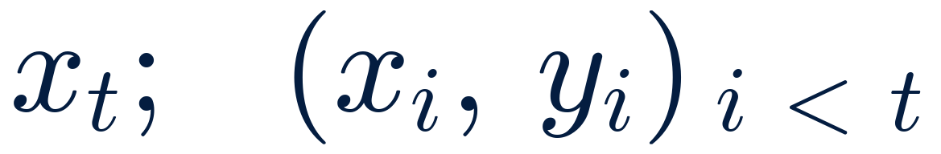
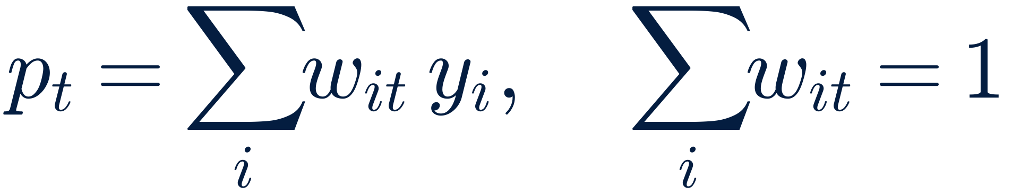
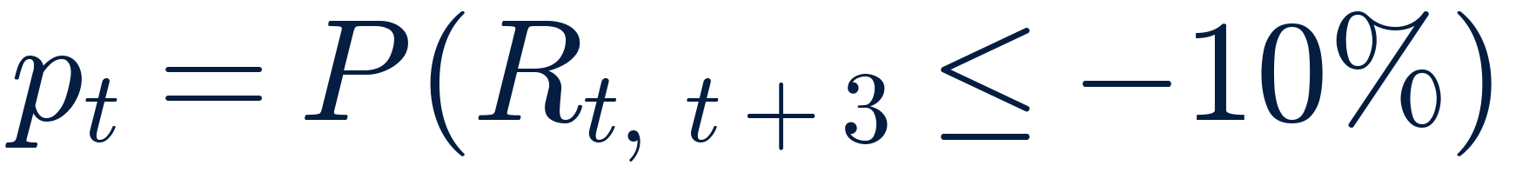
Relevance-based prediction (RBP)
INPUTS
MODEL
OUTPUTS
13 predictors at the prior month’s end
Every past month since 1930: its predictors and whether a 10% loss followed
Each past month weighted by its relevance to today (similarity plus unusualness)
Averaged over predictor subsets and relevance cut-offs, weighted by fit
Probability of a 10% loss over the next three months
Warning when the probability is at or above 10%, 15% or 20%
Fit of each forecast: how much to trust it

Slide 13
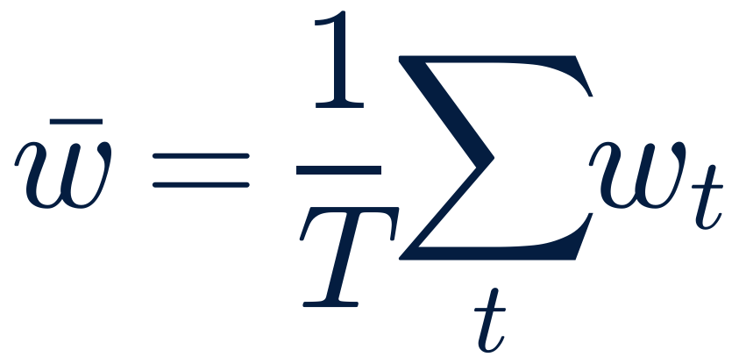
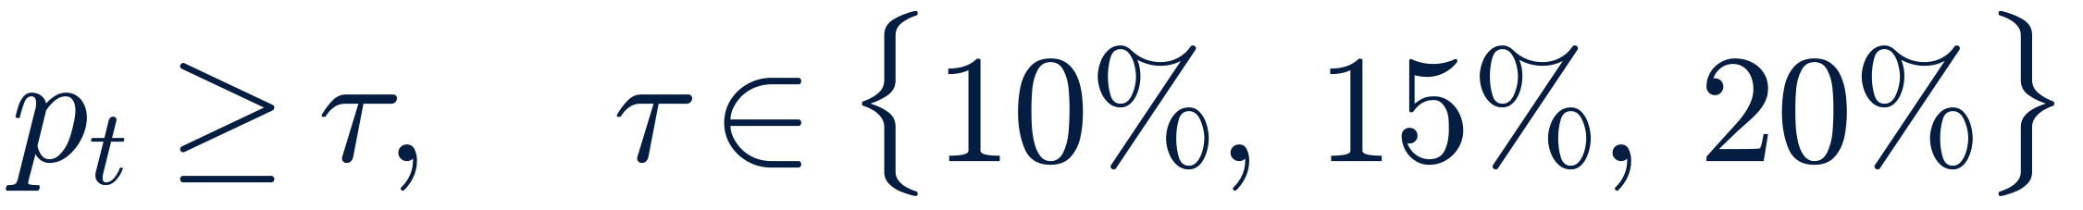
Trading Rule
SIGNAL
POSITION
MEASURE
A warning when the model’s probability of a 10% loss is at or above the threshold
Thresholds: 10%, 15%, 20%
No warning: 80% stocks, 20% 10-year Treasuries
Warning: 50% stocks for the next month
RBP scaled by fit: a warning cuts stocks further when fit is high
Top 25% fit (of the last 60): 40% stocks
Top 50% fit: 60% stocks
Lower fit: warning ignored, 80%
Against a static mix at the rule’s average stock weight
Annual return
Maximum drawdown
Sharpe ratio

Slide 14
Results at a 10% threshold
Warning: forecast probability of a 10% loss ≥ 10% · 420 month-ends, 1991–2025 · 21 followed by a 10% loss
At 10% | Empirical frequency | Normal distribution | Logistic regression | Neural net | Gradient boosting | Penalized logit | RBP, all forecasts | RBP, top 50% fit | RBP, top 25% fit
Warnings (months) | 0 | 291 | 72 | 51 | 57 | 17 | 161 | 133 | 98
Average 3-month return after a warning | – | 2.6% | 5.0% | 6.2% | 2.3% | 6.8% | 2.9% | 2.8% | 2.5%
Average 3-month return otherwise | 2.9% | 3.4% | 2.4% | 2.4% | 3.0% | 2.7% | 2.9% | 2.9% | 3.0%
True positives (warnings followed by a loss) | – | 6.2% | 1.4% | 3.9% | 12.3% | 17.6% | 8.7% | 10.5% | 12.2%
False positives (warnings with no loss) | 0 | 273 | 71 | 49 | 50 | 14 | 147 | 119 | 86
Share of 10% losses preceded by a warning | 0% | 86% | 5% | 10% | 33% | 14% | 67% | 67% | 57%
Trading rule: annual return | 10.1% | 9.5% | 9.3% | 9.1% | 9.7% | 9.8% | 9.4% | 9.8% | 10.3%
Trading rule: maximum drawdown | -41% | -23% | -39% | -38% | -36% | -34% | -25% | -25% | -25%
Static mix: annual return | 10.1% | 8.9% | 9.8% | 9.9% | 9.9% | 10.0% | 9.5% | 9.6% | 9.7%
Static mix: maximum drawdown | -41% | -29% | -38% | -39% | -39% | -40% | -34% | -36% | -37%

Slide 15
Results at a 15% threshold
Warning: forecast probability of a 10% loss ≥ 15% · 420 month-ends, 1991–2025 · 21 followed by a 10% loss
At 15% | Empirical frequency | Normal distribution | Logistic regression | Neural net | Gradient boosting | Penalized logit | RBP, all forecasts | RBP, top 50% fit | RBP, top 25% fit
Warnings (months) | 0 | 0 | 41 | 17 | 16 | 11 | 57 | 55 | 53
Average 3-month return after a warning | – | – | 4.1% | 7.8% | 6.2% | 7.0% | 4.5% | 4.5% | 4.3%
Average 3-month return otherwise | 2.9% | 2.9% | 2.7% | 2.7% | 2.7% | 2.8% | 2.6% | 2.6% | 2.7%
True positives (warnings followed by a loss) | – | – | 2.4% | 5.9% | 6.2% | 27.3% | 10.5% | 10.9% | 11.3%
False positives (warnings with no loss) | 0 | 0 | 40 | 16 | 15 | 8 | 51 | 49 | 47
Share of 10% losses preceded by a warning | 0% | 0% | 5% | 5% | 5% | 14% | 29% | 29% | 29%
Trading rule: annual return | 10.1% | 10.1% | 9.2% | 9.5% | 9.8% | 10.0% | 9.4% | 9.5% | 9.6%
Trading rule: maximum drawdown | -41% | -41% | -41% | -38% | -38% | -34% | -33% | -33% | -33%
Static mix: annual return | 10.1% | 10.1% | 9.9% | 10.0% | 10.0% | 10.1% | 9.9% | 9.9% | 9.9%
Static mix: maximum drawdown | -41% | -41% | -39% | -40% | -40% | -41% | -39% | -39% | -39%

Slide 16
Results at a 20% threshold
Warning: forecast probability of a 10% loss ≥ 20% · 420 month-ends, 1991–2025 · 21 followed by a 10% loss
At 20% | Empirical frequency | Normal distribution | Logistic regression | Neural net | Gradient boosting | Penalized logit | RBP, all forecasts | RBP, top 50% fit | RBP, top 25% fit
Warnings (months) | 0 | 0 | 17 | 9 | 5 | 7 | 16 | 16 | 16
Average 3-month return after a warning | – | – | 7.3% | 8.5% | 4.1% | 8.0% | 7.6% | 7.6% | 7.6%
Average 3-month return otherwise | 2.9% | 2.9% | 2.7% | 2.8% | 2.9% | 2.8% | 2.7% | 2.7% | 2.7%
True positives (warnings followed by a loss) | – | – | 0.0% | 11.1% | 20.0% | 28.6% | 18.8% | 18.8% | 18.8%
False positives (warnings with no loss) | 0 | 0 | 17 | 8 | 4 | 5 | 13 | 13 | 13
Share of 10% losses preceded by a warning | 0% | 0% | 0% | 5% | 5% | 10% | 14% | 14% | 14%
Trading rule: annual return | 10.1% | 10.1% | 9.2% | 9.8% | 10.0% | 10.0% | 10.1% | 10.1% | 10.1%
Trading rule: maximum drawdown | -41% | -41% | -41% | -38% | -40% | -38% | -34% | -34% | -34%
Static mix: annual return | 10.1% | 10.1% | 10.0% | 10.1% | 10.1% | 10.1% | 10.0% | 10.0% | 10.0%
Static mix: maximum drawdown | -41% | -41% | -40% | -41% | -41% | -41% | -40% | -40% | -40%

Slide 17
RBP Limits the Drawdown
At 10% | Average stocks | Dynamic Return | Static Return | Dynamic Drawdown | Static Drawdown | Dynamic Sharpe | Static Sharpe
RBP | 68% | 9.4% | 9.5% | -25% | -34% | 0.73 | 0.69
RBP, scaled by fit | 69% | 10.0% | 9.5% | -20% | -35% | 0.80 | 0.69
Logistic regression | 75% | 9.3% | 9.8% | -39% | -38% | 0.64 | 0.68
Neural net | 76% | 9.1% | 9.9% | -38% | -39% | 0.62 | 0.67

Slide 18
Growth of $1 invested in January 1991

Slide 19
Drawdowns by Strategy

Slide 20
RBP warns as falls begin, and through the rebound
Shaded: month-ends followed by a 10% loss over the next three months · RBP on 13 predictors, median of three engine calls

Slide 21
RBP’s Predictions in Different Regimes
 | Tech sell-off 2000–02 | GFC 2007–09 | COVID 2019–20 | Post-COVID 2020–25
Top three predictors
1 | Turbulence | Past 3-month return | GARCH volatility | CAPE
2 | Absorption-ratio shift | Absorption-ratio shift | Absorption-ratio shift | Inflation
3 | CAPE | CAPE | Industrial production | Credit spread
Top five observations
1 | Oct 1937 (5%) | Oct 1937 (6%) | Oct 2008 (9%) | Mar 2022 (4%)
2 | May 1998 (5%) | Dec 1937 (4%) | Sep 2008 (8%) | Sep 2008 (4%)
3 | Dec 1937 (5%) | Sep 1937 (4%) | Nov 2008 (7%) | Apr 1974 (4%)
4 | Sep 1937 (4%) | Nov 1931 (4%) | Dec 2008 (4%) | Aug 2000 (3%)
5 | Feb 1938 (4%) | Oct 1931 (4%) | Sep 1932 (3%) | May 1974 (3%)

Slide 22
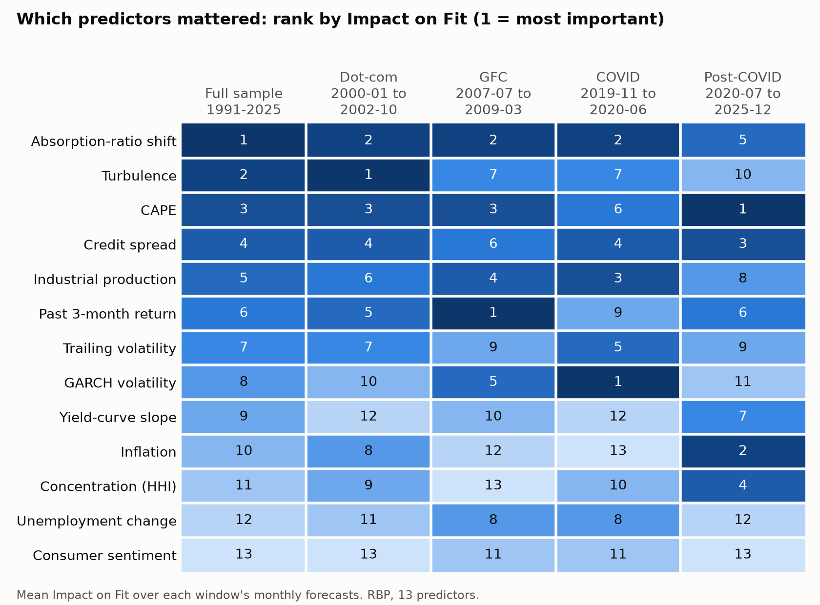
Different predictors matter in different crises
Rank by Impact on Fit
Absorption-ratio shift: consistently top 2
GFC: Past Return dominates
COVID: GARCH Volatility dominates
Post-COVID: CAPE and Inflation show outsized importance

Slide 23
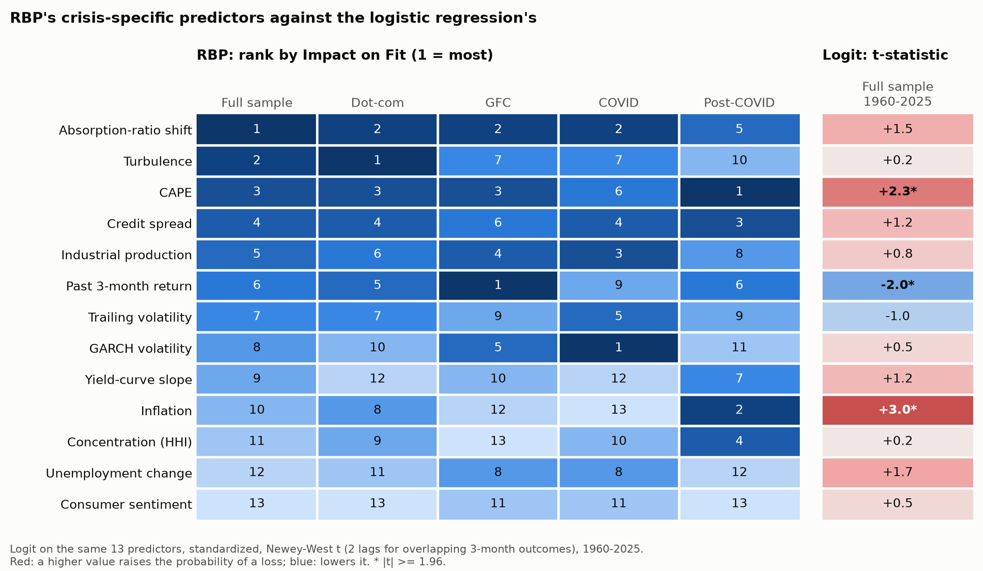
What a regression misses
One t-statistic per predictor
Inflation: Logit’s strongest predictor, varying importance in RBP
Turbulence: Low t-statistic versus RBP’s importance
Only 3 of 13 predictors with |t| ≥ 1.96

Slide 24
Conclusions
RBP proved to be the most protective model against drawdowns
Most losses warned of
Fit as confidence
14 of 21 losses preceded by a warning at 10%, against 7 at most for the regressions and machine learning
Fit had a significant impact with 9.8% of forecasts followed by a loss, against a 5.0% base rate
Fit-scaled rule: −20% drawdown against −35%
What matters, and when
Limits
Turbulence led in the tech sell-off, past return in the GFC, GARCH volatility in COVID, and CAPE and inflation after COVID
21 loss months in 12 episodes; most warnings come once a fall has begun, so returns after a warning are higher

Slide 25
Thank you
With thanks to Jake Xia (Harvard Management Company), Professor Mark Kritzman, and Cel Kulasekaran and Cambridge Sports Analytics for the RBP engine.

