Slide 1

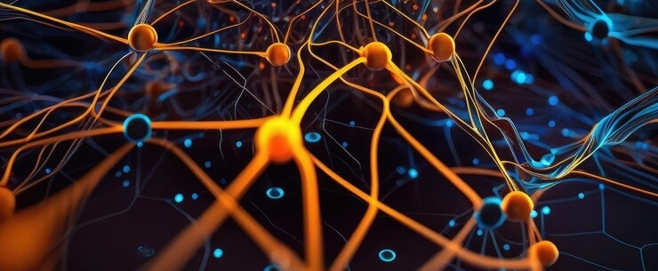
Lucid: A Non-intrusive, Scalable and Interpretable Scheduler for Deep Learning Training Jobs
Conference ASPLOS 2023
Seminar Hot Topics in Operating Systems, Unine
To the attention of Prof. P. Felber and Dr B. Lepers

Slide 2
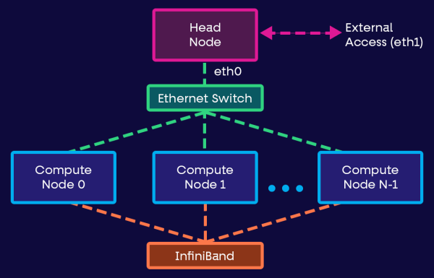
What’s a company cluster ?
Deep learning (DL) workloads
Jobs
GPUs
Large-scale clusters
Match ?
Scheduler
DL engineers
Maxime Welcklen
Paper presentation: LUCID
Seminar hot topics on OS
BeNeFri, University of Neuchâtel
Notes:
Source: https://www.run.ai/guides/multi-gpu/gpu-clusters

Slide 3
Table of content
Context and SoTA
DL scheduler principle
DL workloads
GPU utilization
Scheduler tricks: Elastic training
Scheduler tricks: Job packing
Scheduler tricks: Profiling and Estimations
Challenges of scheduling for DL
Implementation
Structure of LUCID
Profiler
Profiler: Packing analyze model
Job-pair binder
Orchestrator
Optimizers
Results
Test setup
Job completion time
Job queuing delay
Impact of models
Response to challenged of scheduling for DL
Limitations
Conclusion
Maxime Welcklen
Paper presentation: LUCID
Seminar hot topics on OS
BeNeFri, University of Neuchâtel

Slide 4




I – Context and SoTA
Maxime Welcklen
Paper presentation: LUCID
Seminar hot topics on OS
BeNeFri, University of Neuchâtel

Slide 5
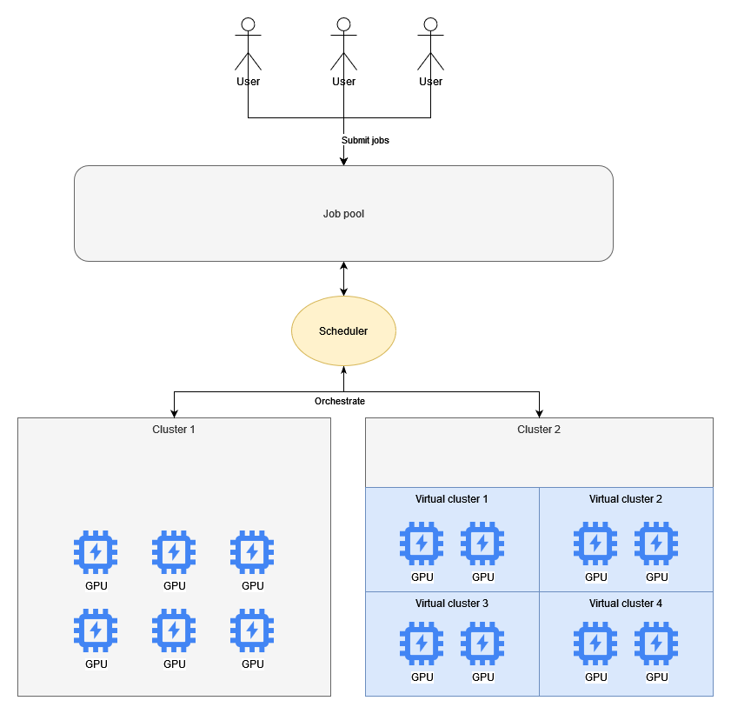
DL scheduler principle
Role: Interface
Users (Jobs)
Cluster (GPUs)
Objective Maximize Job Completion Time (JCT), minimize queuing time
Know the jobs
Metrics ?
Know the clusters
Throughput ?
‘Orchestrate’ ?
Pre-emption
Maxime Welcklen
Paper presentation: LUCID
Seminar hot topics on OS
BeNeFri, University of Neuchâtel

Slide 6
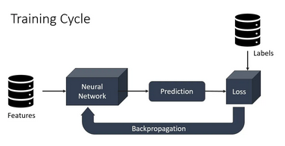
DL workloads What do Dl schedulers have to work with ?
Deep learning
Iterative: SGD; Batch, epoch
Repetitive: Users, type
Heterogenous distribution
95% small-scale
90% hyperparameter tuning
Microsoft are humans too
70% jobs failing
Debugging
Maxime Welcklen
Paper presentation: LUCID
Seminar hot topics on OS
BeNeFri, University of Neuchâtel
Notes:
Source: https://galaxyinferno.com/epochs-iterations-and-batch-size-deep-learning-basics-explained/

Slide 7
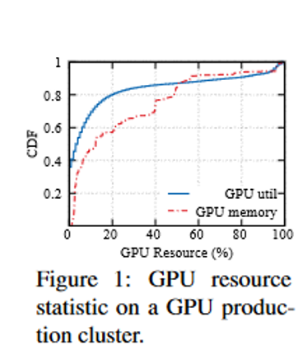
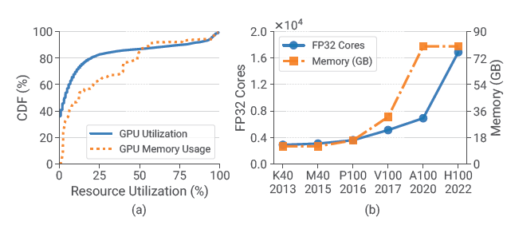
Observation: GPU utilization
16% of GPU attain 50% utilization
GPU capacities scaling up
Maxime Welcklen
Paper presentation: LUCID
Seminar hot topics on OS
BeNeFri, University of Neuchâtel
Notes:
Cumulative distribution function: One week GPU usage stats

Slide 8
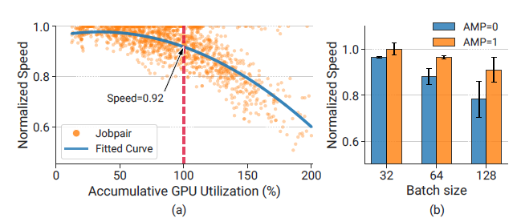
Scheduler tricks: Elastic training
Elastic
Batch, workers
How ?
Code introspection
Pre-emption
Problems
Accuracy loss
Pre-emption overhead
Maxime Welcklen
Paper presentation: LUCID
Seminar hot topics on OS
BeNeFri, University of Neuchâtel
Notes:
3A: Cases of job packing
Normalized speed = Ratio of collocated / exclusive job speed.

Slide 9
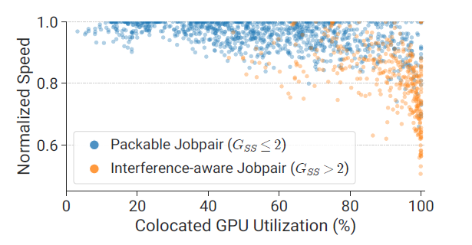
Scheduler tricks: Job packing
How many ?
Pairs
Which ones ?
Affinity
Interferences
Existing solutions: Intrusive
Maxime Welcklen
Paper presentation: LUCID
Seminar hot topics on OS
BeNeFri, University of Neuchâtel
Notes:
Instrusive means: Require library or code intrusion to know which jobs can go together

Slide 10

Scheduler tricks: Profiling and estimations
Find dogs
Estimations on jobs
Estimations on job-pairs
Estimations on clusters
Problems
Black boxes
Pre-emption
Inefficiency
Introspection
Pytorch
ScheduleTorch
Scheduler
GPU cluster
Maxime Welcklen
Paper presentation: LUCID
Seminar hot topics on OS
BeNeFri, University of Neuchâtel

Slide 11
Challenges of scheduling for DL
Inflexible and error-prone
High integration and maintenance cost
Model quality degradation of adaptive training
Limited scalability
Opaque decision making and hard to adjust
Maxime Welcklen
Paper presentation: LUCID
Seminar hot topics on OS
BeNeFri, University of Neuchâtel
Notes:
1: Code inspection required specific libraries –What happened in case of bug ? Users have to modify their code
2: Maintenance cost ? Deployment ? Need a whole team
3: Batch size, loss of accuracy unacceptable
4: Schedulers become bottlenecks (time to decide). Scale: (Linear programming) Thousands of seconds, (RL)10 jobs vs 1000 runnable.
5: How to explain choices ? Debug ?

Slide 12
II - Implementation
Maxime Welcklen
Paper presentation: LUCID
Seminar hot topics on OS
BeNeFri, University of Neuchâtel

Slide 13
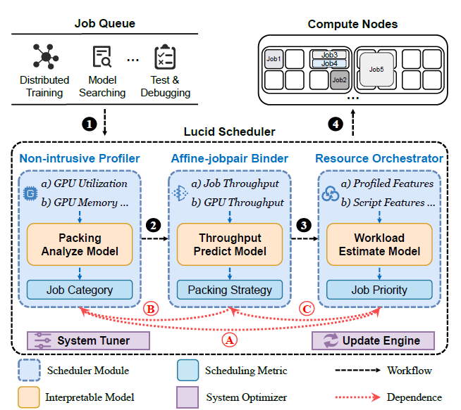
Structure of LUCID
Non-intrusive Scalable Interpretable
Profiler
Analyze, categorize jobs
Debugs and test ?
Recording and history
Jobpair binder
Decides pairs to be executed
Cluster throughtput
Ressource orchestrator
Allocate jobs
Maxime Welcklen
Paper presentation: LUCID
Seminar hot topics on OS
BeNeFri, University of Neuchâtel
Notes:
Non-intrusive: Preemption-free, zero effort or modification of framework
Principle: Three modules to help scheduling
Each module has an interpretable model

Slide 14
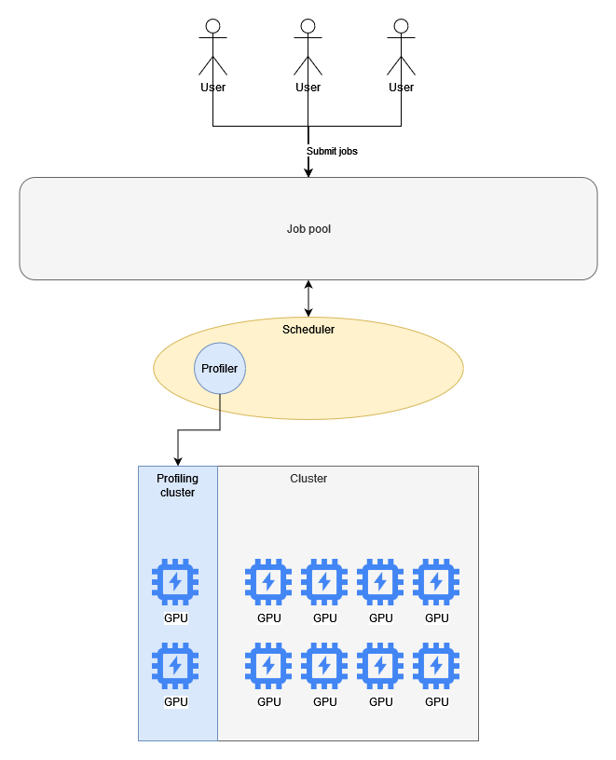
Profiler
Empiric observations (Tprof)
Fail fast
Collect metrics
GPU utilization
GPU memory footprint
GPU memory utilization
Two dimensional: Space and time
Avoid bottleneck due to Tprof ?
Decoupled cluster
Adjust profiling scaling: N, T, C
Packing analyze model
Maxime Welcklen
Paper presentation: LUCID
Seminar hot topics on OS
BeNeFri, University of Neuchâtel
Notes:
Nprof: Max scale of jobs being profiled, if N(job) > Nprof, then the job is sent and profiled through metrics (profiled a-posteriori)
Tprof: Time to profile
Cprof: Throughput of profiling cluster

Slide 15
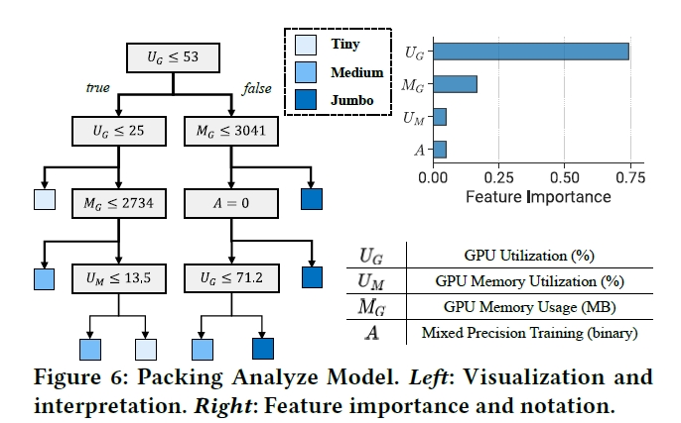
Profiler: Packing analyze model
Decision tree
Categories: Tiny, Medium, Jumbo
Sharing score
Filter short lifespan jobs
Maxime Welcklen
Paper presentation: LUCID
Seminar hot topics on OS
BeNeFri, University of Neuchâtel
Notes:
Categories:
A job is regarded as Tiny if its average normalized speed is greater than a customizable tiny job threshold (e.g., 0.95), and Medium if the speed is between tiny and medium job thresholds. Otherwise, the job will be labeled as Jumbo
DT uses minimal cost-complexity pruning

Slide 16
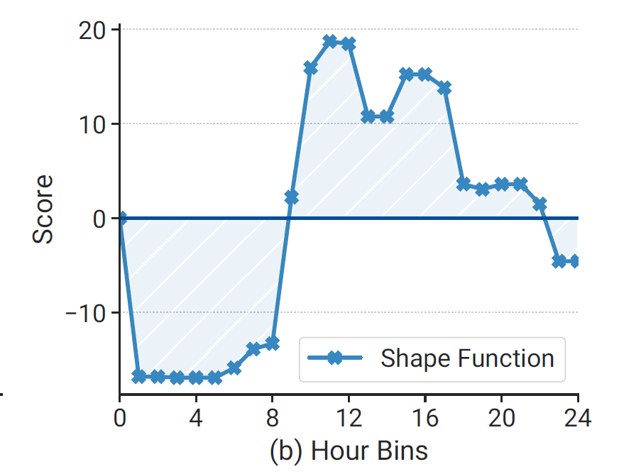
Affine Job-pair binder
Find interference-free pairs
Jobs without interference
Jobs with similar demands
GSS: GPU sharing score (<=2)
Dynamic strategy, Indolent packing: Throughput predict model
Cluster jobs; GPU throughtput
Lazy: Is packing necessary ?
GA2M: shape functions
Maxime Welcklen
Paper presentation: LUCID
Seminar hot topics on OS
BeNeFri, University of Neuchâtel
Notes:
Ressource utilization hard limit: Avoid out of memory
Jobs with similar demands: avoid stragglers
Indolent ~== Lazy packing

Slide 17
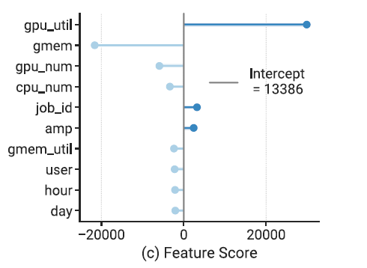
Orchestrator
Avoid HOL problem
Long-running jobs cause starvation
Workload estimate model Based on prior data
Compute job priority
Predict duration * #GPU
Penalize long jobs
Cold start ?
Predict duration based on user
Fallback: average of similar GPU demands
Maxime Welcklen
Paper presentation: LUCID
Seminar hot topics on OS
BeNeFri, University of Neuchâtel
Notes:
prediction result = the sum of every feature score + the intercept constant

Slide 18
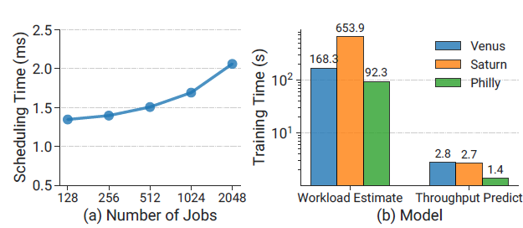
Optimizers
System tuner
Hyperparameters adjustment
Tune via history / simulation
Update engine
Changes generate models drift
Periodically re-train
Maxime Welcklen
Paper presentation: LUCID
Seminar hot topics on OS
BeNeFri, University of Neuchâtel

Slide 19
III - Results
Maxime Welcklen
Paper presentation: LUCID
Seminar hot topics on OS
BeNeFri, University of Neuchâtel

Slide 20
Test Setup
Physical (few) / Simulated (Many)
Compare to
FIFO
SJF: Shortest job first
QSSF: Quasi SSF
Non-preemptive, black box
Horus
Packing; model analysis; intrusive; black box
Tiresias
Preemptive, intrusive
Maxime Welcklen
Paper presentation: LUCID
Seminar hot topics on OS
BeNeFri, University of Neuchâtel
Notes:
SJF: Requires perfect information on jobs, impossible in practice
QSSF: Non-preemptive

Slide 21
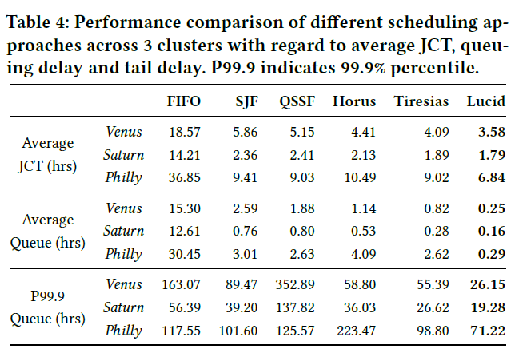
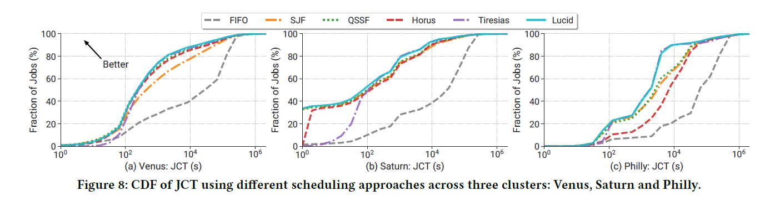
Results – Jobs completion time
Lucid outshines for short-to-medium jobs
Lucid has good tail management (P99)
Maxime Welcklen
Paper presentation: LUCID
Seminar hot topics on OS
BeNeFri, University of Neuchâtel

Slide 22
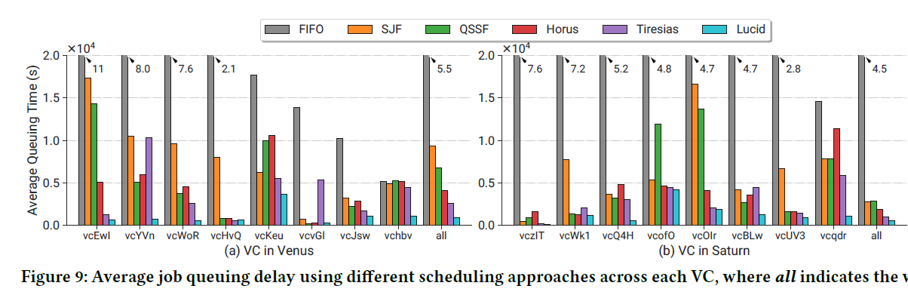
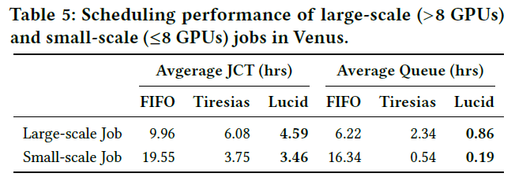
Results – Job queuing delay
Tprof: 60s
Advantage
No preemption
No overhead
Maxime Welcklen
Paper presentation: LUCID
Seminar hot topics on OS
BeNeFri, University of Neuchâtel

Slide 23
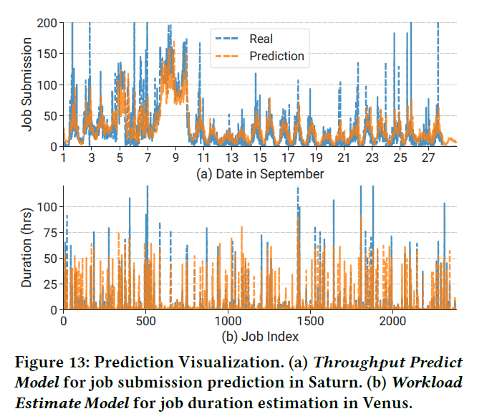
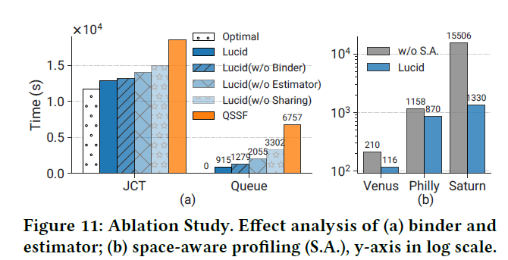
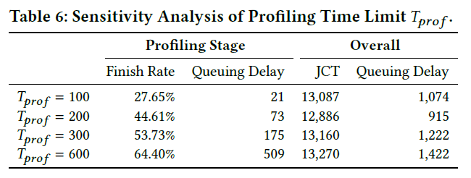
Results – Impact of models
Ablation studies
Prediction accuracy
Profiling sensitivity
Maxime Welcklen
Paper presentation: LUCID
Seminar hot topics on OS
BeNeFri, University of Neuchâtel

Slide 24
Response to challenges
Inflexible and error-prone Efficient non-intrusive scheduling
High integration and maintenance cost Low deployment cost
Model quality degradation of adaptive training Model performance preservation
Limited scalability Scalability to large-scale cluster
Opaque decision making and hard to adjust Transparent system tuning
Maxime Welcklen
Paper presentation: LUCID
Seminar hot topics on OS
BeNeFri, University of Neuchâtel
Notes:
1: No intrusion into user code
2: Easily integrated into systems such as K8, low maintenance
3: LUCID doesn’t touch models
4: Adapt to bursts of jobs, low runtime
5: Interpretable modules

Slide 25
Limitations
Lacking features
Fairness ?
SLA ?
Different infrastructures
Heterogenous GPUs ?
More components (CPUs) ?
Maxime Welcklen
Paper presentation: LUCID
Seminar hot topics on OS
BeNeFri, University of Neuchâtel

Slide 26
Conclusion
Novel concept
Profiler-filter
Indolent binder focused on interference-free pairs
Orchestrator considers GPUs and history
Equal to excellent performance
Even compared to pre-emptive, intrusive schedulers
Simple, interpretable models
KISS ?
Empirical values
No intrusion, few efforts
Identify, address concerns of SoTA schedulers
At equal efficiency, the gain in explanibility is not negligible.
Maxime Welcklen
Paper presentation: LUCID
Seminar hot topics on OS
BeNeFri, University of Neuchâtel

Slide 27
Thank you !
Maxime Welcklen
Paper presentation: LUCID
Seminar hot topics on OS
BeNeFri, University of Neuchâtel

Slide 28
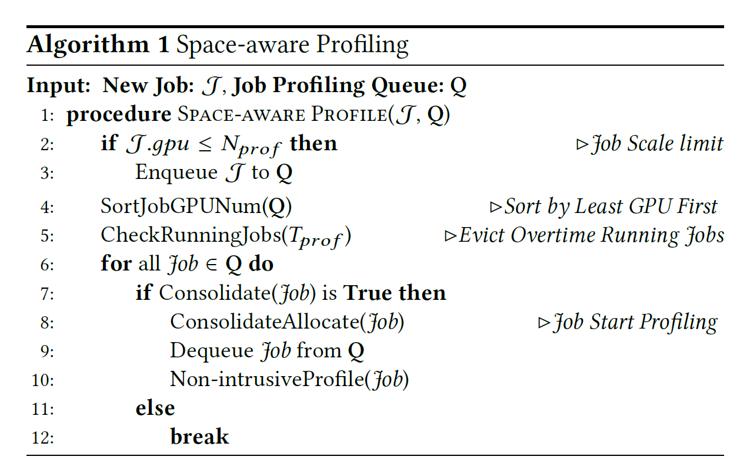
Annexe I – Profiling code

Slide 29
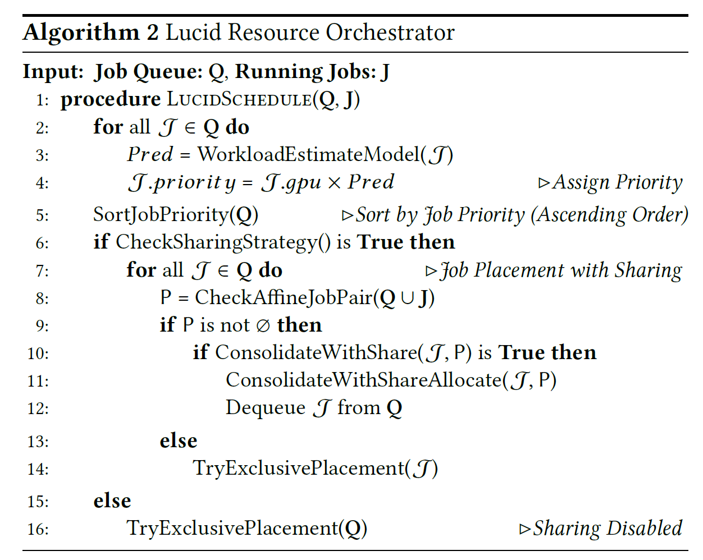
Annexe II – Orchestrator code

