Slide 1



Reconstruction of online writing signal from offline image Can the time (t) be robustly inferred by a transformer architecture ?
Status Update
11/11/2024

Slide 2
Objectives
Based on existing transformer models, Assess trainability of a transformer-based architecture in infering basic pen kinematic: Position and speed
2/8

Slide 3
Cluster
Engineering work
Dockerization
GPU drivers
Save models, images, ID
3/8

Slide 4
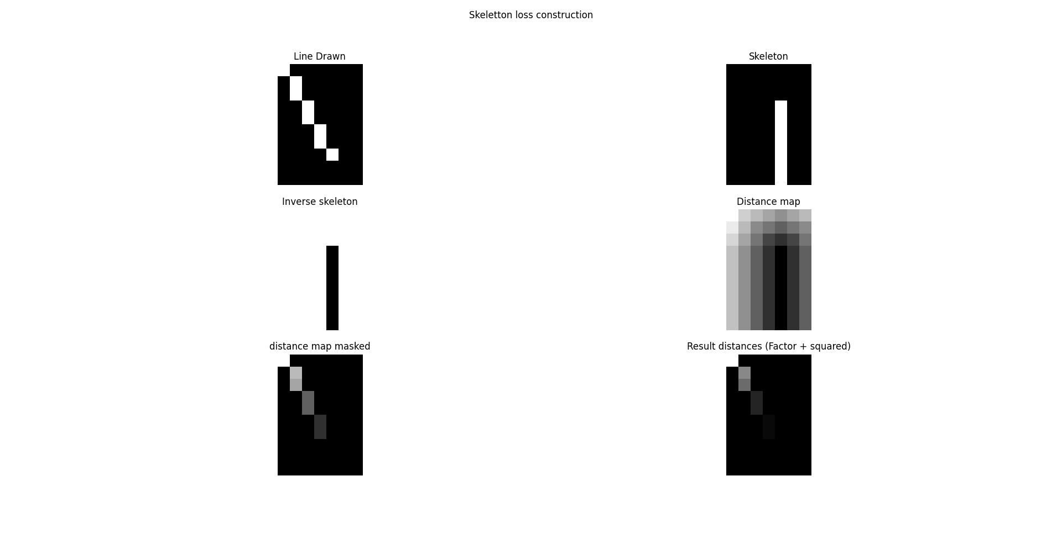
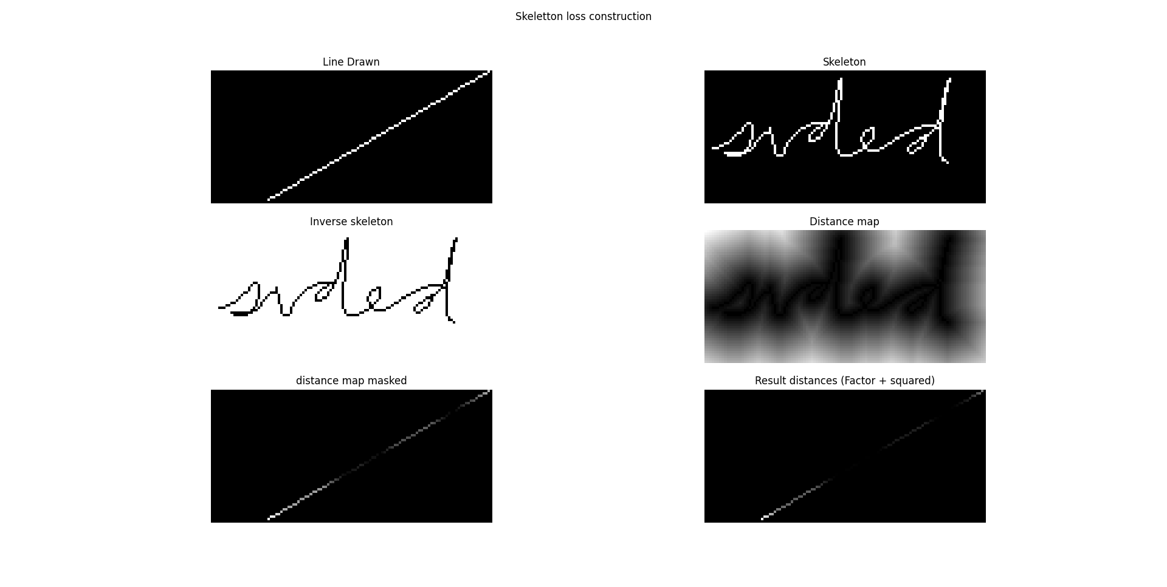
Skeleton loss
Objective: Smoothingthe loss compared to pixel difference
Distance map
Normalization
Squared
Mask on predicted line
Sum of norm distances
4/8

Slide 5
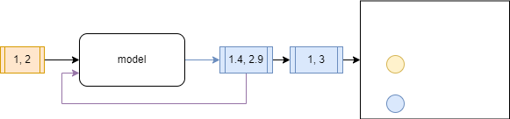
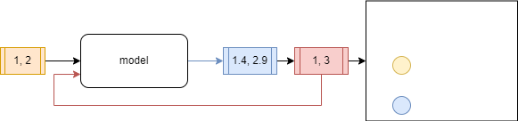
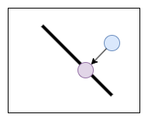
Inference- quantization
Model needs continuous output
Smooth losses
Sensitive / react to changes
Give meaningfull feedbacks
Input coordinates are discrete
Not normalized
integer between [0, MAX_W/H]
Normalized
Float between [0,1] with step 1/MAX_W/H
Inputs never seen when infering
Solution: quantizing input before auto-regression
Interesting: Correcting on skeleton ?
5/8

Slide 6
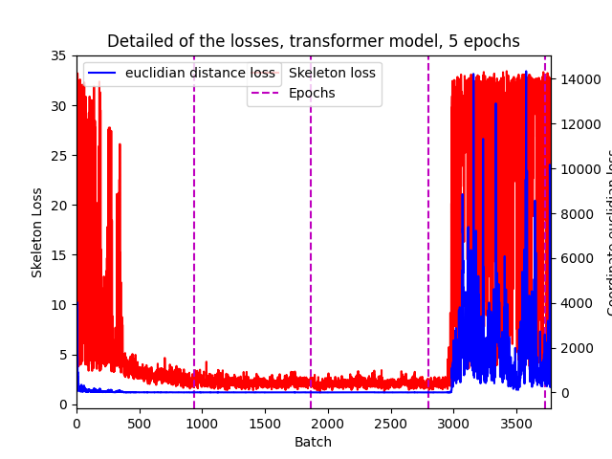
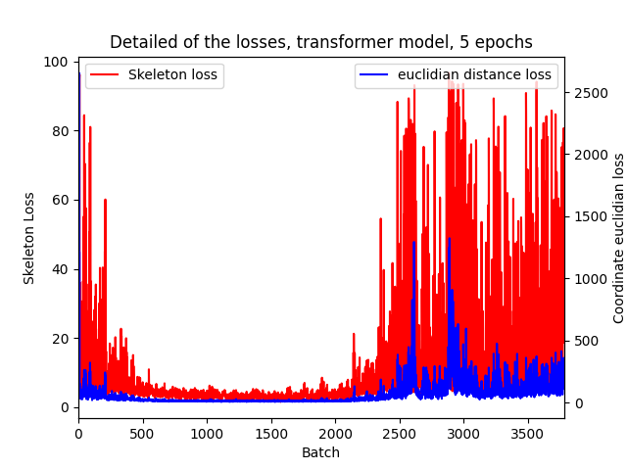
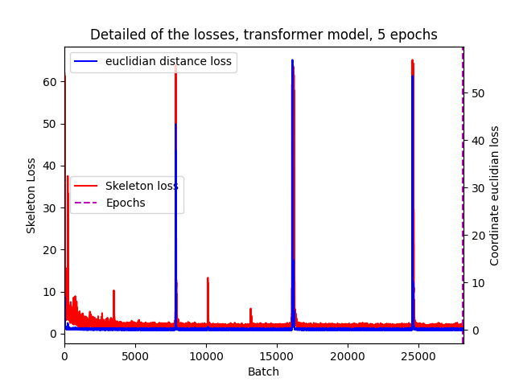
Divergence
Learning rate 1e-3
Sudden explosion of the losses
Deletion of EOS loss
Confusing model ?
Lower learning rate (~1e-4)
Bad batches less impactful
Model corrects itself
6/8

Slide 7
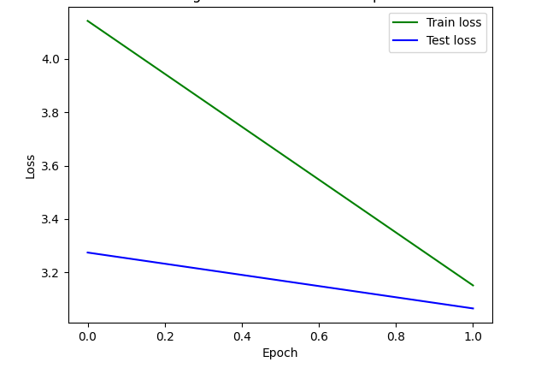
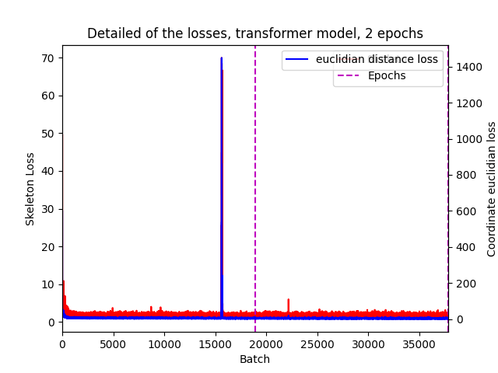
Medium scale training
10% of BRUSH
Batch size 32
Patches (16,16)
Embedding size 256
Encoder heads 8
Encoder layers 12
No LSTM
No Pred token
LR 5e-3
Dropout 0.05
Demo
7/8

Slide 8
Larger scale Training
Iterative training
Progressive loading of dataset
RayTune
8/8

