Slide 1

Handwriting: Reconstruction of online signal from offline image
Can the pen kinematic be robustly inferred by a transformer architecture ?

Slide 2

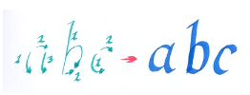
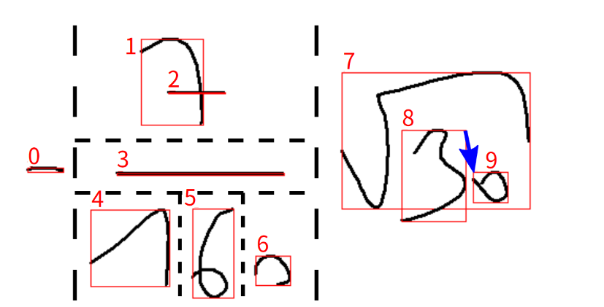
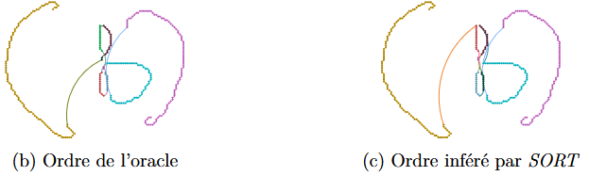

Set, Sort !
Doctoral thesis January 2024
Transformer-based architecture
Notion of Dructus
Ordering of substrokes
“Important to have the online signal directly in the output and not a substrokes representation […] The ultimate objective is without a doubt to evolve to a system that can transform a whole page of text into an online signal.”
Maxime Geminiani Welcklen
Master Thesis Defense
2/39

Slide 3
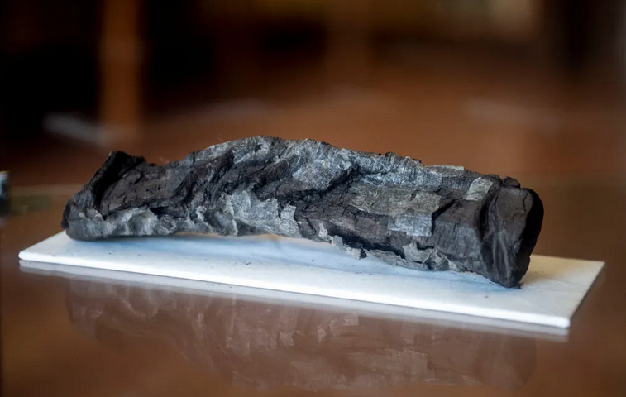
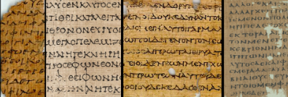
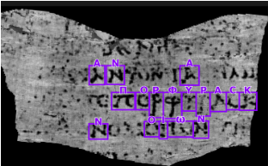
Computer Vision for Historical documents
University of Basel
Department of Ancient Civilizations
EGRAPSA: Retracing the evolutions of handwritings in Graeco-Roman Egypt thanks to digital palaeography
I have written
80’000 papyri, ancient Greek
Herculaneum burnt papyrus
1’800 scrolls
Computer Vision challenge, 2022
Decypher words
Maxime Geminiani Welcklen
Master Thesis Defense
3/39

Slide 4
Objectives
Create Online signal from Offline data
Use a Transformer-based architecture
Investigate the inference capacities over handwriting Speed / Trajectories
Maxime Geminiani Welcklen
Master Thesis Defense
4/39

Slide 5
Table of contents
Design
Goal
Fundational works
Data
Data processing
Architecture
Data augmentation
Losses and Metrics
Experiments
Structural Features
Impact of Augmentation
Finding the best Candidate
Impact of training size
LSTM Ablation Study
3. Results
Success on small signals
Failure to stop
Character-based observation
Large signals
LLM
Demo
Future Works
Return on objectives
Conclusion
Maxime Geminiani Welcklen
Master Thesis Defense
5/39

Slide 6
I - Design
Maxime Geminiani Welcklen
Master Thesis Defense
6/39

Slide 7


Goal
Generate Online signal from Offline images
Trajectories
Speed
Fixed sampling
10ms
Comparisons ?
(1,2)
(1,3)
(1,4)
(2,4)
Compare
Image + Start point
Vector of coordinates
Maxime Geminiani Welcklen
Master Thesis Defense
7/39

Slide 8
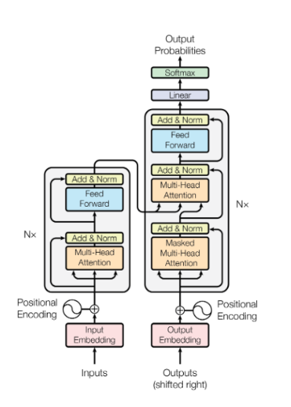
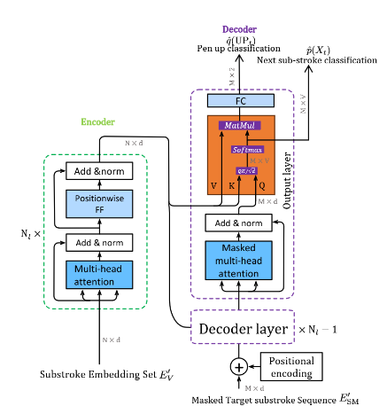
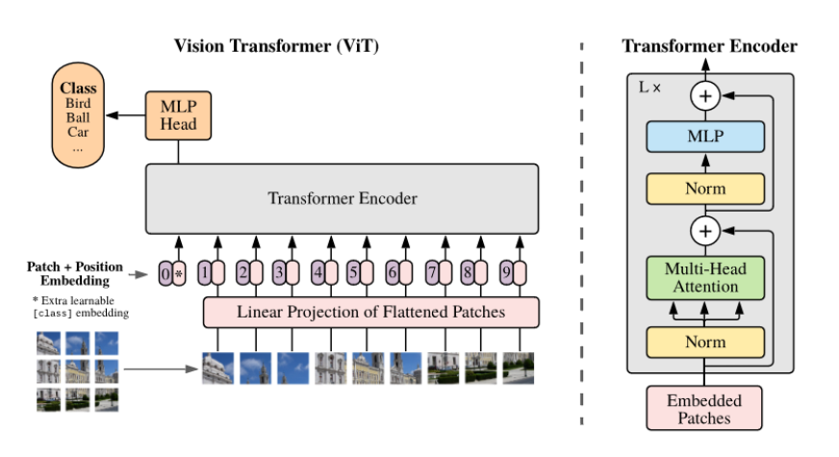
Fundationals works
Vision Transformers – ViT
Patches - Embeddings, Tokens
Set, Sort !
Strokes, Substrokes
Attention Is All You Need
[Self]-attention, Data parallelization
Maxime Geminiani Welcklen
Master Thesis Defense
8/39

Slide 9

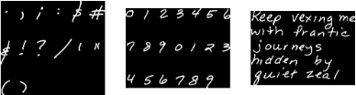
Data
BRUSH, UNIPEN, CROHME, IAM
Coordinate vectors, Sampling
Scale: ViT = 300M Images
BRUSH
UNIPEN
~ 29’000 signals images, ~7M Datapoints
~500’000 signals limited strokes
Average signal length: 14 points
Average image size: 28x22
Homogeneous
~ 314’000 signals images, ~70M Datapoints
~2,5M signals limited strokes
Average signal length: 49 points
Average image size: 49x44
Non-Homogeneous
Maxime Geminiani Welcklen
Master Thesis Defense
9/39

Slide 10

Data Processing
Constraints
Limited size: 96x96
Single strokes
Training
Teacher forcing
parallelization
Maxime Geminiani Welcklen
Master Thesis Defense
10/39

Slide 11

Data Processing
Strokes separation
Maxime Geminiani Welcklen
Master Thesis Defense
11/39

Slide 12
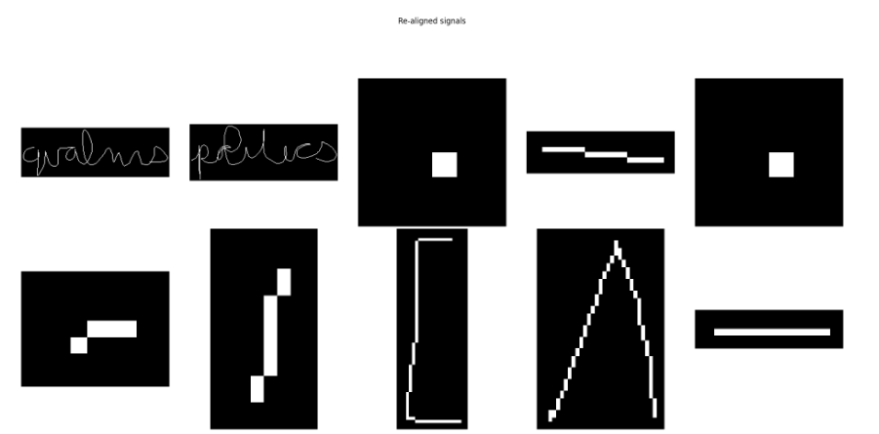
Data Processing
Alignement
Maxime Geminiani Welcklen
Master Thesis Defense
12/39

Slide 13
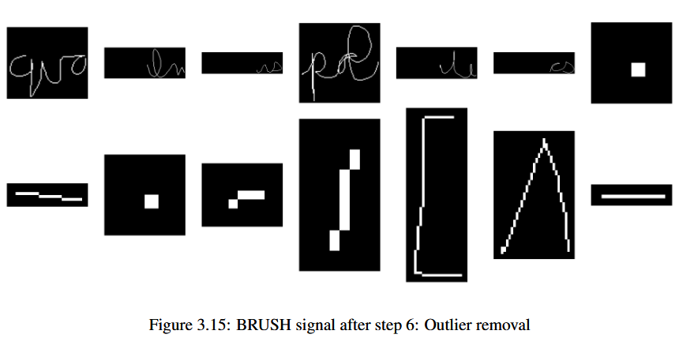
Data Processing
Outliers Removal
Maxime Geminiani Welcklen
Master Thesis Defense
13/39

Slide 14
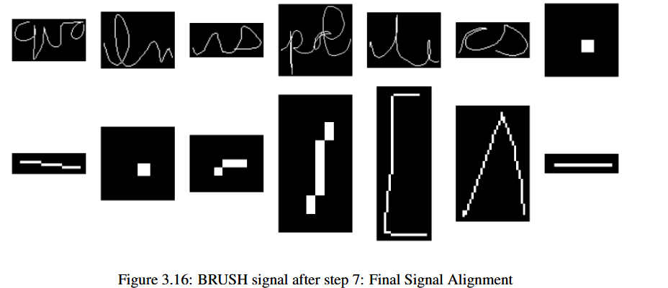
Data Processing
Alignement
Maxime Geminiani Welcklen
Master Thesis Defense
14/39

Slide 15
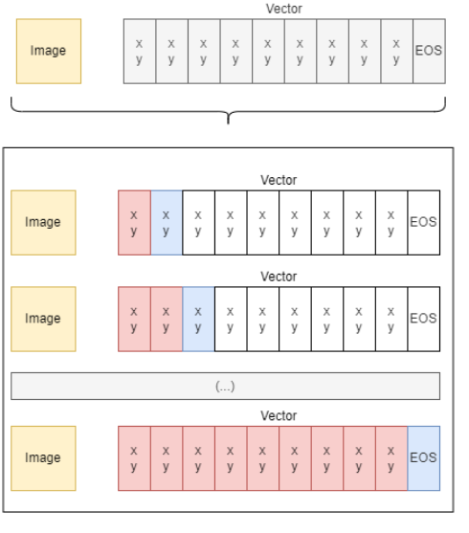
Data Processing
Teacher forcing
Batches
Signal -> subsignals
Maxime Geminiani Welcklen
Master Thesis Defense
15/39

Slide 16
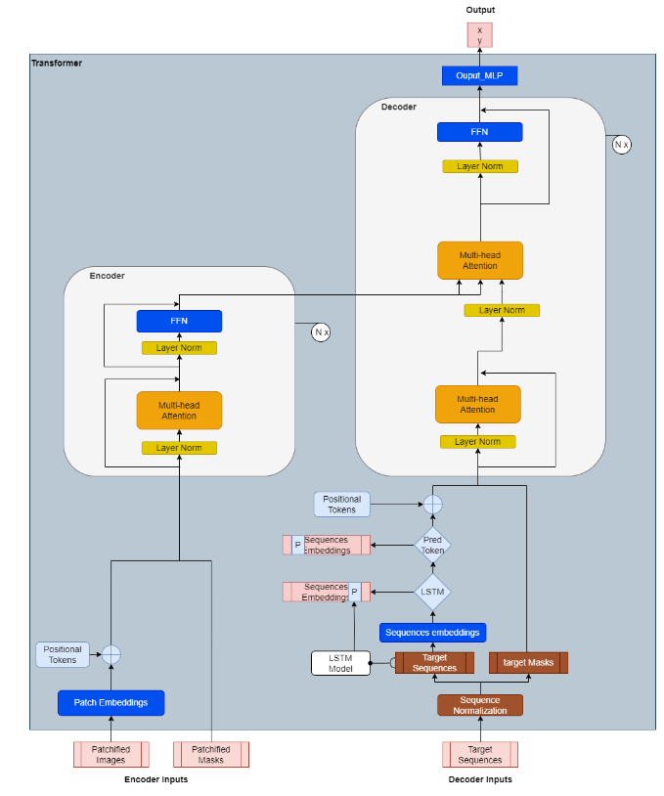
Architecture
ViT Encoder
Mixed data
Images as input
Coordinates on target sequence
Red: inputs, outputs
Blue: Structural propositions
Maxime Geminiani Welcklen
Master Thesis Defense
16/39

Slide 17
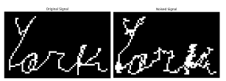
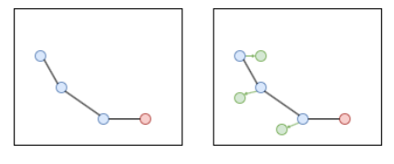
Data Augmentation
Early problems during inference
Discretization of positions
Gaussian Noise on coordinates
Target Sequence, not encoder image
Maxime Geminiani Welcklen
Master Thesis Defense
17/39

Slide 18
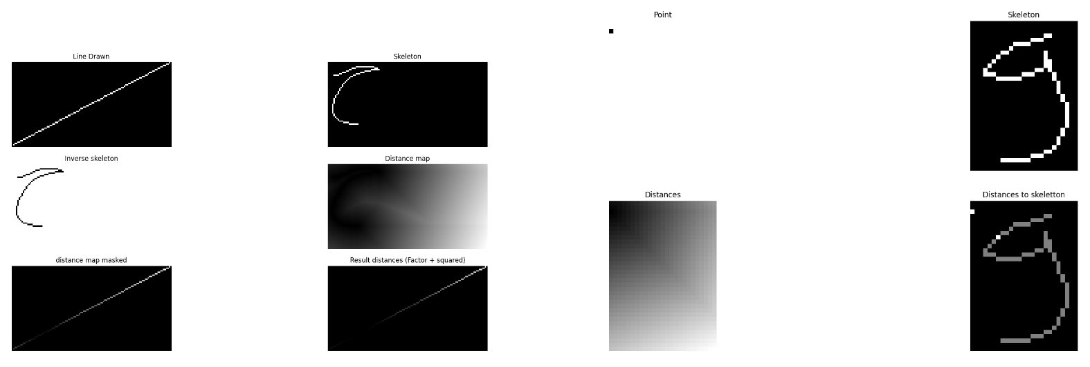
Losses and Metrics
Three losses considered
Euclidean Loss: Speed
Dist(Predicted, expected)
Skeleton Loss: Shapes
Diff(Original_skel, Predicted_skel)
Closest(Predicted_pixel, Skeleton)
EOS: Stopping instruction
Maxime Geminiani Welcklen
Master Thesis Defense
18/39

Slide 19
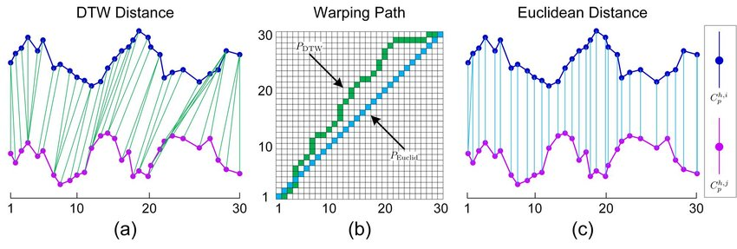
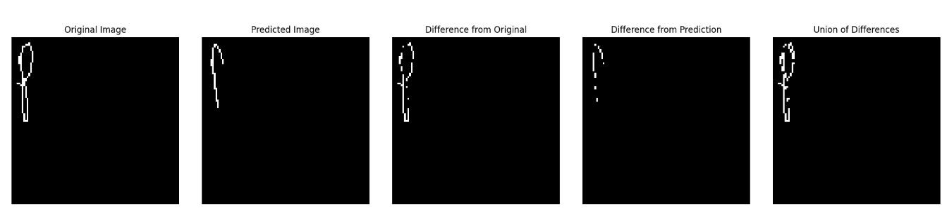
Losses And Metrics
Euclidean Distances
DTW
Image differences
Maxime Geminiani Welcklen
Master Thesis Defense
19/39

Slide 20
II – Experiments
Maxime Geminiani Welcklen
Master Thesis Defense
20/39

Slide 21
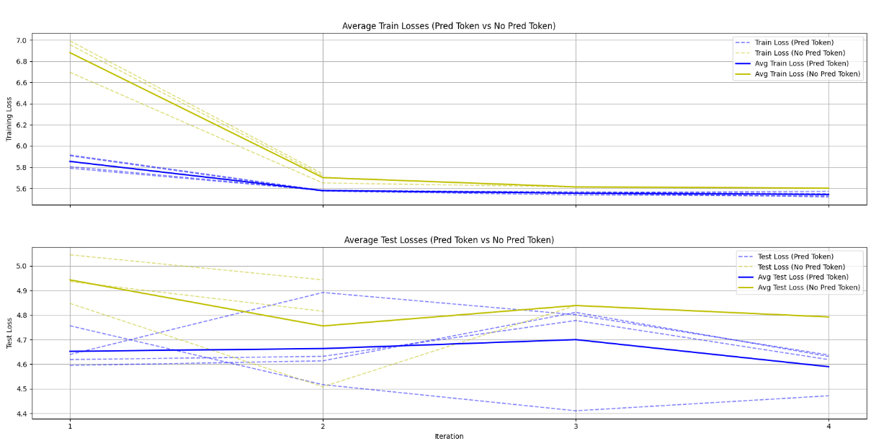
Structural Features
Small Dataset (1M), 4 epochs
Prediction Tokens
LSTM
Learnable position tokens
Maxime Geminiani Welcklen
Master Thesis Defense
21/39

Slide 22
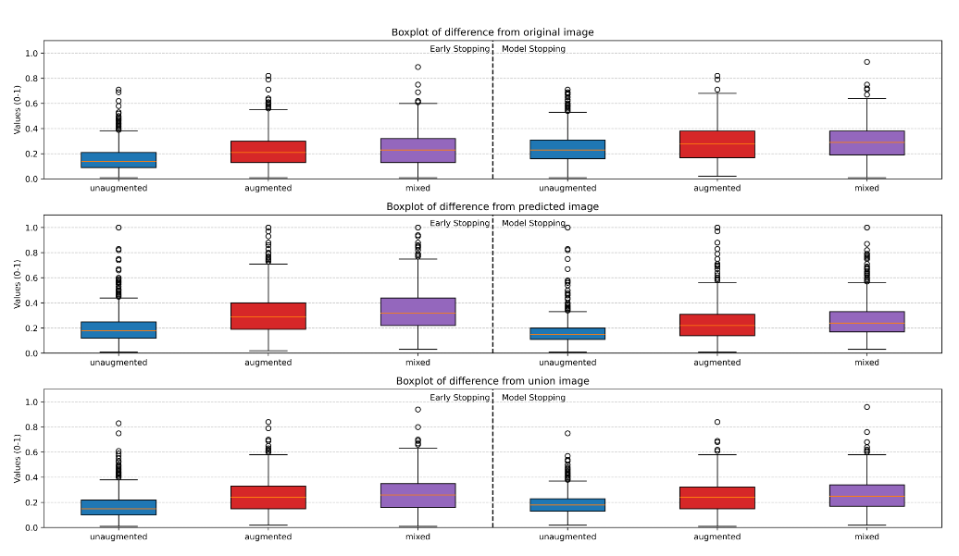
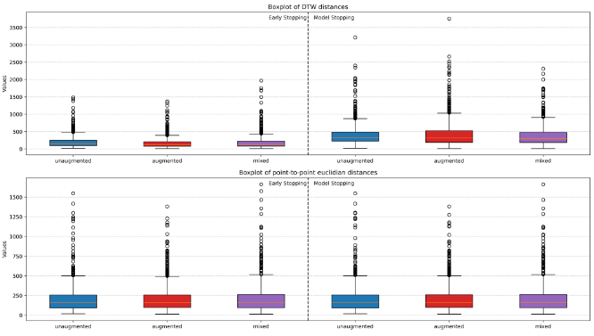
Impact of Augmentation
Gaussian Augmentation
Training three models
Un-augmented
Augmented
Mixed
Analyze results on Inference
Maxime Geminiani Welcklen
Master Thesis Defense
22/39

Slide 23
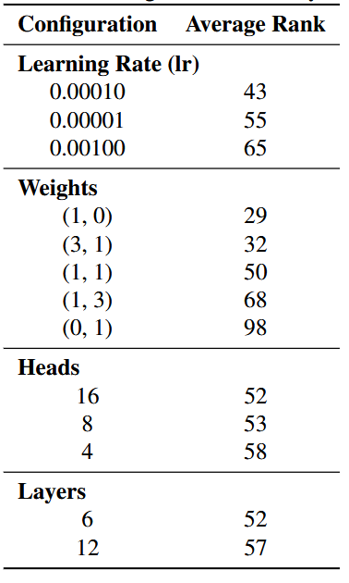
Finding the Best Candidate
Prediction Token
LSTM
Learnable tokens
Image Size
Patch Size
Hidden Dimension
Context length
Batch Size
LR
Heads
Layers
FFN act. functions
FFN expansion ratio
Loss weights
Skeleton loss mode
Gaussian STD - Mean
Yes
No
No
96 x 96
16 x 16
256
50
512
Leaky Relu
4
Last Pixel
1, 0
LR | 1e-3, 1e-4, 1e-5
Heads | 4, 8, 16
Layers | 6, 12
Losses W | (1,0) (1,1) (1,3) (0,1) (1,1) (3,1)
108 candidates
Median at 54
Maxime Geminiani Welcklen
Master Thesis Defense
23/39

Slide 24
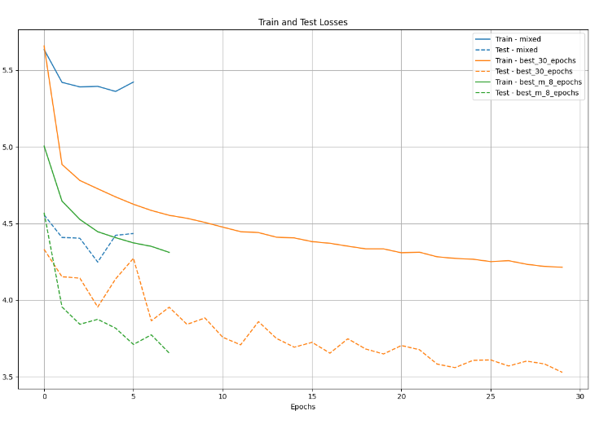
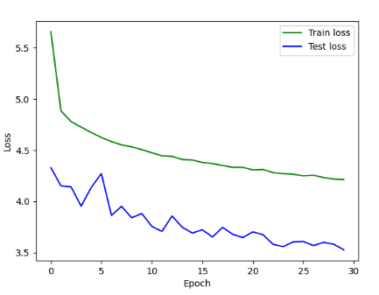
Impact of Training size
Impact of larger dataset
1M datapoints, 30 epochs, 30M datapoints
4M datapoints, 8 epochs, 32M datapoints
Training for longer
4 Epochs -> 30 Epochs
No sign of plateau, constant learning
Maxime Geminiani Welcklen
Master Thesis Defense
24/39

Slide 25
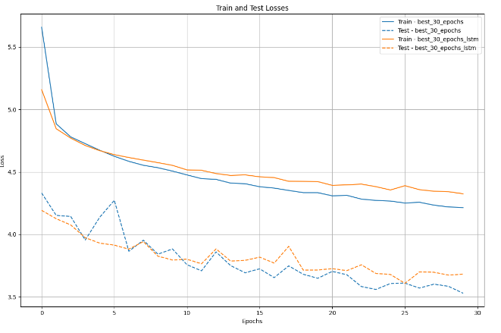
LSTM Ablation study
Best Candidate
30 Epochs
With / Without LSTM
Faster start until epoch 5
Slower convergence
Maxime Geminiani Welcklen
Master Thesis Defense
25/39

Slide 26
III - Results
Maxime Geminiani Welcklen
Master Thesis Defense
26/39

Slide 27
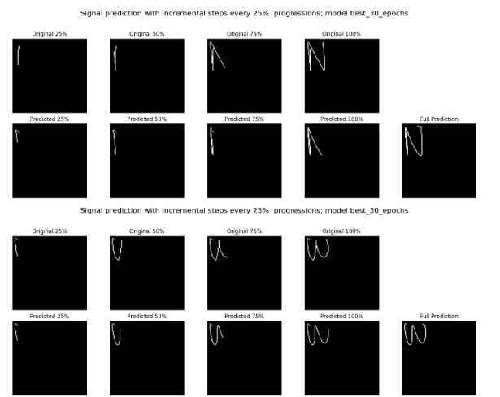
Working small signals
Good predictions, speed on some small signals
One character
Diff images ~50%
3rd Quartile
Maxime Geminiani Welcklen
Master Thesis Defense
27/39

Slide 28
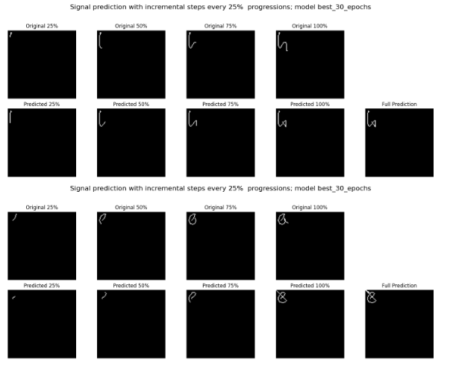
Failures to stop
Difficulty to stop
EOS Token at exactly [-1; -1]
Miss-predictions are very costly
Mitigations
Can be detected
More training
Maxime Geminiani Welcklen
Master Thesis Defense
28/39

Slide 29
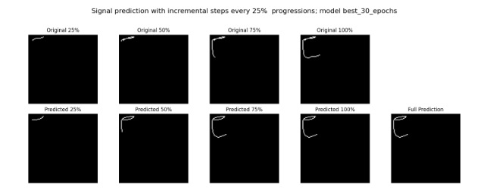
Other issues on small signals
Alphabet learning
Respect of shapes
Maxime Geminiani Welcklen
Master Thesis Defense
29/39

Slide 30
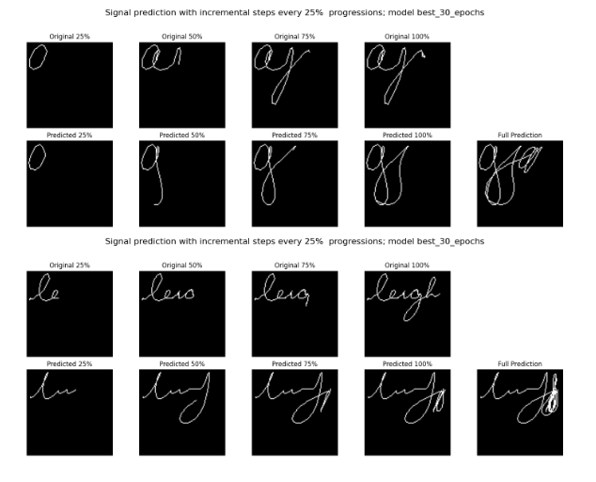
Large signals
Scribbles
Overall Shapes / Bounding boxes
Getting lost
Start, end of word
Context
Maxime Geminiani Welcklen
Master Thesis Defense
30/39

Slide 31
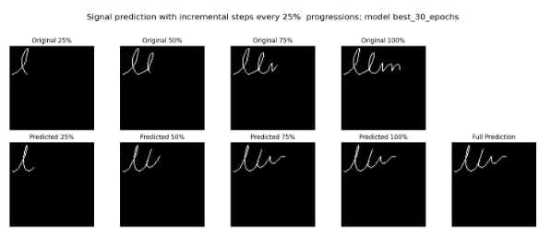
LLM
Ceci n’est pas un LLM
Maxime Geminiani Welcklen
Master Thesis Defense
31/39

Slide 32

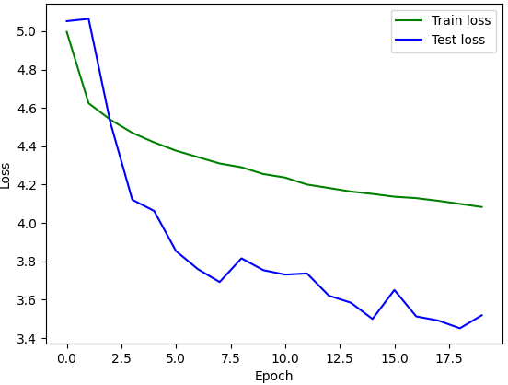
Demo
Medium Dataset
4M Data points
20 epochs
Maxime Geminiani Welcklen
Master Thesis Defense
32/39

Slide 33

Future Works
Relative Speeds / movements
More hardware, more datasets, more training
Better evaluation Metrics
Improve Stop predictions
Knowledge Transfer
Other ductus
Fine-Tuning for tasks
Set, Sort! Assembly
Maxime Geminiani Welcklen
Master Thesis Defense
33/39

Slide 34
Return on Objectives
Create Online signal from Offline data
Promising results on extracting [x,y] coordinate vector
Use a Transformer-based architecture
Tests on LSTM: Transformer is sufficient
Investigate the inference capacities over handwriting Speed / Trajectories
Good Results on signal of limited length, some limitations might be due to absolute references
Maxime Geminiani Welcklen
Master Thesis Defense
34/39

Slide 35
Conclusion
Satisfying results on x,y coordinates
Learning character-based ductus
Hard to generalize to large signals
Hard to find good signal evaluation
Limited hardware for transformers, very greedy on data
First brick of the road ?
«A transformer model is capable of predicting the pen kinematics from offline images on the English language, with a sufficient dataset and on a restricted alphabet of symbols.»
Maxime Geminiani Welcklen
Master Thesis Defense
35/39

Slide 36

Questions
Maxime Geminiani Welcklen
Master Thesis Defense
36/39

Slide 37
Additional slides
Maxime Geminiani Welcklen
Master Thesis Defense
37/39

Slide 38
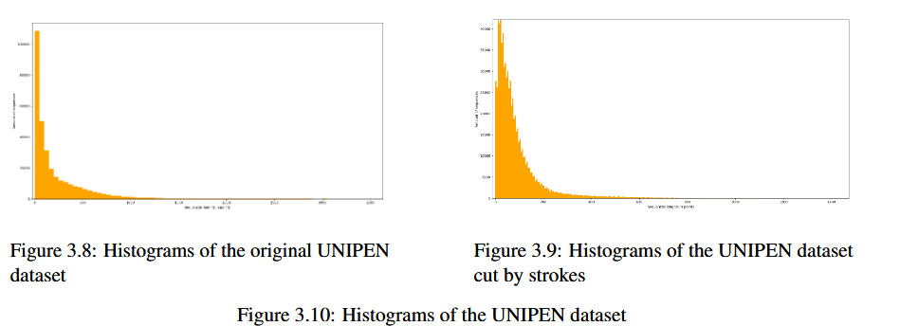
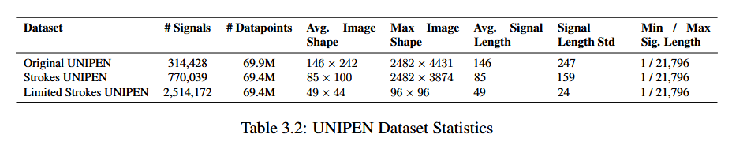
Data – Detailed UNIPEN
Maxime Geminiani Welcklen
Master Thesis Defense
38/39

Slide 39
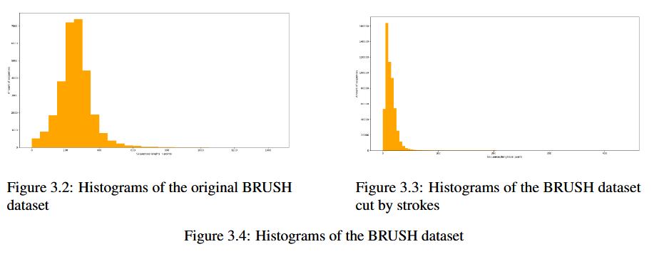
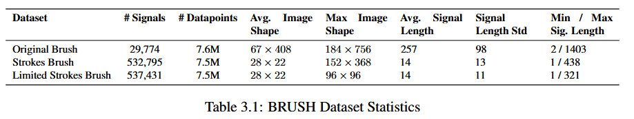
Data – Detailed BRUSH
Maxime Geminiani Welcklen
Master Thesis Defense
39/39

