Slide 1



Reconstruction of online writing signal from offline image Can the time (t) be robustly inferred by a transformer architecture ?
Status Update
18/10/2024

Slide 2
Objectives
Based on existing transformer models, Assess trainability of a transformer-based architecture in infering basic pen kinematic: Position and speed

Slide 3

1. Datasets

Slide 4
Datasets
Brush
Starting dataset, building a model that works
Limited data
Unified data
UNIPEN
Larger dataset(s), scaling training
Resampling
Quantification
RAM

Slide 5
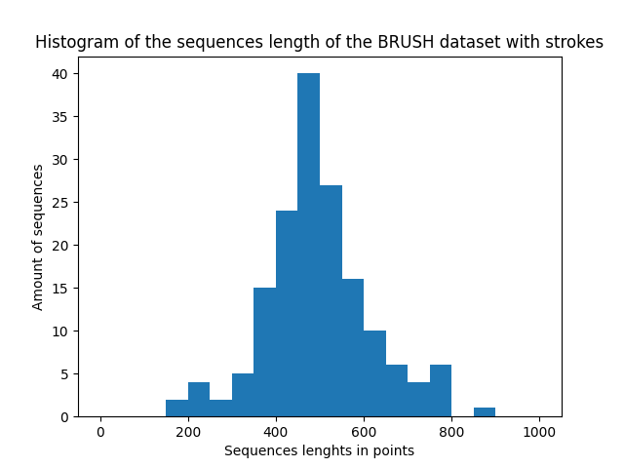
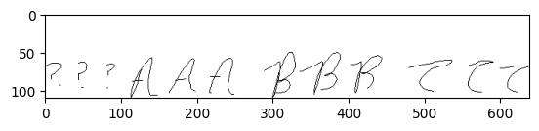
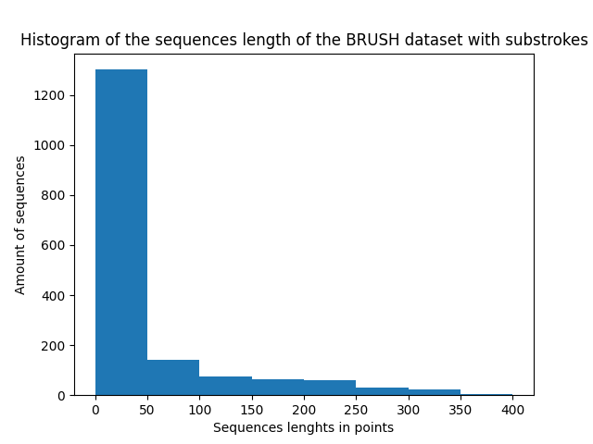
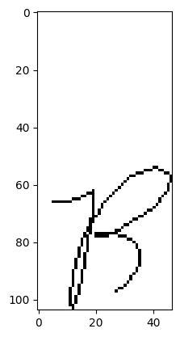
BRUSH - Analysis
Contains X, Y, Penup data
Concept of stroke
Total dataset length is
163 // 1700 sequences // strokes
80943 points
Maximum image shape: 220 * 241 Px
Average image shape: 145.5 * 165 Px

Slide 6
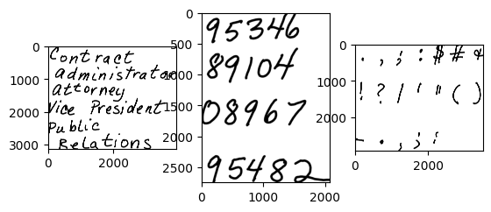
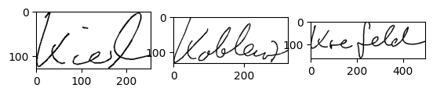
UNIPEN - ANALYSIS
Dataset has multiple sources, aggregate
Dataset handler
Different quantification, sampling
Use documentation to re-quantify, re-sample, correct and sanitize data
Dataset is larger
Larger images
Strokes : ~<1M sequences, ~30M datapoints

Slide 7
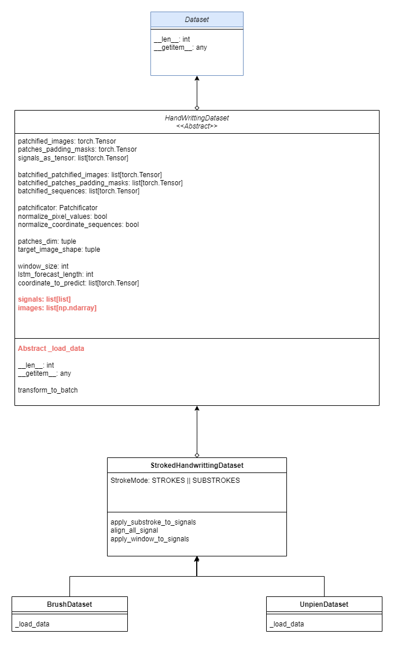
Dataset Architecture
Pytorch Dataset as base class
Base class responsible of the transformation
[x,y] vectors -> tensor data
Transformers, LSTM
Utility class used to resolve common Pre-processing
Cutting strokes
Alignments
Windows
Outliers
Resizing
Data sources
Retrieving [x,y] data

Slide 8
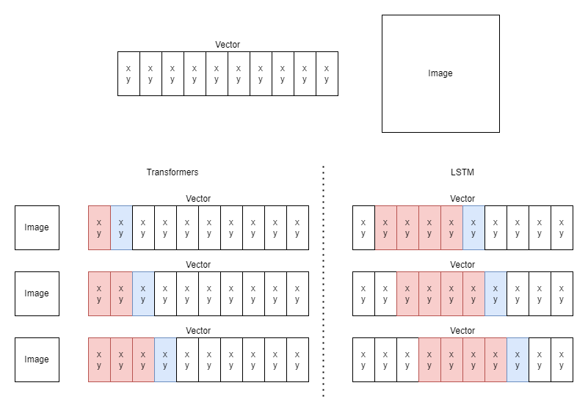
Data processing: Batchification
Take inspiration from text-based LLM
Replace with ‘ground truth’ in learning
Parallelized samples
“Perfect” images recreated from coordinate vector

Slide 9
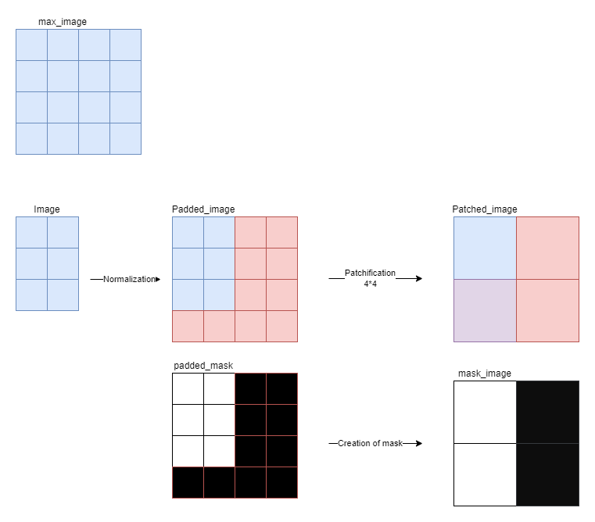
Data processing Patches, Padding
Alignement on max-image
Pytorch tensors must be homogeneous
Create padded image and mask signal in parallel
Use same unfolder to guarantee order
Reduction of mask
All mask = Masked patch
Else Not masked

Slide 10
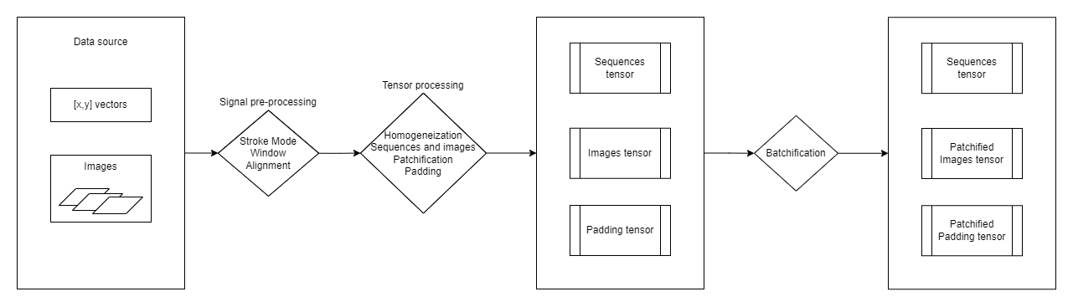
Data processing – whole chain

Slide 11
2. Model
Architecture
Loops

Slide 12
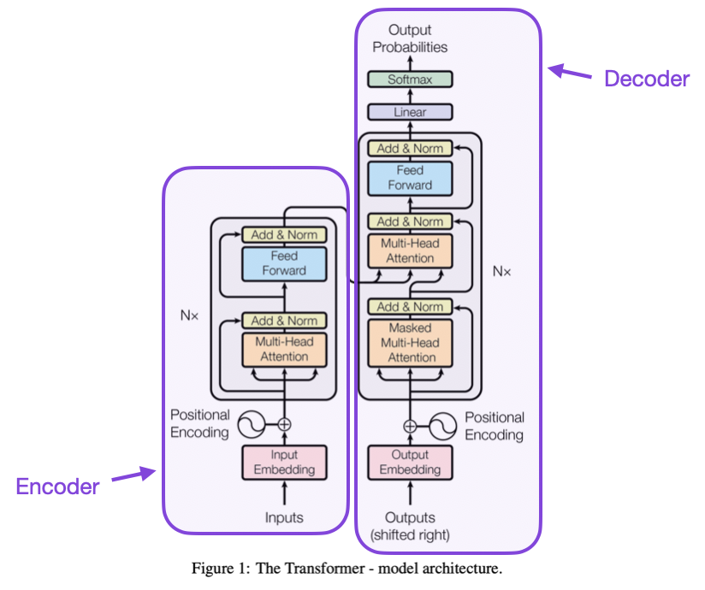
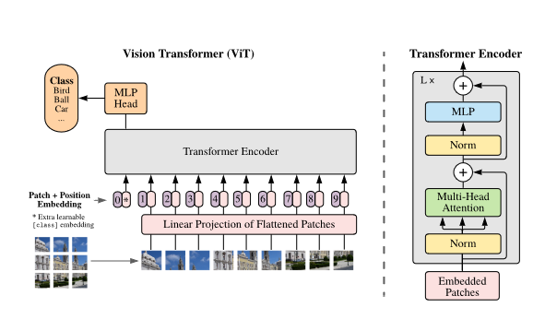
Model
Encoder-Decoder from Text-based transformers (LLMs)
Encoder based on Vision Transformers (VIT)

Slide 13
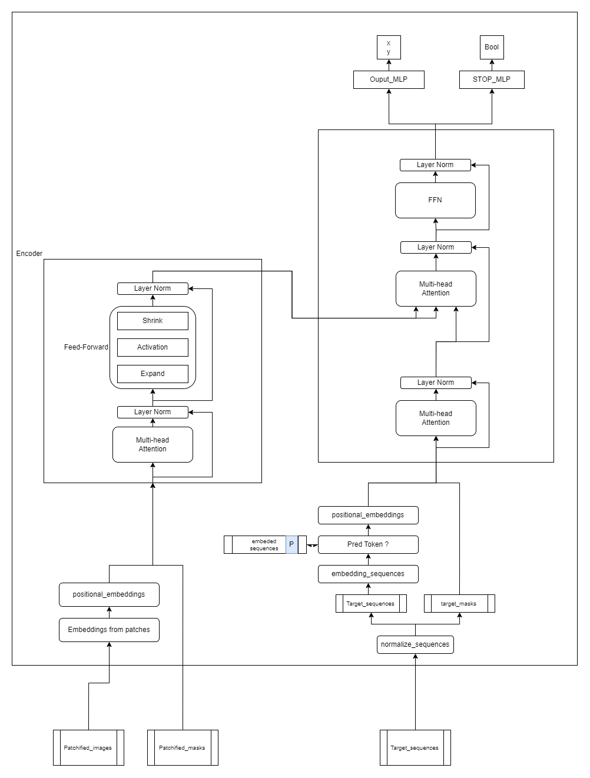
Model – detailed architecture
Patchification, embeddings on encoder similar to VIT
Encoder: Encode image into attention map
Decoder
Query is target sequence
Use encoder output to focus on pixel points
Stop signal
Auto-regressive training need STOP

Slide 14
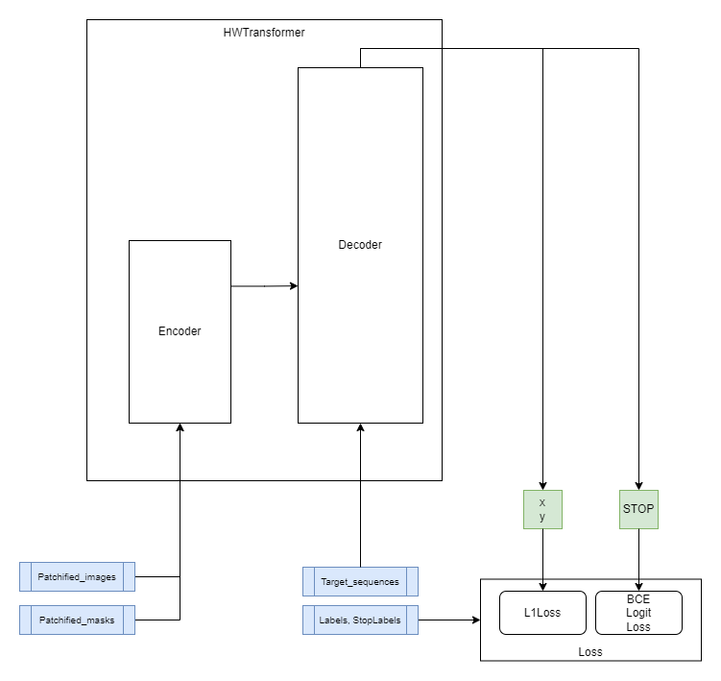
Training loop
Batchified loop
Parallelized thanks to ground truth replacing

Slide 15
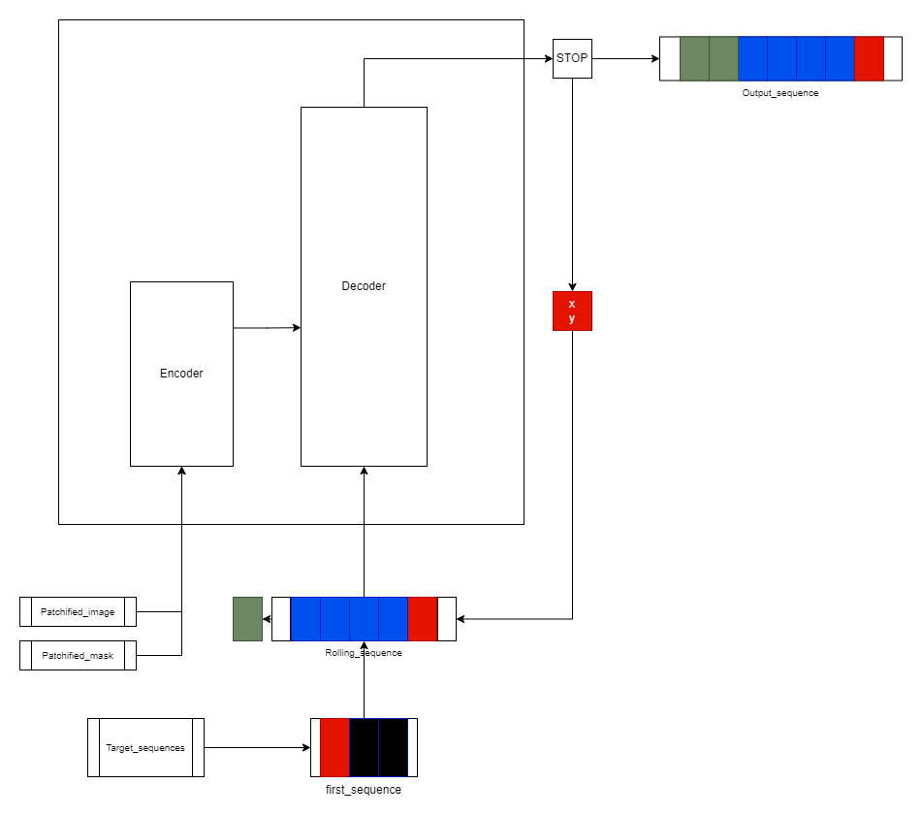
Inference loop
Autoregression
No limit to sequence length
Limit maximum
Detect stops

Slide 16
3. Challenges
Work to be the next focus

Slide 17
Challenge 1 – Train with Hyper-parameters
Transformer-related
Encoder layers
Decoder layers
Encoder heads
Decoders heads (x2)
Autoregressive sequence length
FFN Activation function & Expansion ratio
Architectural / Meta-Hyper-Parameters
LSTM ON/FF
Prediction Token ON/OFF
Dimensionality
Patches dimension
Embedding dimension
Traditional
Normalization pixel values, coordinates
Dropout ratio
Learning rate

Slide 18
Challenge 2 - UNIPEN
Too much data to fit in RAM
Images are larger
Impossible to pre-build tensor of [batch * max_W * max_H] for batchified patches, paddings, sequences
Save to file and load on-demand
Build images on-the-fly
Training time
Rolling window centered on selection

Slide 19
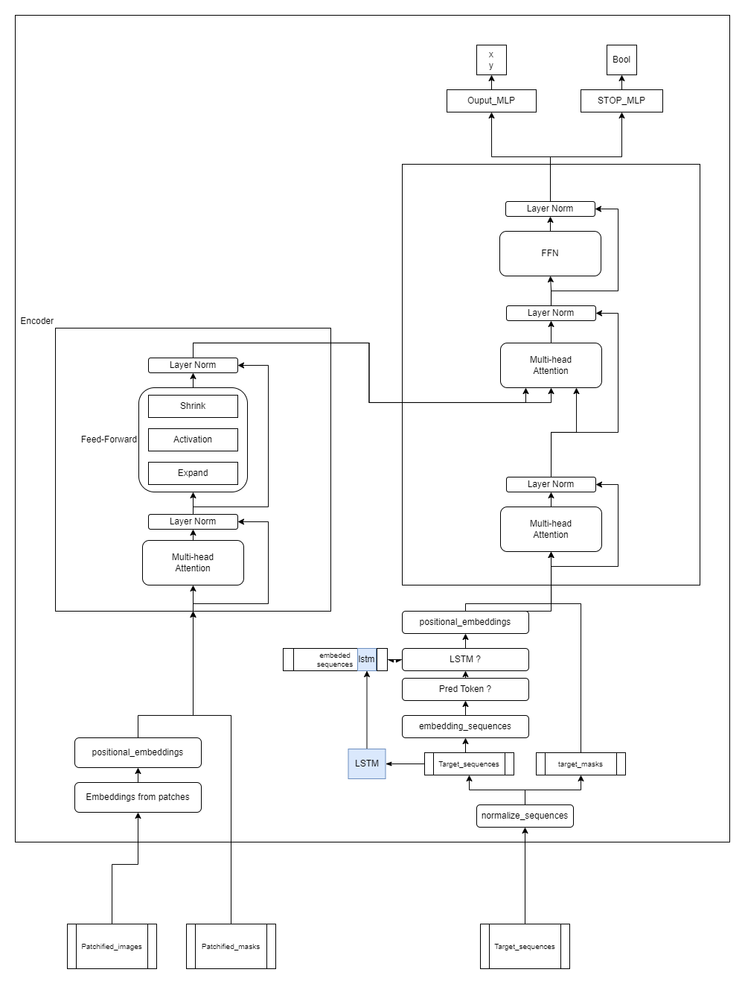
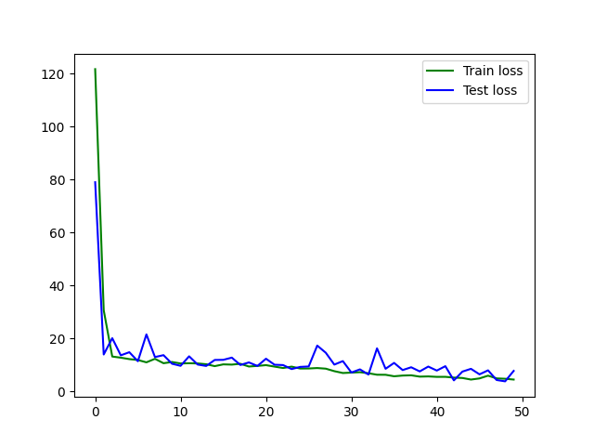
CHALLENGE 3 - LSTM
Trainability of LSTM on HW already proven
LSTM can train on brush
Need to test with/without, assess impact on error

