Slide 1

LUNAR ROVER
Reinforcement Learning and Decision Making Under Uncertainty
Maxime Welcklen and Louis Chaubert
Notes:
Summrise the goal of the project (small explanation of the environment, the details come later)

Slide 2
TABLE OF CONTENTS
ENVIRONMENT as ENV
DISCRETE
CONTINUOUS
TEMPORAL-DIFFERENCE LEARNING as TD
TD(0), TD(λ), MONTE-CARLO
DEEP LEARNING as DL
DEEP QLEARNING

Slide 3





ENVIRONMENT
NAME | IMAGE | DESCRIPTION
ROVER |  | Current location of the agent.
END |  | Goal of the mission. The agent receives a large positive reward if he or she succeeds. It ends the episode.
STANDARD |  | No particular behaviour. The agent will move to the correct tile according to its current state and the action taken.
FRAIL |  | The agent has a 50% probability of falling and receives a large negative reward. This ends the episode.
FAST |  | If the agent's absolute speed is greater than 0, it has a 50% chance of sliding off a tile too far.
CRATER |  | If the agent moves while on this tile, he is moved to an adjacent tile at random, i.e. the action is ignored and chosen at random from the movement actions.
MINERALS | … | This type of tile represents minerals. If the agent decides to drill at this location, he will receive a positive (random) reward.

Slide 4
ENV . ACTIONS
NAME | DESCRIPTION
NOTHING | The agent does nothing.
LEFT | The agent moves to the left.
RIGHT | The agent moves to the right.
UP | The agent moves up.
DOWN | The agent moves down.
DRILL | The agent drills.
Notes:
The actions are the same for the discrete and the continuous environment.
Each actions is penalised by -1 reward (NOTHING and DRILL as well).

Slide 5
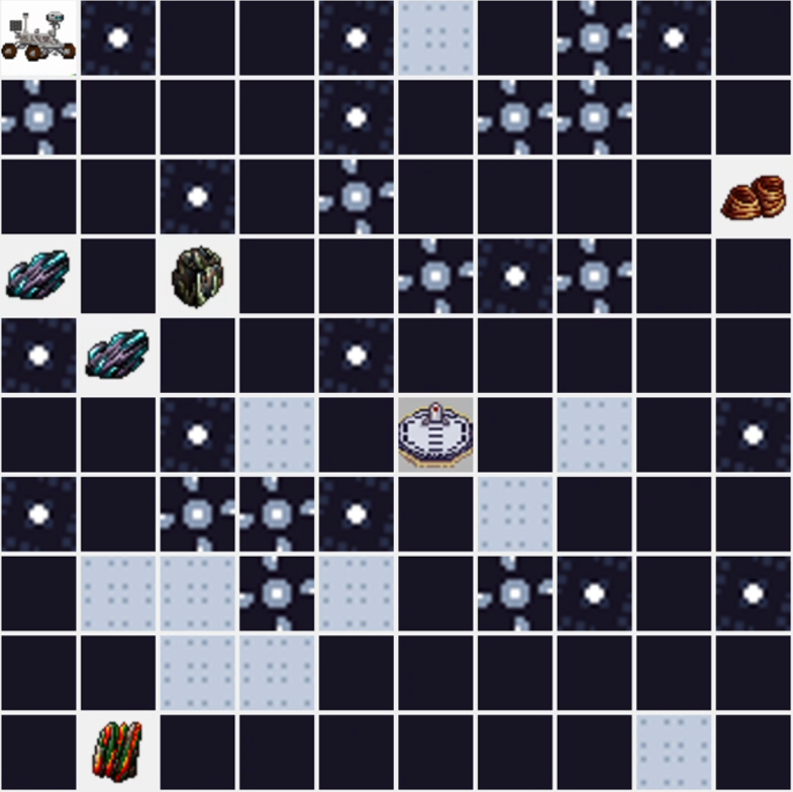
ENV . DISCRETE

Slide 6
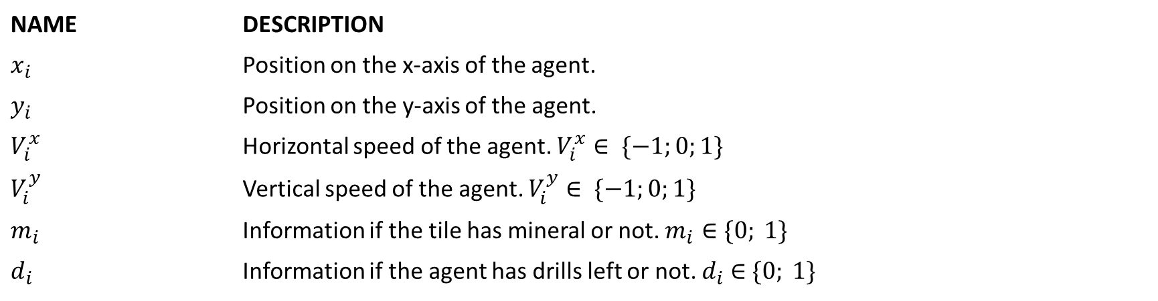
ENV . DISCRETE . STATES
NAME | DESCRIPTION
$$x_{i}$$ | Position on the x-axis of the agent.
$$y_{i}$$ | Position on the y-axis of the agent.
$$V_{i}^{x}$$ | Horizontal speed of the agent. $V_{i}^{x}∈ \{−1;0;1\}$
$$V_{i}^{y}$$ | Vertical speed of the agent. $V_{i}^{y}∈ \{−1;0;1\}$
$$m_{i}$$ | Information if the tile has mineral or not. $m_{i}∈\{0; 1\}$
$$d_{i}$$ | Information if the agent has drills left or not. $d_{i}$ ∈ $\{0; 1\}$
$$possible speeds ∈\{\left(V_{i}^{x}=1,V_{i}^{y}=0\right),\left(V_{i}^{x}=0,V_{i}^{y}=−1\right),\left(V_{i}^{x}=−1,V_{i}^{y}=0\right),\left(V_{i}^{x}=0,V_{i}^{y}=1\right),(V_{i}^{x}=0,V_{i}^{y}=0)\}$$
Notes:
Some combination of “V_x” and “V_y” are forbidden in order to avoid diagonal movement, e.g. V_x = -1 and V_y = -1
“d” is equal to 1 if the number of drills performed is smaller than the maximum number of drills allowed.

Slide 7
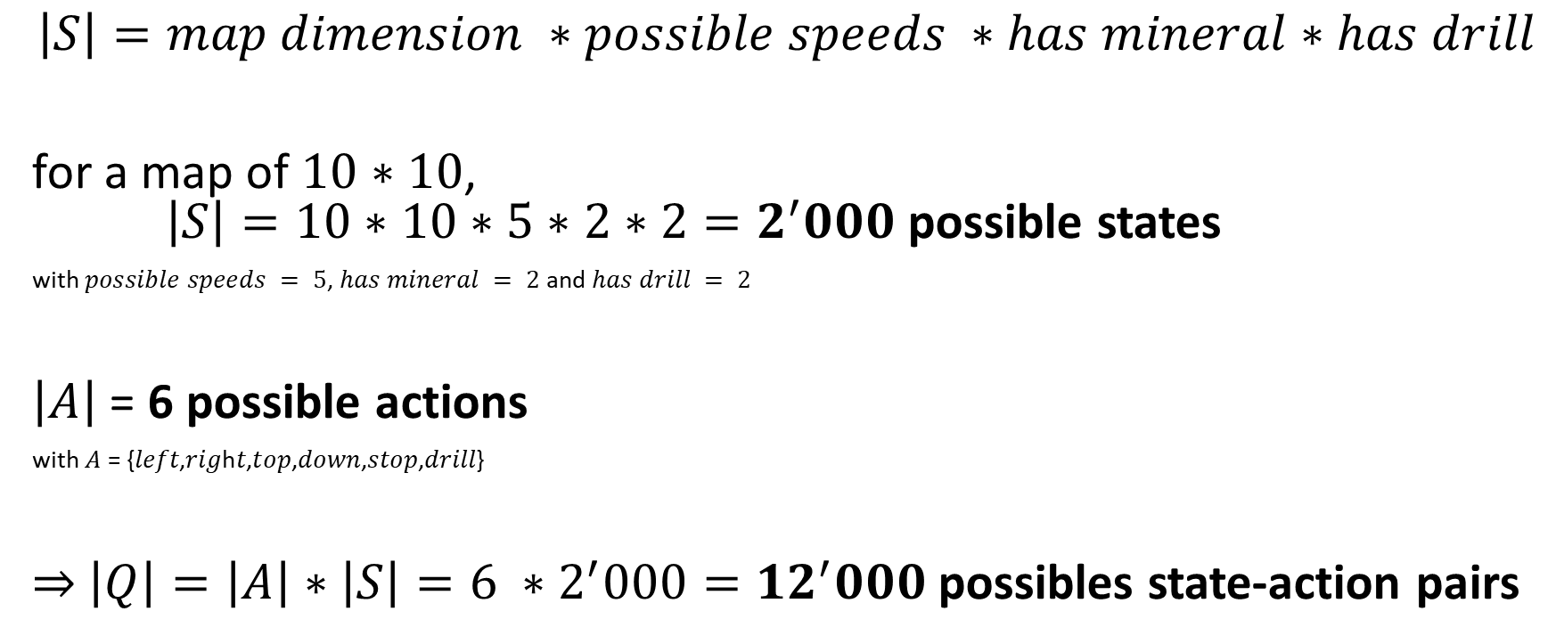
ENV . DISCRETE . QTABLE
$$\left|S\right|=map dimension ∗possible speeds ∗has mineral∗has drill$$
for a map of $10∗10$, $\left|S\right|=10∗10∗5∗2∗2=2^{′}000$ possible states
with $possible speeds = 5$, $has mineral = 2$ and $has drill = 2$
$\left|A\right| \text{= }\text{6}$ possible actions
with $\text{A} \text{=} \text{\{}\text{left}\text{,}\text{rig}\text{h}\text{t}\text{,}\text{top}\text{,}\text{down}\text{,}\text{stop}\text{,}\text{drill}\text{\}}$
⇒ $\left|Q\right|=\left|A\right|∗\left|S\right|=6 ∗2^{′}000={12}^{′}000$possibles state-action pairs

Slide 8
ENV . CONTINUOUS

Slide 9
TEMPORAL-DIFFERENCE LEARNING as TD
TD(0)
TD(λ)
MONTE-CARLO
Notes:
Goal: comparison of the lambdas with Qlearning (evtl. Sarsa)
What do we want to compare?
How fast do they converge?

Slide 10
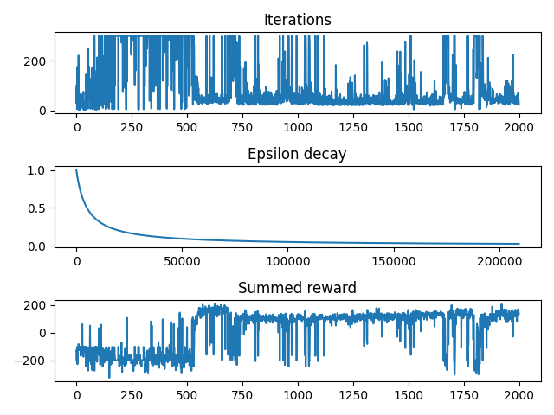

TD . experiment
Lambda (λ) | Discount (γ) | Reward*
0.0 | 0.99 | 170
0.2 | 0.8 | 105
0.4 | 0.6 | 122
0.6 | 0.4 | 119
0.8 | 0.2 | 143
1.0 | 0.01 | 170
Qlearning with $γ=0.99$ and $λ=0.0$
Epsilon function: arithmetic with $k=5^{′}000$
$$α=0.6$$
2’000 episodes
Notes:
Equivalent to qlearning without eligibility traces
Finds the end after a few episodes (~ 250) but randomness on the way
Finds the end after a few episodes but almost completely ignores the minerals on its way
Same behaviour but tends to use the type of tile to its advantage (e.g. the fast tiles)
“
Tries to collect more minerals as before
Almost always collect the maximum number of minerals and tries to use the tiles to its advantage

Slide 11
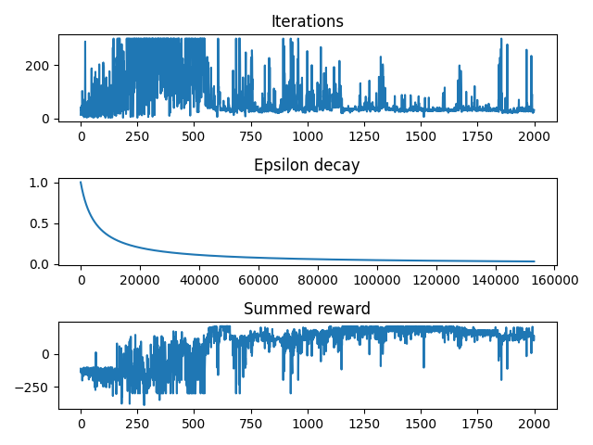

TD . experiment
Lambda (λ) | Discount (γ) | Reward*
0.0 | 0.99 | 170
0.2 | 0.8 | 105
0.4 | 0.6 | 122
0.6 | 0.4 | 119
0.8 | 0.2 | 143
1.0 | 0.01 | 170
Qlearning with $γ=0.01$ and $λ=1.0$
Epsilon function: arithmetic with $k=5^{′}000$
$$α=0.6$$
2’000 episodes
Notes:
Equivalent to qlearning without eligibility traces
Finds the end after a few episodes (~ 250) but randomness on the way
Finds the end after a few episodes but almost completely ignores the minerals on its way
Same behaviour but tends to use the type of tile to its advantage (e.g. the fast tiles)
“
Tries to collect more minerals as before
Almost always collect the maximum number of minerals and tries to use the tiles to its advantage

Slide 12
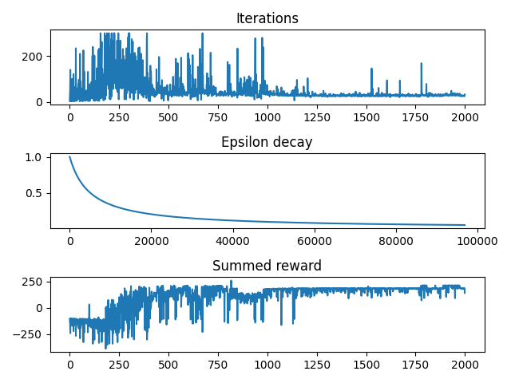

TD . experiment
Lambda (λ) | Discount (γ) | Reward*
0.0 | 0.99 | 170
0.2 | 0.8 | 105
0.4 | 0.6 | 122
0.6 | 0.4 | 119
0.8 | 0.2 | 143
1.0 | 0.01 | 170
1.0 | 0.1 | 212
Qlearning with $γ=0.1$ and $λ=1.0$
Epsilon function: arithmetic with $k=5^{′}000$
$$α=0.6$$
2’000 episodes
Notes:
ACHTUNG! BUG FOUND! THE AGENT WAS ABLE TO DRILL 4TIMES (BUT MAX DRILL = 3) BUT REALLY STABLE

Slide 13
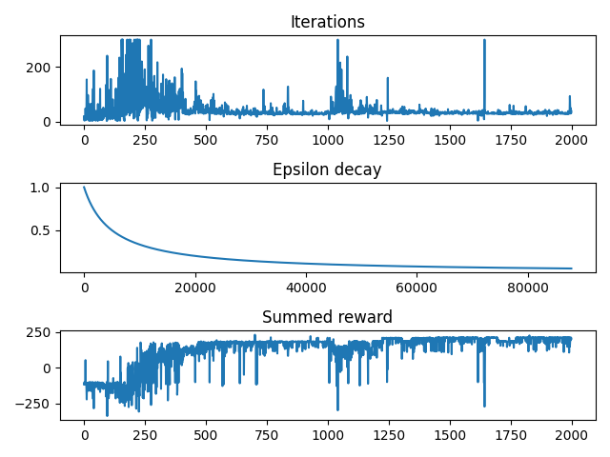

TD . experiment
Lambda (λ) | Discount (γ) | Reward*
0.0 | 0.99 | 170
0.2 | 0.8 | 105
0.4 | 0.6 | 122
0.6 | 0.4 | 119
0.8 | 0.2 | 143
1.0 | 0.01 | 170
1.0 | 0.1 | 212
1.0 | 0.2 | 212
Qlearning with $γ=0.2$ and $λ=1.0$
Epsilon function: arithmetic with $k=5^{′}000$
$$α=0.6$$
2’000 episodes
Notes:
SAME AS BEFORE

Slide 14
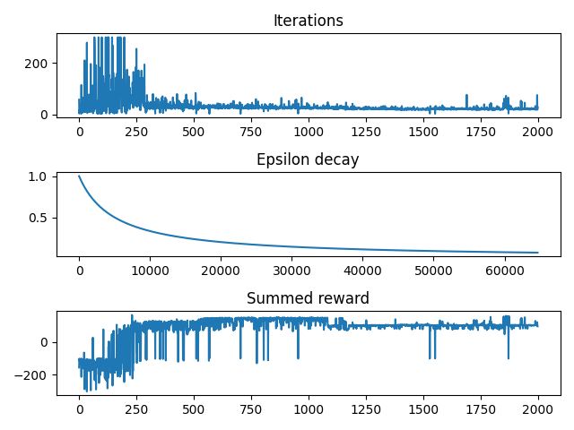

TD . experiment
Lambda (λ) | Discount (γ) | Reward*
0.0 | 0.99 | 170
0.2 | 0.8 | 105
0.4 | 0.6 | 122
0.6 | 0.4 | 119
0.8 | 0.2 | 143
1.0 | 0.01 | 170
1.0 | 0.1 | 212
1.0 | 0.2 | 212
0.3 | 0.6 | 104
Qlearning with $γ=0.6$ and $λ=0.3$
Epsilon function: arithmetic with $k=5^{′}000$
$$α=0.6$$
2’000 episodes

Slide 15
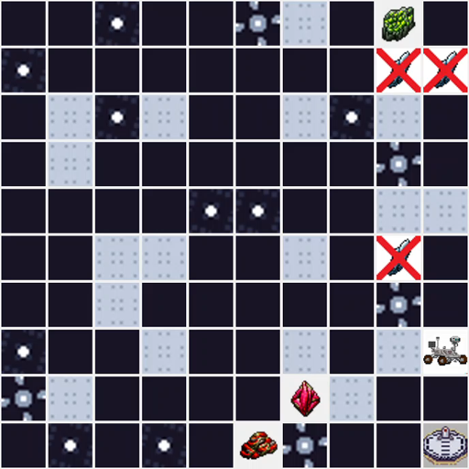
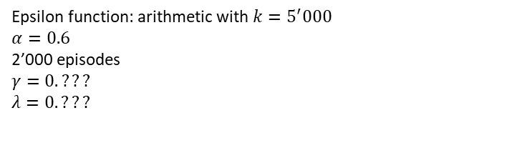
TD . Experiment from .expert
Epsilon function: arithmetic with $k=5^{′}000$
$$α=0.6$$
2’000 episodes
$$γ=0.???$$
$$λ=0.???$$

Slide 16
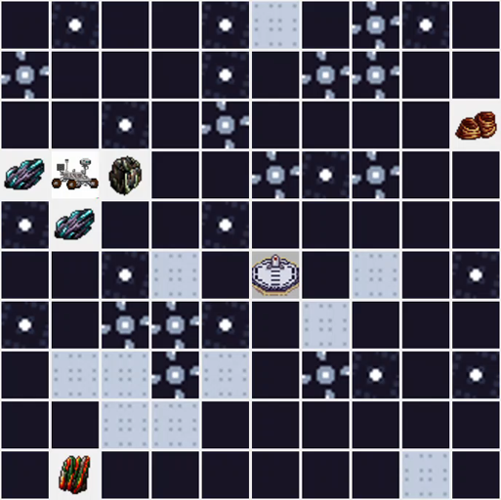
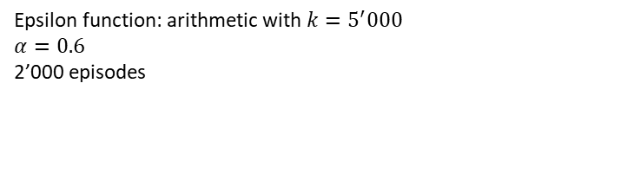
TD . Experiment from .fun
Epsilon function: arithmetic with $k=5^{′}000$
$$α=0.6$$
2’000 episodes

Slide 17
DEEP LEARNING as DL

Slide 18
DL . DEEP QLEARNING

Slide 19
QUESTIONS
?

