Slide 1
ECE 50863 Project 3 Report Template
Name and email:
Collaborator (if applicable):
Submit as a pdf, labeled <firstname1.lastname1.firstname2.lastname2.Project3.first.pdf>, <firstname1.lastname1.firstname2.lastname2.Project3.final.pdf>
[If single member team, please just include firstname1.lastname1]

Slide 2
Instructions
Please follow this template for all milestones, but update the material with each milestone.
For checkpoint, comparisons only need to present implemented algorithms.
Answers should be typed. Handwritten documents are not permitted.
Your report should be submitted in pdf format only.
Please keep your answers to the point.
Graphs should be carefully plotted, with the X and Y axis clearly labeled with appropriate legends.
For a slide with a graph have a 1 line “take-home” message (what does the result show?)
Avoid 2 graphs on the same slide to ensure clarity.

Slide 3
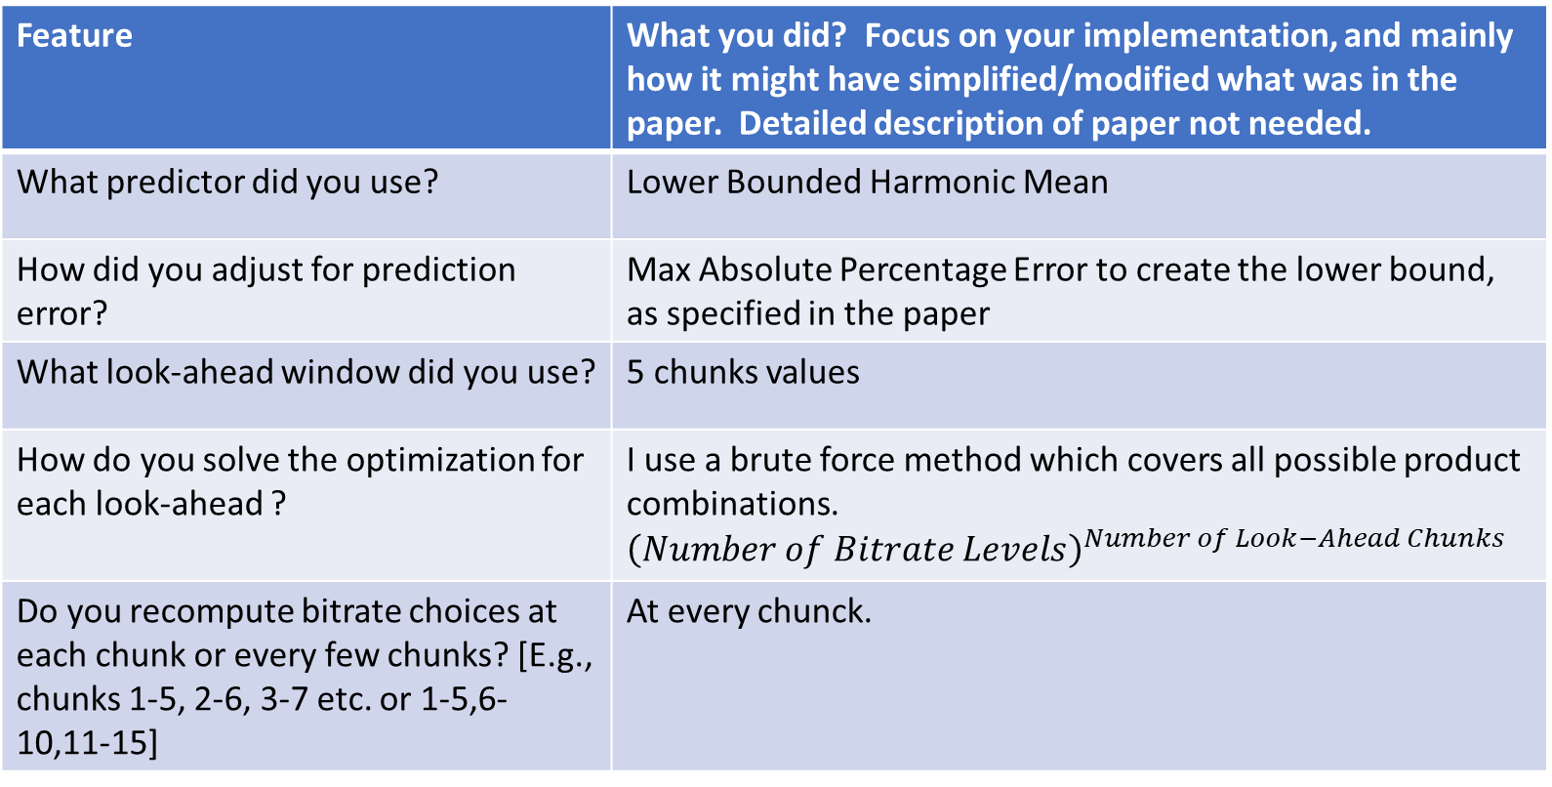
Base Algorithm: RobustMPC
Feature | What you did? Focus on your implementation, and mainly how it might have simplified/modified what was in the paper. Detailed description of paper not needed.
What predictor did you use? | Lower Bounded Harmonic Mean
How did you adjust for prediction error? | Max Absolute Percentage Error to create the lower bound, as specified in the paper
What look-ahead window did you use? | 5 chunks values
How do you solve the optimization for each look-ahead ? | I use a brute force method which covers all possible product combinations. ${\left(Number of Bitrate Levels\right)}^{Number of Look−Ahead Chunks}$
Do you recompute bitrate choices at each chunk or every few chunks? [E.g., chunks 1-5, 2-6, 3-7 etc. or 1-5,6-10,11-15] | At every chunck.

Slide 4
BaseAlgorithm: RobustMPC
Use a bulleted list to explain any thing else you think important for the base implementation not covered in the previous slide. Include any simplifications you made, or other significant features you implemented

Slide 5
Base Algorithm: BBA-2
Feature | What you did? Focus on your implementation, and mainly how it might have simplified/modified what was in the paper. Detailed description of paper not needed.
How was initial period handled to avoid being conservative
How did you map buffer levels to chunk sizes?

Slide 6
BaseAlgorithm: BBA-2
Use a bulleted list to explain any thing else you think important for the base implementation not covered in the previous slide. Include any simplifications you made, or other significant features you implemented

Slide 7
Your approach [Use more slides if needed] For checkpoint, this is a proposed approach. For final replace with what you actually did.
What is the goal of your approach and why do you think it might do better?
Provide key details of your approach. [Avoid low-level implementation details] Justify key choices. Use a bulleted list.

Slide 8
Results: [More slides if needed] [For checkpoint, only focus on baseline algorithms, you can update for final]
Present the settings where you compared?
Was it default config we provided? or
Different settings (e.g., smaller buffer size)?
Present comparison results of all algorithms on the set of traces/configurations that we provided.
We suggest using a bar graph (X-Axis: traceID, Y-Axis: QoE metric)
You may also additionally use a CDF (e.g., see Fig 8 in MPC paper).
Please give some thought to what additional graphs to present in as compact yet informative/insightful a manner as possible.
Reporting the composite score is useful, but it may be helpful to also report other metrics especially when they can help provide more insights.

Slide 9
Results Discussion [More slides if needed]
What are your conclusions?
Does an algorithm (or variant) generally work better in all cases?
Do the algorithms have trade-offs, with one working better in certain environments than others?
Do some algorithms favor one metric (e.g. quality) more than others?
In what settings does an algorithm perform the best or the worst, and why?
Please do not just say “Algorithm 1 performs better In Trace 1 and 2, while Algorithm 2 performs better in Traces 3 to 5”. Instead, seek to generalize and see what characteristics those traces have, and try to connect it to how the algorithm works.

Slide 10
Other open-ended explorations if applicable [Add extra slides if needed] – Only for final report.
Address aspects here such as:
Any other approaches you may have implemented/explored and summarize results.
If you came up with additional traces of your own to better distinguish different algorithms, discuss the rationale, and what you found.

Slide 11
Contributions of each student [Skip slide if you did this alone; for checkpoint indicate ”Completed” and “Proposed” for each bullet.]
Name of Student1
Indicate which baseline algorithm implemented.
Bulleted list of other contributions.
Name of Student2
Indicate which baseline algorithm implemented.
Bulleted list of other contributions.

