Slide 1
ECE 50863 Project 3 Report Template
Name and email: Maximilian Drach (mdrach@purdue.edu)
Collaborator (if applicable): Timothy Hein (heint@purdue.edu)
Submit as a pdf, labeled <firstname1.lastname1.firstname2.lastname2.Project3.first.pdf>, <firstname1.lastname1.firstname2.lastname2.Project3.final.pdf>
[If single member team, please just include firstname1.lastname1]

Slide 2
Instructions
Please follow this template for all milestones, but update the material with each milestone.
For checkpoint, comparisons only need to present implemented algorithms.
Answers should be typed. Handwritten documents are not permitted.
Your report should be submitted in pdf format only.
Please keep your answers to the point.
Graphs should be carefully plotted, with the X and Y axis clearly labeled with appropriate legends.
For a slide with a graph have a 1 line “take-home” message (what does the result show?)
Avoid 2 graphs on the same slide to ensure clarity.

Slide 3
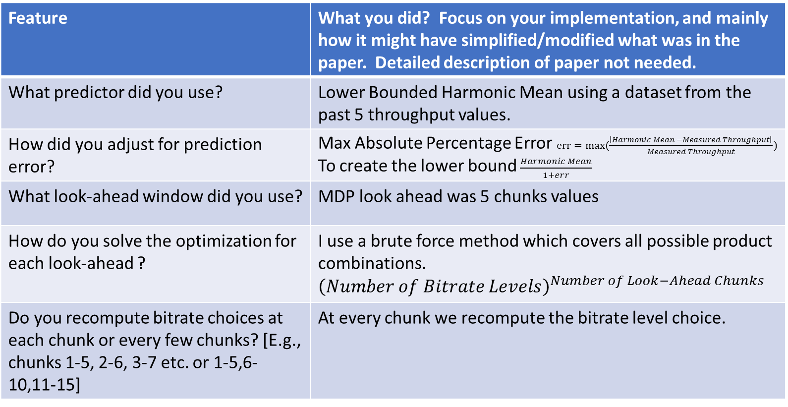
Base Algorithm: RobustMPC
Feature | What you did? Focus on your implementation, and mainly how it might have simplified/modified what was in the paper. Detailed description of paper not needed.
What predictor did you use? | Lower Bounded Harmonic Mean using a dataset from the past 5 throughput values.
How did you adjust for prediction error? | Max Absolute Percentage Error $err=max(\frac{\left|Harmonic Mean −Measured Throughput\right|}{Measured Throughput})$ To create the lower bound$\frac{Harmonic Mean}{1+err}$
What look-ahead window did you use? | MDP look ahead was 5 chunks values
How do you solve the optimization for each look-ahead ? | I use a brute force method which covers all possible product combinations. ${\left(Number of Bitrate Levels\right)}^{Number of Look−Ahead Chunks}$
Do you recompute bitrate choices at each chunk or every few chunks? [E.g., chunks 1-5, 2-6, 3-7 etc. or 1-5,6-10,11-15] | At every chunk we recompute the bitrate level choice.

Slide 4
BaseAlgorithm: RobustMPC
Use a bulleted list to explain any thing else you think important for the base implementation not covered in the previous slide. Include any simplifications you made, or other significant features you implemented
In our RobustMPC implementation we do not optimize the start-up time parameter. Since we have no previous throughput data, it is hard for us to optimize an ideal start-up time with out more data. Therefore, in our implementation I pick the lowest bitrate level for the initial chunk request.
We optimize for average video quality and average quality variation using the absolute bitrate level. While we use the chuck bitrate to optimize the rebuffer factor.
For optimizing the rebuffer factor, we also make sure the value is a minimum of 0 thus not differentiating value that do not decrease the buffer level.
We simplify the RobustMPC by not accounting for the waiting time in between chunks request.

Slide 5
Base Algorithm: BBA-2
Feature | What you did? Focus on your implementation, and mainly how it might have simplified/modified what was in the paper. Detailed description of paper not needed.
How was initial period handled to avoid being conservative
How did you map buffer levels to chunk sizes?

Slide 6
BaseAlgorithm: BBA-2
Use a bulleted list to explain any thing else you think important for the base implementation not covered in the previous slide. Include any simplifications you made, or other significant features you implemented

Slide 7
Your approach [Use more slides if needed] For checkpoint, this is a proposed approach. For final replace with what you actually did.
What is the goal of your approach and why do you think it might do better?
The MPC implementation has an error were is does not differentiate the positive impact a bitrate level has on the buffer, this is because the rebuffering term has a minimum of 0. If we were to decrease the minimum to say -10 this would allow the MPC to gauge the positive impact that lower bitrate levels enable.
Provide key details of your approach. [Avoid low-level implementation details] Justify key choices. Use a bulleted list.

Slide 8
Results: [More slides if needed] [For checkpoint, only focus on baseline algorithms, you can update for final]
Present the settings where you compared?
Was it default config we provided? or
Different settings (e.g., smaller buffer size)?
Present comparison results of all algorithms on the set of traces/configurations that we provided.
We suggest using a bar graph (X-Axis: traceID, Y-Axis: QoE metric)
You may also additionally use a CDF (e.g., see Fig 8 in MPC paper).
Please give some thought to what additional graphs to present in as compact yet informative/insightful a manner as possible.
Reporting the composite score is useful, but it may be helpful to also report other metrics especially when they can help provide more insights.

Slide 9
MPC QoE Scores (min buffer level = 0)

Slide 10
MPC QoE Scores (min buffer level = -10)

Slide 12
Results Discussion [More slides if needed]
What are your conclusions?
Does an algorithm (or variant) generally work better in all cases?
Do the algorithms have trade-offs, with one working better in certain environments than others?
Do some algorithms favor one metric (e.g. quality) more than others?
In what settings does an algorithm perform the best or the worst, and why?
Please do not just say “Algorithm 1 performs better In Trace 1 and 2, while Algorithm 2 performs better in Traces 3 to 5”. Instead, seek to generalize and see what characteristics those traces have, and try to connect it to how the algorithm works.

Slide 13
Other open-ended explorations if applicable [Add extra slides if needed] – Only for final report.
Address aspects here such as:
Any other approaches you may have implemented/explored and summarize results.
If you came up with additional traces of your own to better distinguish different algorithms, discuss the rationale, and what you found.

Slide 14
Contributions of each student [Skip slide if you did this alone; for checkpoint indicate ”Completed” and “Proposed” for each bullet.]
Name of Student1
Indicate which baseline algorithm implemented.
Bulleted list of other contributions.
Name of Student2
Indicate which baseline algorithm implemented.
Bulleted list of other contributions.

