Slide 1
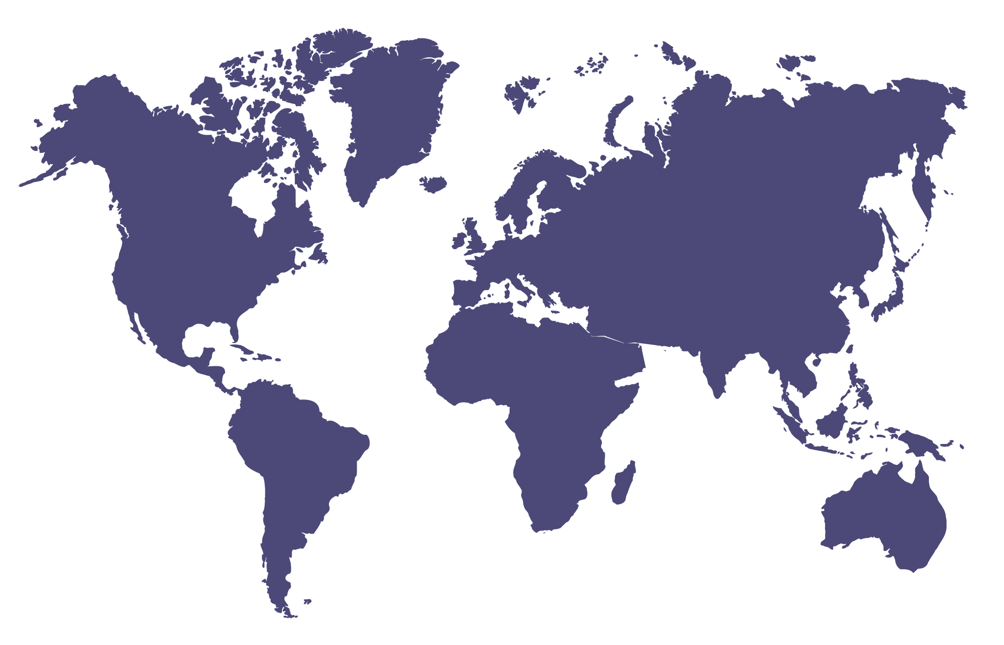
Problem: Genome Data Held in Silos, Unshared, not Standardized for Exchange
No one institute has enough on its own to make progress. Every researcher and clinician should be able to compare their genome data to others.
Notes:
The issue we are addressing is that with accumulation of genomic information in pediatric oncology and medicine in general, we are faced with the problem of data silos. Where data are generated and stored at different locations and there are no effective mechanisms to share and consolidate the data.

Slide 2
We need a public ledger for sharing
GATTTATCTGCTCTCGTTG
GAAGTACAAAATTCATTAATGCTATGCACAAAATCTGTAG
TAGTGTCCCATCTATTT
C

Slide 3
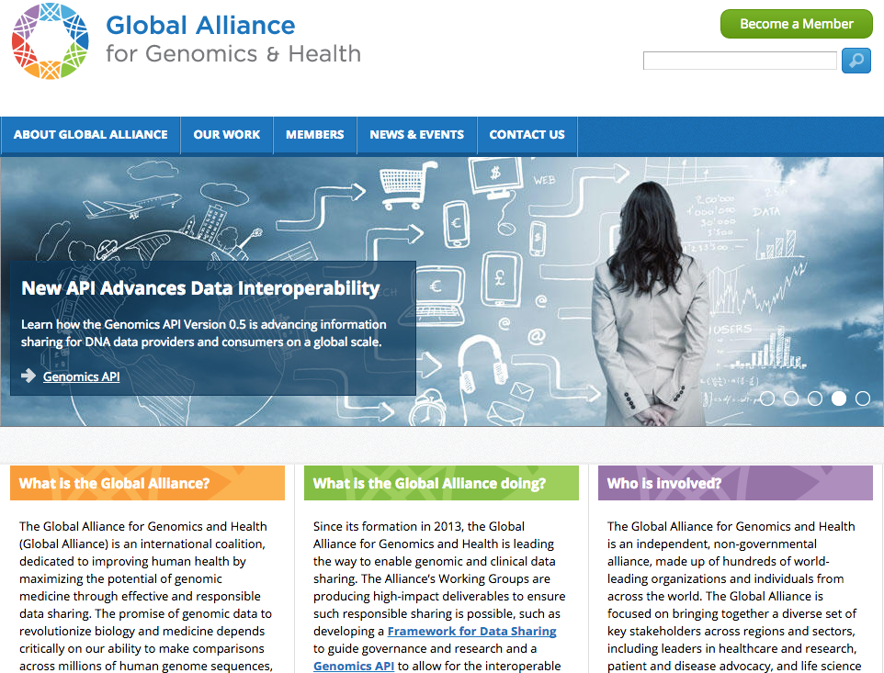
Alliance for data sharing
UC Santa Cruz Genomics Institute
Notes:
Second, to defeat cancer, we need to go global.
In his State of the Union speech, President Obama called for 1 million cancer genomes.
That's what will give us the statistical power to defeat cancer.
We need a ”global DNA sharing network" for the secure sharing of genomic and clinical data.
That's why I co-founded the Global Alliance for Genomics and Health
We are mobilizing hundreds of institutions worldwide to build the definitive open-source Internet protocols to share DNA.
This is opening the floodgates to even greater collaboration.
Competition among medical centers can make them reluctant to share their patients' data with each other.
We need to get over that.
Bear in mind, every major medical center now offers DNA sequencing tests

Slide 4

Enabling Responsible Sharing of Genomic and Clinical Data
GA4GH Founded on June 5, 2013
More than 400 insitutional members
From more than 40 countries,
Approx. 1/3 are companies
Mission: to enable rapid progress in biomedicine
Strategy:
support major driver projects
create and maintain interoperability of technology platform standards
develop guidelines and harmonizing procedures for privacy and ethics in the international regulatory context
engage stakeholders across sectors to encourage the responsible and voluntary sharing of data and of methods
Notes:
Angel Pizarro: Amazon
Jonathan Bingham: Google
Bob Davidson: Microsoft
Laura Van ‘T Veer, Benedict Paten, Adam Margolin

Slide 5
Cancer Global Data Sharing
Cancer is driven by mutations in DNA. Precision treatment of cancer depends on knowledge of these mutations
Start with a Pilot:
-build a mechanism for recording cancer DNA mutations and clinical information from millions of cancer patient participants across the world
-Initially called the Actionable Cancer Genome Initiative
-Cancer is the right place to start. Once this is working, similar technology could be used to share DNA information for other diseases

Slide 6
Example proposed public record
gene: BRAF
variant: V600E
Patient ID: 163a0083-26fa-4705-bcfb-d264c4cff796
Gender: Male
Ethnicity: White Caucasian
Age at Diagnosis: 57
Tumor Classification: non-small-cell lung carcinoma (MeSH D002289)
Tissue or organ of origin: Lung
Tumor morphology: Squamous (epidermoid)

Slide 7
Data Sharing Specifications
Data open and available to all
Ubiquitously accessible on the Internet
Can scale to accept donations from 1000s of sources
Not maintained by any central authority or tied to any single country, location or institution
Not corruptible
Protects participant privacy
Stable design so that it may be used by many 3rd party application programs (“apps”)
Notes:
Like a utility, such as the Internet itself.

Slide 8
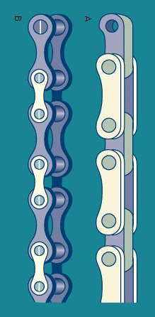
This is accomplished with a Shared Public Ledger
Ethereum: https://www.ethereum.org/foundation
Ripple: https://ripple.com/
Hyperledger: https://github.com/hyperledger/hyperledger
IBM Open BlockChain: www.ibm.com/blockchain/
MIT Enigma project enigma.media.mit.edu
AirBnB (proposed): www.coindesk.com/airbnb-exec-use-blockchain/
Notes:
Ethereum https://www.ethereum.org/foundation (Swiss nonprofit) or Ripple/Codious https://codius.org/
“BlockChain” is a database where each addition contains the checksum of the all previous additions.
No changes possible
Lots of traction in the IT/Financial industry:
The basis of BitCoin digital currency
Ethereum - support on Microsoft Azure
IBM Open BlockChain
Linux Foundation HyperLedger:
Linux project with several contributers: https://github.com/hyperledger/hyperledger

Slide 9
Simplest Shared Public Ledger
Record of transactions over time
Transaction is adding information to the database
Special case: New information marks previous information as out-of-date
It is only possible to add more transactions, no transaction is ever erased or altered
1000s of copies of the ledger all over the world are kept in sync while additional transactions come in from multiple sources by miners
A shared public ledger keeps track of data provenance, i.e. when and how data was entered and updated, so users have the reputation/reliability information they need to filter out data they don’t want

Slide 10
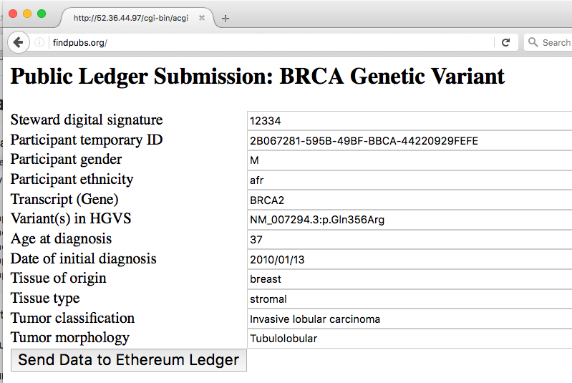
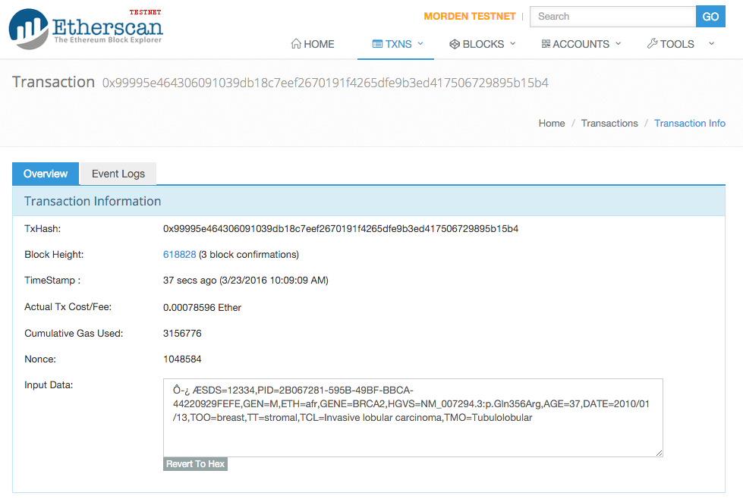
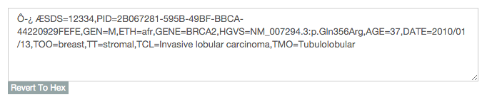
Ethereum Cancer KnowLedger Pilot
Website at findpubs.org
See:
https://github.com/maximilianh/acgi
Notes:
Once data has been submitted, the input website is not needed anymore. Data lives its own life on the ethereum network.
Cost is not an issue if we run our own ethereum blockchain, as we own the “money” and can give it to anyone for free.
Could be called “gecus = genome computation units” or similar. limited supply makes sure that no one spams the public network.
Otherwise, if using public ethereum block chain:
As shown above, current transaction fee of 76870 gas = 0.0007859600 ether = 0.0092250476$.
Single variant variant cost < 1cent
Storing 10 variants 1.2 cents (as variants can be packed into a single record = space saving)

Slide 11
Who will use the shared public ledger?
Data Users are:
Professional Researchers
Citizen Scientists
Clinicians
Developers of molecular dx, drugs, decision analysis tools
Payers
Patients/participants
Regulatory agencies and treatment guideline organizations
?
Shared Public Ledger
?
?
?

Slide 12

Where do the data come from?
?
Ultimately, all data comes from individual participants who wish to share their genetic and clinical information for research or improvement of medicine
?
?
?
?
?
?
?
?

Slide 13
How do data enter the ledger?
Researchers
Clinicians
?
Shared Public Ledger
participants
Individuals
Developers

Slide 14
A participant works with a Trusted Steward to add their information to the ledger

Slide 15
Possible Trusted Stewards
Medical research institutions (e.g. GENIE institutions)
Hospitals and clinics
Patient registry services and clinical trial recruitment organizations
Patient agency advocate groups – possibly providing service to allow patients to maintain agency over data AND participate in clinical trials (e.g. Sage Trust and Genetic Alliance)
Genetic testing companies
All trusted stewards use the same software (provided by GA4GH) to add information to the ledger
System is designed to support thousands of stewards globally
Notes:
SAGE trust, genetic alliance,

Slide 16
Trusted Stewards
Data Users
Medical Clinics
Researchers
Clinicians
Patient Advocacy Groups
Shared Public Ledger
participants
Patient Registries
Developers
Testing Companies
Individuals

Slide 17
What goes into the public ledger and what stays with the steward?
Public Ledger
Participant’s genetic variants in selected genes
~1 dozen broad, non-identifying clinical features
Steward’s identity and contact info
Random numerical ID for participant
Steward
Participant personal identifying information and staged consent
Participant’s extended clinical and genetic info
Possibly identifying
Participant’s instructions for sharing addl info with qualified researchers w/o recontact
Participant’s instructions for recontact

Slide 18
Example: participant -> public ledger
Participant visits doctor at a medical clinic
Doctor orders genetic test
Doctor suggests data donation through steward (possibly her own institution)
Test results come back

Slide 19
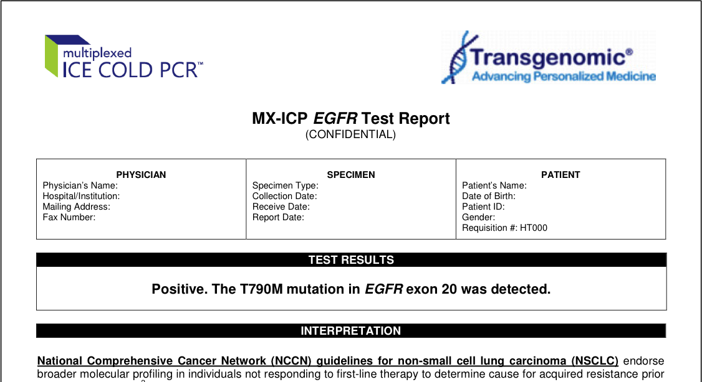
Test Results

Slide 20
Participant visits steward
Steward records from the participant:
personal information
test results
additional genetic and clinical data
consent to donate to database
additional sharing and recontact preferences
Steward appends participant’s publicly sharable genetic/clinical data to public ledger

Slide 21
Trusted Stewards
Data Users
Medical Clinics
Researchers
Clinicians
Patient Advocacy Groups
Shared Public Ledger
participants
Patient Registries
Developers
Testing Companies
Individuals

Slide 22
Recontact
Data user discovers mutations of interest by using 3rd party app on the public ledger and wants more information about the participant that provided in the ledger
Data user contacts participant’s steward
Steward has info about under what circumstances the participant will share additional data or agrees to be recontacted
As appropriate, steward will
supply additional information to data user or
set up contact between user and participant

Slide 23
Trusted Stewards
Data Users
Medical Clinics
Researchers
Third-Party App
Clinicians
Patient Advocacy Groups
Shared Public Ledger
participants
Patient Registries
Developers
Testing Companies
Individuals

Slide 24
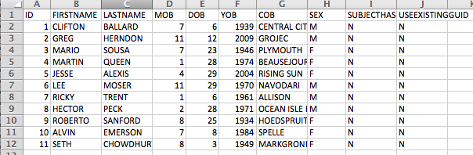
How do two stewards know if they have a participant in common?
On the public ledger, a participant is identified with a random number
Each steward securely stores personal identifiable information for their participants; only they can associate participant with a public random number
Personal identifiable information is compared between the two stewards without revealing any information except which participants they have in common by a cryptographic trick (secure multiparty computation)
To make it comparable, personal information could be collected by the NIH NDAR GUID standard

Slide 25

Demo: secure multiparty computation to compute private set intersection
Internet
Homomorphic
encryption
Steward A
100,000 participants
10 overlap with B
Steward B
100,000 participants
10 overlap with A
Neither server sees the personal information on the other. Only the checksum identifying the participants in common is visible, nothing else
Runtime: 10 seconds over a transatlantic link, single CPU
Implementation and experiments by Max Haeussler
Notes:
Protocol was secure under the semi-honest model.

Slide 26
Who can be a steward?
Any entity that:
Has a legitimate permanent contact
Follows the rules
Has enough participants to prevent “participant reidentification by steward” (small stewards can be anonymously pooled)
All stewards will have Internet ratings; these can be available on a ledger (e.g. like AirBnB); users can filter out unreliable steward data

Slide 27
Who pays for all this?
System can be designed and implemented for a few million dollars; long term maintenance is the only issue
Governments or philanthropies (possibly associated with hospitals, patient advocacy groups, etc.) could supply general funding
“Taxes” on genetic tests could provide revenue
Stewards can be motivated to secure data donations either by altruism or commissions from data users
3rd party app developers can charge for use of their tools or sell advertising to support their efforts and to support the public ledger

Slide 28
Summary
A completely decentralized, public database is possible, while still protecting privacy
We need this because “trust is local”
No single state government or private organization can/should own or control all the world’s genetic data
Once launched, a shared public ledger grows and is maintained organically by the global community because it benefits them, much like the Internet itself

