Slide 1
Equatorial Sea Level Rise what drives it and why it matters
AM10 – Data Visualization, Study Group 3

Slide 2
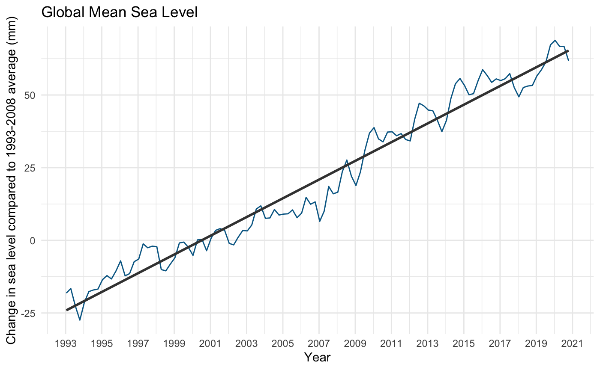
Introduction
Overview
Sea level rise (SLR) has been considered one of the most severe impacts of climate change. Observations show that global mean sea level is on the rise, with rate accelerating in recent years.¹
In 2020, global sea level set a record high – 68.8mm above 1993-2008 average levels.
Problem Statement
What are the drivers and implications of SLR?
Drivers
Implications
Thermal Expansion
1
GDP
1
Polar Ice Melting
Land
2
2
3
Population
(National Geographic, 2019)
¹ Our world in data:: Global mean sea level rise is measured relative to the 1993 - 2008 average sea level. The dataset used here is the average from the two datasets: the widely-cited Church & White dataset, and the University of Hawaii Sea Level Center (UHLSC).
Notes:
Sea level rise (SLR) has been considered one of the most severe impacts of climate change. Based on the dataset that we have obtained and based on our analysis, there is a noticeable trend going upwards. In fact, global sea level was at a record high in 2020. Hence, we would like to find out what are the factors contributing to this rise in sea level, as well as the implications or impact of sea level rise.
To give an overview, the change in sea levels are often linked to two primary factors - thermal expansion and polar ice melting. On the other hand, there are many implications of sea level rise but we will be focusing on 3 main buckets – GDP, Land and Population.
In the next few slides, we will further elaborate on the data we collected as well as the analysis we performed that helped test and confirm our conclusion
Source:
https://ourworldindata.org/grapher/sea-level-rise?country=~OWID_WRL
https://www.climate.gov/news-features/understanding-climate/climate-change-global-sea-level
https://www.nationalgeographic.com/environment/article/sea-level-rise-1
The change in sea levels is linked to three primary factors, all induced by ongoing global climate change:
https://www.nationalgeographic.com/environment/article/sea-level-rise-1

Slide 3
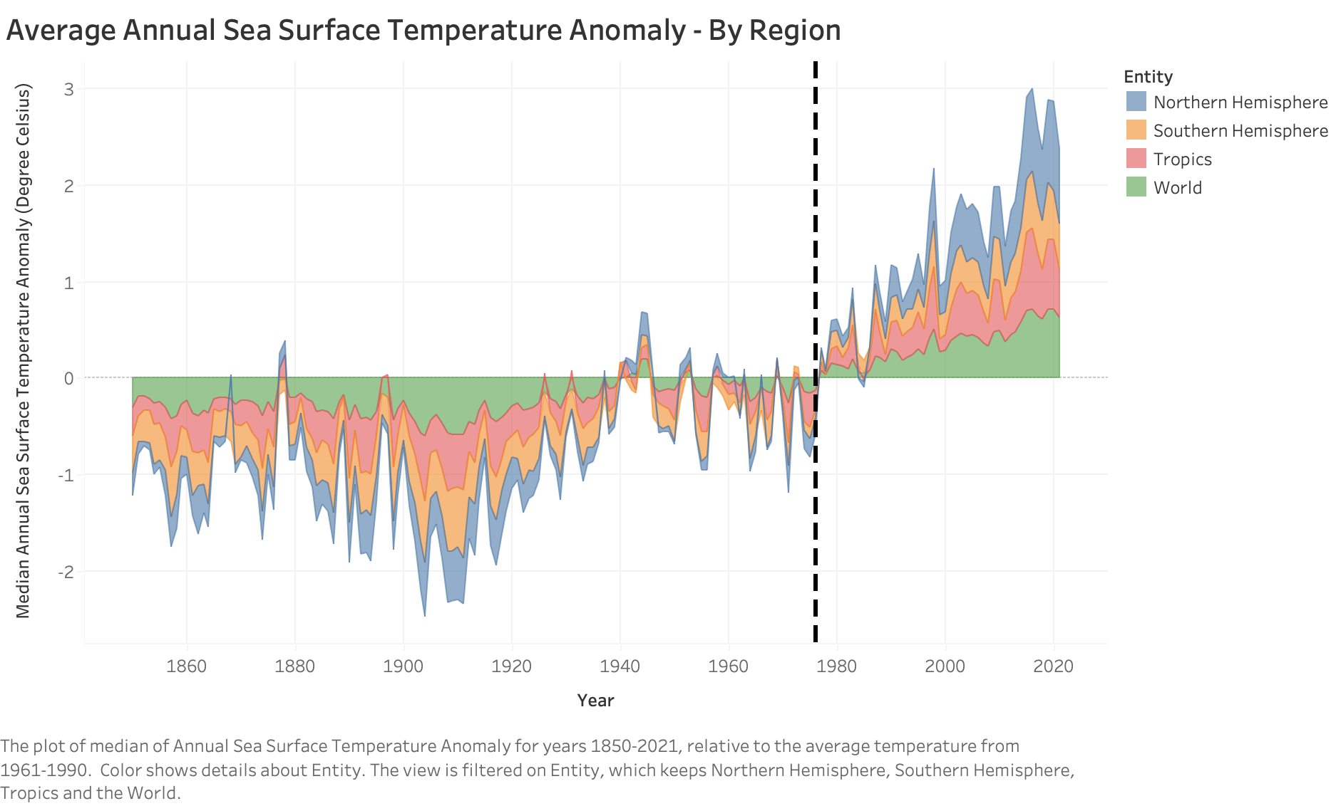
Ocean Temperatures have spiked globally
Drivers of Sea Level Rise
Thermal Expansion: Sea Levels are rising as ocean surface temperatures warm up and expand in volume. ¹
1
Positive temperature anomalies indicate observed temperature is warmer than the baseline
2
1977 is the beginning of high ocean temperatures, affecting mostly the Northern Hemisphere
3
Warming of ocean surface caused roughly 1/3 of global sea level rise since 2004
¹ Chen et al. (2013) Contribution of ice sheet and mountain glacier melt to recent sea level rise. Nature Geoscience.

Slide 4
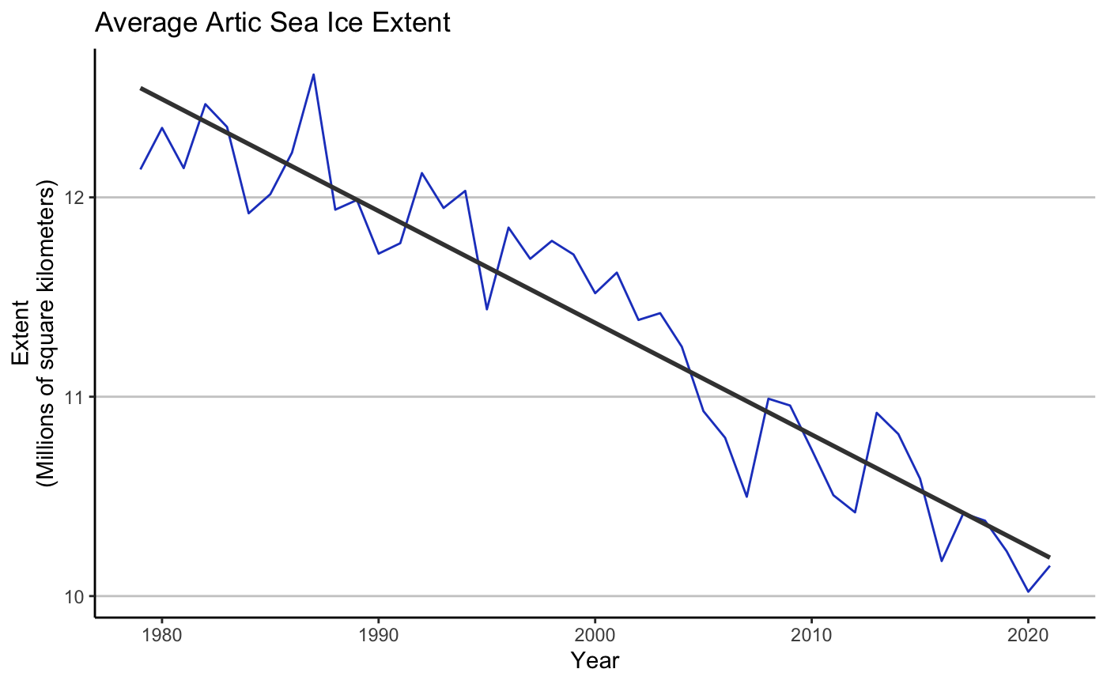
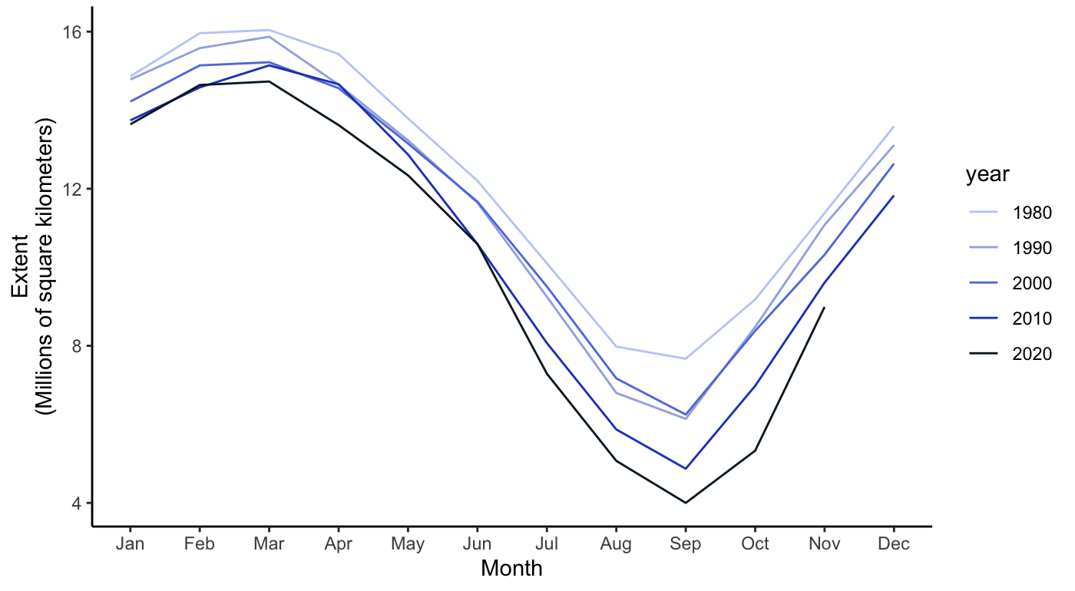
Polar warming has wiped out ice extent
Drivers of Sea Level Rise
Average Arctic Sea Ice Extent
Annual Arctic Sea Ice Trend
Decennial
Rate of Change
-13.4%
Arctic Ice Extent has decreased by ~ 30% Seasonal consistency Ice Extent/Volume ↓ Sea Level Rise ↑
1
2
3

Slide 5
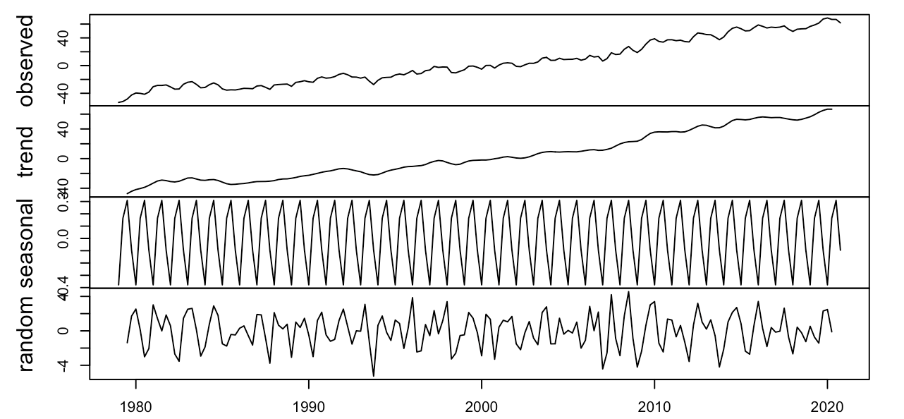
The future of Sea Level Rise
Driver analysis and prediction
Key Driver Analysis
Time Series Decomposition & Prediction
Linear Regression Model¹
Decomposition of additive time series
Variable | Estimate (mm) | P-Value
Temperature Anomaly (Cº) | 65.408 | < 2e-16 ***
Sea Ice Extent Anomaly (M Km²) | -14.734 | 7.41e-11 ***
R² | 84%
Adjusted R² | 83.8%
Number of observations | 168
Thermal Expansion
Ice Extent
SLR
1
There is a clear increasing trend in sea level
5°C
-47.6M
km²
1 m
2
Monthly average sea level has obvious seasonal characters
3
HoltWinters: Sea level will increase by 1 m by 2120 in 95% confidence interval upper level
¹ Regression model run on Northern Hemisphere Sea Level
Notes:
Here we use the quarter data from 1979 to 2020 to explore how the key drivers can impact the sea level rise. Both temperature anomaly and sea ice extent anomaly are significant and our model adjusted R square reached 0.83, which means sea level rise is highly dependent on these two drivers. And from the estimate, we can infer that
If Northern Hemisphere Ocean Temperature Anomalies reached 5 Degrees Celsius and sea ice extent anomaly reached -47.6 millions of sq km. then the sea level rise will reach 1 meter.
The extent anomaly is calculated by subtracting the month's 1981 to 2010 mean from its extent for that year.

Slide 6
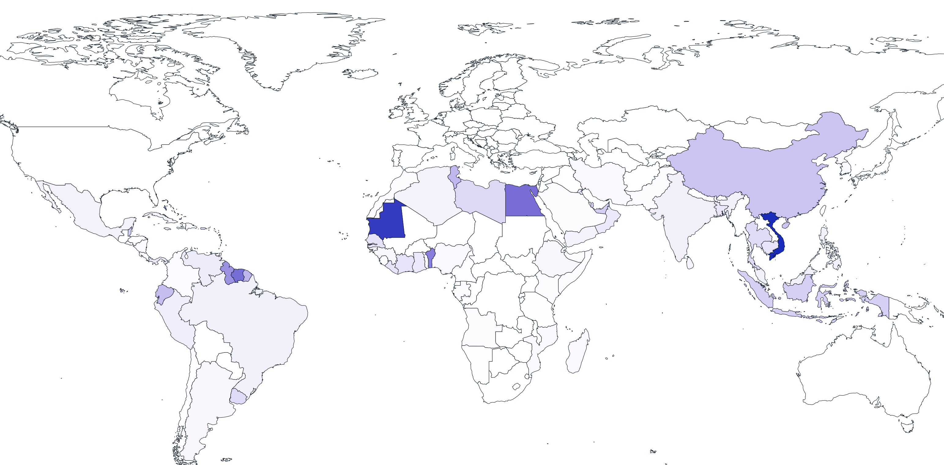



SLR most impactful surrounding equator
Global Implications: 1m SLR
GDP $220b
Population
57m
Land
220k km²

Slide 7

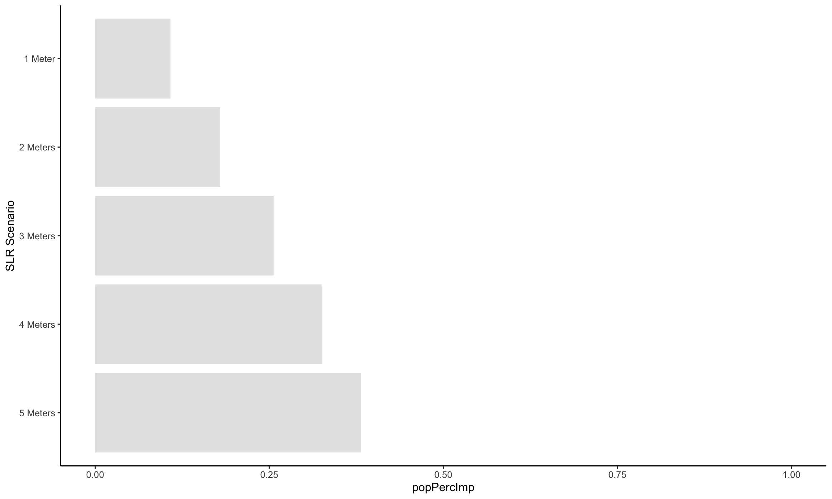

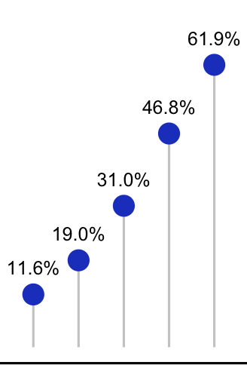







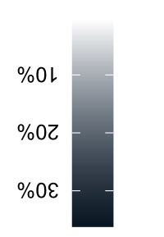
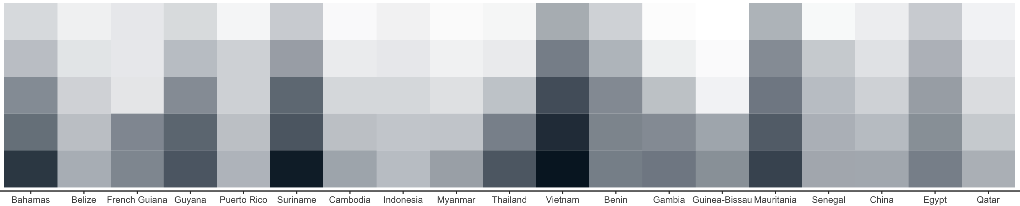
SLR consequences distributed unevenly
Vietnam
A look at the most affected regions
Population
Land
SLR
%
1m
10
Vietnam
2m
18
Bahamas
3m
25
4m
33
5m
38
SLR
1m
2m
3m
4m
5m
GDP
SLR
Latin America
South East Asia
Sub-Saharan Africa
1m
1m
2m
10%
2m
3m
20%
3m
4m
4m
30%
5m
5m
Notes:
https://thenounproject.com/search/?q=wave

Slide 8
SLR consequences distributed unevenly
Vietnam
A look at the most affected regions
Population
Land
SLR
%
1m
10
Vietnam
2m
18
Bahamas
3m
25
4m
33
5m
38
SLR
1m
2m
3m
4m
5m
GDP
SLR
Latin America
South East Asia
Sub-Saharan Africa
1m
1m
2m
10%
2m
3m
20%
3m
4m
4m
30%
5m
5m
Notes:
https://thenounproject.com/search/?q=wave

Slide 9
SLR consequences distributed unevenly
Vietnam
A look at the most affected regions
Population
Land
SLR
%
1m
10
Vietnam
2m
18
Bahamas
3m
25
4m
33
5m
38
SLR
1m
2m
3m
4m
5m
GDP
SLR
Latin America
South East Asia
Sub-Saharan Africa
1m
1m
2m
10%
2m
3m
20%
3m
4m
4m
30%
5m
5m
Notes:
https://thenounproject.com/search/?q=wave

Slide 10
SLR consequences distributed unevenly
Vietnam
A look at the most affected regions
Population
Land
SLR
%
1m
10
Vietnam
2m
18
Bahamas
3m
25
4m
33
5m
38
SLR
1m
2m
3m
4m
5m
GDP
SLR
Latin America
South East Asia
Sub-Saharan Africa
1m
1m
2m
10%
2m
3m
20%
3m
4m
4m
30%
5m
5m
Notes:
Whats nice to see in this heatmap is that there are jumps in some countries for given m rises, e.g. French guiana

Slide 11






Conclusion
Key Takeaways and Limitations
What drives it
Why it matters
Thermal Expansion
If trends continue…
57m people affected
220k km² land flooded
Sea level will rise by 1m
2020 witnessed 0.7C rise in sea surface temperature
Polar Ice Melting
Average Arctic Sea Ice Extent has decreased
Limitations
Limited confidence about prediction due to insufficient historical data of key drivers
Overlooking critical implications due to analysis of only two main drivers
1
2
Notes:
1 – time series
2 – Only two drivers analysed
3 -

Slide 13
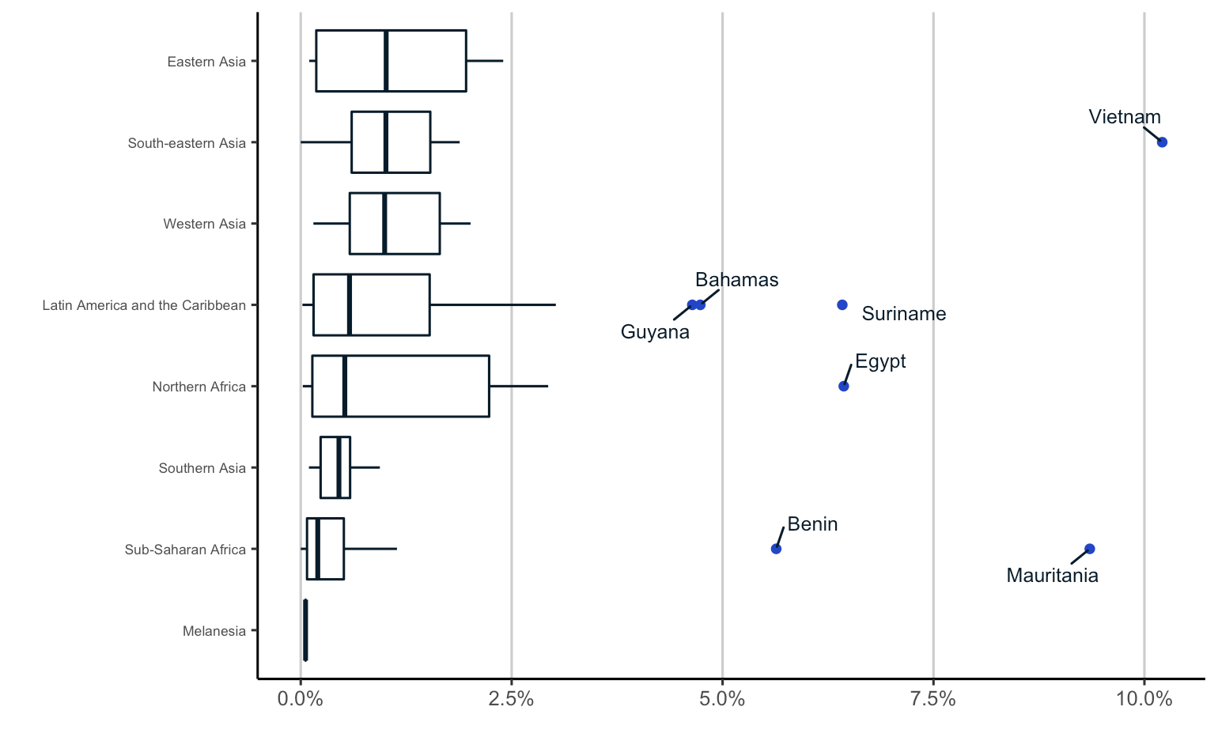

Explanation on how the impact on GDP etc. is measured
1m

Slide 14
Outline
Storyline
Issue – News headlines, Statistics on already felt implications
Demonstrate based on drivers
Why is it important
Model
Implications for gdp/land/population
Conclusion
Technicals
1. Thermal Expanison (Kashish)
2. Polar Melting (Sabrina)
3. Model (Simon, Amy)
4. Implications (Max/Rowman)
Land, GDP, Population
5. Recommendations/Conclusions
Roman
Notes:
TODO LIST:
Introduction (Roman)
Thermal Expansion (Kashish)
Polar (Sabrina)
Regression (Amy)
Time Series (Simon)
Conclusion (Max)

Slide 15
Problem Statement
Drivers and Implications of sea level rise: A scenario analysis
Forecasting: what are the drivers, what are the implications, when will the implications happen?
Background Info. What were the key issues raised?
Thermal Expansion: › talk about main scientific standing (main takeaway/quote for referenced report)
Ice Melting:
Equatorial concentration:
Scenario Implications:
One sentence on how this report helps to map out key implications to engage in policy formulation

