Slide 1

Introducing weave-cli
Powering the Next Generation of AI Agents
github.com/maximilien/weave-cli
Your Universal VDB Development Tool
Maximilien.ai

Slide 2

What Are Vector Databases?
Specialized databases optimized for storing and querying high-dimensional vector embeddings that represent semantic meaning of data.
Market Growth
$2.2B
2024 Market Size
Why Critical for AI Agents?
Enable semantic search beyond keyword matching
Power RAG systems with contextual knowledge retrieval
Support real-time similarity search at scale
Essential for LLM memory and context management
$10.6B
2032 Projection
23.5% CAGR

Slide 3

How They Work: Embeddings & Vector Space
The Process
Key Concepts
1. Embedding Generation
Convert text, images, audio to numerical vectors using ML models
High-Dimensional Space
Vectors typically have 768-4096 dimensions, representing complex semantic relationships.
2. Vector Indexing
Semantic Proximity
Organize vectors using algorithms like HNSW, IVF for fast search
Similar concepts cluster together in vector space, enabling contextual search.
ANN Algorithms
3. Similarity Search
Approximate Nearest Neighbor algorithms trade perfect accuracy for millisecond query times.
Find nearest neighbors using cosine similarity or Euclidean distance
Notes:
HNSW == HNSW (Hierarchical Navigable Small World) is a graph-based algorithm used for fast and accurate approximate nearest neighbor (ANN) search in high-dimensional vector spaces. It works by creating a layered graph of vectors, allowing it to efficiently narrow down the search from the top layers with long-range connections down to the bottom layers for fine-tuned results. While it offers high performance and scalability, it can be memory-intensive, particularly for very large datasets.
IVF == IVF (Inverted File Index) is a vector search technique that partitions vectors into clusters, with each cluster having a centroid. To find similar vectors, a query first identifies the nearest centroids and then searches only the vectors within the corresponding clusters, making it much faster than a brute-force search. This method is a common and efficient way to handle large-scale vector data for applications like similarity search in databases.

Slide 4
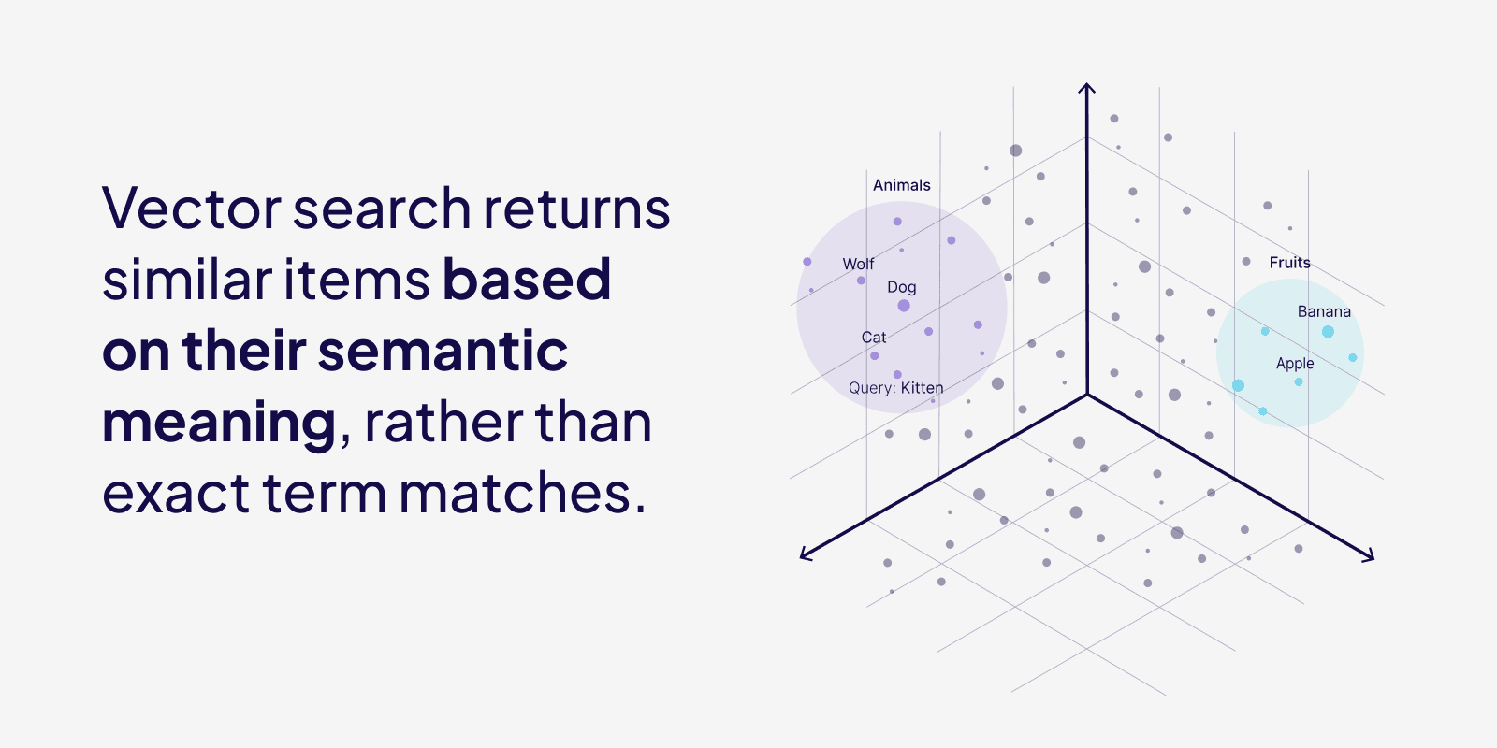
How They Work: Embeddings & Vector Space (cont.)
Credit: weaviate.io/blog/vector-search-explained
Notes:
HNSW == HNSW (Hierarchical Navigable Small World) is a graph-based algorithm used for fast and accurate approximate nearest neighbor (ANN) search in high-dimensional vector spaces. It works by creating a layered graph of vectors, allowing it to efficiently narrow down the search from the top layers with long-range connections down to the bottom layers for fine-tuned results. While it offers high performance and scalability, it can be memory-intensive, particularly for very large datasets.
IVF == IVF (Inverted File Index) is a vector search technique that partitions vectors into clusters, with each cluster having a centroid. To find similar vectors, a query first identifies the nearest centroids and then searches only the vectors within the corresponding clusters, making it much faster than a brute-force search. This method is a common and efficient way to handle large-scale vector data for applications like similarity search in databases.

Slide 5
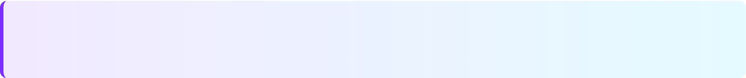

The Hybrid Search Solution
The Challenge
Pure semantic search can miss exact matches that traditional keyword search excels at finding.
1
Semantic Search
2
Keyword Search
Understands context and intent
Finds conceptually similar results
Works across languages
Precise exact matches
Fast for specific terms
Good for technical queries
Hybrid Search = Best of Both Worlds
Combine vector similarity with keyword matching using RRF for optimal accuracy.
Notes:
RRF == Reciprocal Rank Fusion (RRF) is a ranking method that combines multiple ranked lists into a single, unified ranking by assigning a score based on the reciprocal of the rank. It prioritizes documents that appear at higher ranks across different lists, giving more weight to top results and reducing the contribution of lower-ranked documents non-linearly. RRF is often used in hybrid search to merge results from different retrieval methods, like semantic and full-text search, into a more relevant final ranking.
BM25 == BM25 (Best Match 25) is a ranking function used in information retrieval to estimate a document's relevance to a given search query based on keyword matching. It calculates a score by considering a document's term frequency, the rarity of the terms across all documents (inverse document frequency), and the document's length. BM25 is effective for precise, keyword-based searches and is a default algorithm in many search platforms like Elasticsearch and OpenSearch.

Slide 6

Data Processing: The Foundation
Chunking Strategy Matters
Optimal Size
Overlap
Metadata
256-512 tokens balance
10-20% prevents loss
Enrich with tags
Multimodal Processing
📄 Documents
PDF parsing, OCR extraction
🖼️ Images
Pro Tip
CLIP, vision transformers
Quality processing = Better retrieval. Invest in robust pipelines.
🎵 Audio
Whisper transcription
🎥 Video
Frame sampling, fusion

Slide 7


One Tool for All Vector Databases
The Problem
Each VDB has unique APIs and workflows. Switching means learning different interfaces.
weave-cli Solution
Use Cases
Multi-VDB evaluation
Provider migration
RAG development
Optimizing search (multi search)
Benchmarking
✓ Unified Interface
✓ Fast Prototyping
One CLI for all VDBs
Test multiple VDBs
✓ Dev to Prod
✓ AI-Powered
Seamless transitions
Agent-assisted ops
Integration Time
✓ Benchmarking
✓ Open Source
~10x Faster
Compare & optimize
MIT License

Slide 8
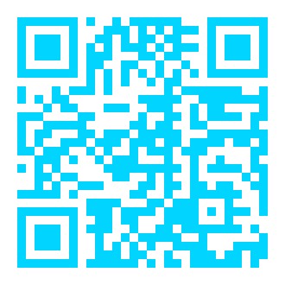
Live Demo Time!
⭐ Star us on GitHub
github.com/maximilien/weave-cli
Fast Setup
Multi-VDB
Open Source
5 min to first query
10+ VDBs
MIT License

