Slide 1
CS 446: Machine Learning
Dan Roth
University of Illinois, Urbana-Champaign
danr@illinois.edu
http://L2R.cs.uiuc.edu/~danr
3322 SC

Slide 2
CS446: Machine Learning
Tuesday, Thursday: 17:00pm-18:15pm 1404 SC
Office hours: Mon 3:00-4:00 pm [my office]
TAs: Chase Duncan; Qiang Ning, Subhro Roy, Hao Wu
Assignments: 7 Problems sets (Programming)
Weekly (light) on-line quizzes
Discussion sections
Mid Term Exam
Project
Final
Mitchell/Other Books/ Lecture notes /Literature
Registration to Class

Slide 3
CS446 Machine Learning: Today
What is Learning?
Who are you?
What is CS446 about?

Slide 4
What is Learning
The Badges Game……
Who are you?
Notes:
Badges game
Don’t give me the answer
Start thinking about how to write a program that will figure out whether my name has + or – next to it.

Slide 5
An Owed to the Spelling Checker
I have a spelling checker, it came with my PC
It plane lee marks four my revue
Miss steaks aye can knot sea.
Eye ran this poem threw it, your sure reel glad two no.
Its vary polished in it's weigh
My checker tolled me sew.
A checker is a bless sing, it freeze yew lodes of thyme.
It helps me right awl stiles two reed
And aides me when aye rime.
Each frays come posed up on my screen
Eye trussed to bee a joule...

Slide 6
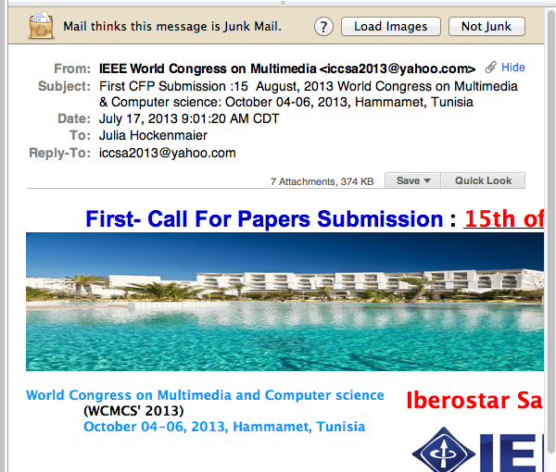
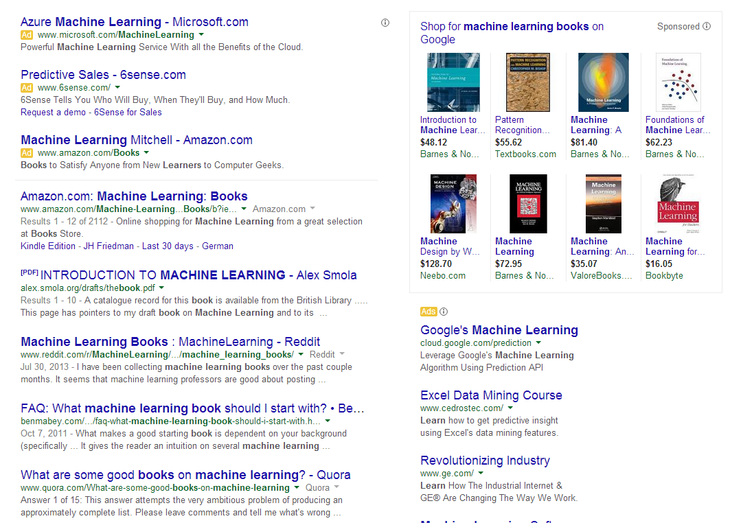
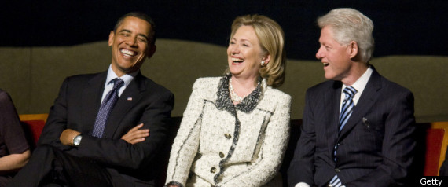
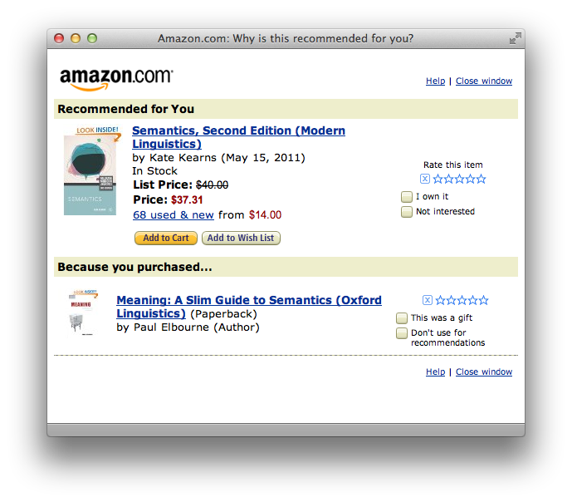
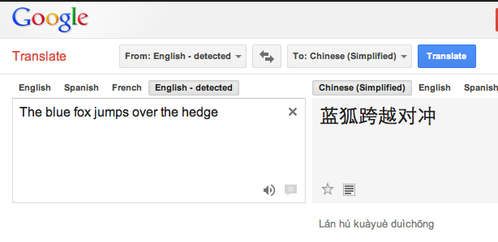
Machine learning is everywhere

Slide 7
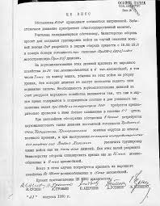
Applications: Spam Detection
This is a binary classification task: Assign one of two labels (i.e. yes/no) to the input (here, an email message)
Classification requires a model
(a classifier) to determine which
label to assign to items.
In this class, we study algorithms and techniques to learn such models from data.
Documents Labels
Documents Politics, Sports, Finance
Sentences Positive, Negative
Phrases Person, Location
Images cats, dogs, snakes
Medical records Admit again soon/Not
…..
?

Slide 8
Ambiguity Resolution
Can I have a peace of cake ? piece
...Nissan Car and truck plant is …
…divide life into plant and animal kingdom
Buy a car with a steering wheel (his money)
(This Art) (can N) (will MD) (rust V) V,N,N
The dog bit the kid. He was taken to a veterinarian
hospital
Learn a function that maps observations in the domain
to one of several categories or <.

Slide 9
Comprehension
(ENGLAND, June, 1989) - Christopher Robin is alive and well. He lives in England. He is the same person that you read about in the book, Winnie the Pooh. As a boy, Chris lived in a pretty home called Cotchfield Farm. When Chris was three years old, his father wrote a poem about him. The poem was printed in a magazine for others to read. Mr. Robin then wrote a book. He made up a fairy tale land where Chris lived. His friends were animals. There was a bear called Winnie the Pooh. There was also an owl and a young pig, called a piglet. All the animals were stuffed toys that Chris owned. Mr. Robin made them come to life with his words. The places in the story were all near Cotchfield Farm. Winnie the Pooh was written in 1925. Children still love to read about Christopher Robin and his animal friends. Most people don't know he is a real person who is grown now. He has written two books of his own. They tell what it is like to be famous.
1. Christopher Robin was born in England. 2. Winnie the Pooh is a title of a book.
3. Christopher Robin’s dad was a magician. 4. Christopher Robin must be at least 65 now.
This is an Inference Problem; where is the learning?
Notes:
9

Slide 10
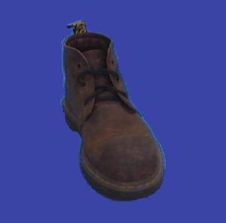
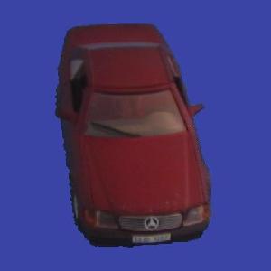
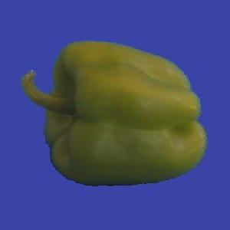
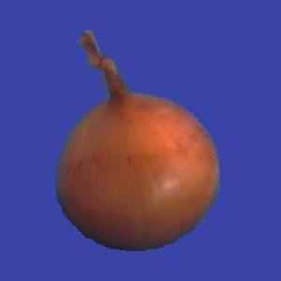
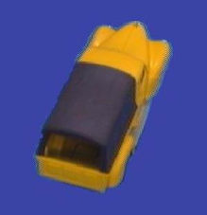
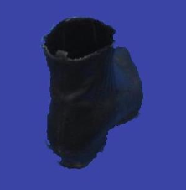
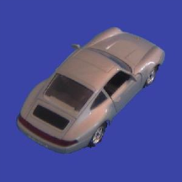
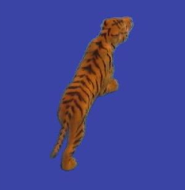
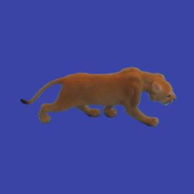
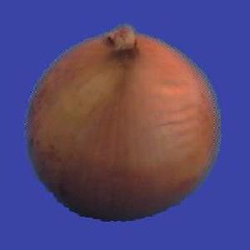
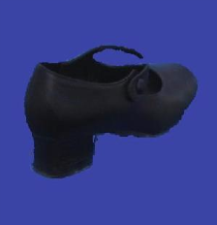
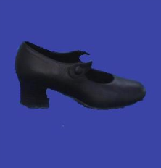
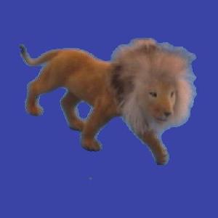
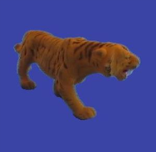
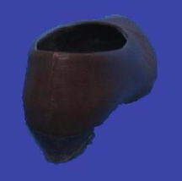
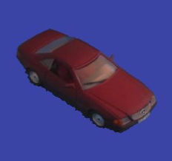
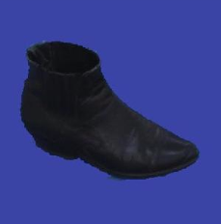
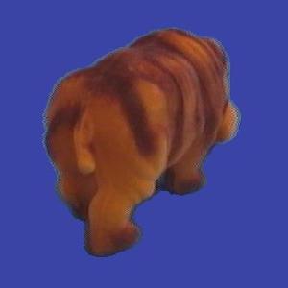
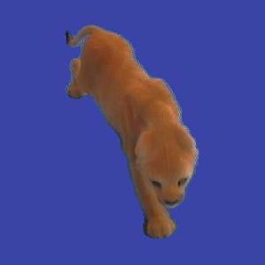
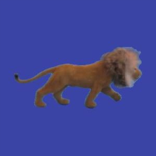
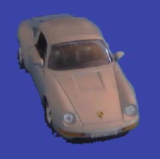
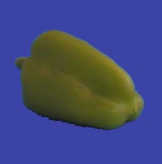

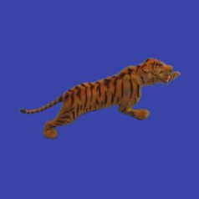
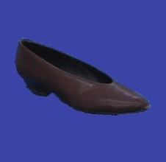
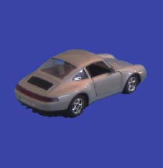
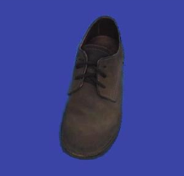
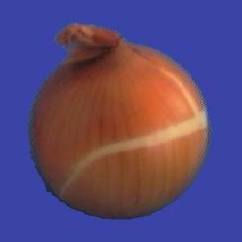
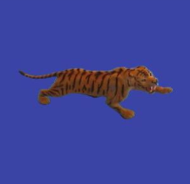
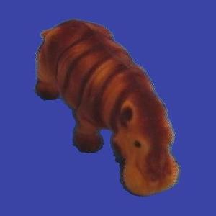
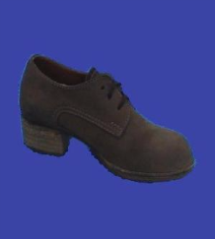
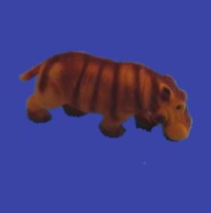
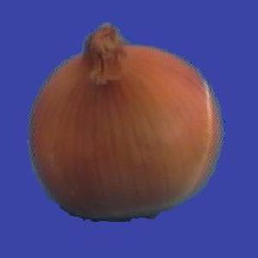
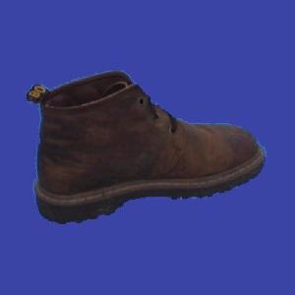
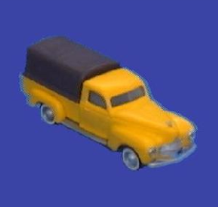
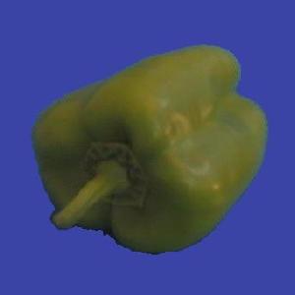
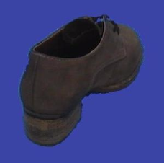
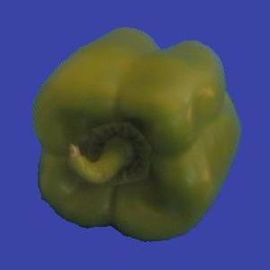
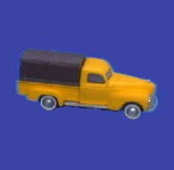
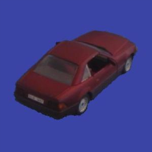
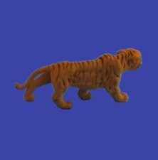
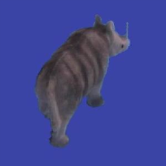
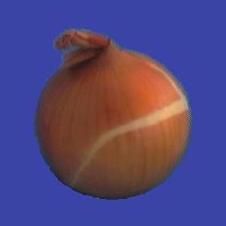
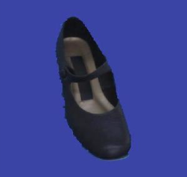
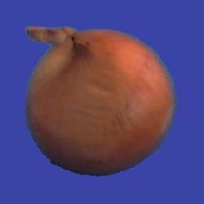










Slide 11
Learning
Learning is at the core of
Understanding High Level Cognition
Performing knowledge intensive inferences
Building adaptive, intelligent systems
Dealing with messy, real world data
Analytics
Learning has multiple purposes
Knowledge Acquisition
Integration of various knowledge sources to ensure robust behavior
Adaptation (human, systems)
Decision Making (Predictions)

Slide 12
Learning = Generalization
H. Simon -
“Learning denotes changes in the system that are adaptive in the sense that they enable the system to do the task or tasks drawn from the same population more efficiently and more effectively the next time.”
The ability to perform a task in a situation which has never been encountered before

Slide 13
Learning = Generalization
The learner has to be able to classify items it has never seen before.
Mail thinks this message is junk mail.
Not junk

Slide 14
Learning = Generalization
The ability to perform a task in a situation which has never been encountered before
Classification
Medical diagnosis; credit card applications; hand-written letters; ad selection; sentiment assignment,…
Planning and acting
Navigation; game playing (chess, backgammon, go); driving a car
Skills
Balancing a pole; playing tennis
Common sense reasoning
Natural language interactions
Generalization depends on the Representation as much as it depends on the Algorithm used.

Slide 15
Why Study Learning?
Computer systems with new capabilities.
Develop systems that are too difficult or impossible to
construct manually .
Develop systems that can automatically adapt and
customize themselves to the needs of the individual
user through experience.
Discover knowledge and patterns in databases,
e.g. discovering purchasing patterns for marketing purposes.
Solve the kinds of problems now reserved for humans.

Slide 16
Why Study Learning?
Computer systems with new capabilities.
Understand human and biological learning
Understanding teaching better.

Slide 17
Why Study Learning?
Computer systems with new capabilities.
Understand human and biological learning
Understanding teaching better.
Time is right.
Initial algorithms and theory in place.
Growing amounts of on-line data
Computational power available.
Necessity: many things we want to do cannot be done by “programming”.

Slide 18
Learning is the future
Learning techniques will be a basis for every application that involves a connection to the messy real world
Basic learning algorithms are ready for use in applications today
Prospects for broader future applications make for exciting fundamental research and development opportunities
Many unresolved issues – Theory and Systems
While it’s hot, there are many things we don’t know how to do

Slide 19
Work in Machine Learning
Artificial Intelligence; Theory; Experimental CS
Makes Use of:
Probability and Statistics; Linear Algebra; Theory of Computation;
Related to:
Philosophy, Psychology (cognitive, developmental), Neurobiology, Linguistics, Vision, Robotics,….
Has applications in:
AI (Natural Language; Vision; Planning; HCI)
Engineering (Agriculture; Civil; …)
Computer Science (Compilers; Architecture; Systems; data bases)
Analytics
Very active field
What to teach?
The fundamental paradigms
Some of the most important algorithmic ideas
Modeling
And: what we don’t know

Slide 20
Course Overview
Introduction: Basic problems and questions
A detailed example: Linear threshold units; key algorithmic idea
Online Learning
Two Basic Paradigms:
PAC (Risk Minimization)
Bayesian theory
Learning Protocols:
Supervised; Unsupervised; Semi-supervised
Algorithms
Gradient Descent
Decision Trees (C4.5)
[Rules and ILP (Ripper, Foil)]
Linear Threshold Units (Winnow; Perceptron; Boosting; SVMs; Kernels)
Neural Networks (Backpropagation)
Probabilistic Representations (naïve Bayes; Bayesian trees; Densities)
Unsupervised /Semi supervised: EM
Clustering; Dimensionality Reduction
Who knows DTs ?
Who knows NNs ?

Slide 21
CS446: Machine Learning
Tuesday, Thursday: 17:00pm-18:15pm 1404 SC
Office hours: Mon 3:00-4:00 pm [my office]
TAs: Chase Duncan; Qiang Ning, Subhro Roy, Hao Wu
Assignments: 7 Problems sets (Programming)
Weekly (light) on-line quizzes
Discussion sections
Mid Term Exam
Project
Final
Mitchell/Other Books/ Lecture notes /Literature
Registration to Class
Send me email after class
Title: CS446 LastName, First Name, net id, Registration
Body: Have you sent me email already (when)? Any other information

Slide 22
CS446: Machine Learning
Participate, Ask Questions
What do you need to know:
Theory of Computation
Probability Theory
Linear Algebra
Programming (Java; your favorite language; some Matlab)
Homework 0 – on the web
Who is the class for?
Future Machine Learning researchers/Advanced users

Slide 23
CS446: Policies
Cheating
No.
We take it very seriously.
Homework:
Collaboration is encouraged
But, you have to write your own solution/program.
(Please don’t use old solutions)
Late Policy:
You have a credit of 4 days (4*24hours); That’s it.
Grading:
Possibly separate for grads/undergrads.
5% Quizzes; 25% - homework; 30%-midterm; 40%-final;
Projects: 25% (4 hours)
Questions?
Info page
Note also the Schedule Page and our Notes

Slide 24
CS446 Team
Dan Roth (3323 Siebel)
Tuesday/Thursday, 1:45 PM – 2:30 PM (or: appointment)
TAs
Chase Duncan Tues 12-1 (3333 SC)
Subhro Roy Wed 4-5 (3333 SC)
Qiang Ning Thur 3-4 (3333 SC)
Hao Wu Fri 1-2 (3333 SC)
Discussion Sections: (starting 3rd week)
Tuesday: 11 -12 [3405 SC] Subhro Roy [A-I]
Wednesdays: 5 -6 [3405 SC] Hao Wu [J-L]
Thursdays: 2 - 3 [3405 SC] Chase Duncan [M-S]
Fridays: 4 -5 [3405 SC] Qiang Ning [T-Z]

Slide 25
CS446 on the web
Check our class website:
Schedule, slides, videos, policies
http://l2r.cs.uiuc.edu/~danr/Teaching/CS446-17/index.html
Sign up, participate in our Piazza forum:
Announcements and discussions
https://piazza.com/class#fall2017/cs446
Log on to Compass:
Submit assignments, get your grades
https://compass2g.illinois.edu
Scribing the Class [Good writers; Latex; Paid Hourly]

Slide 26
What is Learning
The Badges Game……
This is an example of the key learning protocol: supervised learning
First question: Are you sure you got it?
Why?
Issues:
Prediction or Modeling?
Representation
Problem setting
Background Knowledge
When did learning take place?
Algorithm
Notes:
Badges game
Don’t give me the answer
Start thinking about how to write a program that will figure out whether my name has + or – next to it.

