Slide 1
Statistical Significance for
2 x 2 Tables
Chapter 13

Slide 2
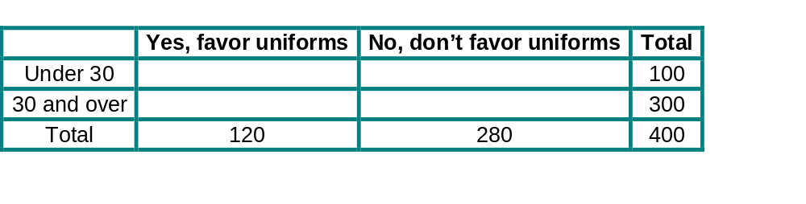
Thought Question:
Suppose a sample of 400 people included 100 under age thirty and 300 aged thirty and over. Each person asked whether or not they supported requiring public school children to wear uniforms. Fill in the table below, if there is no relationship between age and opinion on this question. Explain your reasoning. (Hint: Notice that overall, 30% favor uniforms.)

Slide 3
Measuring the Strength of the Relationship
The Meaning of Statistical Significance
If a relationship between two categorical variables is statistically significant it means that the relationship observed in the sample was unlikely to have occurred unless there really is a relationship in the population.
However, even if the relationship in the population is real, it may be so small as to be of little practical importance. Statistical significance doesn’t necessarily mean a relationship is meaningful!

Slide 4
Measuring the Relationship in a 2 x 2 Contingency Table
Strength of the relationship measured by difference in the percentages of outcomes for the two categories of the explanatory variable. Sample size is important too.
Example 1: Aspirin and Heart Attacks
Aspirin Group: Percentage who had heart attacks = 0.94%
Placebo Group: Percentage who had heart attacks = 1.71%
Difference: only 1.71% – 0.94% = 0.77%
Are we convinced by the data that there is a real relationship in the population between taking aspirin and risk of heart attack? Need to assess if the relationship is statistically significant.

Slide 5
Measuring the Relationship in a 2 x 2 Contingency Table
Example 2: Young Drivers, Gender and Alcohol
Males: Percentage drinking in past 2 hours = 16%
Females: Percentage drinking in past 2 hours = 11.6%
Difference: 16% – 11.6% = 4.4%
If population percents were equal, how likely would we be to observed a sample with a difference as large as 4.4% or larger?
Example 3: Ease of Pregnancy and Smoking
Nonsmokers: Percentage pregnant in 1st cycle = 41%
Smokers: Percentage pregnant in 1st cycle = 29%
Difference: 41% – 29% = 12%
Is a difference of 12% large enough to rule out chance?

Slide 6
Strength of the Relationship versus Size of the Study
Example 1: Aspirin and Heart Attacks
Difference: only 1.71% – 0.94% = 0.77%
Experiment included over 22,000 men, so small difference should convince us aspirin works for represented population.
Example 2: Young Drivers, Gender and Alcohol
Difference: 16% – 11.6% = 4.4%
Rather small, based on only 619 respondents and
was not convincing to the Supreme Court.
Example 3: Ease of Pregnancy and Smoking
Difference: 41% – 29% = 12%
Larger, but again only based on 586 subjects. Convincing?

Slide 7
Steps for Assessing
Statistical Significance
Basic steps for hypothesis testing:
Determine the null hypothesis and the alternative hypothesis.
Collect the data and summarize them with a single number called a ‘test statistic’.
Determine how unlikely the test statistic would be if the null hypothesis were true.
Make a decision.

Slide 8
Step 1: Determine the null hypothesis and the alternative hypothesis.
Alternative Hypothesis: what researchers interested
in showing to be true (aka ‘research hypothesis’).
Null Hypothesis: some form of ‘nothing happening’
Q: Are two categorical variables related? …
Null Hypothesis: There is no relationship between the
two variables in the population.
Alternative Hypothesis: There is a relationship between the
two variables in the population.
Note: Hypotheses established before collecting any data.
Not acceptable to use same data to determine and test hypotheses.

Slide 9
Stating The Hypotheses
Example 1: Aspirin and Heart Attacks
Null Hypothesis: There is no relationship between taking aspirin
and risk of heart attack in the population.
Alternative Hypothesis: There is a relationship between taking aspirin
and risk of heart attack in the population.
Example 2: Young Drivers, Gender and Alcohol
Null Hypothesis: Males and females in the population are equally likely to drive within two hours of drinking alcohol.
Alternative Hypothesis: Males and females in the population are not equally likely to drive within two hours of drinking alcohol.
Example 3: Ease of Pregnancy and Smoking
Null Hypothesis: Smokers and nonsmokers are equally likely to get pregnant in 1st cycle in population of women trying to get pregnant.
Alternative Hypothesis: Smokers and nonsmokers are not equally likely to get pregnant in 1st cycle in population of women trying to get pregnant.

Slide 10
The Chi-Square Test
Step 2: Collect data and summarize with a ‘test statistic’.
Chi-square statistic: compares data in sample to what would be expected if no relationship between variables in the population.
Step 3: Determine how unlikely test statistic would be
if the null hypothesis were true.
p-value: probability of observing a test statistic as extreme as the one observed or more so, if the null hypothesis is really true. (For chi-square: more extreme = larger value of chi-square statistic.)
Step 4: Make a decision.
If chi-square statistic is at least 3.84, the p-value is 0.05 or less, so conclude relationship in population is real. That is, we reject the null hypothesis and conclude the relationship is statistically significant.
Notice that chi-square stat and p-value have inverse relationship, as the chi-square stat increases the p-value decreases (study becomes more significant).

Slide 11
Computing the Chi-Square Statistic
Compute the expected number in each cell, assuming the null hypothesis is true. (assuming there is no relationship)
Compare the observed and expected numbers.
Compute the chi-squared statistic.
Expected number = (row total)(column total)
(table total)
Compare observed and expected in each cell by:
(observed number – expected number)²
expected number
Chi-square statistic = sum of comparison values
over all cells.
Note: Method valid only if no empty cells and all expected counts ≥ 5.

Slide 12
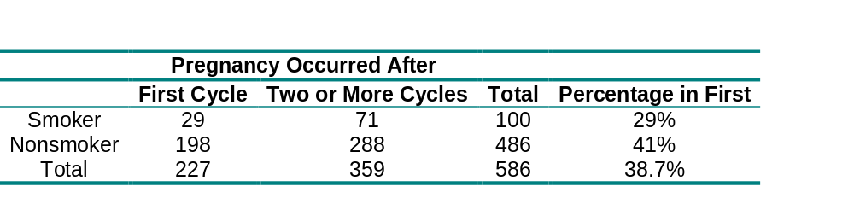
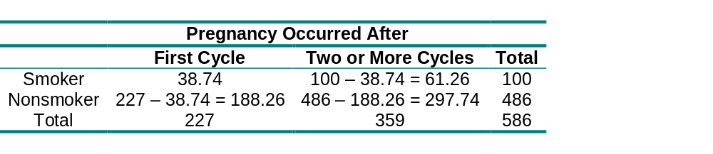
Example 3: Ease of Pregnancy and Smoking
Compute the expected numbers.
Expected number of smokers pregnant after 1st cycle:
(100)(227)/586 = 38.74
Just need to compute one expected value and can fill in the rest of the table from it.
Expected Numbers:

Slide 13
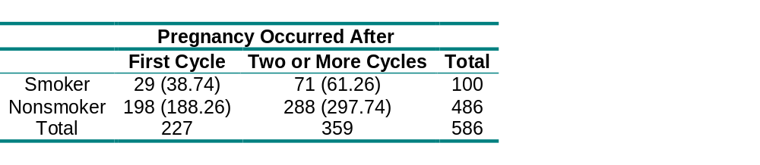

Example 3: Ease of Pregnancy and Smoking
Here are the Observed (and Expected) numbers:
Compare Observed and Expected numbers.
(observed number – expected number)²/(expected number)
First cell: (29 – 38.74)²/(38.74) = 2.45
Remaining cells shown in table below.
Compute the chi-squared statistic.
chi-square statistic = 2.45 + 1.55 + 0.50 + 0.32 = 4.82

Slide 14
Making the Decision
Relationship statistically significant if
the chi-square statistic is at least 3.84.
Example 3: Ease of Pregnancy and Smoking
The chi-square statistic of 4.82 is larger than 3.84, therefore the p-value is smaller than .05.
There is a statistically significant relationship between smoking and time to pregnancy.
The difference observed in time to pregnancy between smokers and nonsmokers in the sample indicates a real difference for the population of all similar women.

Slide 15
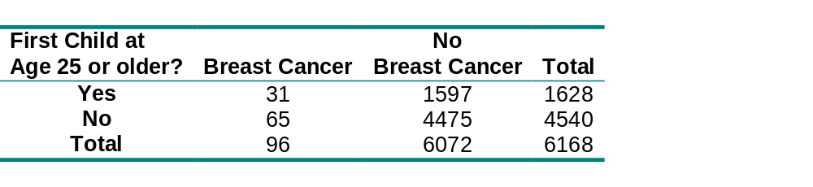
Example 4: Age at Birth of First Child
and Breast Cancer
Step 1: Determine null and alternative hypotheses.
Null Hypothesis: There is no relationship between age at birth of first child and breast cancer in the population of women who have had children.
Alternative Hypothesis: There is a relationship between age at birth of first child and breast cancer in the population of women who have had children.

Slide 16
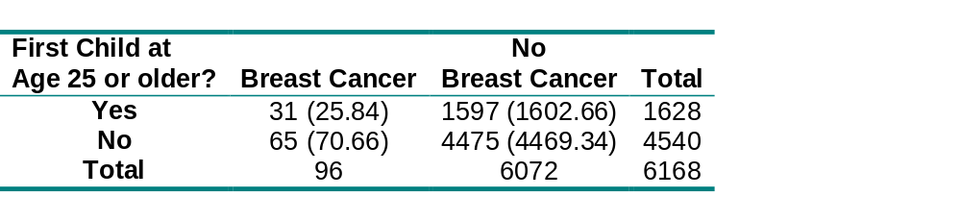
Example 4: Age at Birth of First Child
and Breast Cancer
Step 2: Collect data and compute test statistic.
Expected count for “Yes and Breast Cancer”:
(1628)(96)/6168 = 25.34
Can find the remaining expected numbers by subtraction.
Here are the Observed (and Expected) numbers:
Chi-square statistic = 1.75

Slide 17
Example 4: Age at Birth of First Child
and Breast Cancer
Step 3: Determine how unlikely the test statistic would be
if null hypothesis were true.
Using Excel: p-value = CHIDIST(1.75,1) = 0.186
Step 4: Make a decision.
The chi-square statistic of 1.75 is less than 3.84 (and p-value of 0.186 is greater than 0.05).
Therefore, the relationship is not statistically significant.
We cannot conclude that the increased risk observed in the sample would hold for the population of women.
Note: Possible confounding variable is use of oral contraceptives at a young age, that may be related to age at birth of first child and may have effect on likelihood of breast cancer.

Slide 18
Practical Versus
Statistical Significance
Statistical significance does not mean two variables have a relationship that is of practical importance.
Table based on very large number of observations will have little trouble achieving statistical significance,
even if relationship between two variables is only minor.
An interesting relationship in a population may fail to achieve statistical significance in sample if there are
too few observations.
It is difficult to rule out chance unless you have either
a strong relationship or a sufficiently large sample.

Slide 19
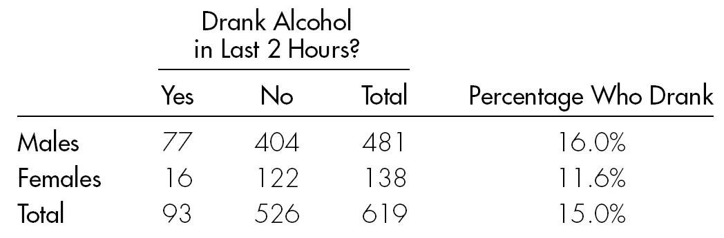
Example 2, continued: Drinking and Driving
Case Study 6.5: Court case challenging law that differentiated the ages at which young men and women could buy 3.2% beer.
Results of Roadside Survey for Young Drivers
Difference: 16% – 11.6% = 4.4%
Might think there is a real relationship in the population, but chi-square statistic = 1.637 => a difference of 4.4% in a sample of only 619 would not be surprising if equal proportions in the population.
If sample were three times larger but same difference, chi-square statistic would be 3(1.637) = 5.01=> it would be statistically significant.

