Slide 1
Estimate
Average Time/ Generation – 16-24 hrs
1 simulation/ 10 days => 500 executions/ Robots, 10 Generations, Population – 50
3 tasks/ QD Algo – 30 – 40 days
Does Parallel run in DST server and CTS lab count as 2 runs?
yes – 30-40 days/algo
no – 60-70 days/algo (considering a single source for running)
QD Algos – Map Elites, CVT ME, Multiresolution ME, Multi-Objective ME, NSLC

Slide 2
Evo gym Parameters
Voxel Grid Size (robot morphology) – (5,5), (7,7)
Population Size – 25, 50
Simulation Time – 5 (Duration for which each robot is simulated)
Map Elites Archive Resolution– 5
Max Evaluations – 250, 500, 750
Generations – 10, 20, 30
Early Stopping Threshold – 1e-3
No Improvement Limit - 5
Map Elites Parameters

Slide 3
Metrics (Map Elites)
Coverage = non empty bins/total bins
Qd score: sum of quality scores of all elites in the bin
How different the solution of 2 maps are
Measure how the feature [actuator ratio and other design criteria] is different
Highest quality scorers across bins
Metrics (For Comparison)
No of gens needed to reach threshold
Max fitness achieved
Mean fitness over generation
Fitness variance
Avg fitness of selected/avg fitness of population

Slide 4
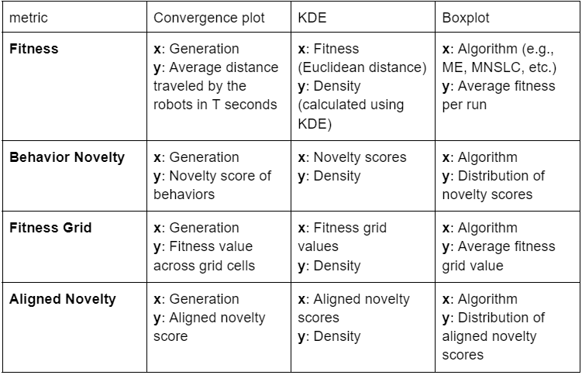

Slide 5
Tasks (Walking and Locomotion)
Easy – Walker-v0, DownStepper-v0
Medium - CaveCrawler-v0, UpStepper-v0
Hard - GapJumper-v0, PlatformJumper-v0
https://evolutiongym.github.io/all-tasks/locomotion.html

