Slide 1
Προγραμματισμός Εφαρμογών Ήχου
ΠΜΣ: Τεχνολογίες Ήχου και Μουσικής
Τμήμα Μουσικής Τεχνολογίας και Ακουστικής
Ελληνική Μεσογειακό Πανεπιστήμιο
Μάξιμος Καλιακάτσος-Παπακώστας
5th Class
12/11/2020

Slide 2
Class content
Audio basics in Pure Data
Wave-shaping basics:
Oscillator
Sawtooth (phasor)
Triangular
Square pulse
Additive
Subtractive
Tables
Modulation
Amplitude modulation
Frequency modulation
ADSR
2_puredata_introduction.pptx
Notes:
<αριθμός>

Slide 3
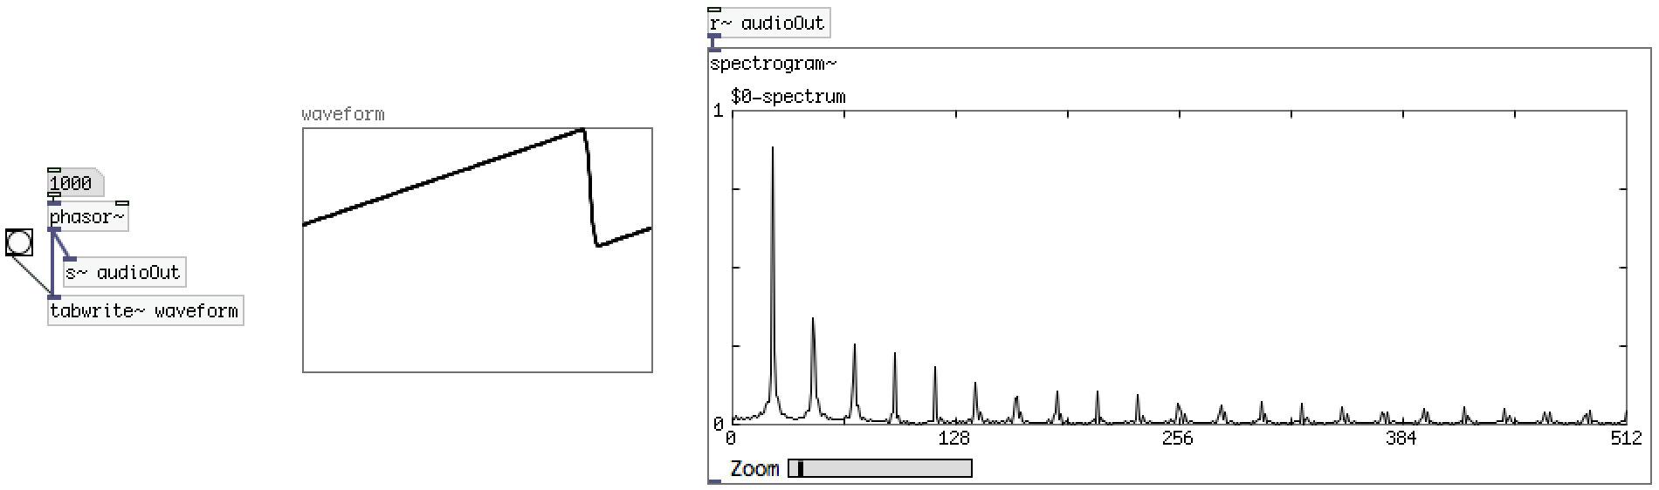
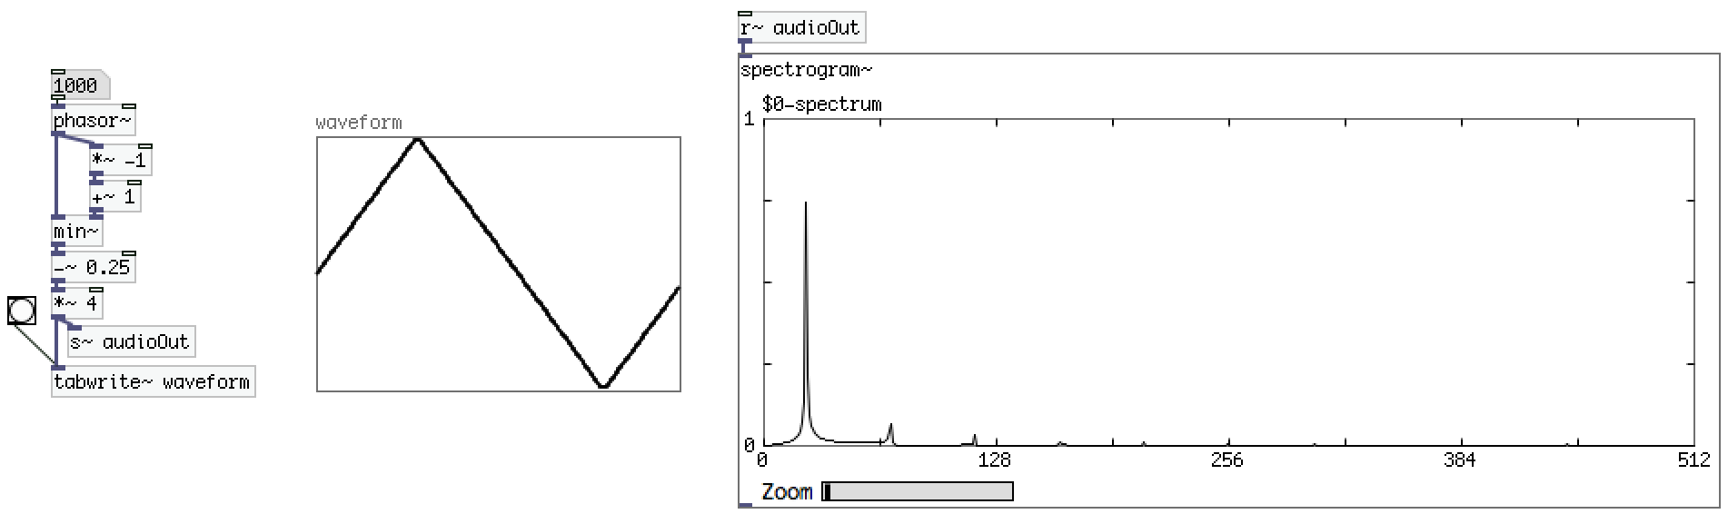
Wave-shaping basics: Sawtooth vs Triangle

Slide 4
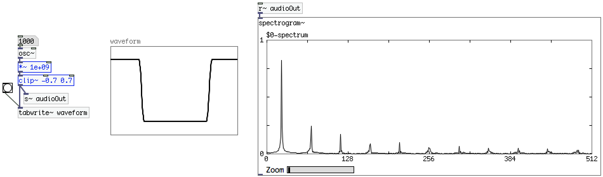
Wave-shaping basics: Sawtooth vs Square

Slide 5
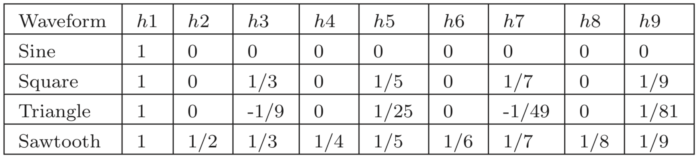
Wave-shaping basics: Harmonic content

Slide 6
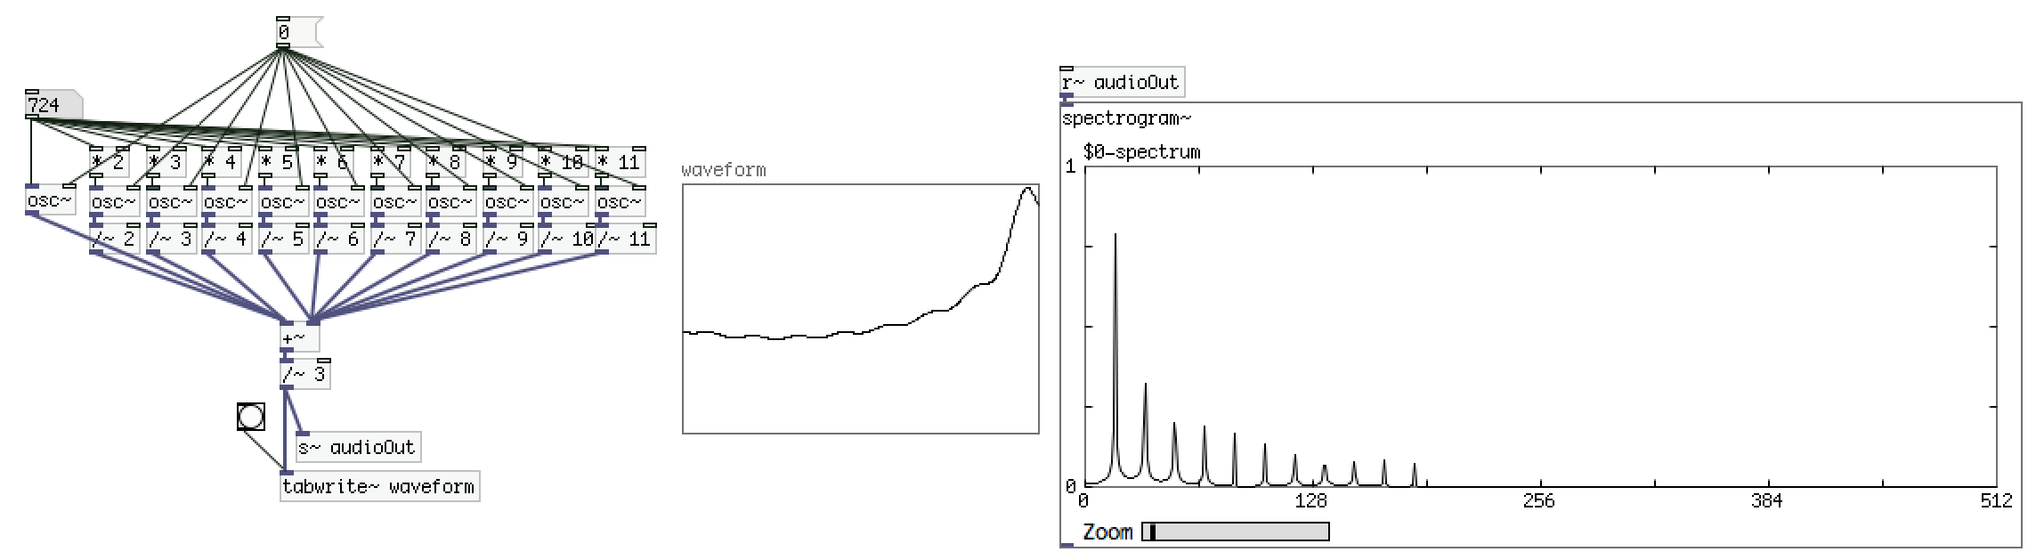
Why not add?: Additive synthesis
Because we spend to much to get to little… We’ll see the benefits of modulation does in a while

Slide 7
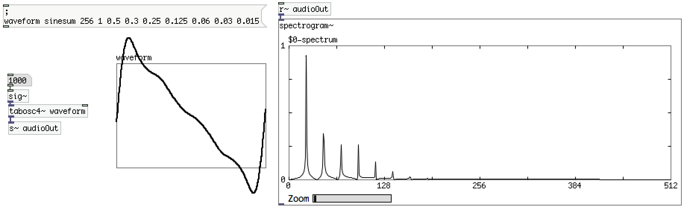
Why not add?: Additive synthesis
There is actually a simpler way, but still, there are simpler ways to make weird timbres!

Slide 8
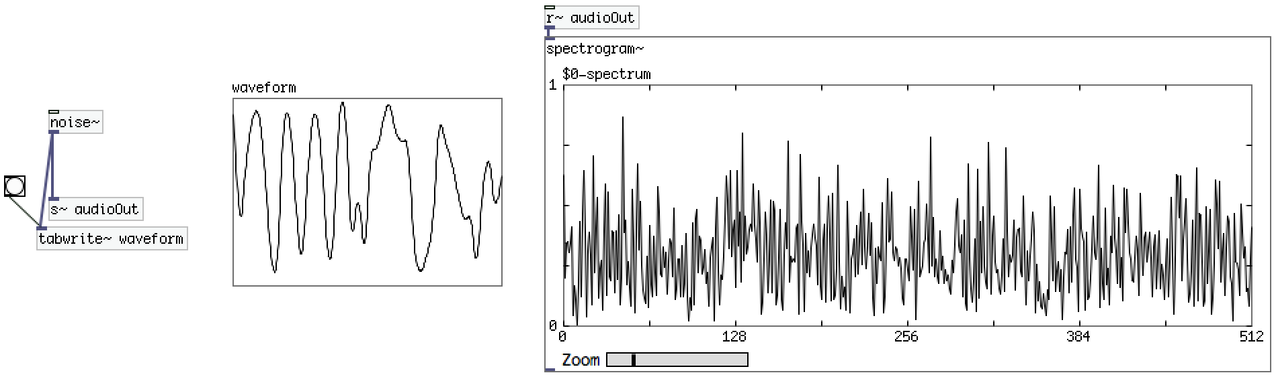
Or do the opposite?: Subtractive synthesis
Example: let’s start with noise.

Slide 9
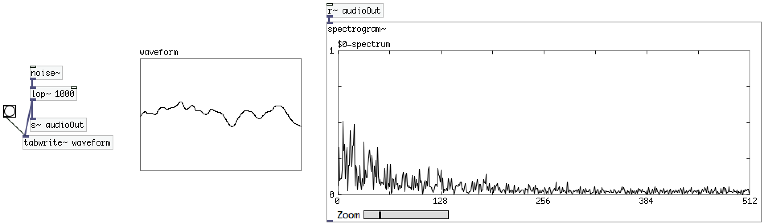
Or do the opposite?: Subtractive synthesis
Example: low pass filter.

Slide 10
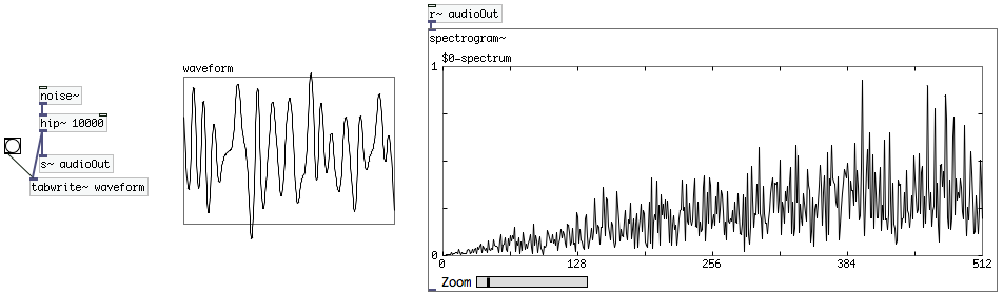
Or do the opposite?: Subtractive synthesis
Example: high pass filter.

Slide 11
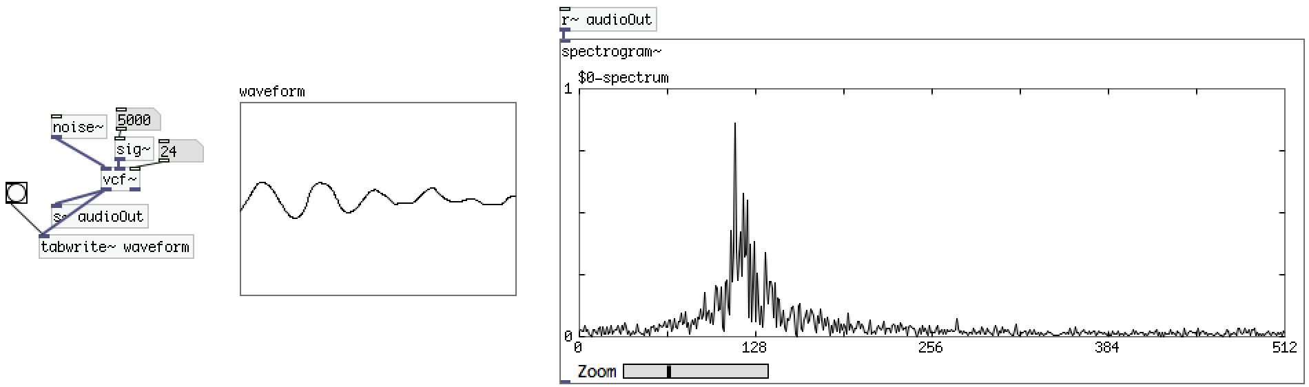
Or do the opposite?: Subtractive synthesis
Example: voltage control filter (band pass).

Slide 12
Table: Why only read from and not write to?

Slide 13
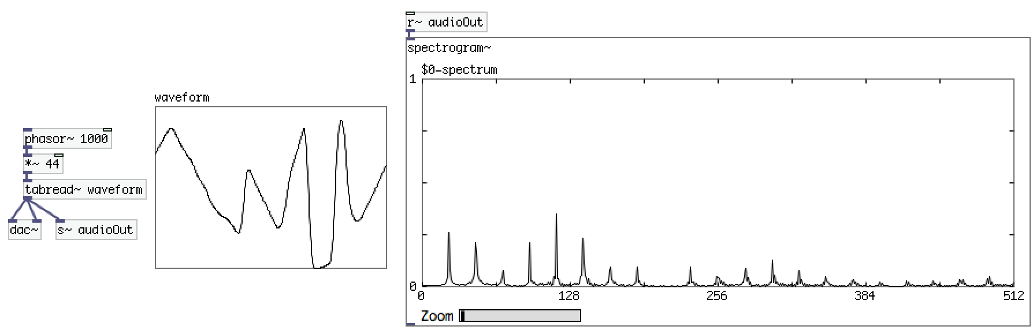
Table: Why only read from and not write to?

Slide 14
Or even better: use [tabosc4~]
There is actually a simpler way, but still, there are simpler ways to make weird timbres!

Slide 15
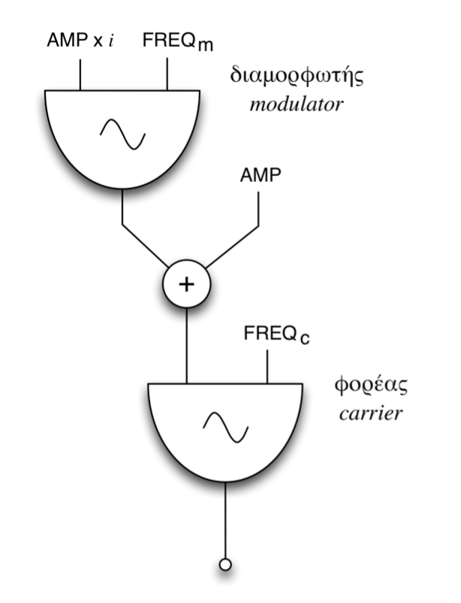
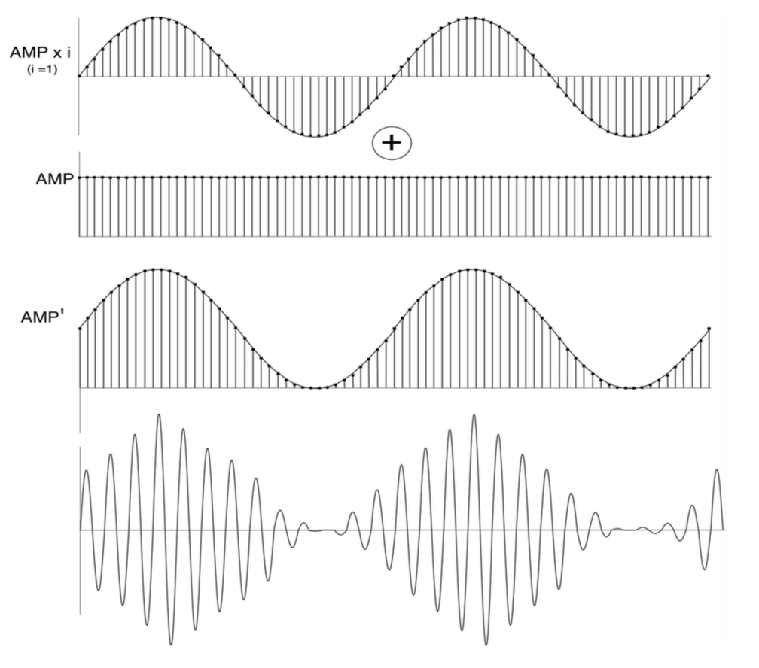
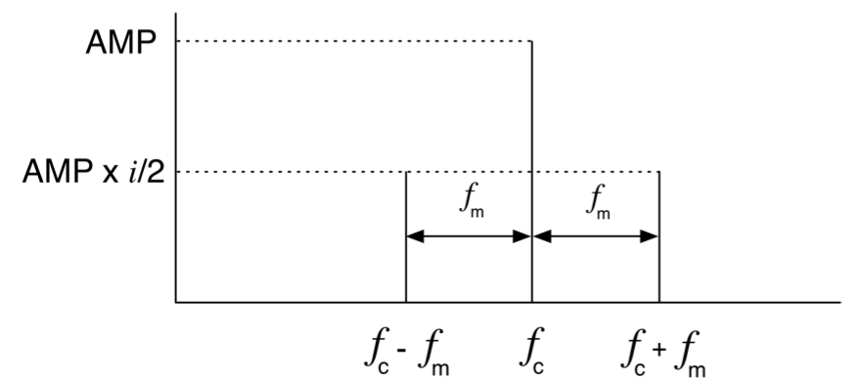
Amplitude modulation

Slide 16
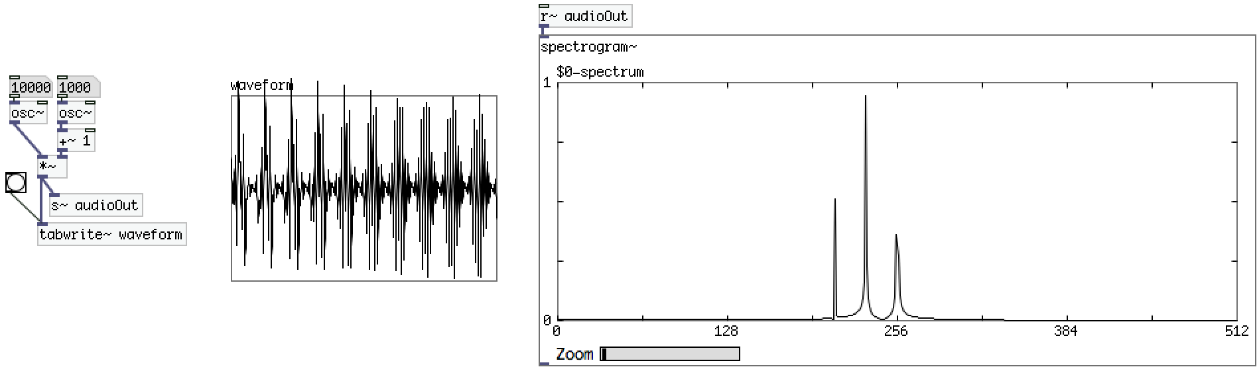
Amplitude modulation

Slide 17
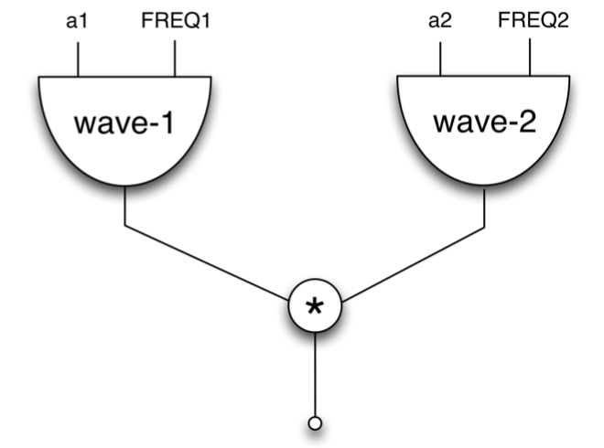
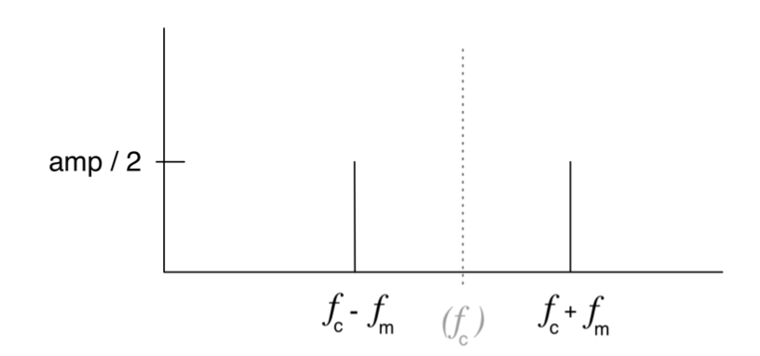
Ring modulation

Slide 18
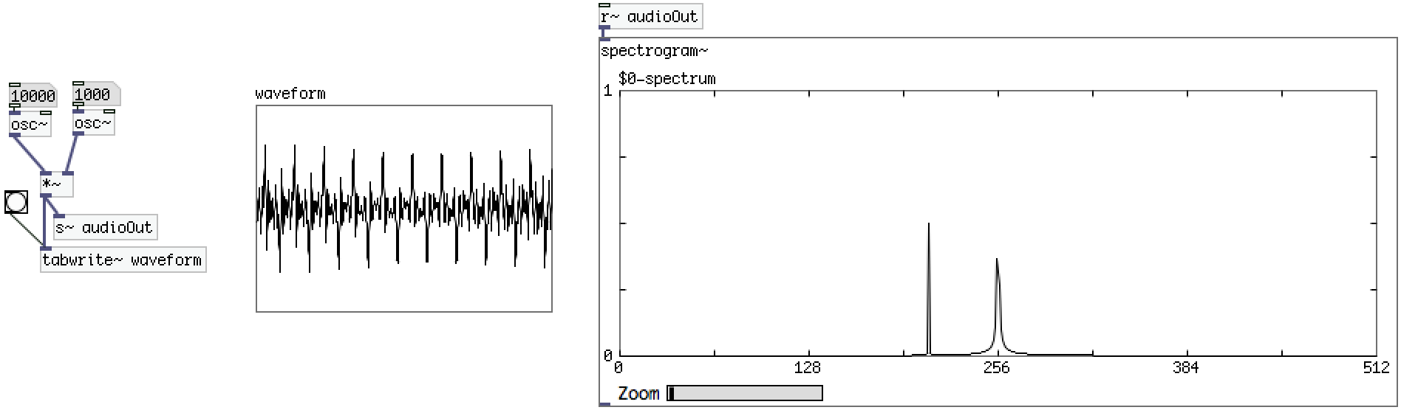
Ring modulation

Slide 19
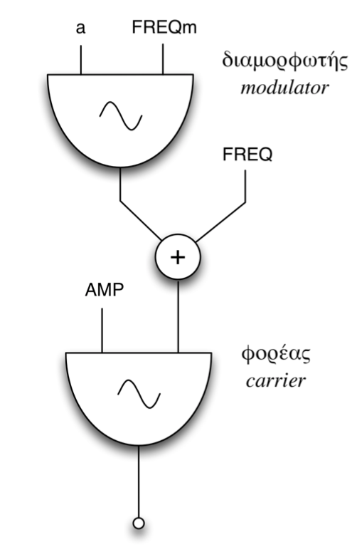
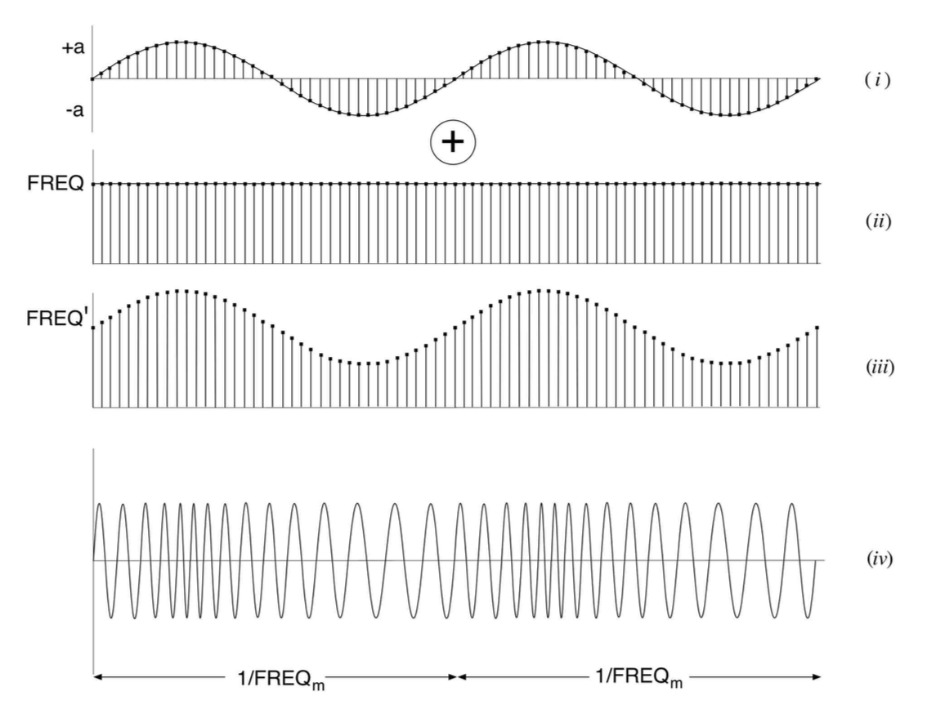
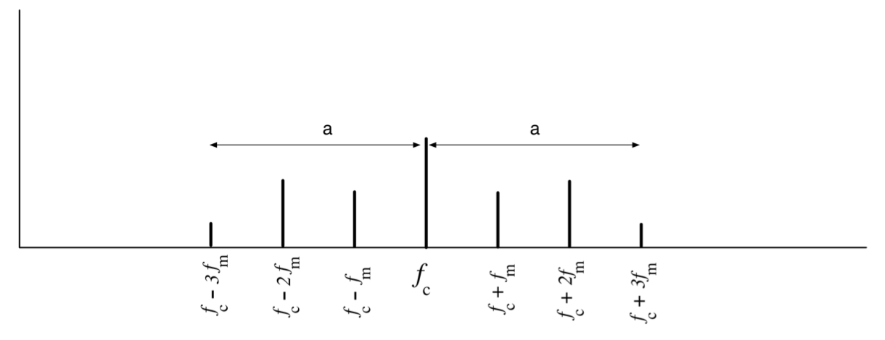
Frequency modulation
Notes:
<αριθμός>

Slide 20
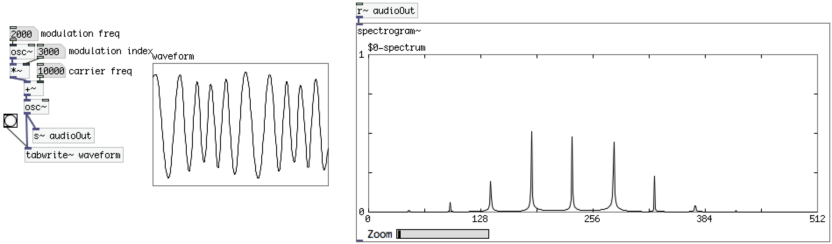
Frequency modulation
Notes:
<αριθμός>

