Slide 1
Προγραμματισμός Εφαρμογών Ήχου
ΠΜΣ: Τεχνολογίες Ήχου και Μουσικής
Τμήμα Μουσικής Τεχνολογίας και Ακουστικής
Ελληνική Μεσογειακό Πανεπιστήμιο
Μάξιμος Καλιακάτσος-Παπακώστας
5th Class
12/11/2020

Slide 2
Class content
Processing Basics
Environment overview
The setup() and draw() functions
Basic and Processing data types
Methods
Useful Processing-reserved variables and methods
The very basics of Object-Oriented Programming
Practical issues
How to learn fast
How to begin a new script
Importing libraries
1_processing_practical.pptx
Notes:
<αριθμός>

Slide 3
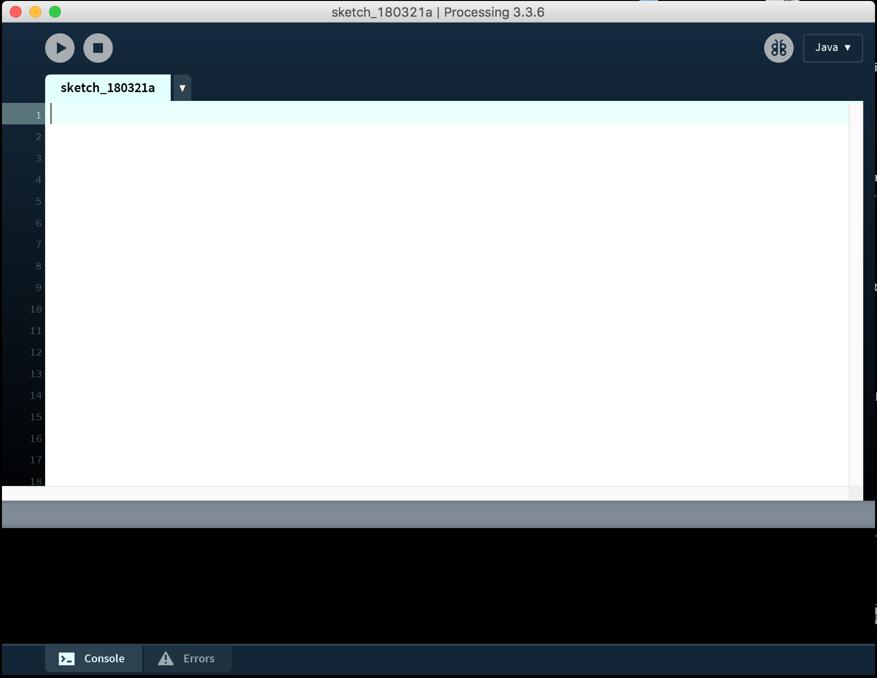
Environment overview
Run script
Stop script
Write script
Print messages and
check for errors

Slide 4
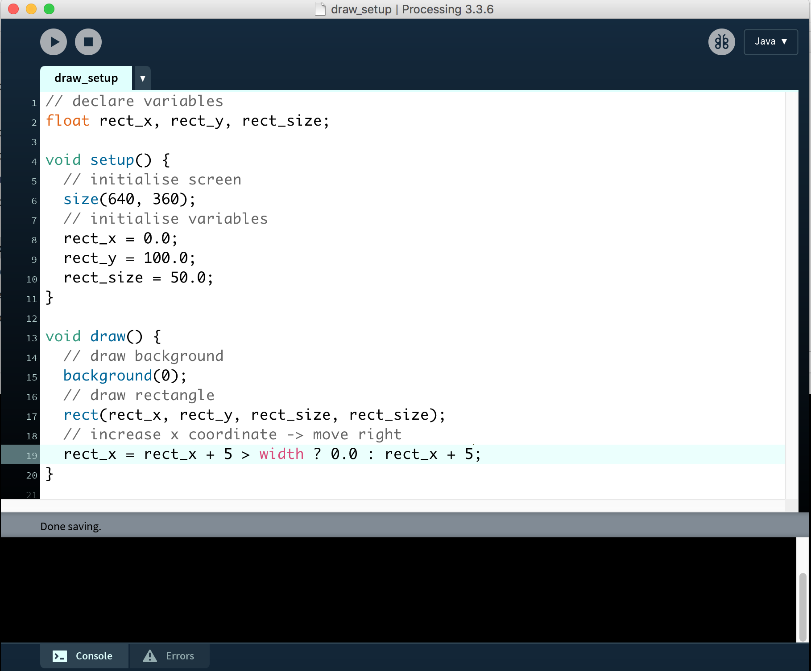
The setup() and draw() functions
Declare (global)
variables
Set screen size
and initialize variables
(set beginning values)
Code in draw() runs
60 times per second
(or according to
frame rate)

Slide 5
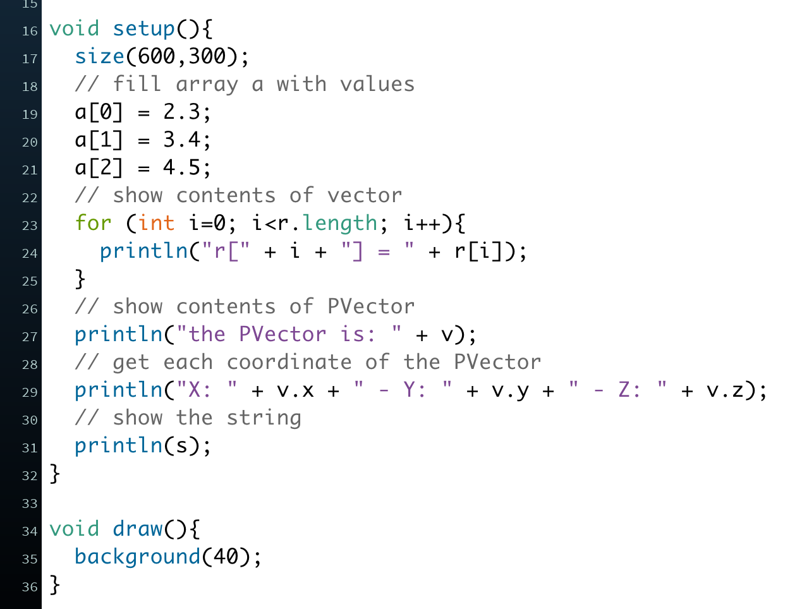
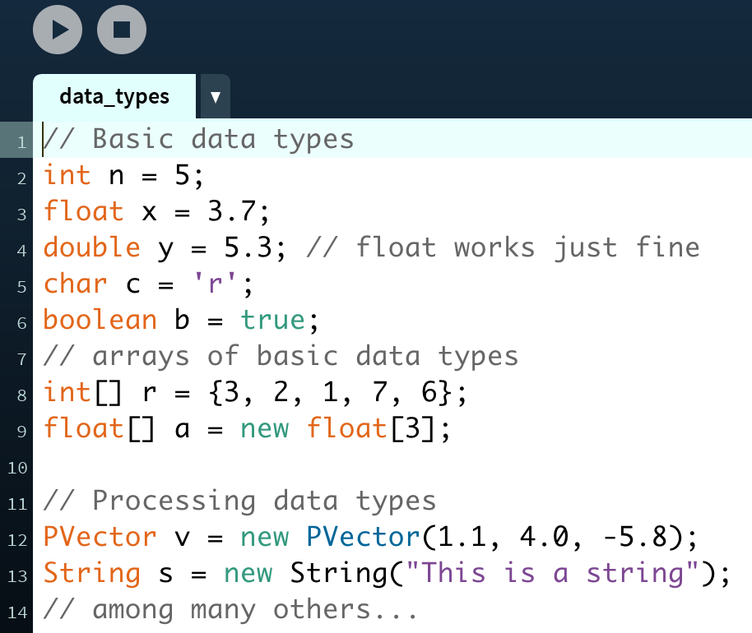
Basic and Processing data types

Slide 6
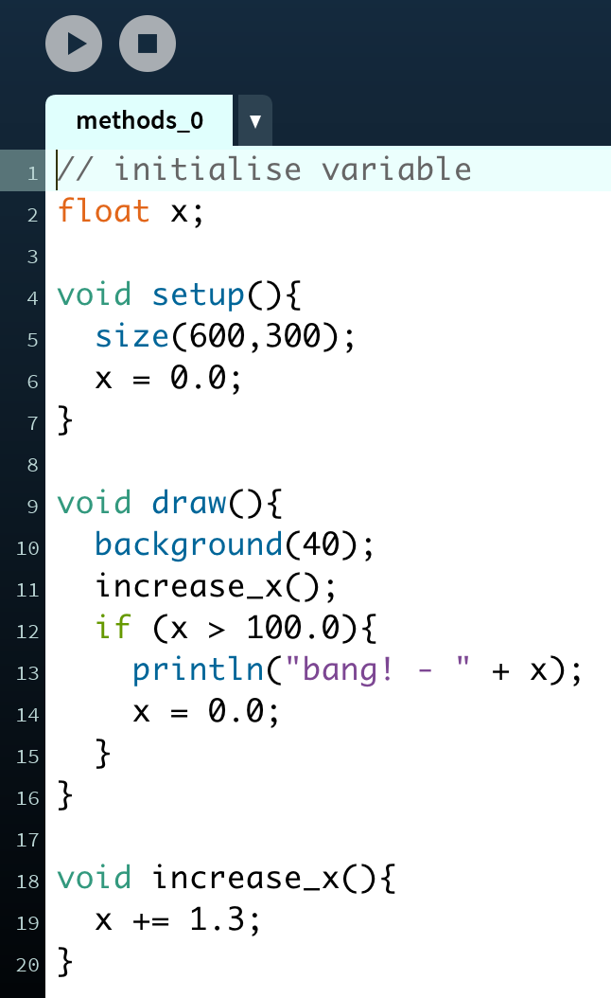
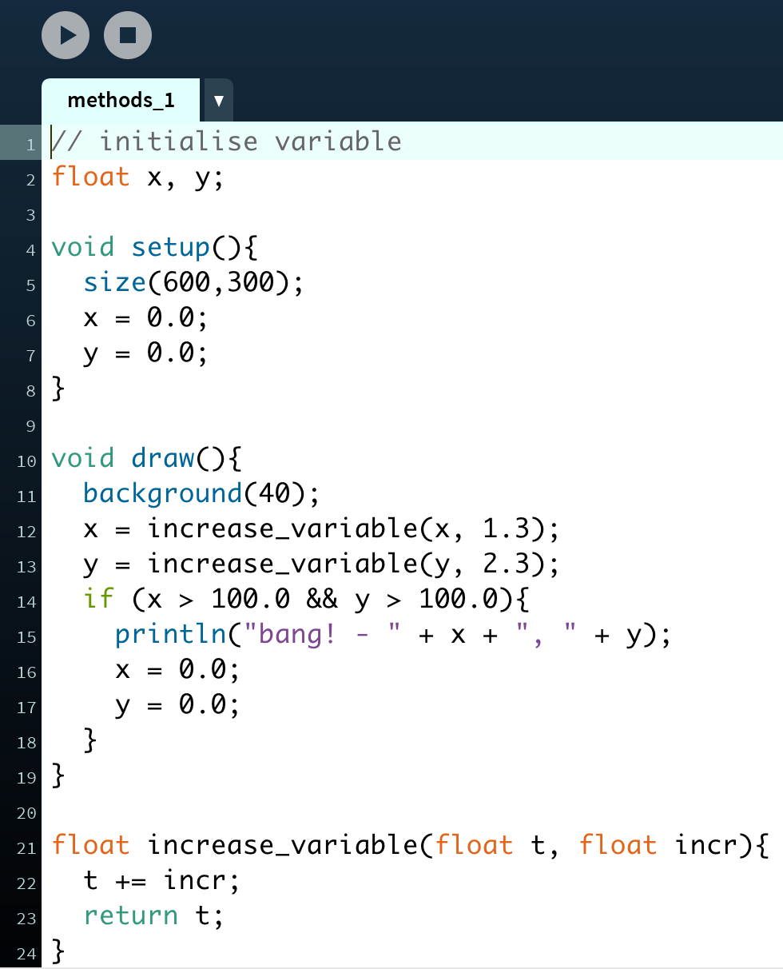
Methods
return function_name(arguments){
}
See:
Processing/part1-basics/d_methods_0
And
Processing/part1-basics/d_methods_1
no return value
no argument inputs
float return value
two argument inputs

Slide 7
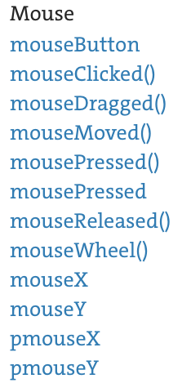
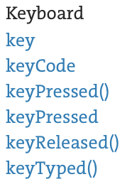
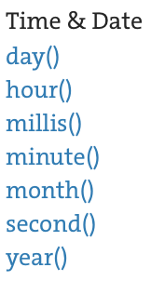
Useful Processing-reserved variables and functions
check out this website:
https://processing.org/reference/
Examples:

Slide 8
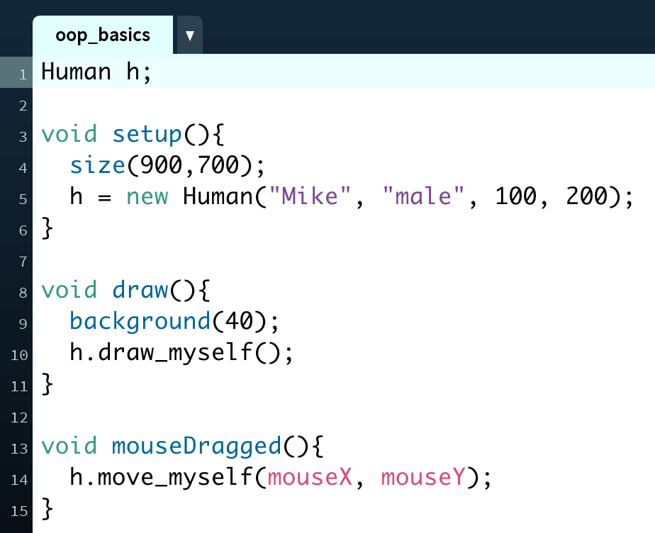
The very basics of OOP
But what is a “Human”?
See:
Processing/part1-basics/f_oop_basics

Slide 9
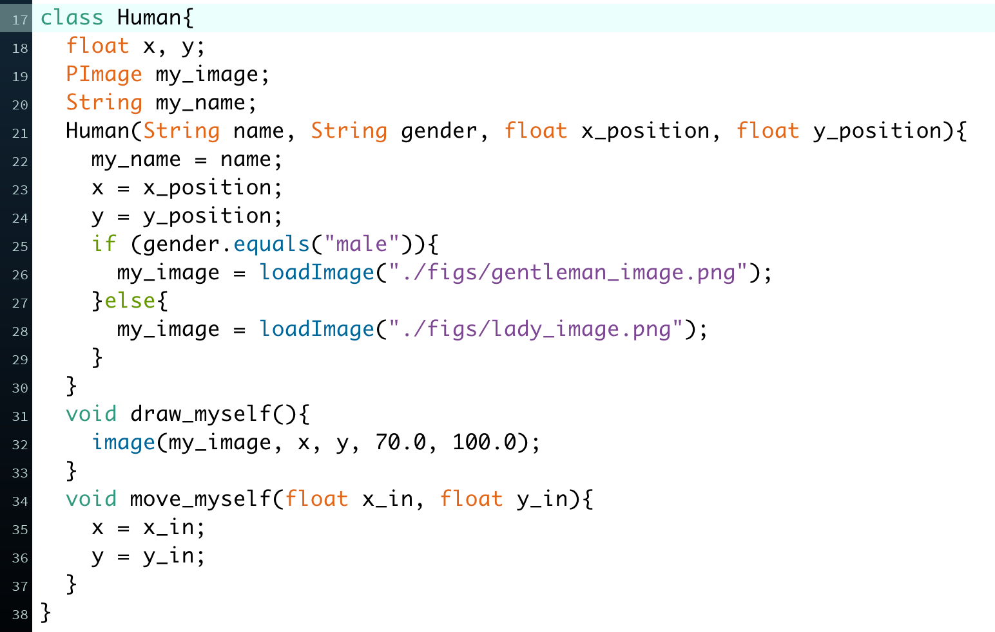
The very basics of OOP

