Slide 1
Προγραμματισμός Εφαρμογών Ήχου
ΠΜΣ: Τεχνολογίες Ήχου και Μουσικής
Τμήμα Μουσικής Τεχνολογίας και Ακουστικής
Ελληνική Μεσογειακό Πανεπιστήμιο
Μάξιμος Καλιακάτσος-Παπακώστας
5th Class
12/11/2020

Slide 2
Class content
Processing Basics
Environment overview
The setup() and draw() functions
Basic and Processing data types
Methods
Useful Processing-reserved variables and methods
The very basics of Object-Oriented Programming
Practical issues
How to learn fast
How to begin a new script
Importing libraries
Bonus: OSC library for communicating with other programs (Pure Data)
0_processing.basics.pptx
← valuable for C++
Notes:
<αριθμός>

Slide 3
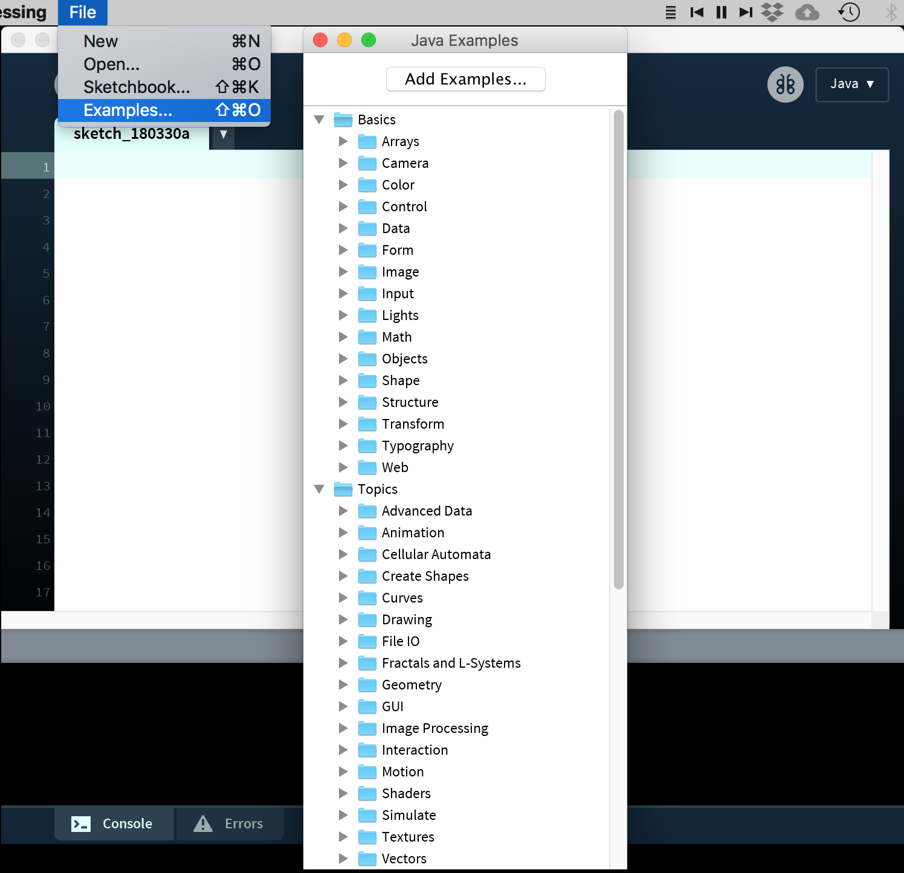
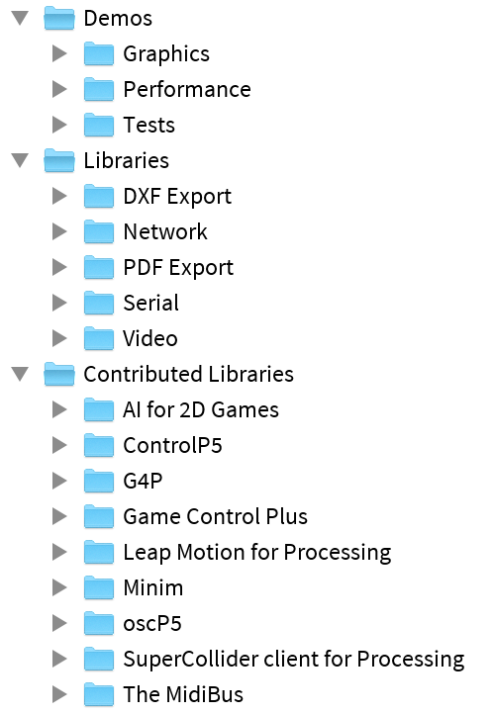
How to learn fast
More examples:

Slide 4
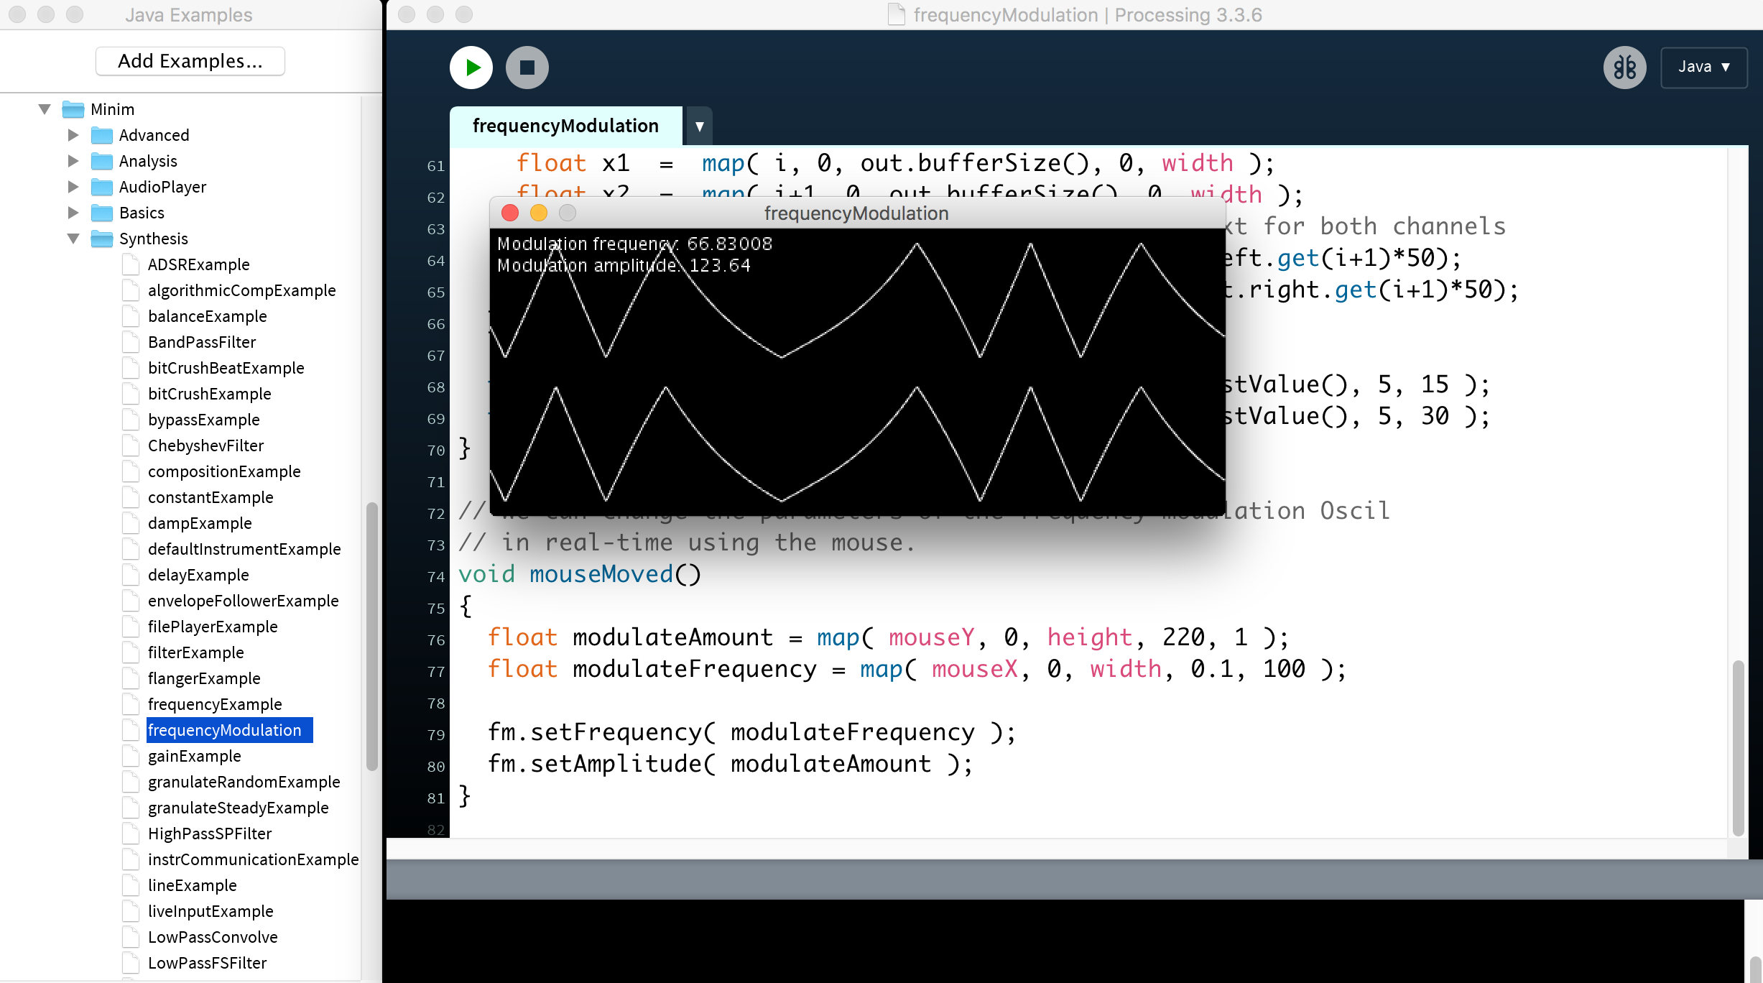
How to begin a new script
Start with an example!
There are too many examples, some of which might already deal with a large part
of what you want to do..

Slide 5
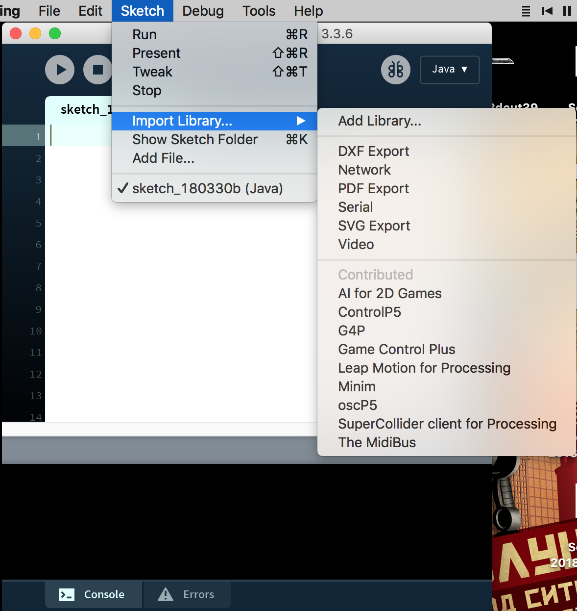
Importing (already added) libraries
Libraries add functionality to Processing. There might be a library for whatever you’re trying to do – so google before you code!
Easy to import in your sketch.

Slide 6

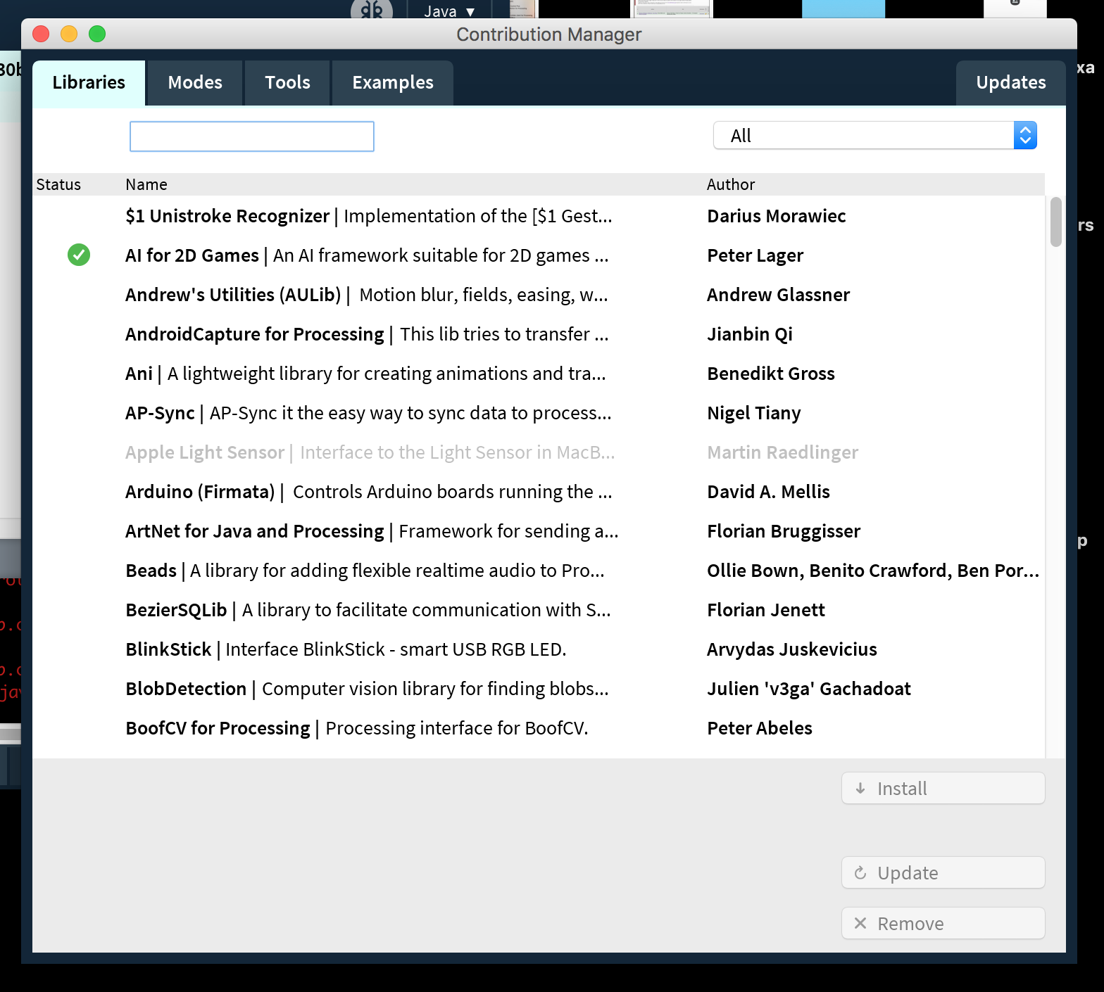
Finding and adding new libraries
Easy way: “officially” submitted library through the included library browsing tool
Convenient
search
tool

Slide 7
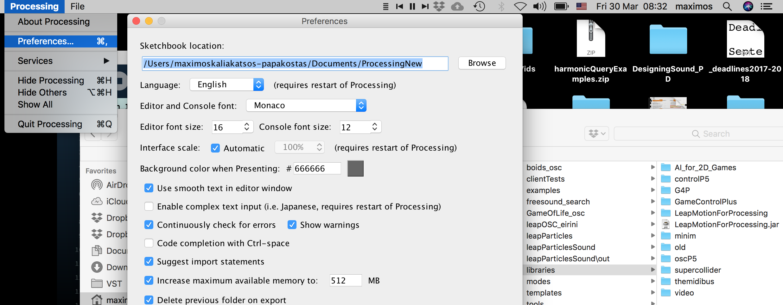
Finding and adding new libraries
How: Just put the downloaded folder of the library in a folder called “library” (if it doesn’t exist, create it) in the declared sketchbook location.
The hard way: “unofficially” contributed as code files in a folder

Slide 8
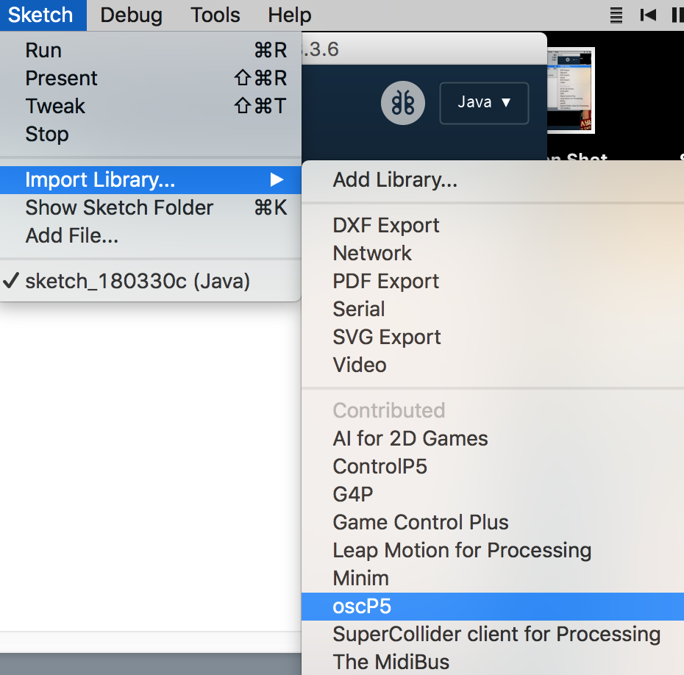
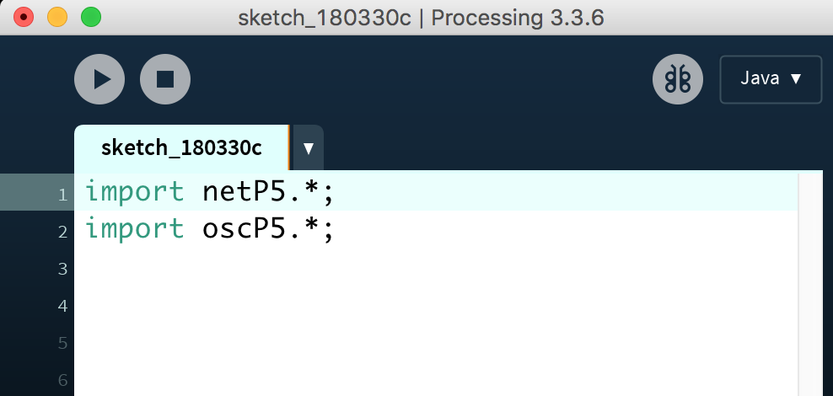
The OSC library for communicating with PD
Make sure you have added it!
After you import it, the following code should be added automatically:

Slide 9
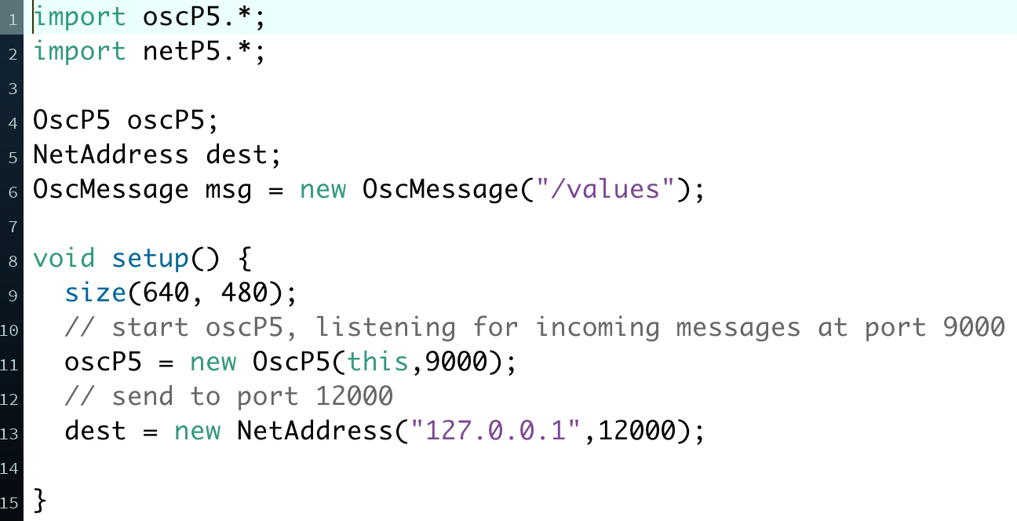
The OSC library: what we need to send messages
Initialise:
oscP5: for listening to incoming messages (we need to do it but we won’t need if for sending)
dest: for sending messages, the port value (12000 or whatever) should match the receiving port in PD
msg: an empty message that we will fill later on

Slide 10
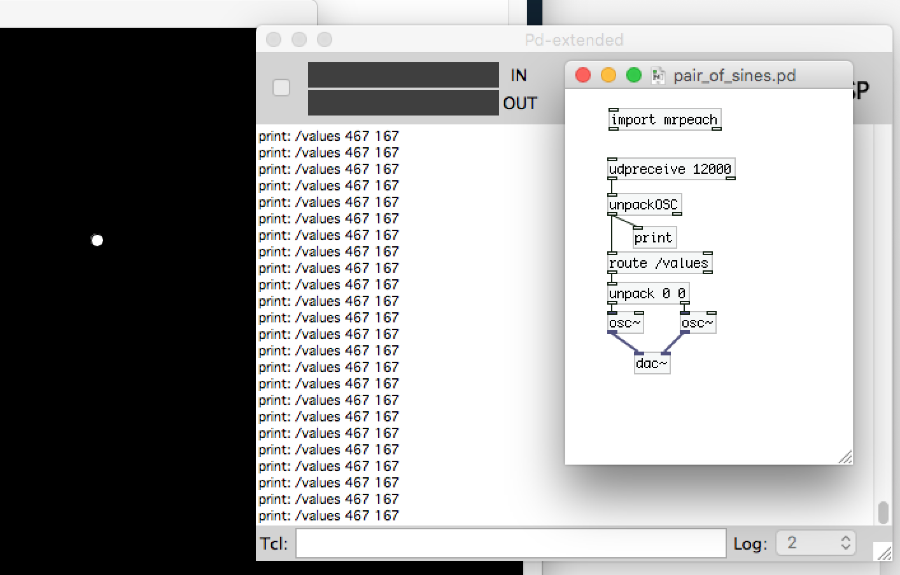
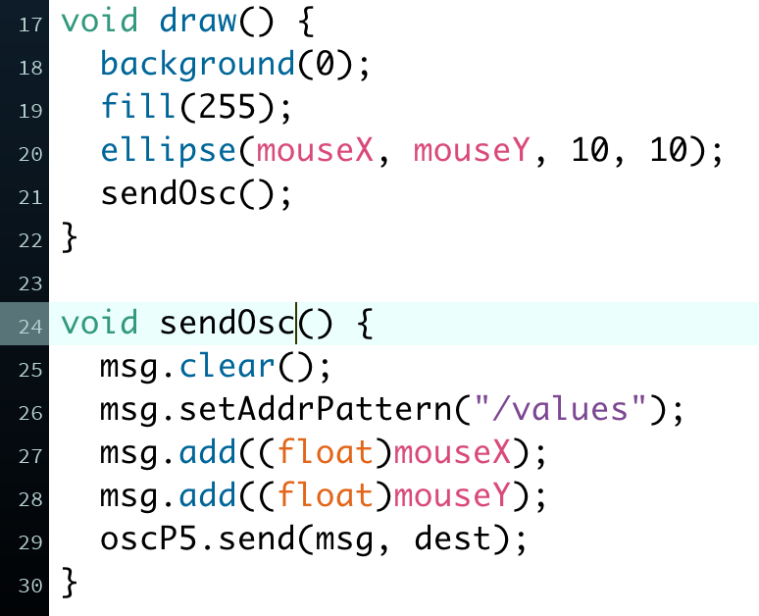
The OSC library: what we need to send messages
Prepare and send message:
sendOsc(): function we created for packing the header “/values” and the mouse X-Y values in a message
msg.clear(): we need to clear the older message before creating the new one.
Identify message address in PD
with [route /values]. This comes in
handy when sending many messages.

