Slide 1
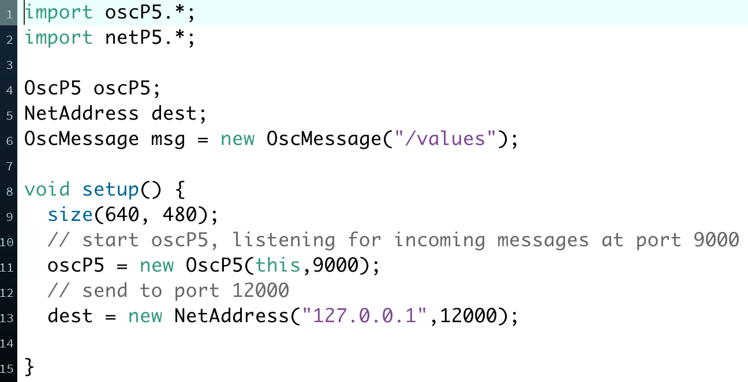
The OSC library: what we need to send messages
Initialize:
oscP5: for listening to incoming messages (we need to do it but we won’t need if for sending)
dest: for sending messages, the port value (12000 or whatever) should match the receiving port in PD
msg: an empty message that we will fill later on

Slide 2
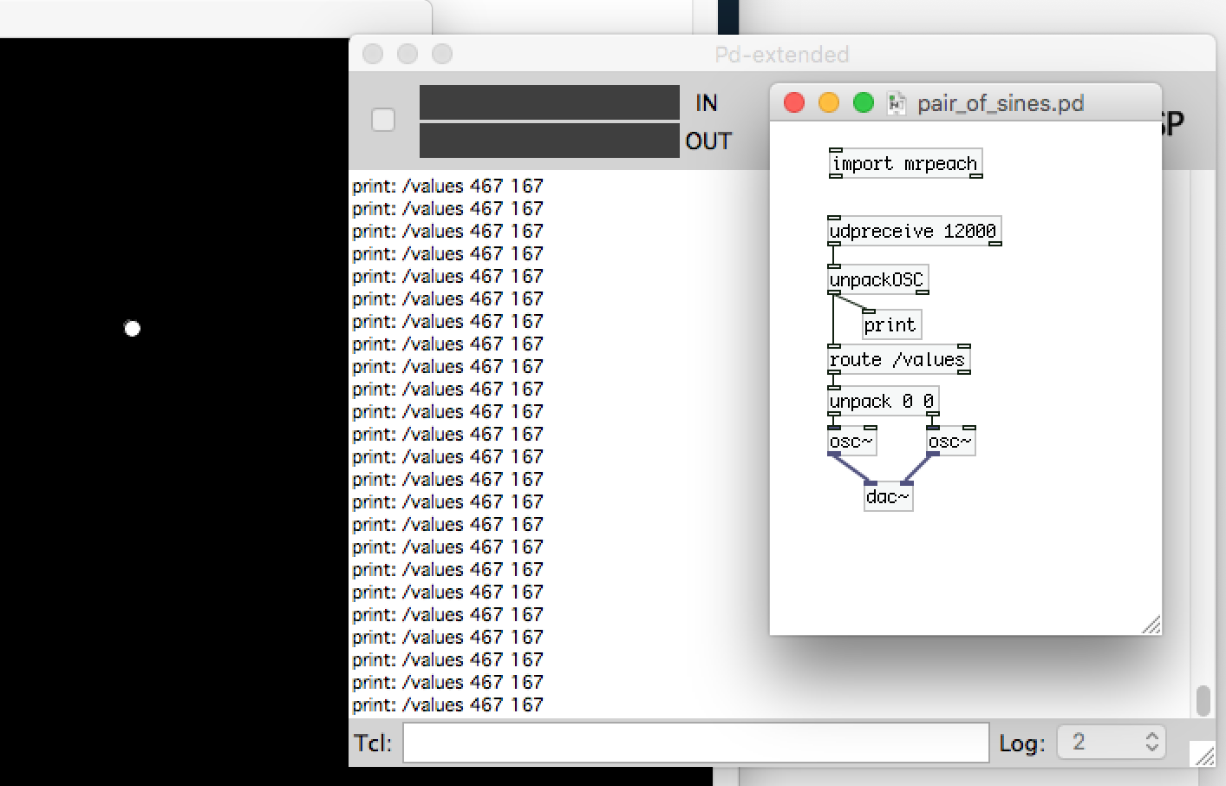
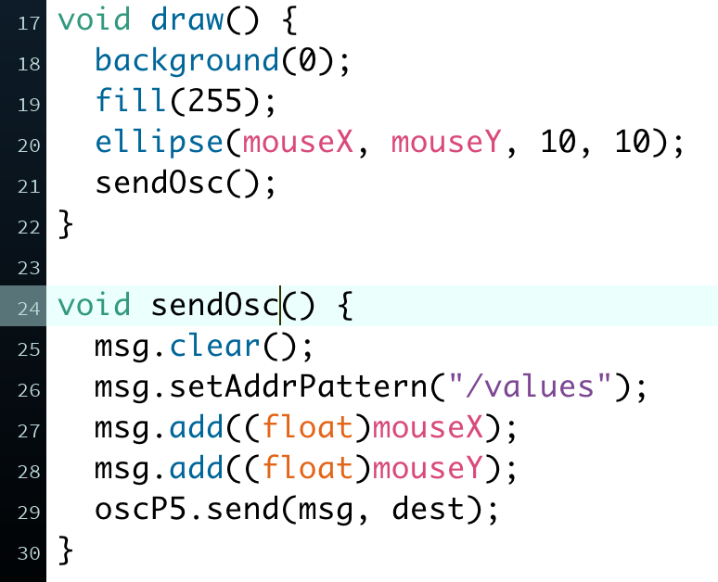
The OSC library: what we need to send messages
Prepare and send message:
sendOsc(): function we created for packing the header “/values” and the mouse X-Y values in a message
msg.clear(): we need to clear the older message before creating the new one.
Identify message address in PD
with [route /values]. This comes in
handy when sending many messages.

