Slide 1
Highly Descriptive Vector-to-Face Generation to Synthesize Authentic Faces (Photofits for Criminology Purposes) via a GAN
By Max Erler and Daniel Schubert
Tutor: Pingchuan Ma
At the Chair of Prof. Dr. Ommer

Slide 2
Goals
Generate Faces via an attribute vector
Design and create framework
Implement and train cDCGAN
Implement and train TediGAN
Photofit-level (criminology)

Slide 3
Framework
Be highly configurable
Allow multiple datasets
Allow multiple networks
Allow multiple metrics
Should allow training, evaluation and use of network
Be extendable
Notes:
With a config a user can set network hyperparameters, parameters for training, select a dataset and if desired give a vector to generate images
Implemented networks: cDCGAN, dataset: celebA, metrics: FID, LPIPS, BRISQUE

Slide 4
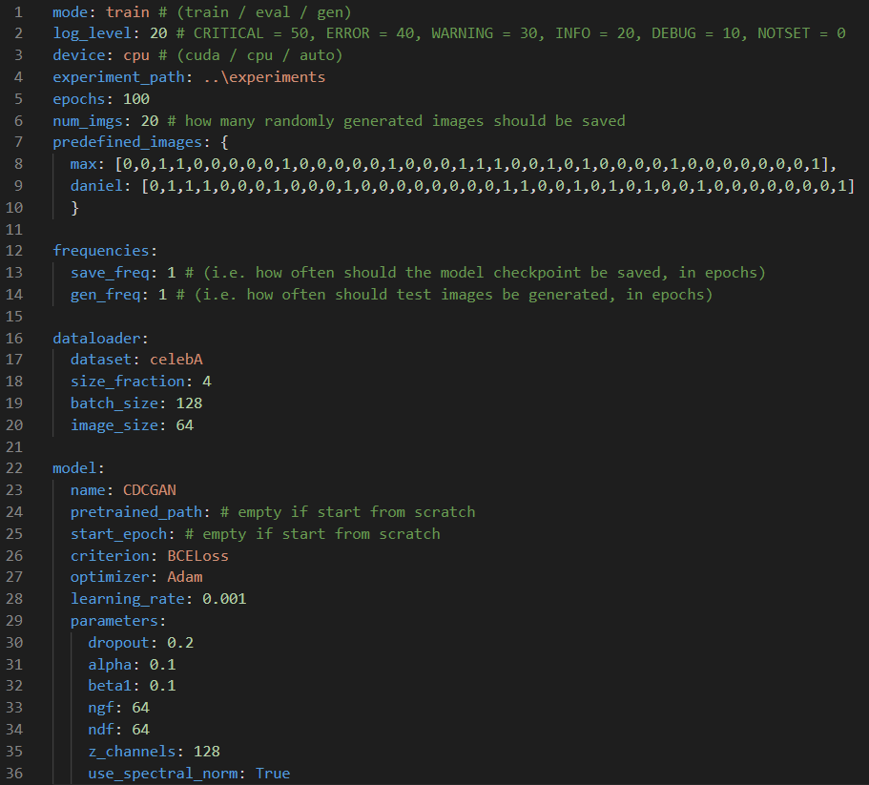
Configuration

Slide 5
Experiments
4 different dropouts
0%
20%
30%
50%
2 layer types
With ‘standard’ convolutional layers
With spectral convolutional layers
celebA Dataset with 25% and 100% of the size
Resulting in 10 runs for at least 100 epochs

Slide 6
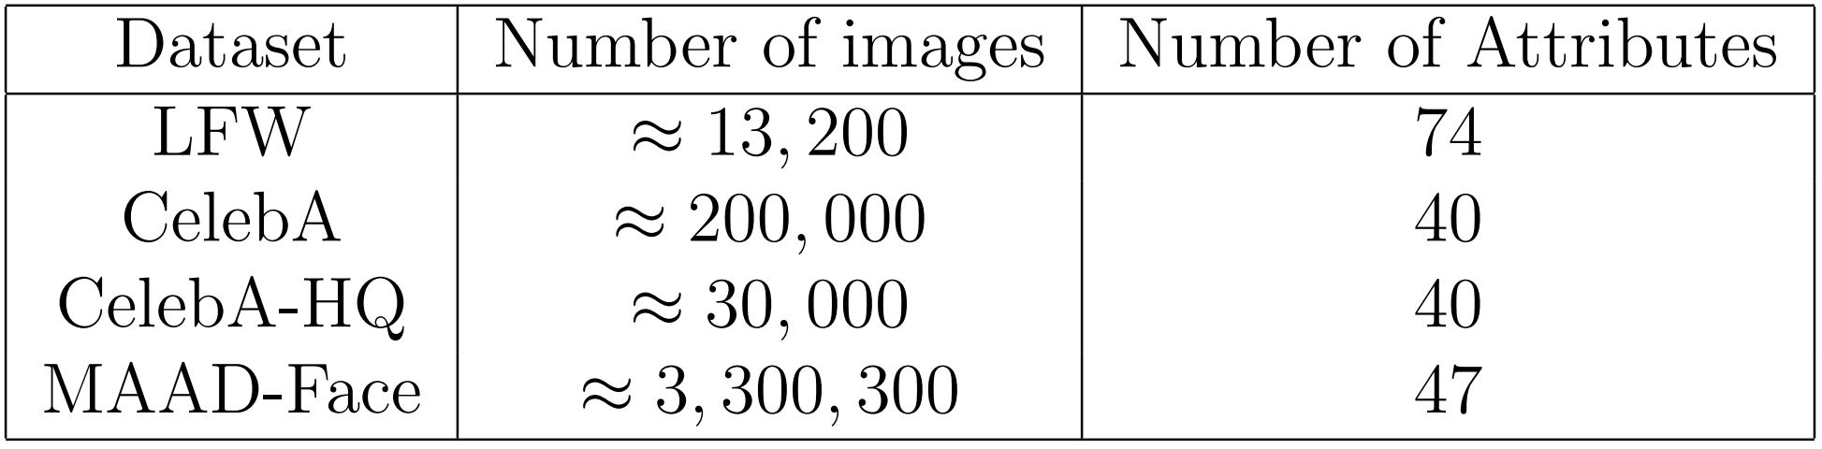
Why celebA?
➔ Trade-off between number of images and number of attributes

Slide 7
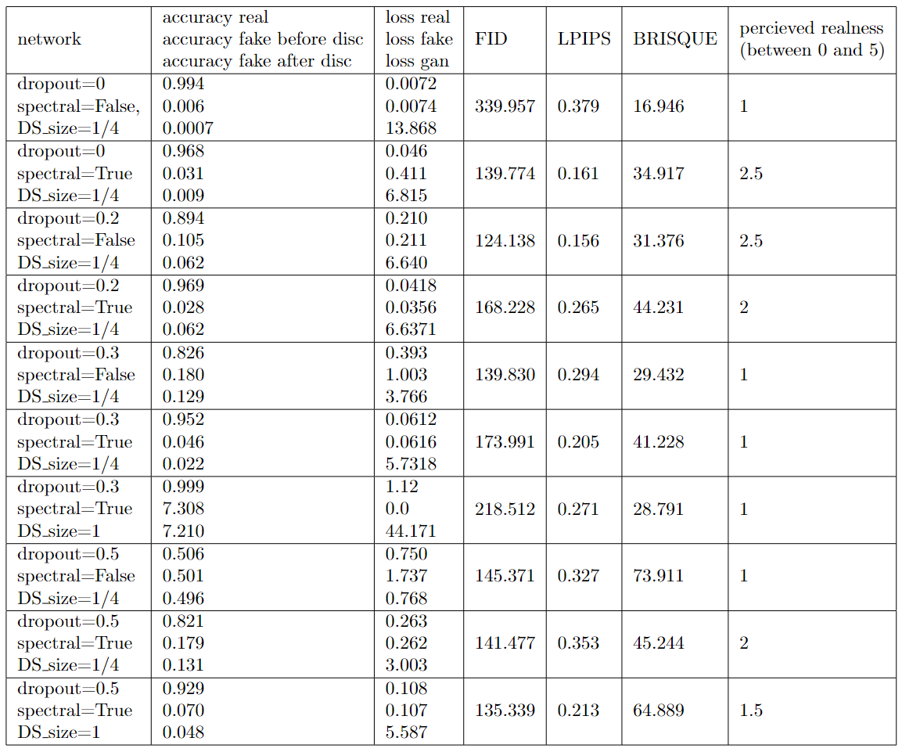









Evaluation of Experiments
Highest perceived realness
Lowest perceived realness

Slide 8
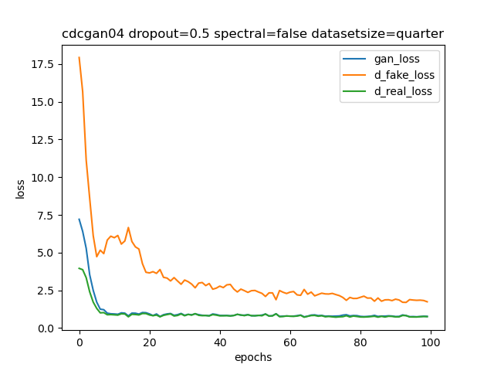
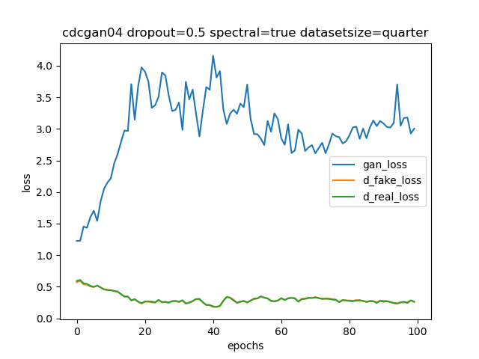




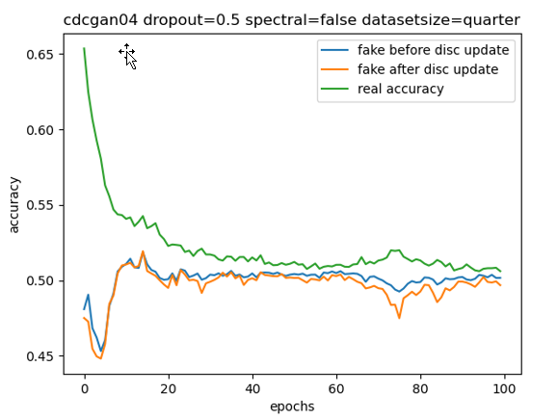

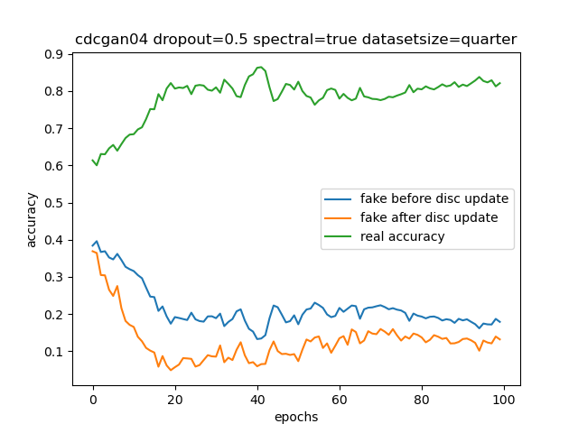



Results – general

Slide 9
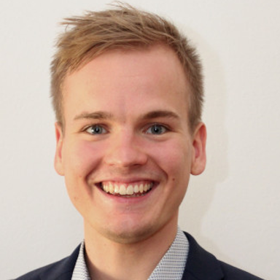

Example Generation
Passport of Daniel (removed for privacy reasons)
Daniel Arched_Eyebrows, Attractive, Bags_Under_Eyes, Big_Nose, Brown_Hair, Male, Mouth_Slightly_Open, No_Beard, Pale_Skin, Smiling, Young
Max Attractive, Bags_Under_Eyes, Blond_Hair, Eyeglasses, High_Cheekbones, Male, Mouth_Slightly_Open, No_Beard, Pale_Skin, Smiling, Young

Slide 10
Future Work
Train on other datasets
Finish re-implementation of TediGAN
Change image size from 64x64 to original size
Develop new specialized dataset for criminology purposes
More attributes (at least 200)
Exclude bad images
Only passport images

Slide 11
Thank you!

