Slide 1
Demo 1 TA Meeting
Maxim Popov, Dylan Booth, Max Mayer-Mader, Zach Campbell, Isaac Lo

Slide 2
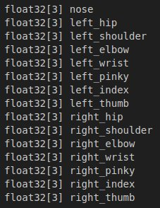
Dylan
Custom ROS Messages
Communication system using ROS between the Camera/MediaPipe and Display Nodes
Setup Callback structure when ROS message is received
Configured CMake for code compilation
Gitlab Wiki - ROS
Challenges:
Abstracting code into separate files for cleanliness with ROS and catkin_make
Future:
Work with Isaac on simulation
kinematics/robot control work

Slide 3
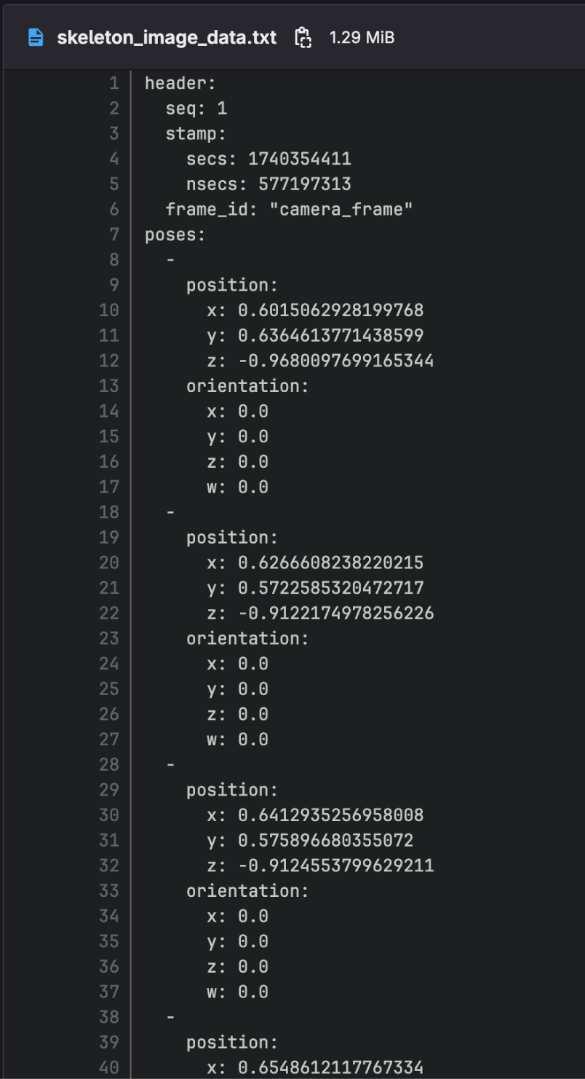
Max
Implemented separate media pipe code
Has skeleton tracking and point outputs
Worked on CI/CD pipeline
Challenge: missing a server for the work flows
Future work
Implement pre-processing to smooth points and check feasibility.

Slide 4
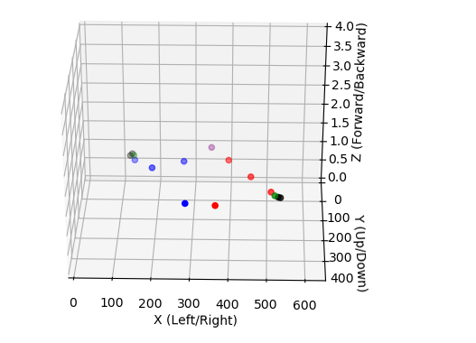
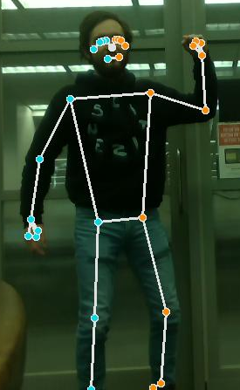
Zach
Created Mediapipe Pose Detection Scripts
Execute Mediapipe on a given image
Read images from laptop camera, write pose-detected images to file
Set up D435i Depth Camera Integration + Demos
Designed high-order callback function to sync depth coordinates and pose coordinates
Initialized Python virtual environment to manage Mediapipe/Depth Camera Dependencies, project setup page on the wiki
Challenges:
GUI on secondary threads conflicts
D435i Frame Scaling
Work In Progress:
Overall system design
Integrating depth code into processing pipeline

Slide 5
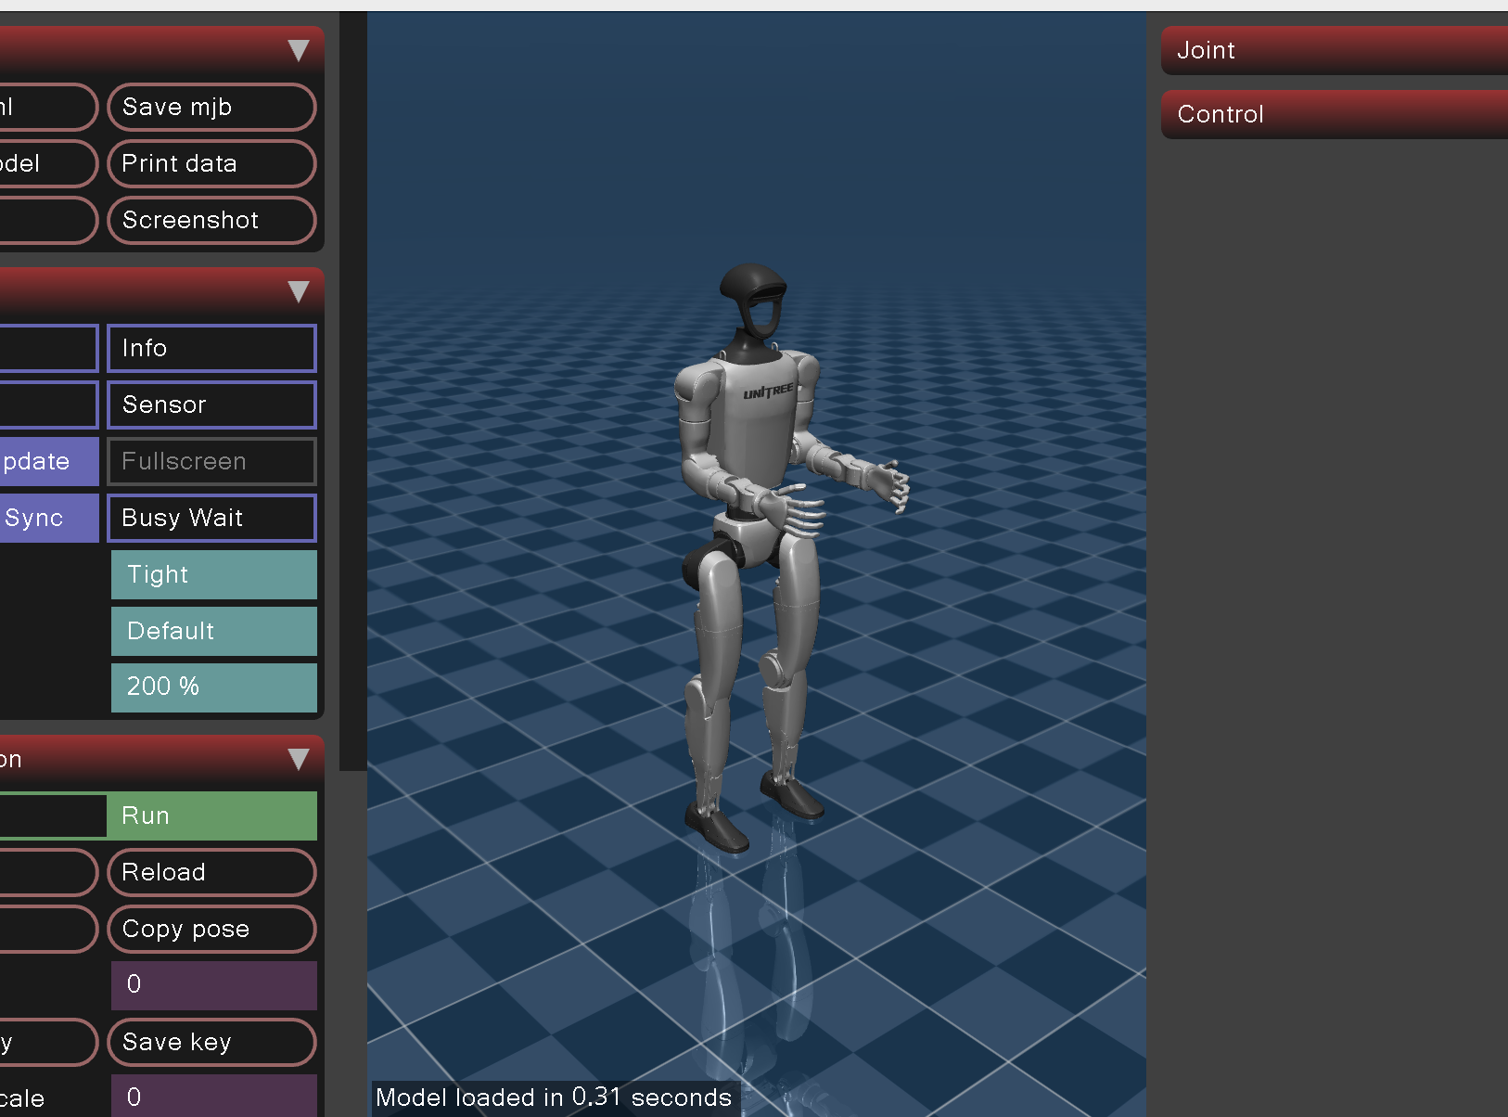
Isaac
Summary of:
Contributions
Simulation research. MuJoCo + Unitree + ROS 1.
Project planning (generally and point preprocessing ideation).
Refactoring and reviewing code.
Note taking. (Isaac = secretary?).
Any challenges
Versioning urk…
Getting Ubuntu working on my devices.
Getting versioning right for MuJoCo/ROS integration
Getting approvals on my clean up PRs lol
Work in progress
Coding my bit of the point/joint angle pipeline, probably proportion transforms.
Code a visual/simulation that we can move from joint angles csv

Slide 6
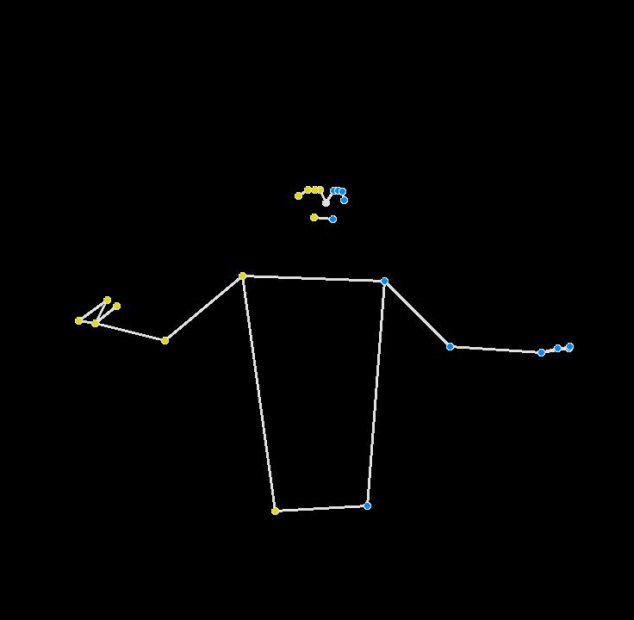
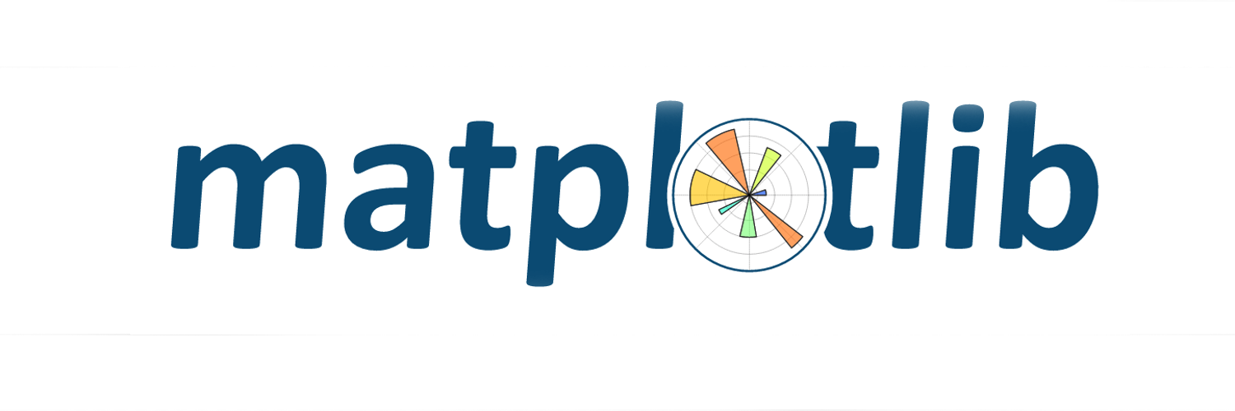
Maxim
Designed architecture for how to process points and pass them through the system
Configured matplotlib to play back points “video”, laying groundwork for real-time processing
Review of project spikes and ticket/project planning
Challenges:
Issue getting correct z points but fixed issue with camera getting depth
Work In Progress:
Figuring out reverse kinematic libraries and integration
Coding point smoothing pipeline module

