Slide 1
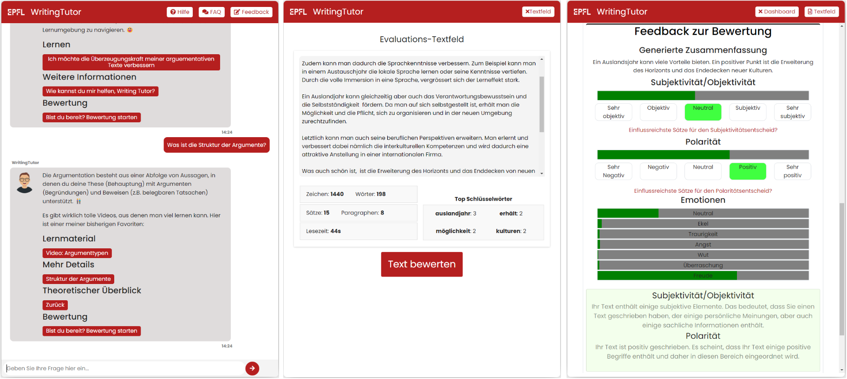
WritingTutor Improving a Conversational Learning Tool
Luca Engel
Supervised by
Thiemo Wambsganss
Bachelor Project Presentation
February 2023
Notes:
Welcome to my bachelor project presentation. During the course of this project, I was supervised by Thiemo.
Machine learning, natural language processing and chatbots are finding implementation areas almost everywhere.
Most notable chatbot that came out recently: chatgpt – we’ve all used it, be it learning phase, when programming, general questions to end a discussion, …
As we can see, Chatbots can be used in a variety of places. In this project, we focused on a chatbot as a conversational tool to improve students’ writing
Previous to this project, Thiemo, together with parsa, designed Writing tutor → help students writing essays (German chatbot)
My task was to : Improve WritingTutor, update design, improve the program flow, text evaluation, overall user experience…
→ This prompted us to choose the following research questions:

Slide 2
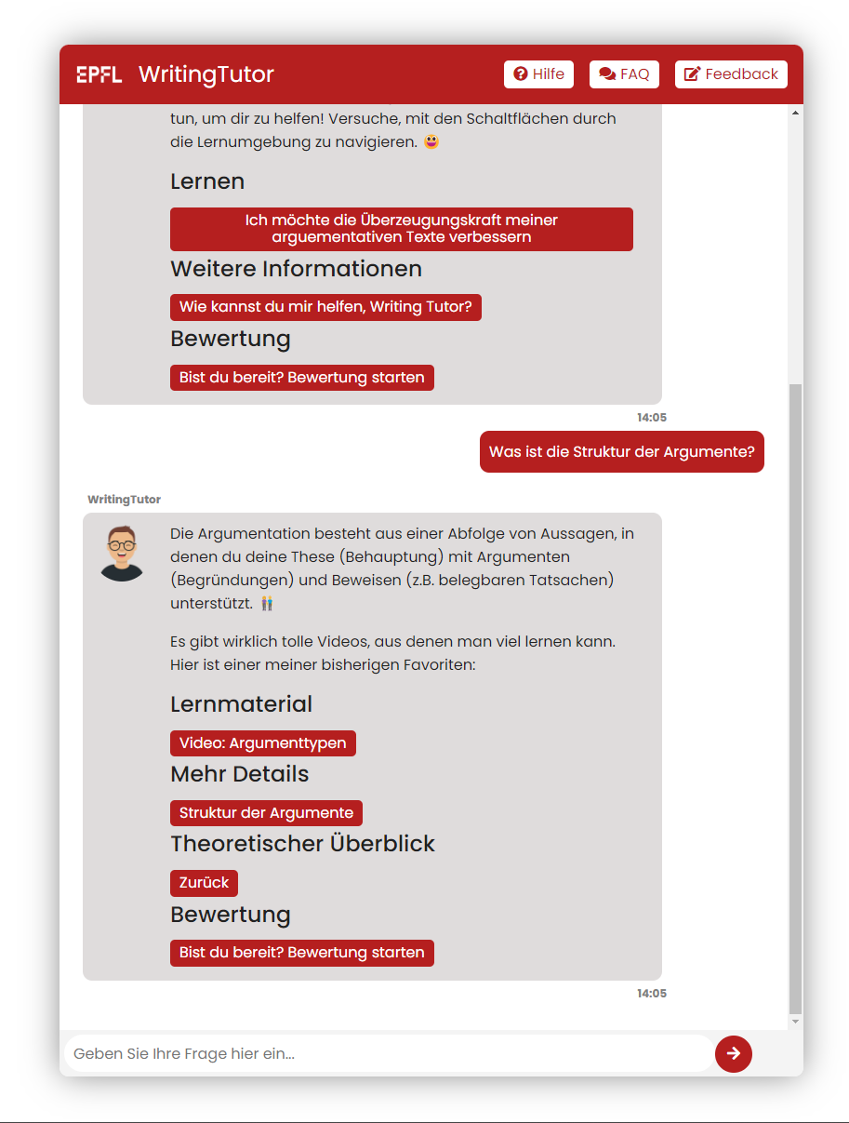
Research Questions
How should one design a chatbot to support students in general writing tasks?
How does the chatbot design influence students’ learning experience?
Notes:
Best way to support students when writing texts
Investigate influence of chatbot design on learning experience
To find answers to those questions:
Based improvements on results field study mentioned before
2nd evaluation at the end of this project to see how those changes were received

Slide 3


Design
Front end
Questions, essay text
Back end
Front end
ReactJs
3 parts
Chat interface
writing interface
evaluation interface
Back end
Python
TextBlob, Hugging Face
Answers,
text evaluation
Notes:
Front end
Old: JavaScript, HTML, CSS → New: ReactJs → more flexible for new implementations
3 parts – QnA with chatbot, text writing interface, evaluation interface
Back end
QnA part done with chatomatic → short explanation
Text evaluation done with language processing models
Polarity, subjectivity: textblob
Emotions, summary huggingface
German Language problems (subjectivity)
Translation to English
DEMO!!!

Slide 4
First Evaluation: Feedback
“I had trouble jumping back and forth between my text and the WritingTutor's inputs.”
“More feedback and more detailed feedback would be great.”
“The program should explicitly highlight which passages are more subjective/objective”
Notes:
Previous to this project, WritingTutor tested in a field study before the beginning of my project.
Feedback used to decide what to improve
Some feedback:
Difficulties switching interfaces
More feedback
Get reasons for the given evaluation

Slide 5
Improvement
“I had trouble jumping back and forth between my text and the WritingTutor's inputs.”
“More feedback and more detailed feedback would be great.”
User experience
Interface switching
More feedback
Text highlighting
“The program should explicitly highlight which passages are more subjective/objective”
Notes:
From that I decided to mainly improve the following points:
UX → make everything smoother (automatically scroll down to the bottom when new chat message, …)
Interface switching → header buttons
More feedback → evaluation interface
TEXT HIGHLIGHTING → reason for given evaluation (polarity / subjectivity/ …)
Text highlighting → show my improvements!!! 2nd demo

Slide 6
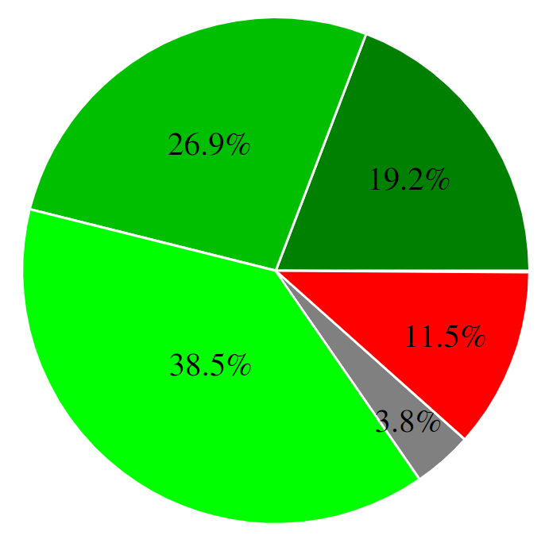
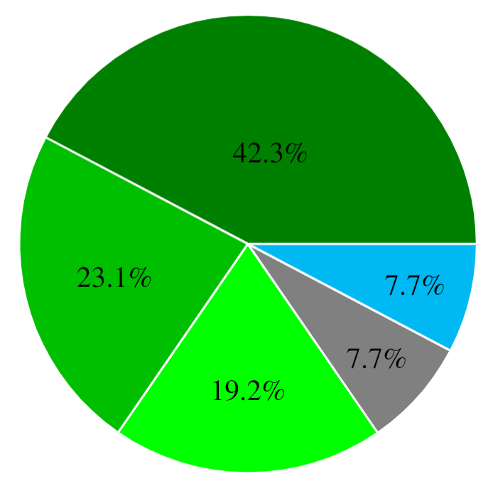
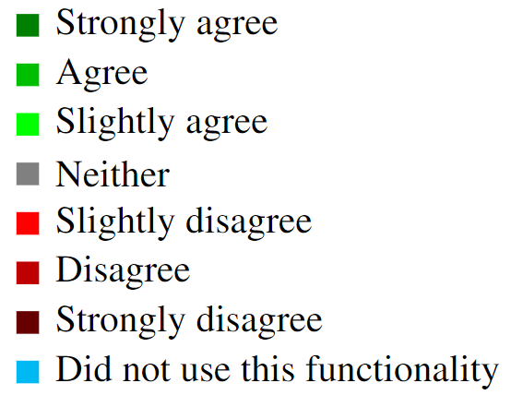
Project Evaluation
The feedback on my essay was helpful.
Sentence highlighting […] clarified how my essay was evaluated.
26 participants
19 men, 7 women
“With [the top keywords highlighted], word repetitions can be found very easily.”
“Text highlighting clarified why my essay was rated the way it was”
Notes:
Evaluation of my project
Set up:
26 paricipants, 19 men, 7 women
18 had highschool as highest level of education
Task:
Use writing tutor → check out the theory, …
With the gained knowledge, write an essay (250-300) words
Evaluate it
Google form with questions mainly concerning the user experience, evaluation, what parts were good, potential improvements

Slide 7
Takeaways
The feedback on my essay was helpful.
Sentence highlighting […] clarified how my essay was evaluated.
Intuitive user interface
Quick responses and evaluation
Text highlighting
More feedback / suggestions
“With [the top keywords highlighted], word repetitions can be found very easily.”
“Text highlighting clarified why my essay was rated the way it was”
Notes:
Find more bullet points for the user interface
Around 90% enjoyed using WritingTutor and found the user interface intuitive
Text highlighting:
Synomyms
Practical to understand evaluation
Mentions of: To know where synonyms might help
Text highlighting wasn’t used for the emotions → people mentioned they would have liked that → takeaway: text highlighting is good and should be used!!!
Feedback / suggestions: some mentioned more tailored feedback (such as text highlighting) / suggestions on how to rewrite parts

Slide 8

Future Work
More feedback and suggestions
Multilanguage support
Multiple text sorts
Better mobile version
Notes:
More feedback and suggestions
From eval: e.g., more feedback that might even suggest how to rewrite certain parts
E.g., make subjective text more objective, …
Multilanguage: self explanatory → also do it in English, … useful since multiple languages could use the same familiar interface!!!
Multiple text sorts: writing very important → emails, scientific texts, …
Better mobile version: space management (overlapping stuff, …) great for shorter texts (like email) and on the go learning!

Slide 9
Conclusion
Feedback and reasons for the feedback
Interactive chat
Adaptivity to speed and needs of the student
How should one design a chatbot to support students in general writing tasks?
Notes:
Specific feedback and reasons for the given assessment are essential for the user to understand why their text is evaluated in a particular way
Interactive chat functionality, users can adapt the learning pace and the content taught to their personal needs and preferences.

Slide 10
Conclusion
Intuitive and easy-to-use interface
Quick evaluation
Accurate responses
How should one design a chatbot to support students in general writing tasks?
How does the chatbot design influence students’ learning experience?
Notes:
Providing the user with an intuitive and easy-to-use user interface is essential
Quick and accurate responses to the user’s input are highly valued
Answers of the chatbot off topic if hand-written questions
With the insights gained during this project and the results of the evaluation, we can see a blueprint of the most important
Aspects that should be considered when creating a chatbot like WritingTutor

Slide 11
Bibliography
Thiemo Wambsganss and Tanja Käser. Effects of Learner Control Features in Designing Conversational Tutoring Systems. Working Paper. 2023.
https://openai.com/blog/chatgpt/, ChatGPT
https://www.flaticon.com/free-icon/server_969438?term=server&related_id=969438, Server icons created by srip – Flaticon
https://www.flaticon.com/free-icon/laptop_1055329?term=laptop&page=1&position=4&origin=search&related_id=1055329, Laptop icons created by Maxim Basinski Premium – Flaticon
https://www.flaticon.com/free-icon/idea_4592490?k=1675697153153&sign-up=google, Future icons created by Freepik - Flaticon

Slide 12
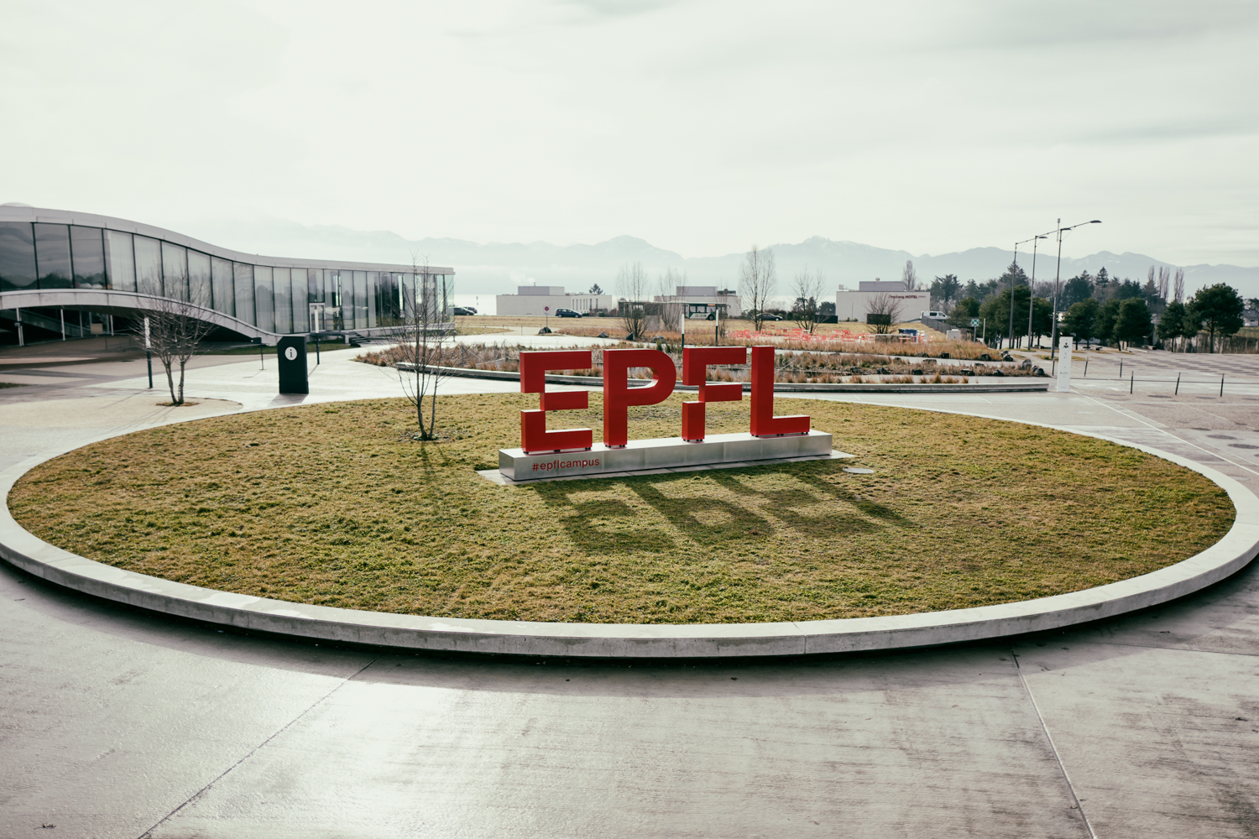
Questions?
Luca Engel
Notes:
Thank you for listening to my presentation!
If you have any questions, I’d be happy to answer them!

