Slide 1
Understanding Air Pollution trends in various Part of Maharashtra, India
Maxim Rohit| MS in Data Science| February 2020

Slide 2
Introduction
The research aims to understand pollutant pattern over the region of Maharashtra, India.
spread
correlation
seasonal pattern
15% of SO2 hotspot located in india
fossil fuel-based power generation - Chandrapur
other Industrial use case
Government Measures
National Clean Air Program : initiated 2019; 102 cities1 Million population; reduce the air pollution by 20 - 30% by 2024
2020 Budget:- INR 4400 crores, up from 460 from 2019
Indian government’s first comprehensive report
1.24 million deaths attributable to air pollution in 2017
Notes:
Insert a picture illustrating a season in your country.

Slide 3
background and Motivation
Indian Government on 8th December 2018 released a first of its kind report detailing the impact of air pollution on Indian living condition. –
Air pollution can be attributed to 12.5% of deaths in India in 2017
In the same report, Spokeperson from Department of Health Research, Ministry of Health & Family Welfare, and ICMR, said
“It is important to have robust estimates of the health impact of air pollution in every state of India in order to have a reference for improving the situation”
The research is dedicated to answer one such question from pollution angle for the state of Maharashtra, State I Live in!
Life expectancy in India has gone down by 1.7 years due to health loss caused by higher air pollutant’s level
Notes:
Insert a map of your country.

Slide 4
Literature Review Unique approaches
Important Findings
Southwest:- Kwai Tsing Port; Northwest: Peral river delta-based factories, Winters pollutant levels are higher than summers
Non-diesel fuel and distillate oils for commercial, domestic heating , closure of coal-based fire plant.
Metropolitan (NO2,SPM) vs rural part (Ozone); Community based plan for motor traffic related pollution reduction
Morning & evening rush hours vs afternoon & night. Slum dweller's are major sufferers. Air pollution’s related diseases outweighs water borne diseases by 5.6 to 1
NO2 & SO2 were found to be negatively co-related with temperature during summer ( uneven heating of land & air flow from sea to land) and monsoon(rain based cleansing) and positively co related during post monsoon.
Studies
Wind & Nearby area Impact , Visually analyzed (Polar System & Parallel co-ordinates), seasonal : Hong kong, China
Pollutant Source : New York, USA
Localities : Madrid, Spain :
Daily pattern : Kolkata, India :
Coastal Region Behavior : Chennai, India
Notes:
Insert a picture of one of the geographic features of your country.

Slide 5
Aim & Objective Unique approaches
Objectives
Separating the high-risk zone will enable better refrainment’s statergy
This enables us if the feature has a major say in the pollution trends, which may help us prioritize our action plan
Understanding the impact of city progression will help plan future development better.
Understanding pollutants correlation will help us modulate them better
Enable us to strategize to the varying seasonal concentration of the pollutants.
Aim
Identify various subdivisions within Maharashtra, India based on Air pollutants.
Understanding the impact of the feature on the pollutant concentration
Impact of progressiveness of the city; like Pune & Mumbai fair against neighbouring towns
Understanding the correlation between various pollutants
Understanding the Seasonal behaviour of the pollutant concentration
Notes:
Insert a picture of one of the geographic features of your country.

Slide 6
Data preparation
We collected data from Central & State based online resources
Rainfall
Elevation for sea level
Industries Count– Small , Medium, Large
Industrial area coverage
Forest cover
Sensex population data
Road : Internal, state & national highways
Pollutant Concentration – NO2, SO2, SPM 10, SPM 2.5
We aggregated the data to monthly level
Percentile 10, 50 and 90 were used study the range of pollutants
Notes:
Insert a picture of one of the geographic features of your country.

Slide 7
Analysis
Clustering : Natural grouping within cities
K-means
Hierarchical clustering
Elbow curve
Silhouette analysis
Principle Component Analysis
Underlying themes
relationship between the variables
Monthly Percentiles (10, 50, 90) for all pollutants
Seasonality
Arima
Classical decomposition
Additive
Multiplicative
Seasonal Decomposition Of Time Series By Loess (STL)
Estimating change in pattern of seasonal components
Notes:
Insert a picture illustrating a season in your country.

Slide 8
Clustering
Overall SPM2.5 & SPM10 levels are beyond acceptable standard for all clusters
Mumbai cluster
Lowest SO2 level, elevation aka seaside, Forest area
Highest number of large Industries, rainfall
Pune Cluster
Highest level for all pollutant, elevation(34% higher), road length, Micro industry count
Lowest rainfall per area
SO2 levels above WHO standards
Others
NO2 , SPM2.5 & SPM10 are 20-30% lower intensity
Highest Forest area
Lowest population density, Industrial count and area spread
Aurangabad all four pollutant levels are continuous increasing
Solapur & Mahad reducing SPM2.5 levels
Chandrapur has high SO2 levels and listed in world SO2 hotspot
We performed two different exercise of clustering
All variable 2004-10
Only Pollutants 1987-2015
Findings from all variables clustering exercise was validated against the larger time frame of pollutant data.
We observed 6 Cluster
Sets of two representing 3 sets
Mumbai – Surprisingly les
Pune – Most Polluted
All others – Least Polluted
Notes:
Insert a picture of an animal and or plant found in your country.

Slide 9
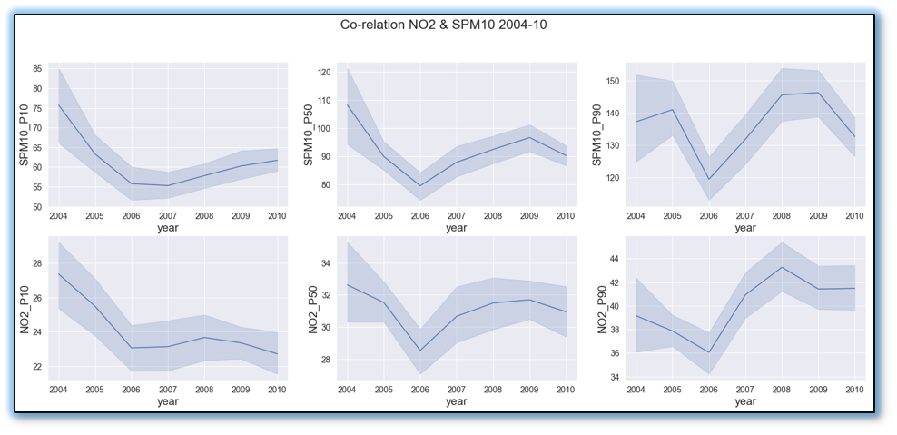
Principal Component analysis
1st : NO2 & SPM10 correlation was highlighted 0.49, 0.52 & 0.56 increasing with percentile 10, 50 & 90.
2nd : SO2 & SPM2.5 till 2007 similar and post that inverse movement
3rd : Highlights the range extending toward extremity for SPM10, as its range expanding as percentile 10 & 90 have opposite loading.
SO2 was only pollutant increasing between 2008-10 recession period, mostly because of constant source,18 coal-based power plant.
4th : NO2 percentile 10 & 50 level stretching represented that daily average levels are going up
NO2 & SPM10 Co-Relation
Notes:
Insert a picture of an animal and or plant found in your country.

Slide 10
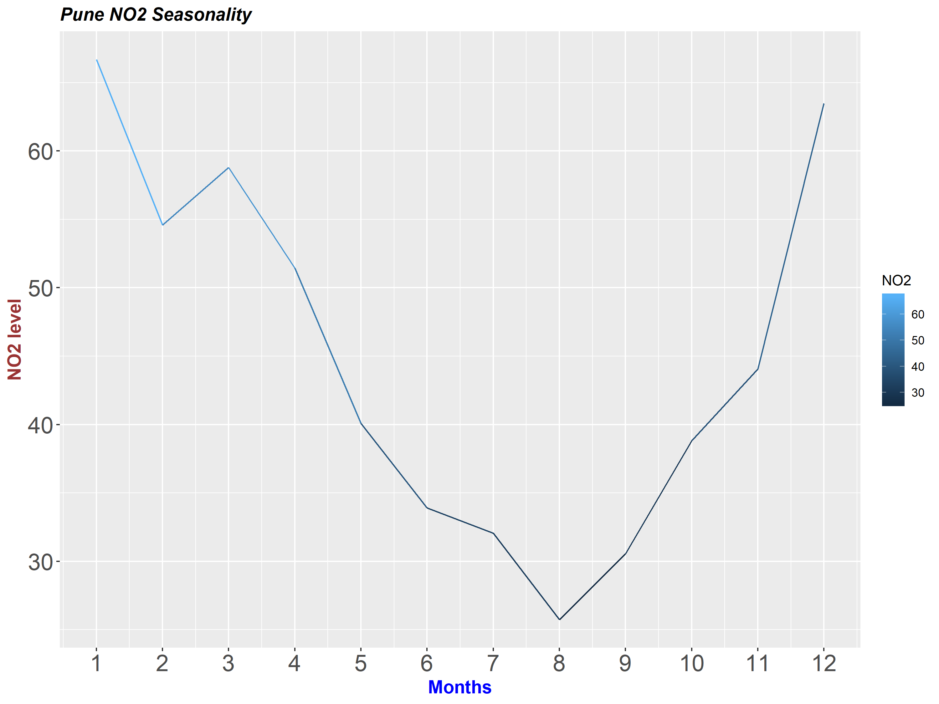
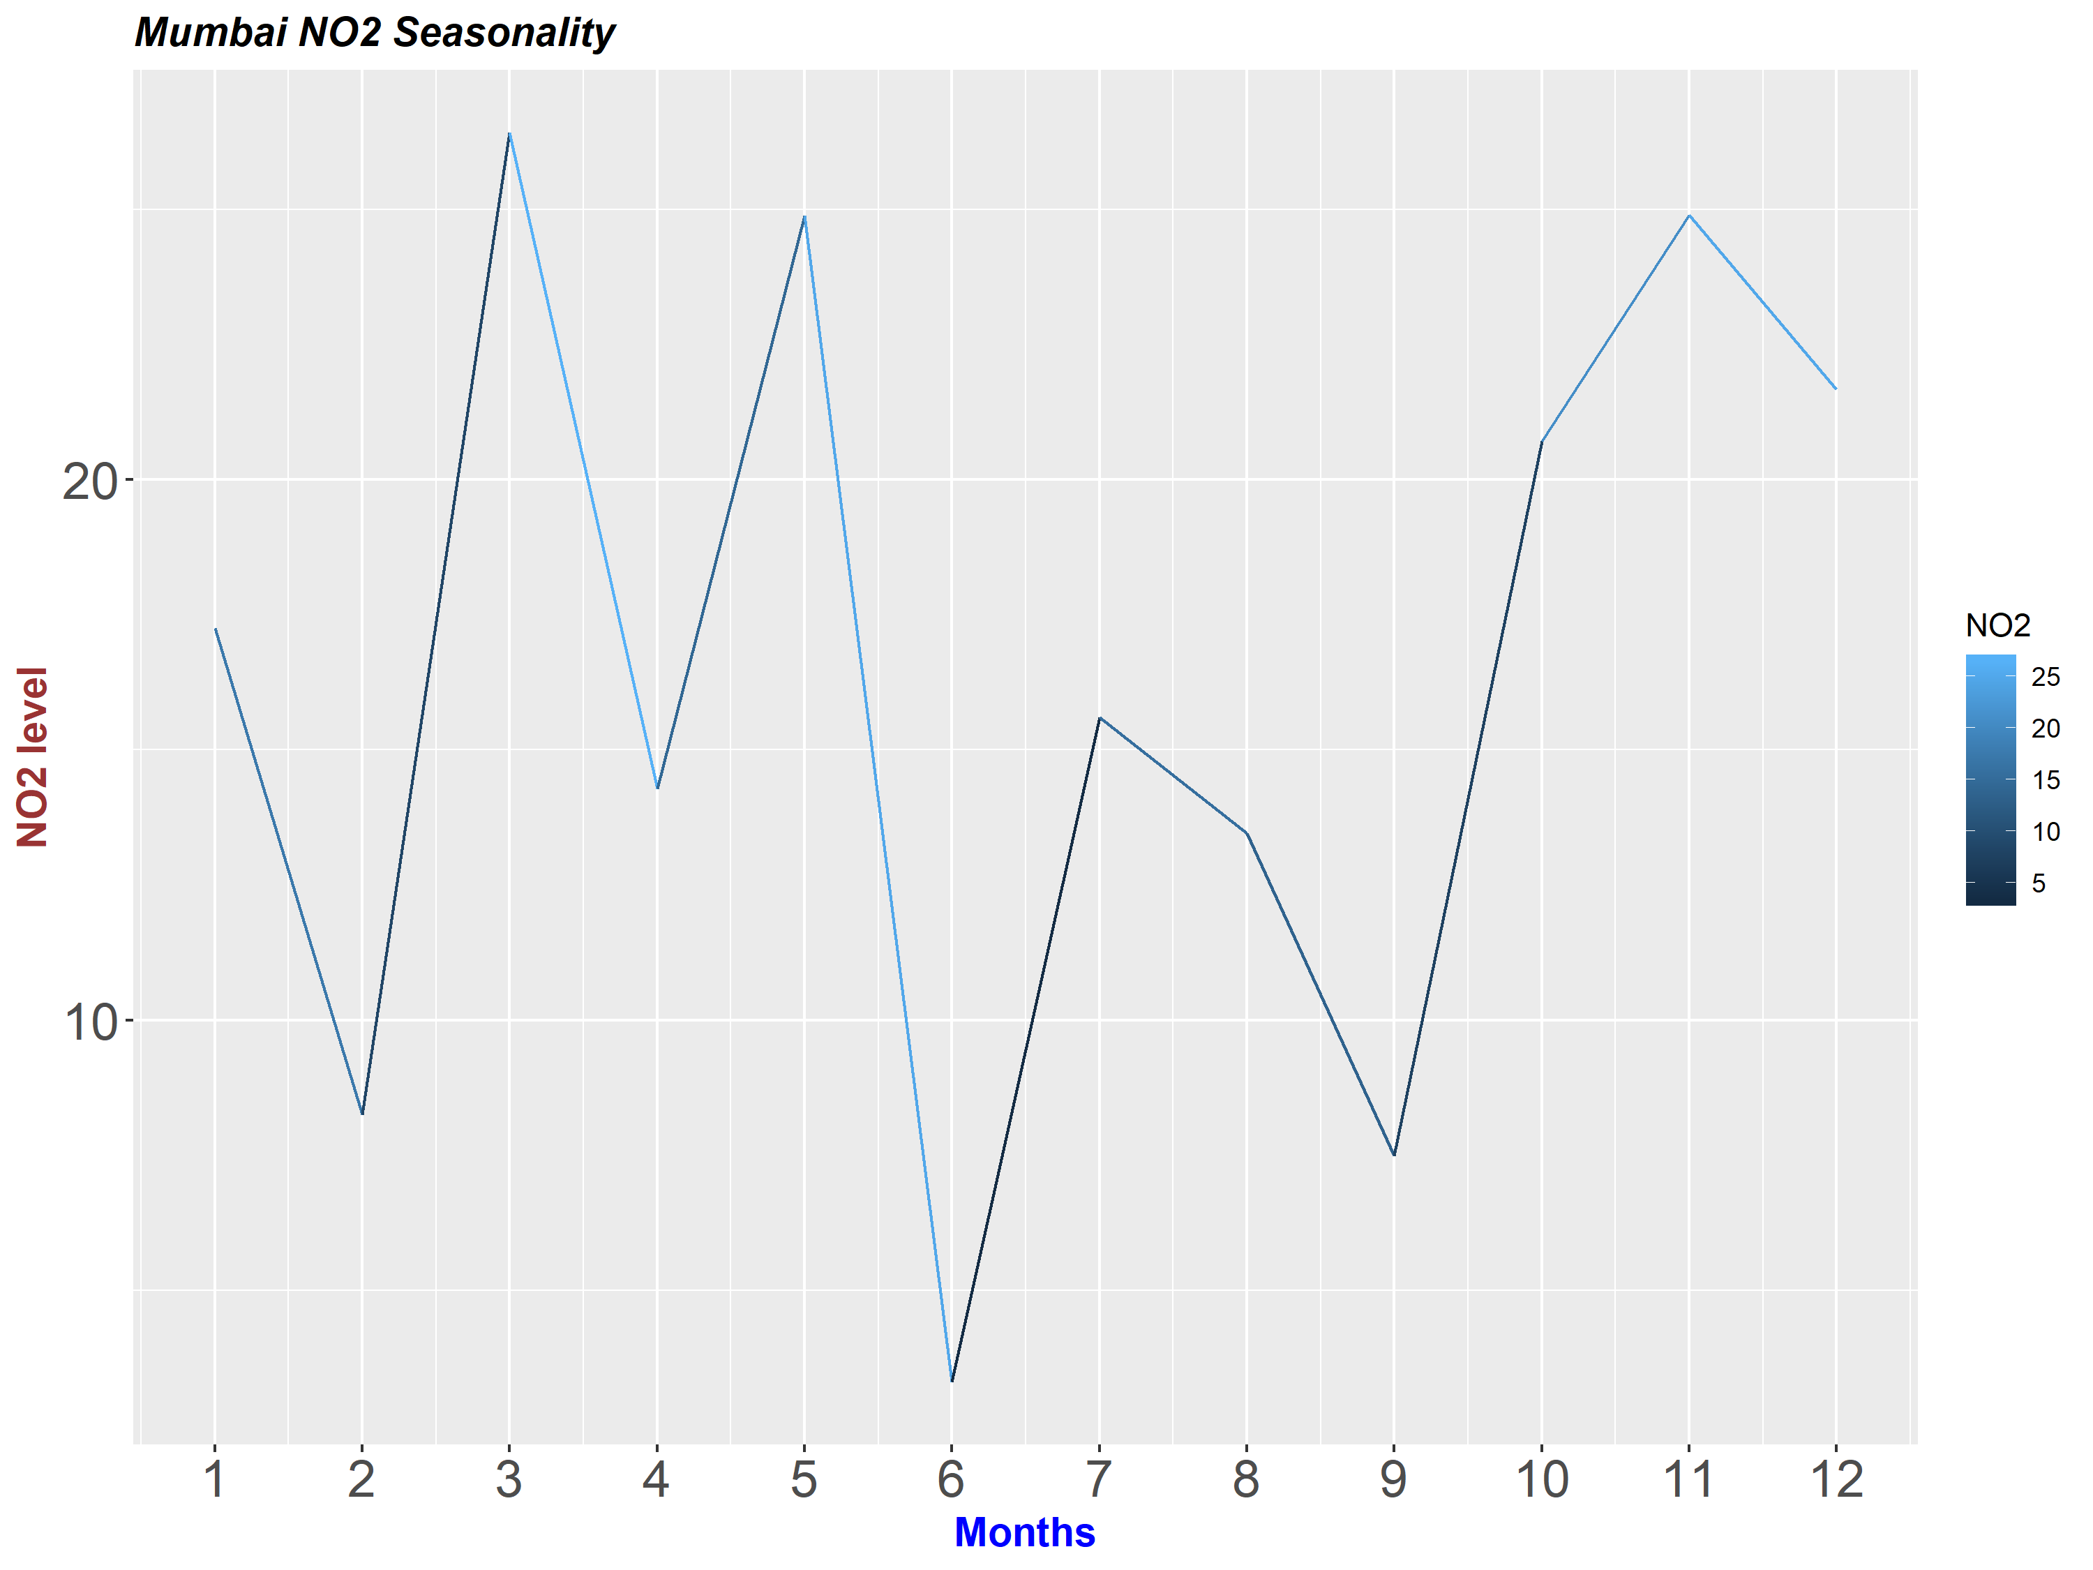
Timeseries-seasonality
Pune NO2 Seasonality
Monsoon season seems the lowest level of pollutant, due to scrubbing nature of rainfall
Post monsoon there is a sharp rise
Pune :
NO2 Nov-April for half of the year rise above acceptable Indian & WHO standards
NO2 : Levels start to drop down in mid summer as we approach rainy sea
SO2 : Winter sees the highest level during Jan & Feb
Mumbai :
NO2 : Sees a lots of variability with even summer seeing spikes in march & may
SO2 seasonal pattern changes over 9 years at a slower rate to NO2 which change in 7 years.
Mumbai NO2 Seasonality
Notes:
Insert a picture of an animal and or plant found in your country.

Slide 11
Conclusion - Findings
Monsoon- Rainy season scrubbing ensure the lowest pollution
Post-Monsoon there is shape spike, leading into higher levels in winter
Mumbai, commercial hub is far less polluted than Pune, owing to closeness to the sea
Pune NO2 levels or half year(post-monsoon till winter)and SO2 for winter months of Jan & Feb see pollutant levels beyond WHO standards.
Progression of a city is a factor as all other cities show similar but lower levels compared to the two metro’s.
SPM2.5/10 both pollutant need urgent attention as their level are far above acceptable Indian and Who standards
SO2 follows its own pattern unlike any other pollutants ,Source:18 coal-based power plants consistent. Chandrapur is a prominent example
Notes:
Add key points in the history of your country to the timeline.

Slide 12
Future Steps
Aurangabad increasing pollution levels warrants details studies, learning from there will help plan better
Analyzing the health related impact of these pollutant with the acquired knowledge of seasonal behavior
Might help in stocking medication & under arrangements
SO2 sources and their correlation with coal-based power sources
Common Sources of NO2 & SPM10
Additional or stricter pollution control measure exploration for post monsoon & winter higher levels
Notes:
Insert a picture illustrating a custom or tradition here.

