Slide 1
Agent Performance Reporting Solution (APRS)
Architecture Design Review

Slide 2
Data Warehouse Reference Architectures

Slide 3
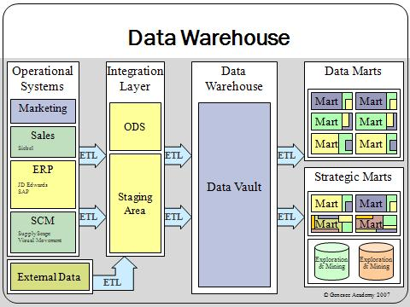
[1] http://en.wikipedia.org/wiki/File:Data_warehouse_overview.JPG

Slide 4
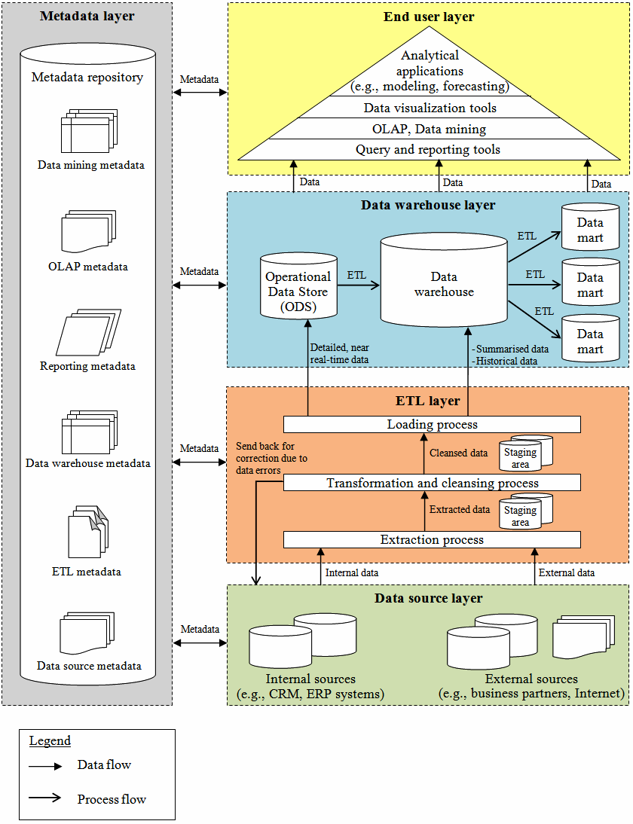
[2] http://www.ibimapublishing.com/journals/CIBIMA/2011/695619/695619.pdf

Slide 5
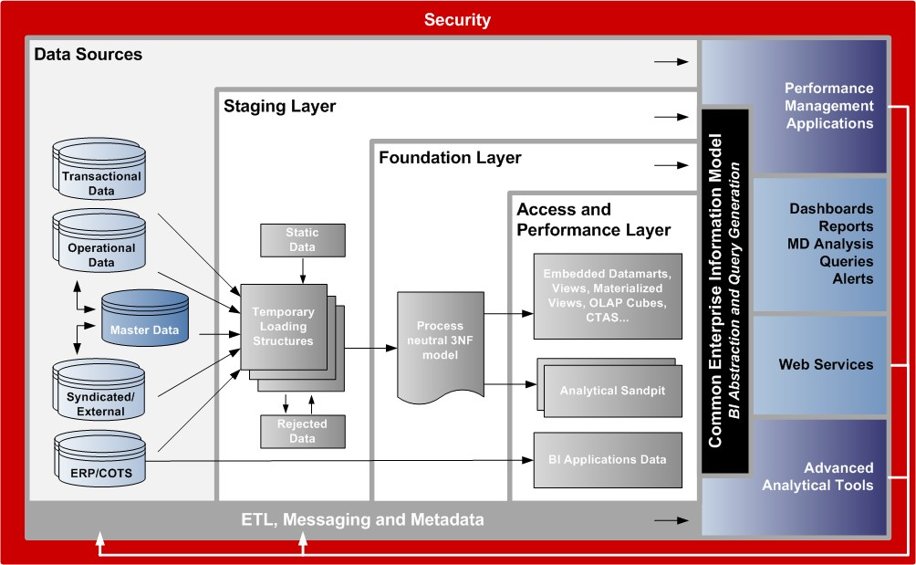
[3] http://www.oracle.com/us/solutions/datawarehousing/058925.pdf

Slide 6
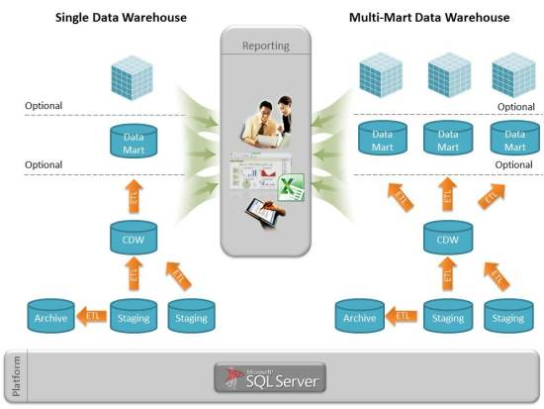
[3] http://dwjunkie.wordpress.com/2011/09/26/data-warehouse-reference-architecture/

Slide 7
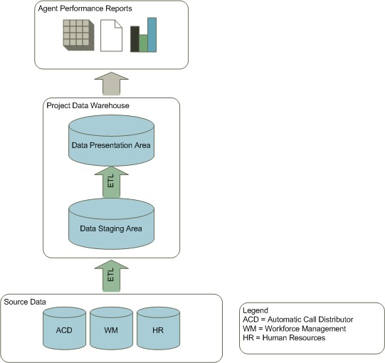
Texas Architecture

Slide 8
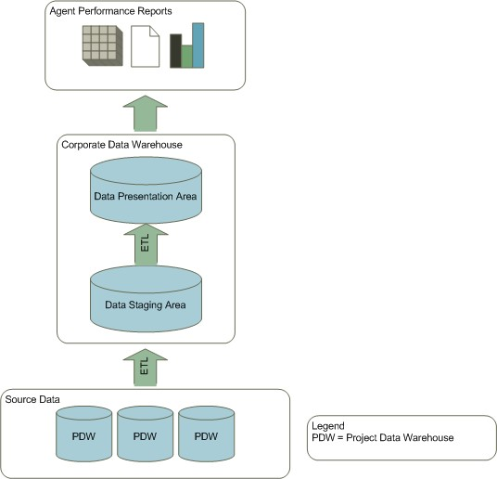
Proposed Corporate Data Warehouse Architecture

Slide 9

The source data for the Corporate Data Warehouse are the Project Data Warehouses
Unless a lower level of granularity is necessary, the source tables will be the dimensional tables from the project data warehouses

Slide 10
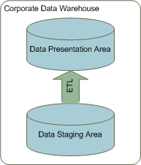
The Corporate Data Warehouse is comprised of 2 distinct layers.
Data Staging Area
Data Presentation Area

Slide 11
Data Staging Area
The staging area serves to load data into the data warehouse as quickly and efficiently as possible
Data in the staging area will be a copy of the dimensional tables from the project data warehouses.
Temporary landing tables will be used to load data into the staging area for failover purposes.

Slide 12
Data Presentation Area
The data presentation area is comprised of the dimensional tables used for reporting and analytical purposes.
Data will be rolled up to the project level by day.
In the case that additional business areas are added to the corporate data warehouse, they will be added as separate data marts joined by conformed dimensions.

Slide 13
What is the relationship between APRS & EMRS?
Will they be co-located?
Will they share dimensions?

Slide 14
What is the vision for “MOTTS”?
Enterprise Data Warehouse?
Extract more information
Collection of corporate Data Marts?
Only extract dimensional model
What are the data retention requirements?

