Slide 1
Agent Performance Reporting Solution (APRS)
Architecture Design Review

Slide 2
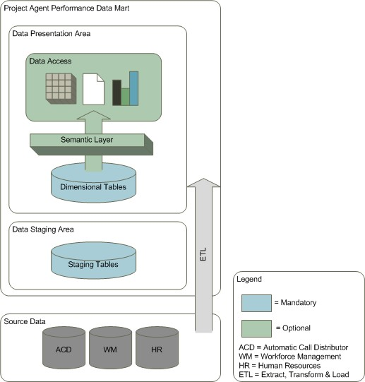
Project Agent Performance Data Mart
At the project level, Data is extracted from call center systems and loaded into a standard format for subsequent loading into the corporate data mart.
Optionally, projects may leverage pre-built presentation objects for project level reporting or build their own.

Slide 3
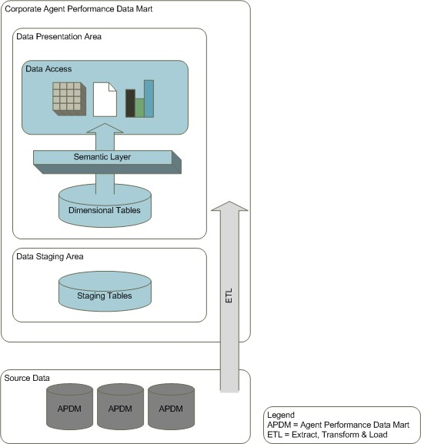
Corporate Agent Performance Data Mart
At the corporate level, agent performance data is extracted from the projects’ data marts for reporting on agent performance by project and date.
Historical data is retained for 60 months and then archived and purged.

Slide 4

Source Data
The source data for the corporate data mart are the projects’ Agent Performance data marts
Unless a lower level of granularity is necessary, the source data will be an aggregate by agent and day.

Slide 5
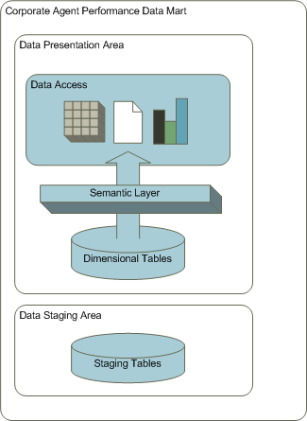
The Corporate Data Mart is comprised of 2 distinct layers.
Data Staging Area
Data Presentation Area

Slide 6

Data Staging Area
The staging area serves to load data into the data mart as quickly and efficiently as possible
Data in the staging area tables will be an extract from the dimensional tables in the project data marts.
Temporary landing tables will be used to load data into the staging area for failover purposes.

Slide 7
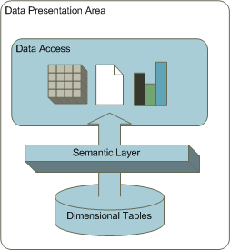
Data Presentation Area
The data presentation area is comprised of the dimensional tables and the semantic layer used for reporting and analytical purposes.
Data will be aggregated by project and date.

Slide 8

Data Access
Data access will be provided by MicroStrategy.
ROLAP cubes, reports and dashboards will leverage the dimensional tables in the data presentation area.

Slide 9
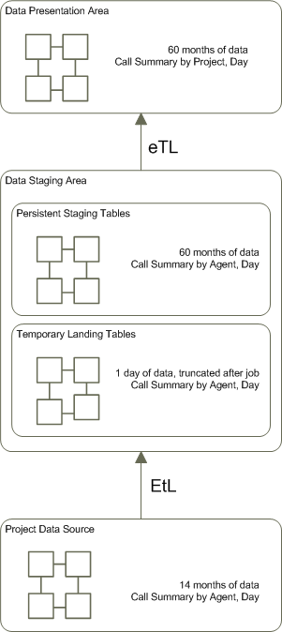
ETL Process
Assumptions
No need for normalized data
Temporary landing tables provide durability in the case of job failure
No transformation until data presentation area to retain flexibility in reporting capabilities
Data is retained for 60 months at the corporate level

