Slide 1
SNN. Patterns encoding
Chaplinskaya Nadezda
Sirius, 2022

Slide 2
Plan
A review of coding schemes.
Comparisons and discussions.
Brian2 realizations.

Slide 3
Sources
Auge D. et al. A survey of encoding techniques for signal processing in spiking neural networks //Neural Processing Letters. – 2021. – Т. 53. – №. 6. – С. 4693-4710. https://link.springer.com/article/10.1007/s11063-021-10562-2
Guo W. et al. Neural coding in spiking neural networks: A comparative study for robust neuromorphic systems //Frontiers in Neuroscience. – 2021. – Т. 15. – С. 638474. https://www.readcube.com/articles/10.3389/fnins.2021.638474

Slide 4
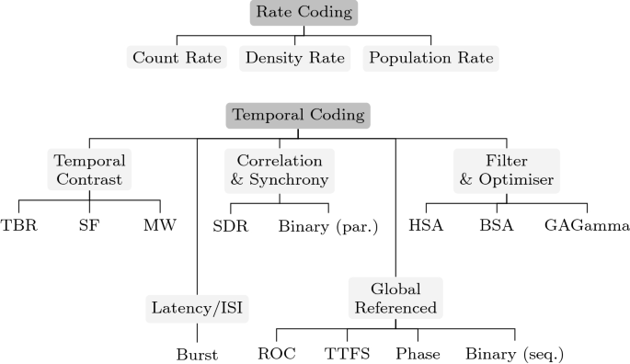
Variety of coding schemes

Slide 5
Variety of coding schemes

Slide 6


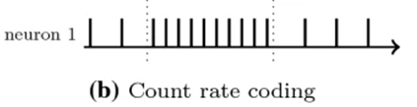

Rate Coding
Count rate (average over time)
The mean firing rate:
$N_{spike}−$ the number of spikes
$T−$ the time window

Slide 7

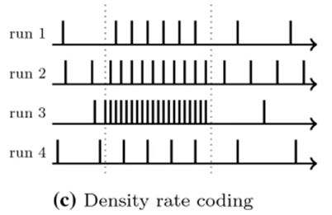

Rate Coding
Density rate (average over several runs)
The spike density:
$N_{spike}−$ the number of spikes over all iterations
$K−$ the total number of iterations
$∆t −$ the duration
// is not biologically plausible

Slide 8

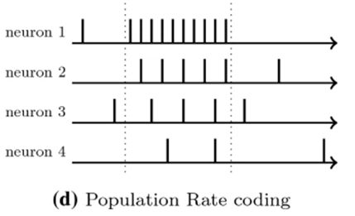

Rate Coding
Population rate (average over several neurons)
The firing rate:
$N_{spike}−$ the number of spikes in the total population
$N−$the total number of neurons
$∆t −$ the duration

Slide 9

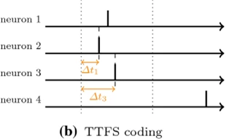
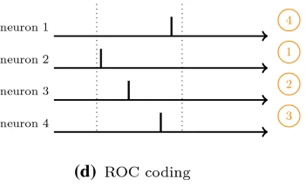
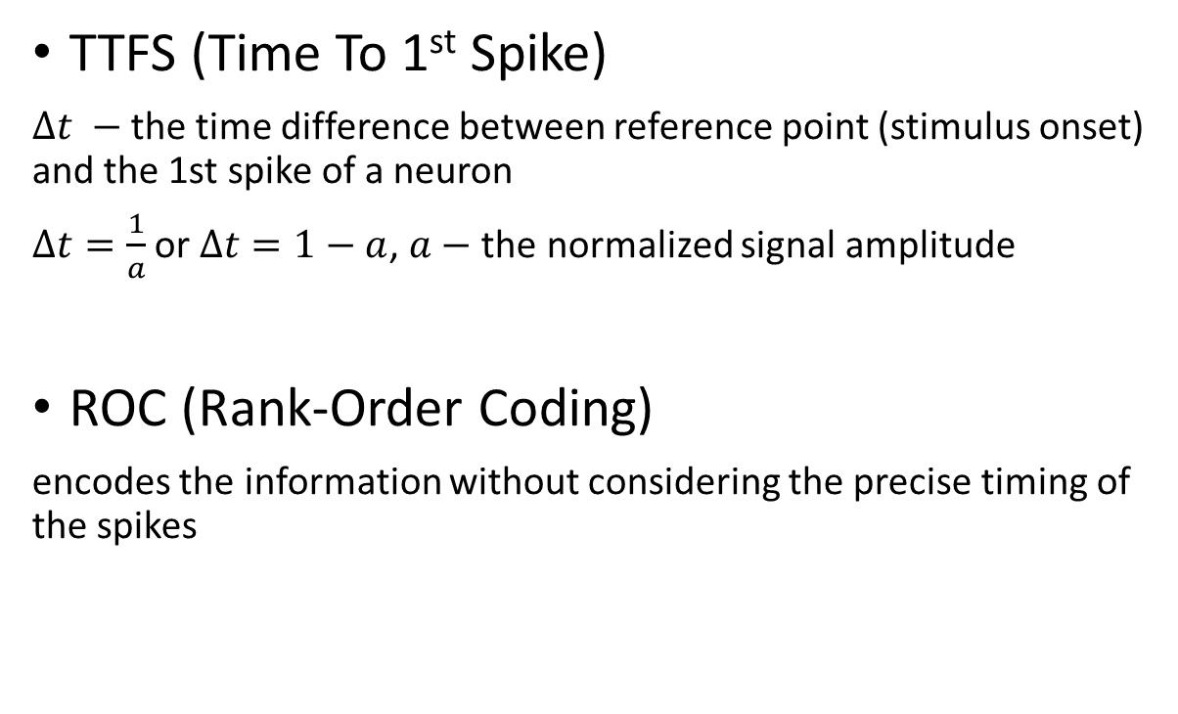
Temporal Coding Global Referenced
TTFS (Time To 1st Spike)
$∆t −$ the time difference between reference point (stimulus onset) and the 1st spike of a neuron
$∆t=\frac{1}{a}$ or $∆t=1−a$, $a−$ the normalized signal amplitude
ROC (Rank-Order Coding)
encodes the information without considering the precise timing of the spikes

Slide 10
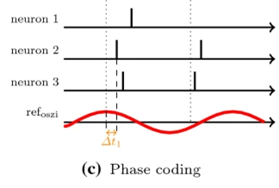
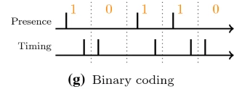
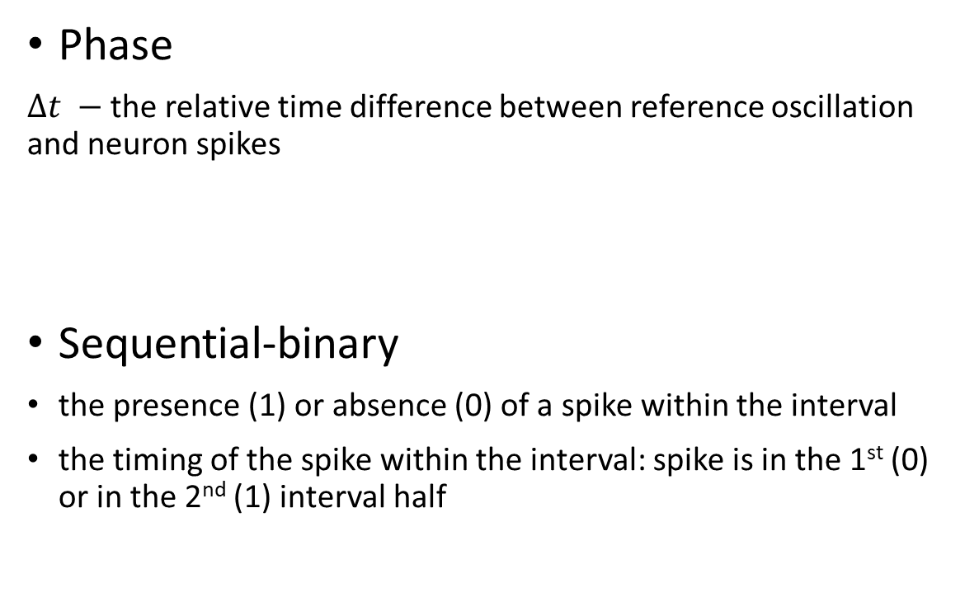
Temporal Coding Global Referenced
Phase
$∆t −$ the relative time difference between reference oscillation and neuron spikes
Sequential-binary
the presence (1) or absence (0) of a spike within the interval
the timing of the spike within the interval: spike is in the 1st (0) or in the 2nd (1) interval half

Slide 11
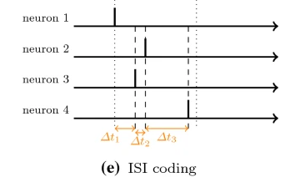
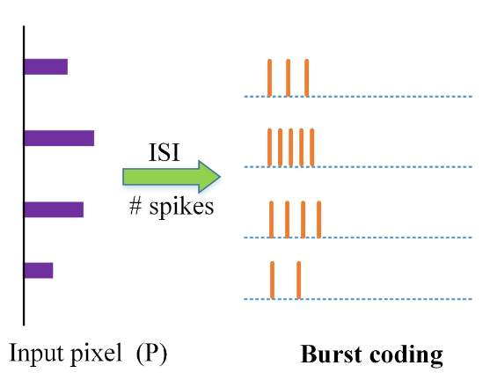
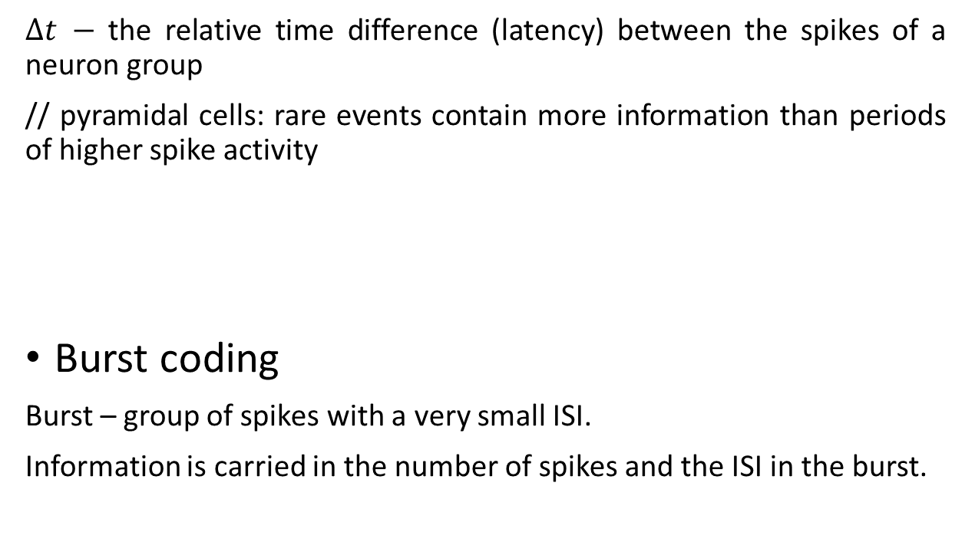
Temporal Coding ISI (Inter-Spike-Interval) or Latency
$∆t −$ the relative time difference (latency) between the spikes of a neuron group
// pyramidal cells: rare events contain more information than periods of higher spike activity
Burst coding
Burst – group of spikes with a very small ISI.
Information is carried in the number of spikes and the ISI in the burst.

Slide 12
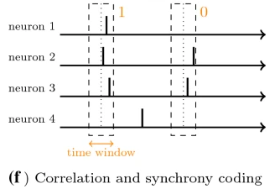
Temporal Coding Correlation and Synchrony
Information is encoded by the distinction of which neurons fire at the same time.
SDRs (Sparse Distributed Representations)
A subset of neurons inside a population is active at any given point of time.
Parallel-binary
Each neuron encodes a specific bit within a larger word.

Slide 13
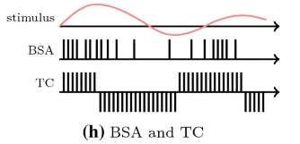
Temporal Coding Filter and Optimizer-based Approaches
BSA (Ben’s Spiker Algorithm) or HSA (Hough Spiker Algorithm)
Use a known filter to compute a spike train for a corresponding input signal.
A spike is generated as soon as the convolution of signal and filter exceeds a certain threshold.
GaGamma
https://link.springer.com/chapter/10.1007/978-3-319-27212-2_9

Slide 14
Temporal Coding Temporal Contrast
Converts an analog signal to a spike train by observing the changes in the signal intensity.
TBR (Threshold-Based Representation)
TBR compares the absolute signal change of an input signal with a threshold and emits positive or negative spikes accordingly.
SF (Step-Forward)
SF uses the next available signal value and checks if the previous value and an additional threshold is exceeded.
MW (Moving-Window)
MW uses a base which is defined by the mean of the previous signal in a time window.

Slide 15
Rate Coding VS Temporal Coding
averages the spike activity over time, populations, or several runs
(+) is robust against fluctuations and noise
(+) simplicity of implementation
(-) generates a huge number of spikes, resulting in high energy consumption and a long inference delay
(-) is less biologically plausible*
relies on the precise timing of every single spike
(-) is very sensitive to fluctuations and noise
(-) involves more complex architectures and lacking training methods
(+) achieves higher information densities and efficiencies
(+) is more biologically plausible
*It has been shown that the human visual system needs 150ms to process object recognition tasks – rate codes would be too slow to explain these fast responses. Further research supports these findings for visual, audio, tactile, and olfactory systems.

Slide 16
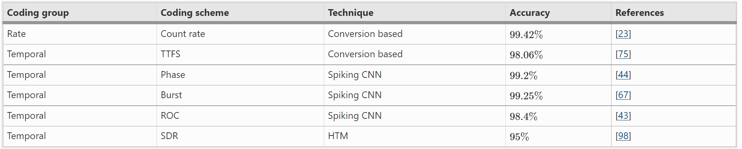
Comparison between MNIST classification implementations with different coding schemes
[23] Esser SK, Appuswamy R, Merolla P, Arthur JV, Modha DS (2015) Backpropagation for energy-efficient neuromorphic computing. In: Advances in neural information processing systems, pp. 1117–1125
[75] Rueckauer B, Liu SC (2018) Conversion of analog to spiking neural networks using sparse temporal coding. In: 2018 IEEE international symposium on circuits and systems (ISCAS), pp. 1–5 . https://doi.org/10.1109/ISCAS.2018.8351295
[44] Kim J, Kim H, Huh S, Lee J, Choi K (2018) Deep neural networks with weighted spikes. Neurocomputing 311:373–386. https://doi.org/10.1016/j.neucom.2018.05.087 Publisher: Elsevier
[67] Park S, Kim S, Choe H, Yoon S (2019) Fast and efficient information transmission with burst spikes in deep spiking neural networks. In: 2019 56th ACM/IEEE design automation conference (DAC), pp. 1–6. IEEE (2019)
[43] Kheradpisheh SR, Ganjtabesh M, Thorpe SJ, Masquelier T (2018) STDP-based spiking deep convolutional neural networks for object recognition. Neural Netw 99:56–67
[98] Truong SN, Pham KV, Min KS (2018) Spatial-pooling memristor crossbar converting sensory information to sparse distributed representation of cortical neurons. IEEE Trans Nanotechnol 17(3):10

Slide 17
Brian2 realizations
See the lesson Seminar 3. Patterns encoding: Brian2 realizations in
Jupiter Notebook: Seminar 3. Coding.ipynb
Github: https://github.com/nadya1462/sirius_2022

