Slide 1
Dead Code Elimination
Maxwell Schaefer and Ulises Soto

Slide 2
What Is Dead Code Elimination?
Dead Code Elimination increases performance in two main ways:
It decreases compiled code size by removing unnecessary instructions.
It increases performance since unnecessary instructions won’t be run.

Slide 3
Non-optimized | Optimized with Pass
int main() { int x = 10; int y = 20; return x; x = x + y; } | int main() { int x = 10; return x; }
int main() { int x = 0; if (x == 0) x = 10; return 0; } | int main() { return 0; }

Slide 4
Function
A function is the basic building block of the AST
The pass is ran for each function independently
Statement
Assignment
If
Expression
And
Or
While
For
Block
Variable
Constant
Call
Each function maintains a live list
return

Slide 5
Implementation
The implementation works through a recursive call of the RemoveDead() function.
This function works differently for each of the three layers of the AST outlined previously.
The pass is run independently on each function.
The pass works by constructing a set of live variables by working backwards from the return at the end of a function.
This works since there are no global variables allowed in this grammar.

Slide 6
int main(int x)
{
int a;
int b;
a = b + 2;
if(a == x)
{
b = b + 1;
}
return a;
}
Live | Dead
return a; // Alive
a
b, x
if(a==b) b = b + 1; // Dead
a
b,x
a = b + 2; // Alive
b
a

Slide 7
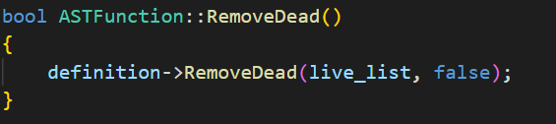
Functions

Slide 8
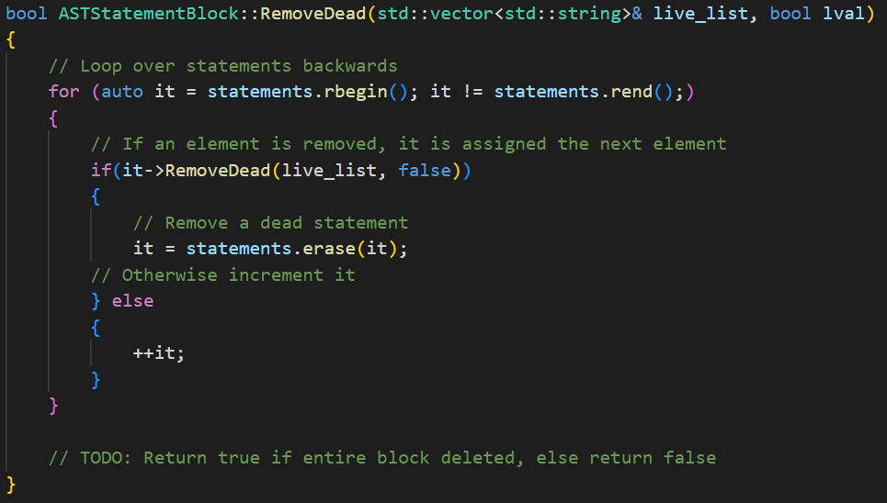
Statement Blocks

Slide 9
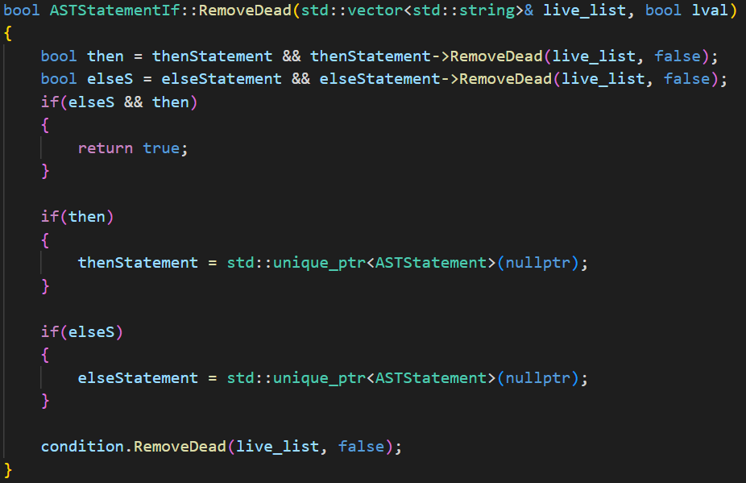
Statement

Slide 10
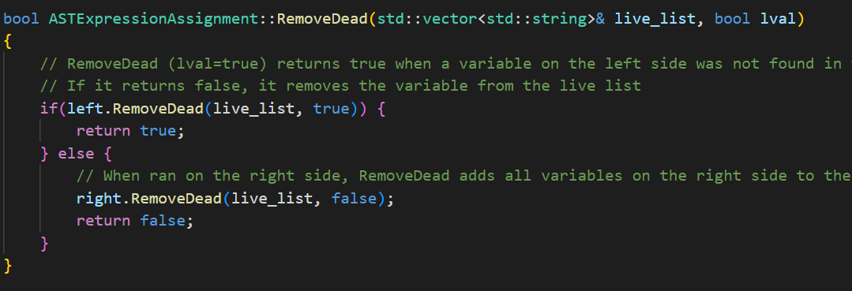
Assignments

Slide 11
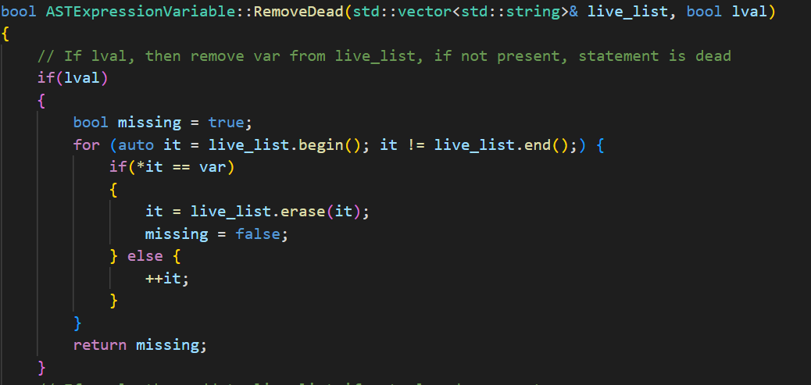
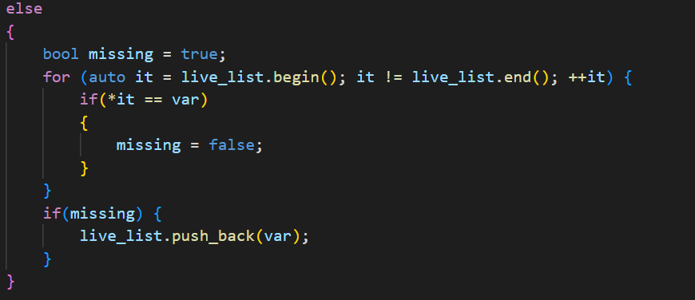

Slide 12
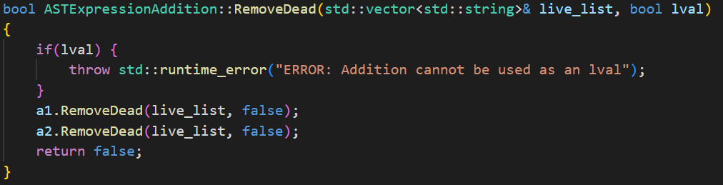
Expressions

Slide 13
Removing unused variables
Variables are only declared at the beginning of functions
After RemoveDead() is ran, another pass will be run on the functions, and removing any stack allocations for variables which are now unused.

Slide 14
Results
We haven’t completed the implementation yet, so results are pending
However, this could make substantial changes to the AST of a program.
Though, it won’t make much of a difference to an ideally written one.
However, we will test it on a sorting algorithm with unnecessary additions, ran on a large set, to see the effects of these unnecessary additions on the code.

