Slide 1

An Enhanced Genetic Algorithm for Web Service Location-Allocation Problem
Hai Huang, Hui Ma, Mengjie Zhang
Evolutionary Computational Research Group
School of Engineering and Computer Science
Victoria University of Wellington, New Zealand
25/03/15
DEXA2014
<number>
Notes:
<number>

Slide 2

Introduction
Service-oriented computing (SOC) provides a new paradigm for
software engineering
complex functionality can be obtained by combining existing services
to reuse existing services so that new software applications can be developed in an agile and cost-efficient way
The location of services plays an important role to minimizing the services response time and therefore improving quality of services (QoS)
To minimize response time it is tempting to deploy multiple instances of atomic services to different locations
However, it is likely to boost the operational costs for the service providers
25/03/15
DEXA2014
<number>
Notes:
<number>

Slide 3
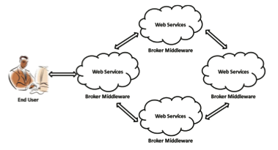
Introduction
The aim of service location-allocation is to find optimal locations for deploying web service instances such that the overall response time becomes minimal for a target user group while restricting overall service cost
known to be a NP-hard optimization problem
the number of possible service location-allocation increases exponentially with the increasing number of web services and locations
25/03/15
DEXA2014
<number>
Notes:
<number>

Slide 4
Related Work
Existing approaches to QoS-aware service composition have
shortcomings:
integer linear programming: exponential computation effort, and
practicability is limited
Genetic programming (GA) has been successful in computing
satisfactory solutions to search and optimization problems
Classical Genetic Algorithm (GA): poor convergence rate and premature peculiarity
This paper proposes an enhanced GA-based approach to efficiently obtain nearly-optimal web service location-allocation
Minimize the aggregate response time and simultaneously restrict the service costs.
25/03/15
DEXA2014
<number>
Notes:
<number>

Slide 5
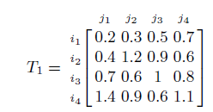


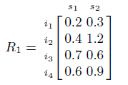
Problem Description
Response time calculation
Service response time matrix
Service location matrix
Examples
User response time matrix can be calculated using service response time matrix T and service allocation time matrix A
25/03/15
DEXA2014
<number>
Notes:
<number>

Slide 6
Problem Description
Service demands measure the importance of as atomic service s which is a component of some composite services A
depends on the frequency of composite services having s has its component and
its position composite services
Composite service demand is the ratio of frequency of service c over total number of service demand within a period of time,
Service position weight of a component service s in the workflow structure of composite service c
25/03/15
DEXA2014
<number>
Notes:
<number>

Slide 7


MFGA for Service Composition
Chromosome: service location matrix
Constraints:
Total number of service should not exceed a given number L
Each atomic service s should be allocated to a location
25/03/15
DEXA2014
<number>
Notes:
<number>

Slide 8
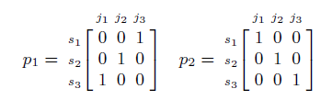

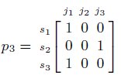
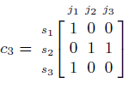
MFGA for Service Composition
Crossover
mutation
25/03/15
DEXA2014
<number>
Notes:
<number>

Slide 9




MFGA for Service Composition
Fitness function
Where
25/03/15
DEXA2014
<number>
Notes:
<number>

Slide 10
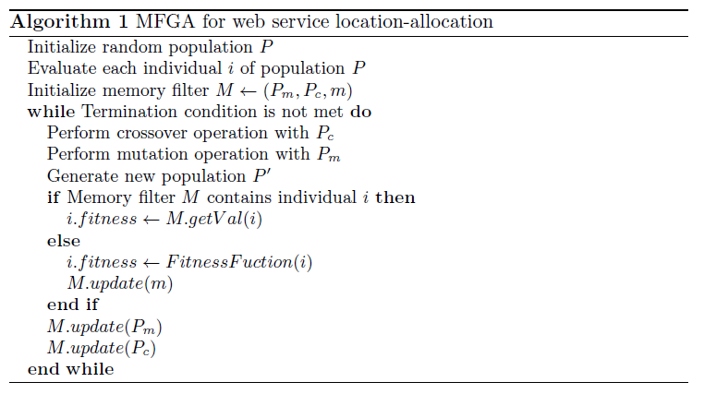
The GP-based Algorithm
25/03/15
DEXA2014
<number>
Notes:
<number>

Slide 11
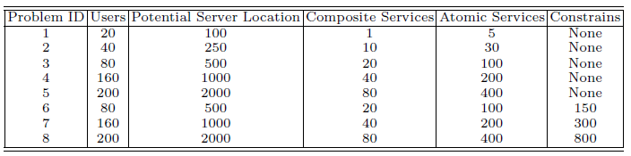
Design of Experiments
Test cases:
generate eight hypothetical service location-allocation problem, with different user numbers and service location numbers
Using existing dataset, WS-DREAM dataset, containing 339 users invoked 5824 web service scattered over the internet
Test environment: a personal computer with 2.3 GHz CPU and 4.0
GB RAM and 30 runs for each experiment.
Parameter settings:
population size 30, 50, 100, 200 and 300 for prob. 1 to 5 respectively
max no. of generations 50, 100, 500, 1000, 1500 for prob. 1 to 5 respectively
crossover prob. 0.6 and mutation prob. 0.2
Memory size m in MFGA: 20%
25/03/15
DEXA2014
<number>
Notes:
<number>

Slide 12
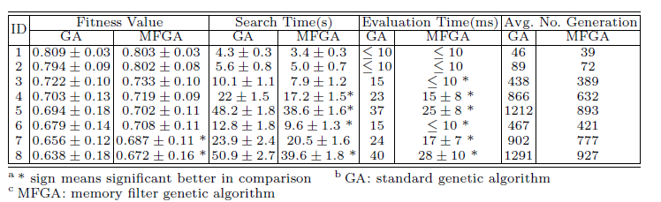
Experimental Results
The fitness values are normalized in the interval of [0, 1], the higher value of the fitness value the faster of the response time
25/03/15
DEXA2014
<number>
Notes:
<number>

Slide 13
Experimental Results
MFGA can significantly reduce search time for Problem 3-8
MFGA can obtain similar fitness for problem 1-5 and slightly better fitness for problem 6-8
25/03/15
DEXA2014
<number>
Notes:
<number>

Slide 14
Conclusions and Future Work
A enhanced GA-based approach for web service location- allocation problemis presented:
a self-adaptive strategy is utilized to dynamically adjust genetic operation possibility, so that better convergence of the evolutionary process can be achieved.
a memory filter is employed that greatly reduces the evaluation time while the diversity of the population
The experimental results demonstrate the effectiveness and
efficiency of our approach in computing near-optimal solutions for the web service location-allocation problem.
Future work will investigate the use of other evolutionary computation techniques in solving the service location-allocation problem
25/03/15
DEXA2014
<number>
Notes:
<number>

Slide 15



Questions?
Thank You
25/03/15
DEXA2014
<number>
Notes:
<number>

