Slide 1
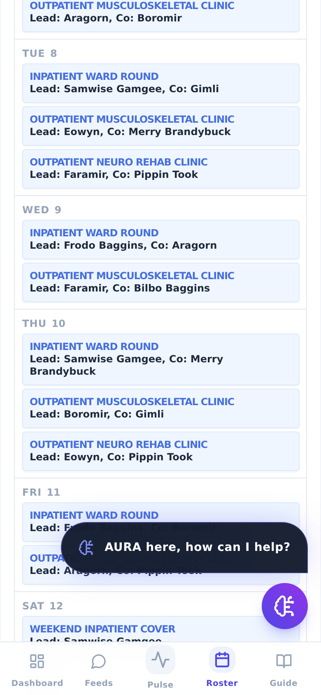
NEXUS
Try the roster for your team
A ten-minute, hands-on walkthrough for Allied Health leads.
Everything happens in a sandbox — nothing you do is saved, and no sign-in is needed.
nexus • v2.1.0 • August 2026

Slide 2
What you are about to try
NEXUS builds a duty roster from the rules you give it — grades, hours ceilings, duty needs — and shows the result as a calendar your team can read, swap on, and export. The demo runs on fictional data.
10 min
0 saved
AH7–AH17
Yours to keep
is all the tryout takes, on your phone or desktop
the sandbox stores nothing and needs no account
the allied-health grade scale is built in, with your own band boundaries
if it fits, register as a lead and bring your team in
The route, in eight steps: open the site → Demo → dashboard → Roster → Configure → your team → duties → Draft. Slides 3–10 walk each one, with the phone view beside the desktop view.
Nothing in this deck is a patient record. Every name you will see — Frodo, Samwise, Steve — is fiction shipped with the sandbox.

Slide 3
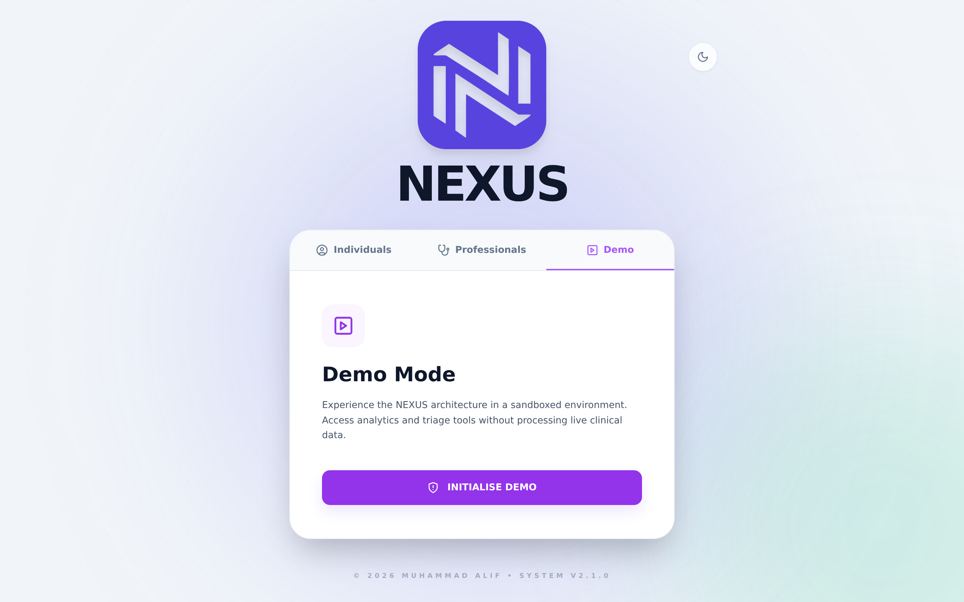
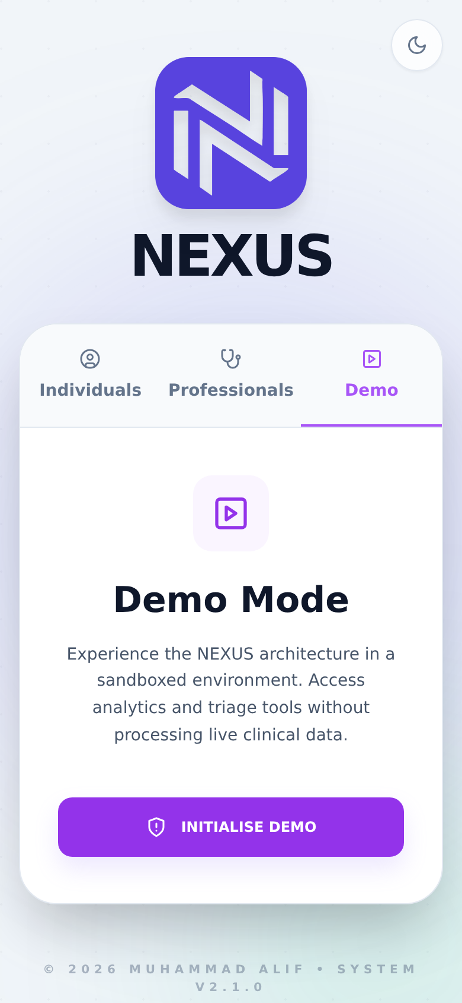
1
Open the site and pick the Demo door
Three tabs on the front door: Individuals (public health screening), Professionals (sign in / register), Demo.
Pick Demo, then INITIALISE DEMO.
No account, no email, nothing stored — the demo answers locally.
DESKTOP
MOBILE
Worth knowing The moon icon (top right) switches dark mode. Everything in this deck is light mode; both work on both devices.

Slide 4
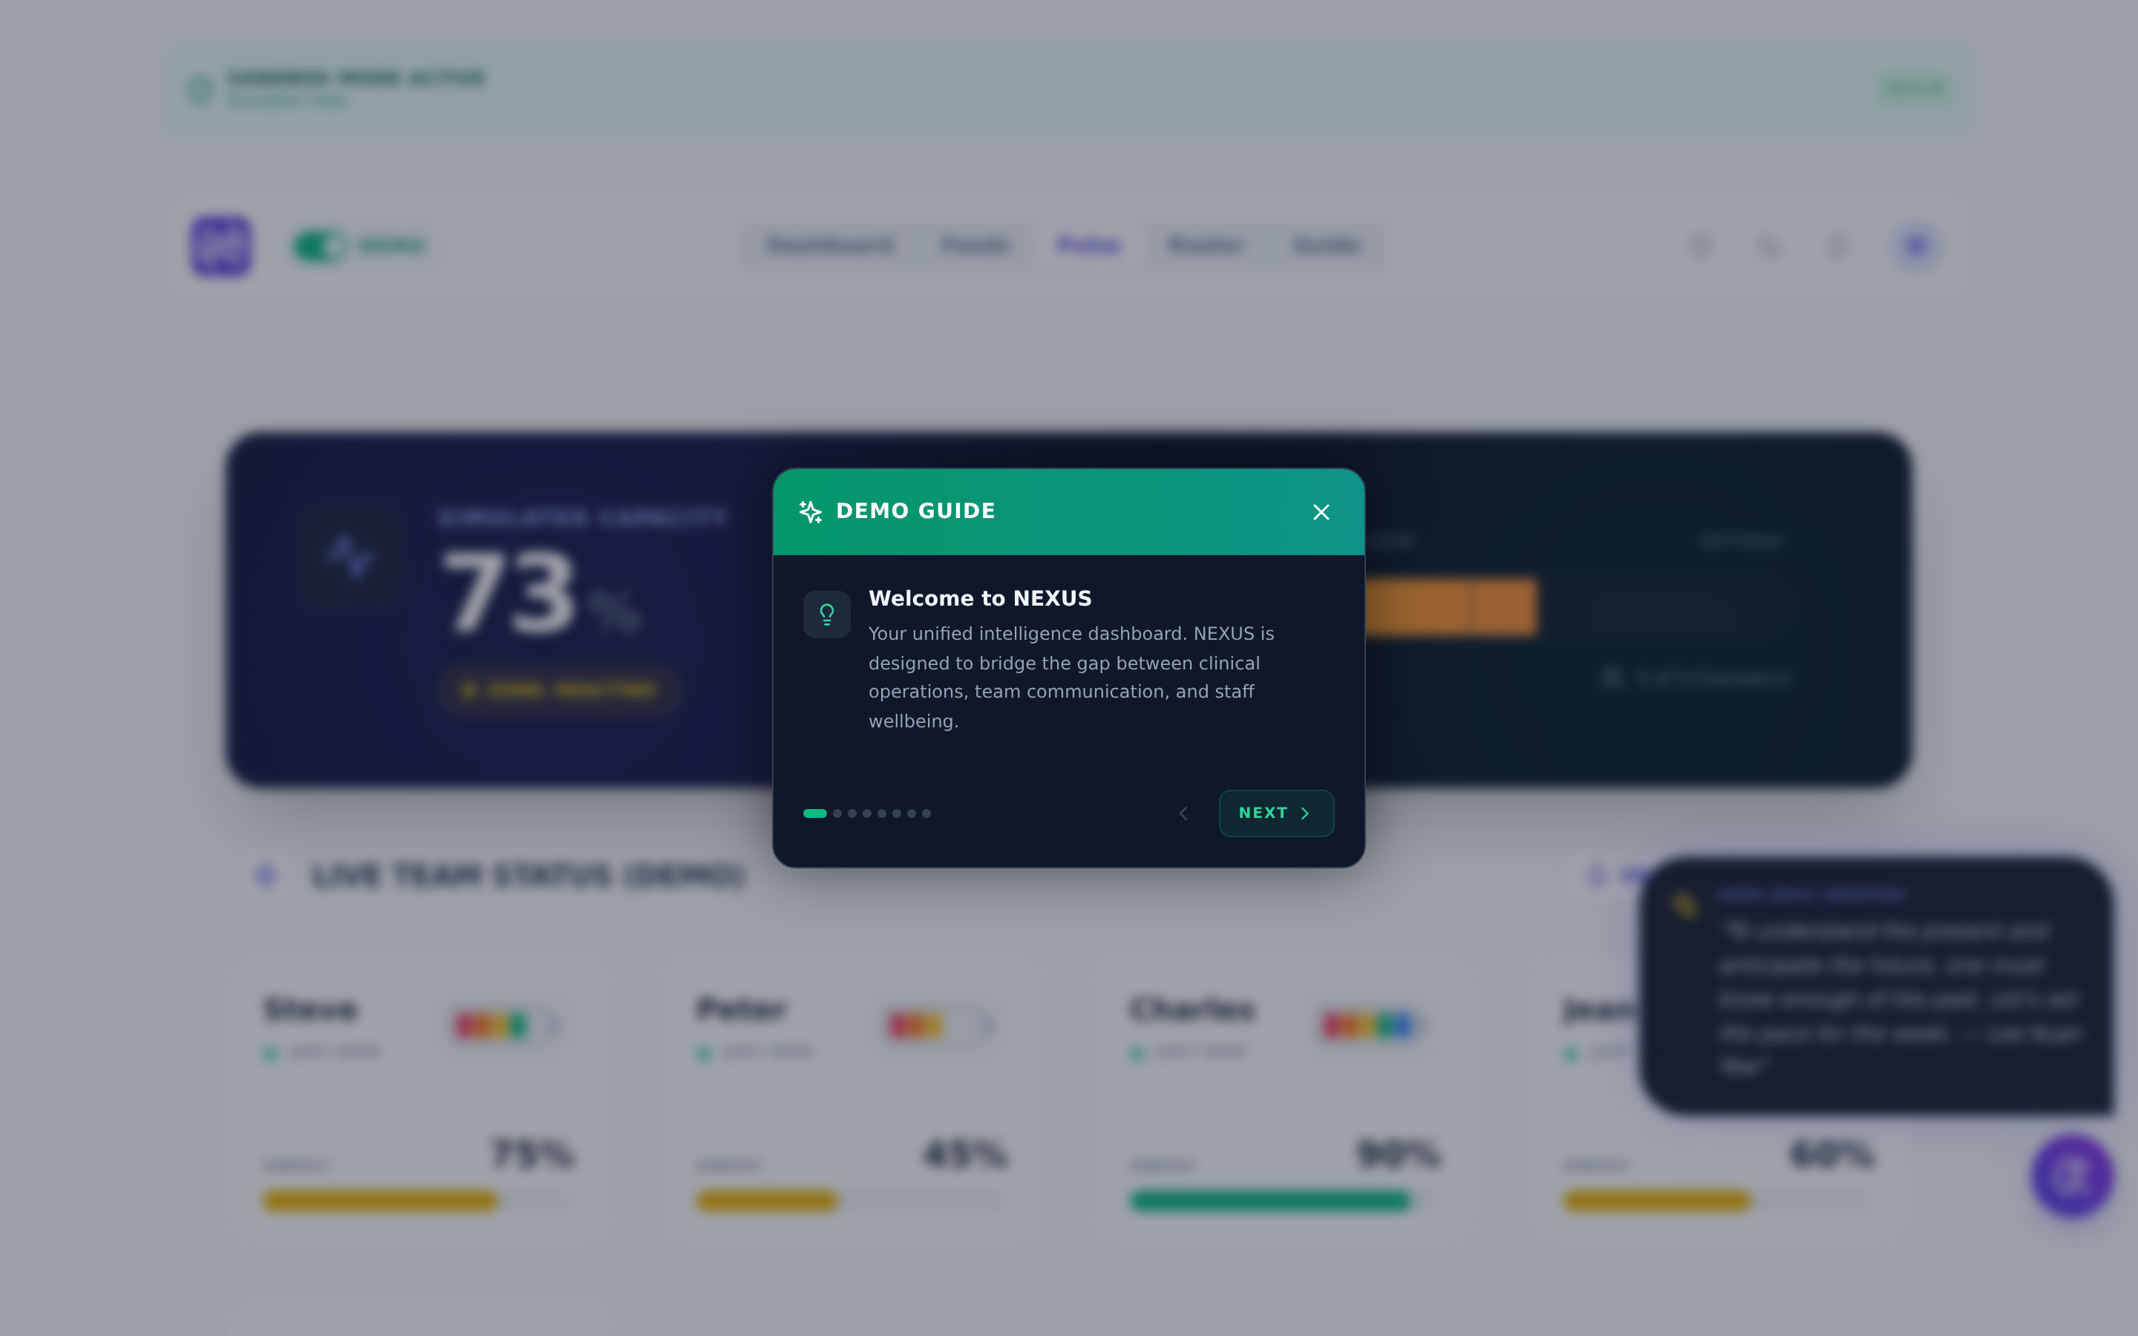
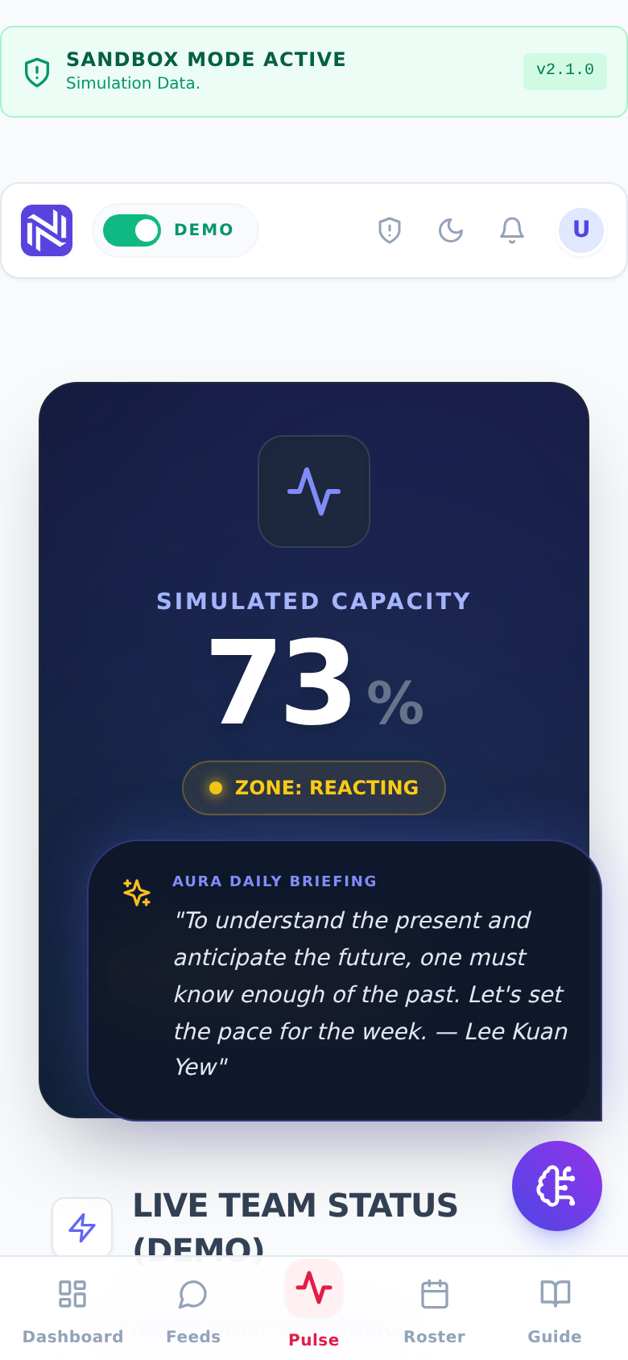
2
The guide greets you; the dashboard is behind it
A short guided tour opens first — Next through it, or close it and explore.
The dashboard shows a simulated team: capacity, wellbeing check-ins, a daily briefing.
The green SANDBOX MODE ACTIVE banner stays on screen the whole time.
DESKTOP
MOBILE
Worth knowing The Guide tab in the navigation reopens the tour any time.

Slide 5
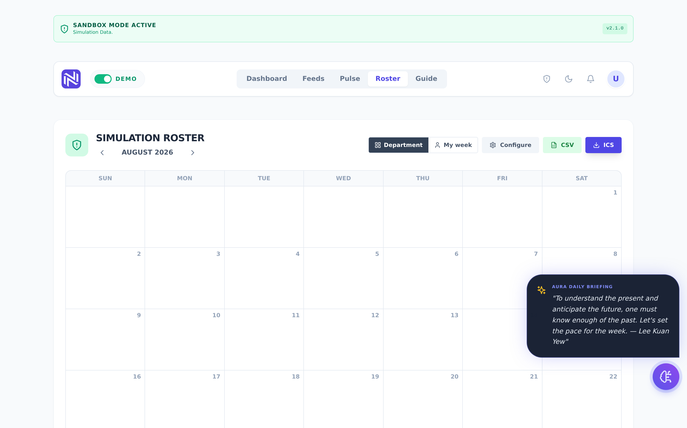
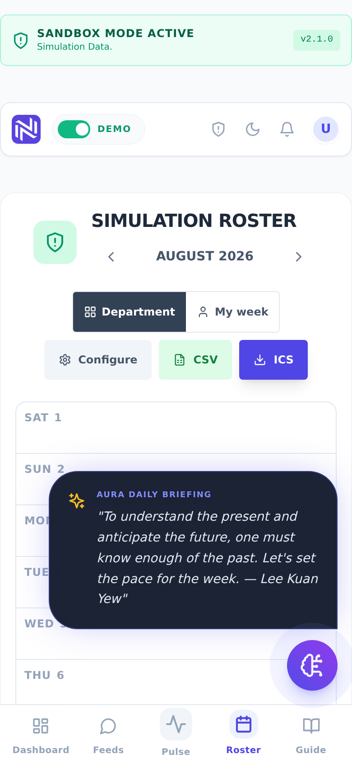
3
Open Roster — the calendar your team would live in
Department shows everyone; My week shows one person’s duties.
CSV and ICS export the roster to a spreadsheet or a calendar app.
Configure is where you describe YOUR service.
On the phone the same calendar stacks vertically — rosters are read at the bedside, not at a desk.
DESKTOP
MOBILE

Slide 6
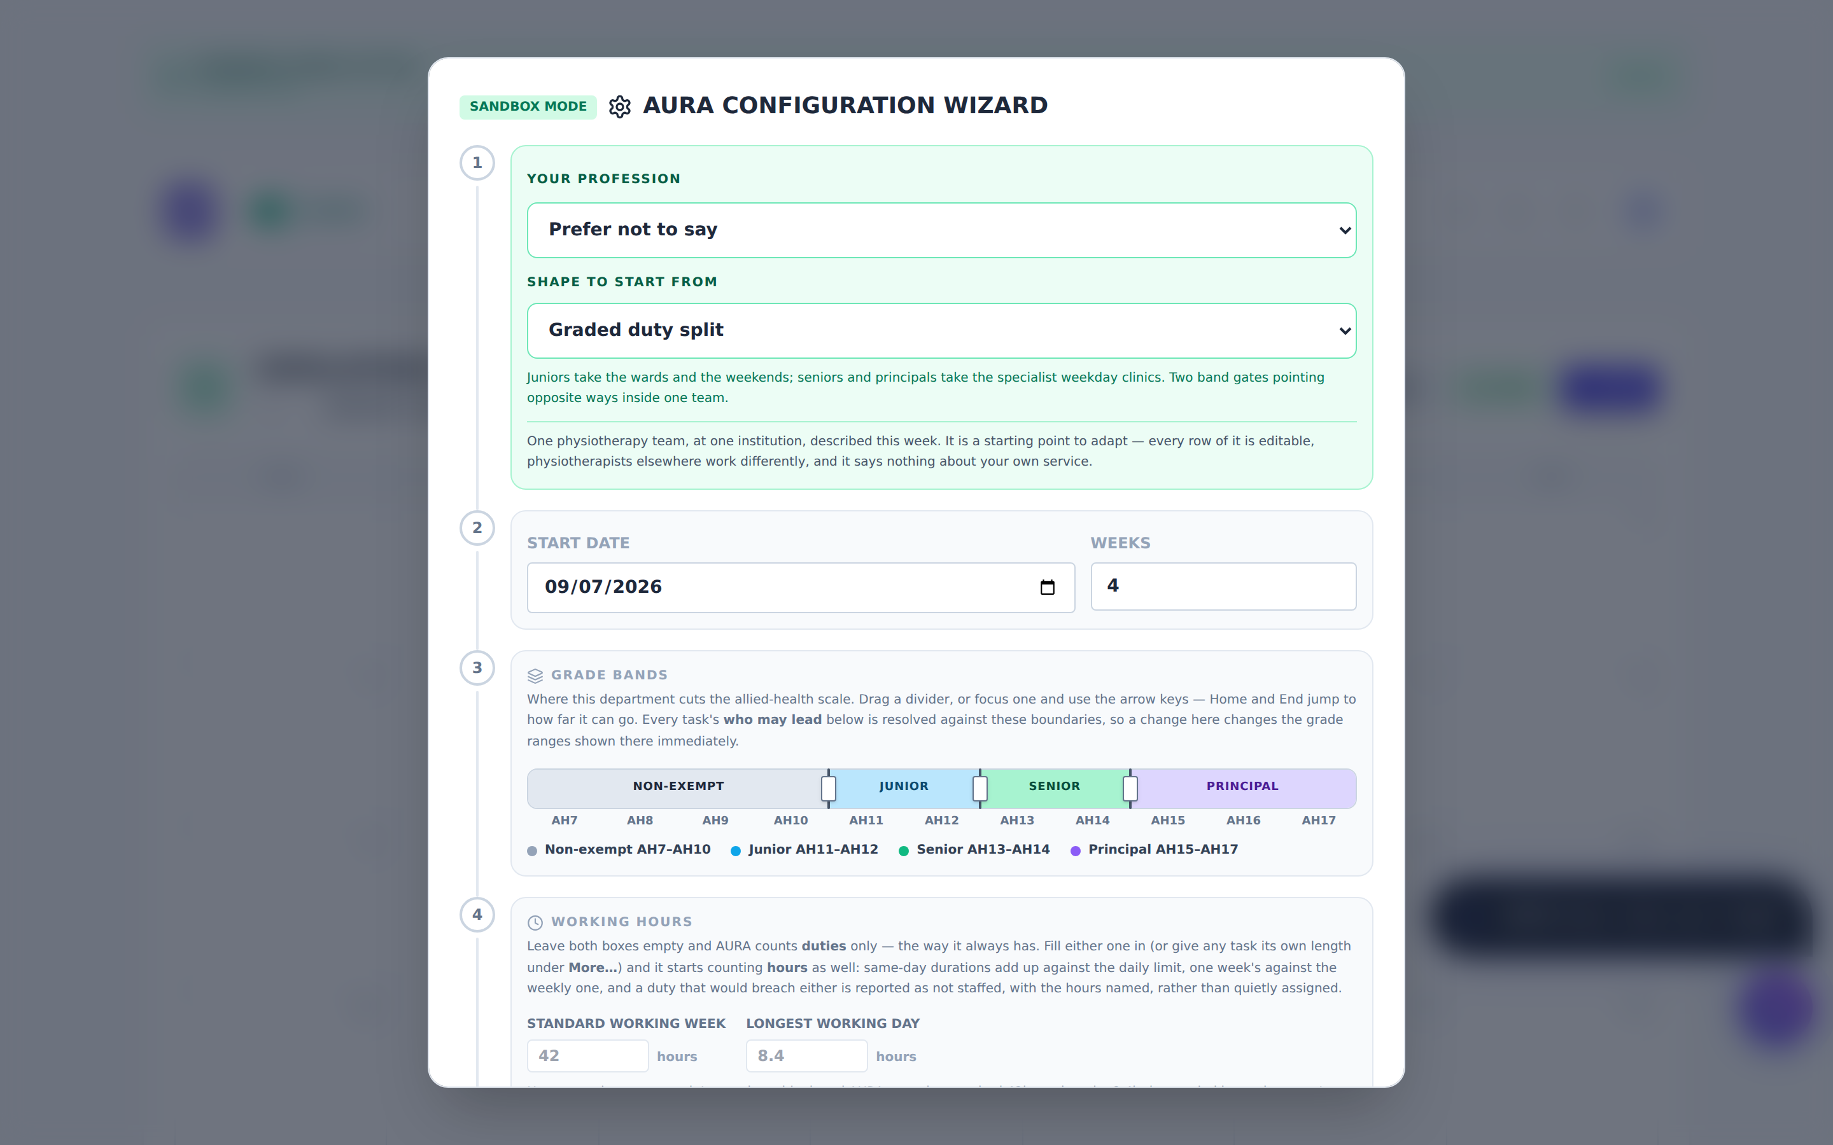
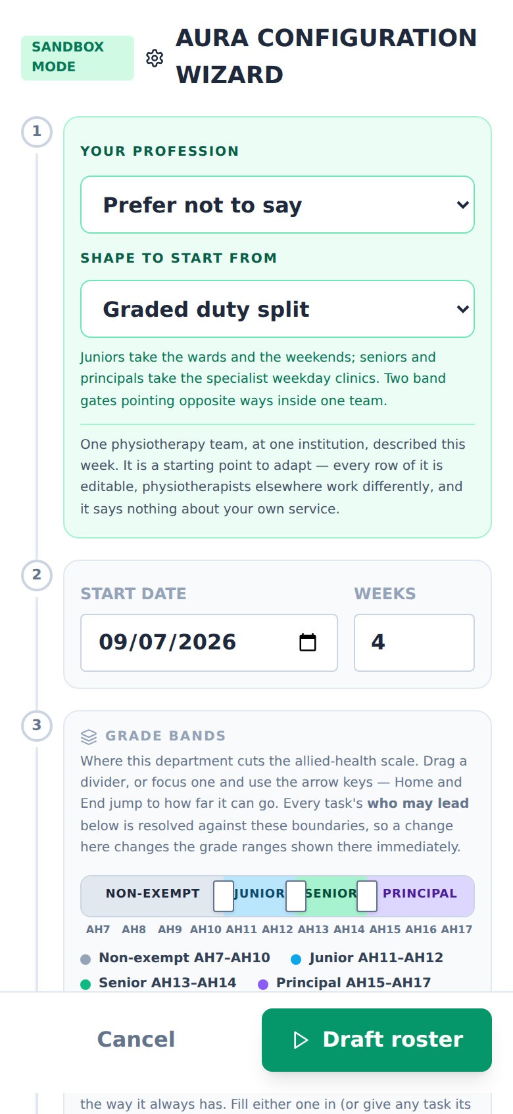
4
Configure: pick a shape to start from
Choose your profession (or don’t — it’s optional).
Pick a starting shape: graded duty split, specialist clinics, team rotation, weekend quotas, and more — or start blank.
Set the start date and how many weeks to plan.
Each shape is a worked example you edit, not a rule you inherit.
DESKTOP
MOBILE
Worth knowing The grade-band slider cuts AH7–AH17 into Non-exempt / Junior / Senior / Principal wherever YOUR department draws those lines. Every duty’s "who may lead" follows it.

Slide 7
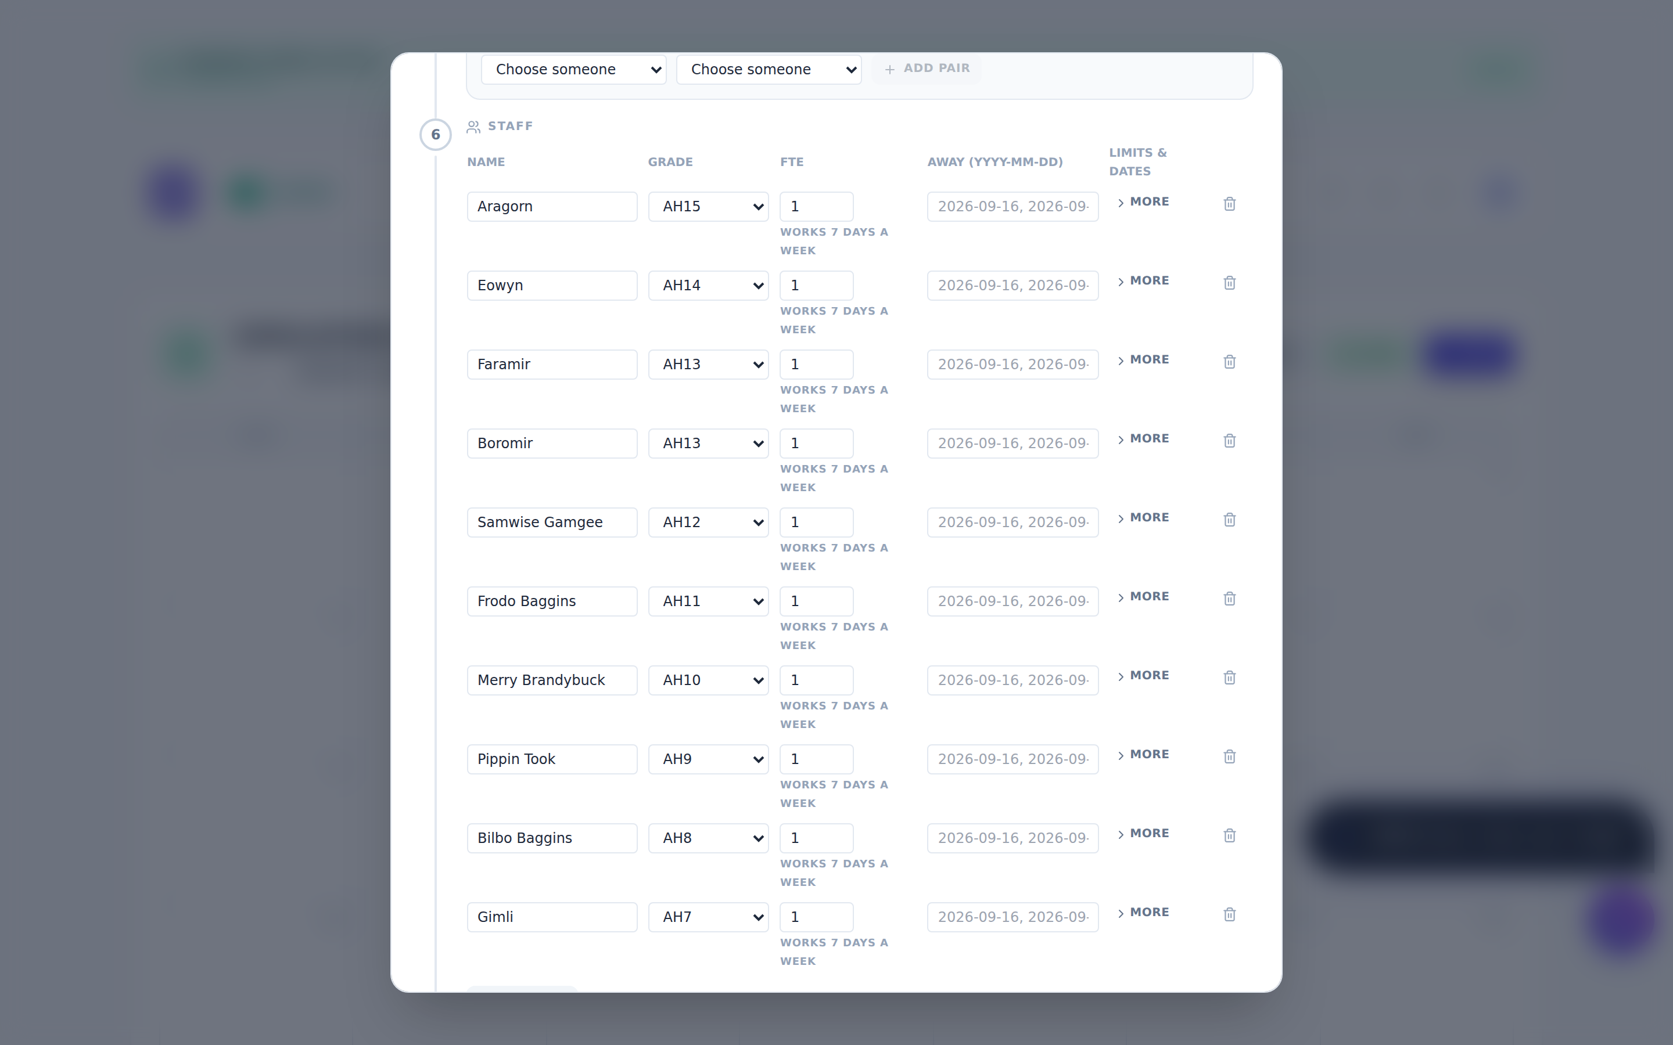
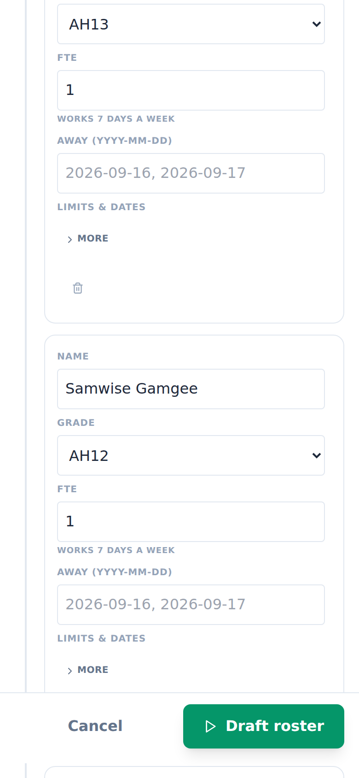
5
Your people: grades, availability, leave
One row per person: name, grade (AH7–AH17 or "not recorded"), FTE, and dates they are away.
The template seeds ten fictional staff — rename, delete, add your own.
Grades stay private in the live app: only a lead sees them, and they never appear on the roster itself.
DESKTOP
MOBILE

Slide 8
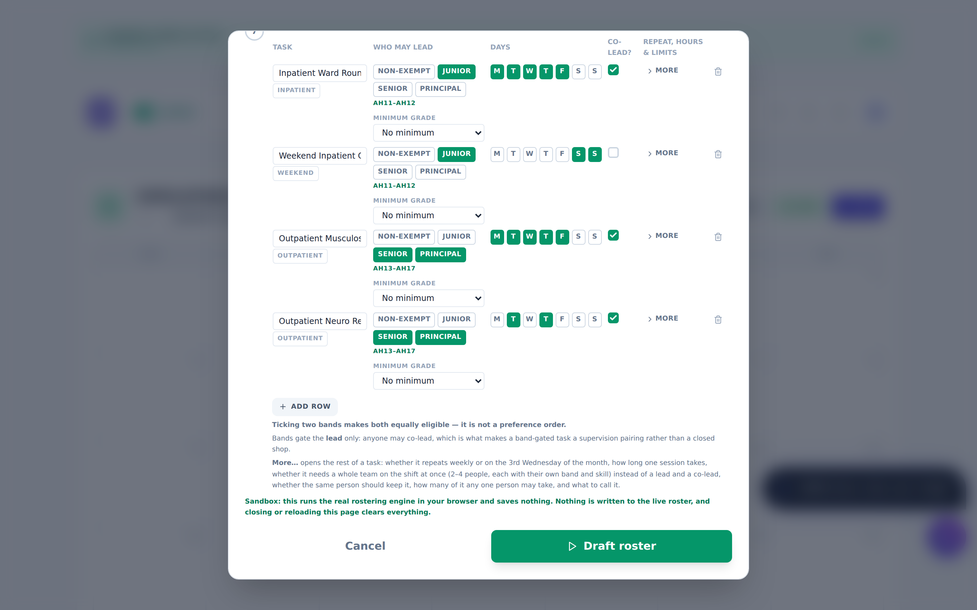
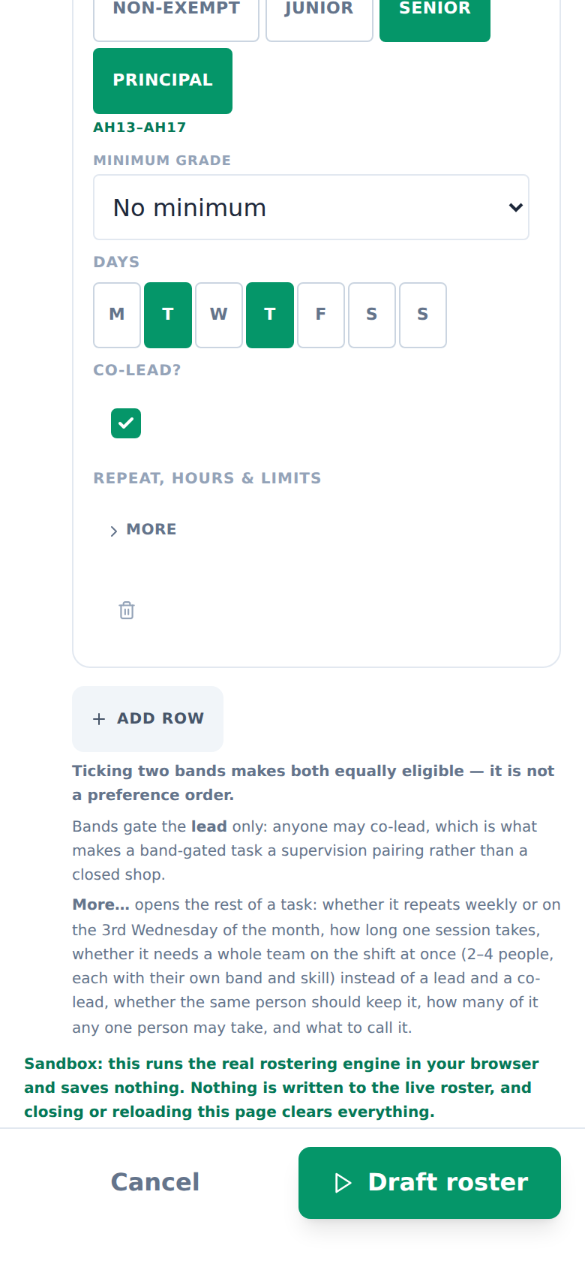
6
Your duties: who, when, and how senior
One row per duty: name it, tick the weekdays it runs, set how many people it needs.
A minimum grade per duty (e.g. "AH11 and above may lead").
Hours ceilings — longest day, standard week, most days in a row — are enforced, and a duty that would breach them is reported as unstaffed with the hours named, never quietly assigned.
DESKTOP
MOBILE

Slide 9
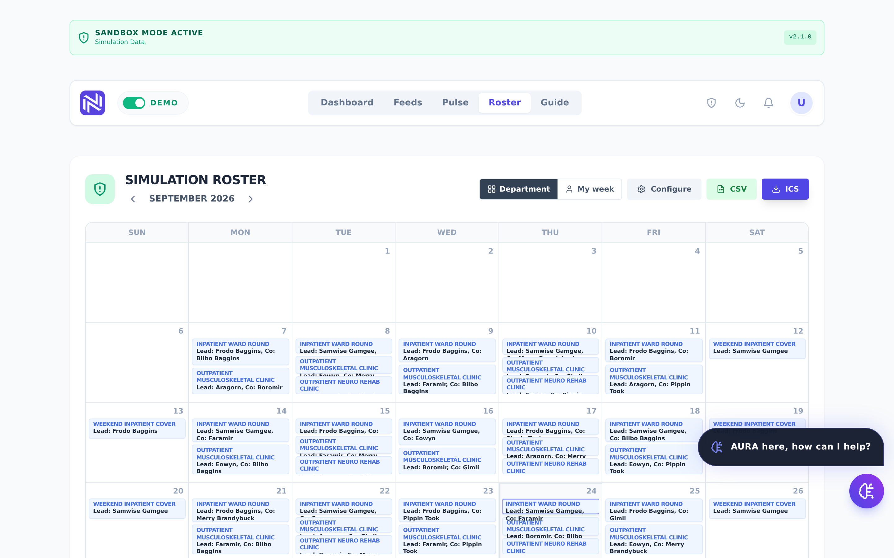
7
Draft roster — and read what came back
One click drafts the whole period: every duty, every day, lead and co named.
The engine is deterministic — the same inputs always produce the same roster. No AI decides who works.
Check the weekends, the grade gates, and anyone’s run of consecutive days.
Not right? Reopen Configure, adjust, draft again — it costs nothing.
DESKTOP
MOBILE
Worth knowing In the live app, staff request swaps from this screen and a lead approves them; the engine re-verifies the day before anything is written.

Slide 10
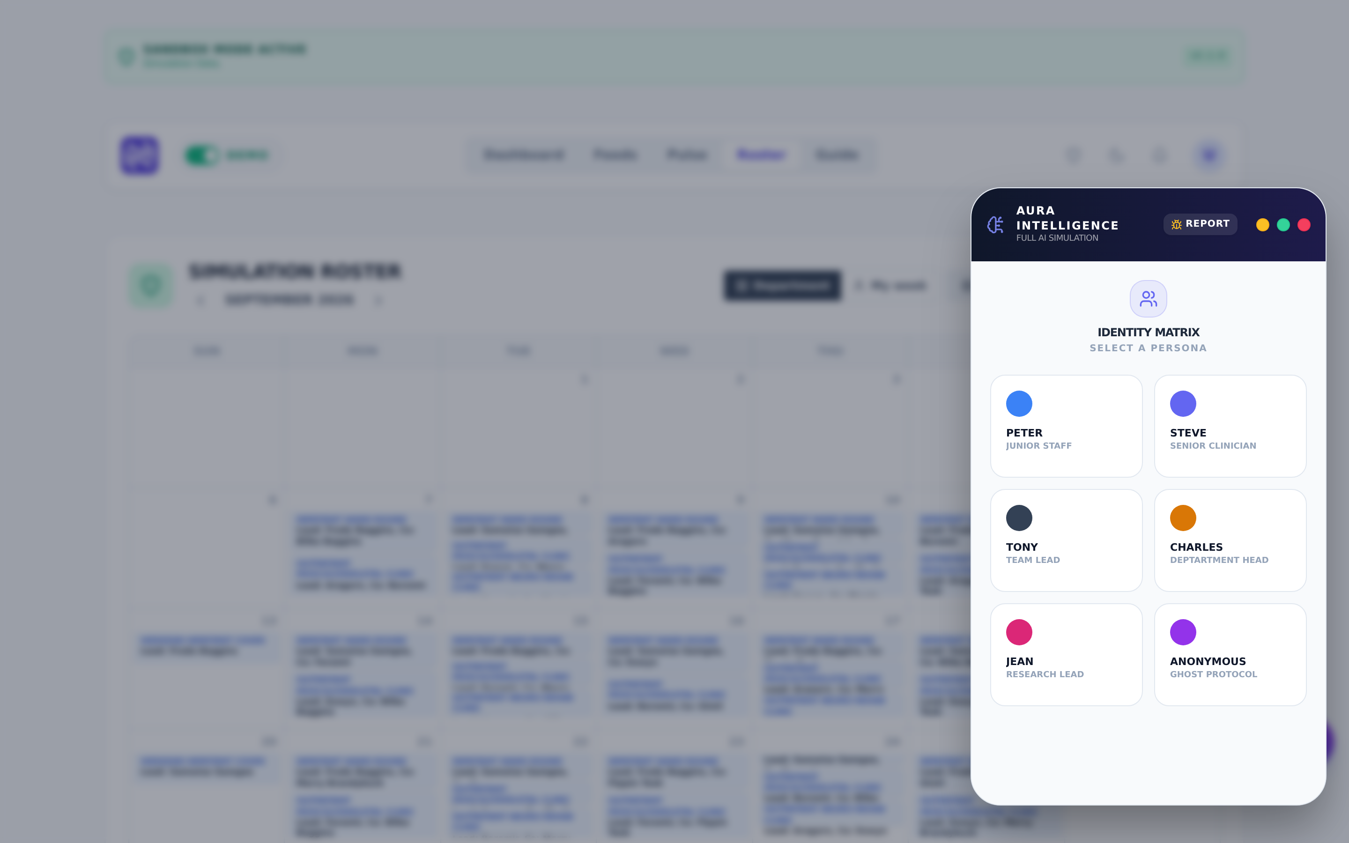
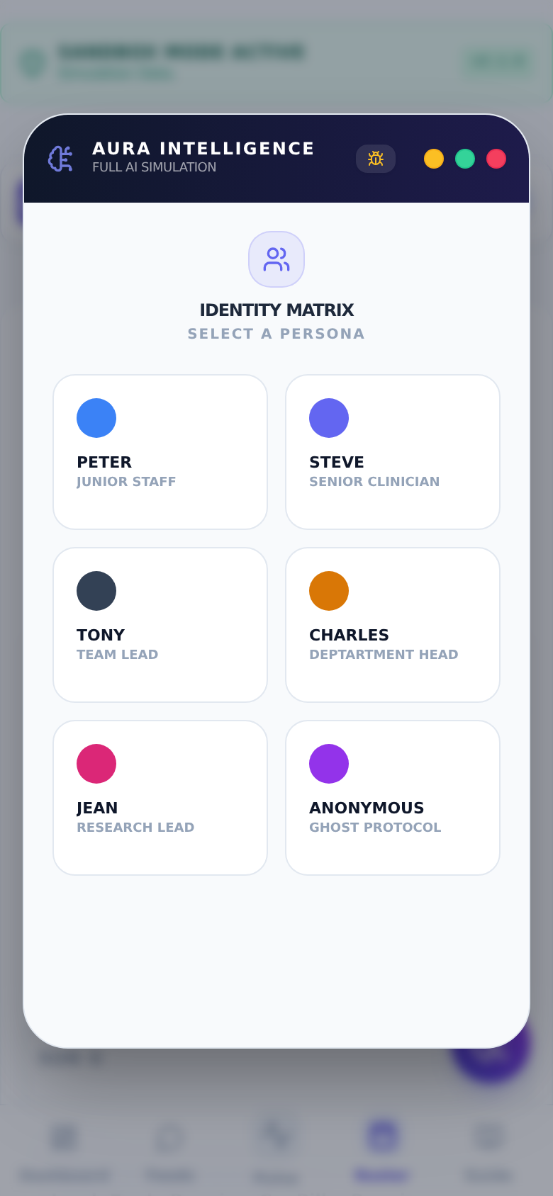
8
Meet AURA — the assistant beside the roster
AURA chats about wellbeing check-ins, drafts documents, and can log workload numbers.
It proposes; you click. AURA never writes anything without a confirmation card.
In the sandbox AURA answers locally — your typing goes nowhere.
The roster engine is separate: AURA explains it but does not decide it.
DESKTOP
MOBILE

Slide 11
Does it fit your service? Judge it on these
Your duties
Your people
Can every duty you actually run be written as a row — its days, its headcount, its minimum grade?
Do grades, part-time FTEs and leave dates cover how your team really varies?
Your rules
Your month
Do the ceilings (longest day, weekly hours, days in a row) match your award and your norms?
Read the drafted calendar as if it were next month. Would you publish it after your usual edits?
If something cannot be expressed, that is exactly the feedback we need — note the duty or rule that did not fit and send it back with your profession attached.

Slide 12
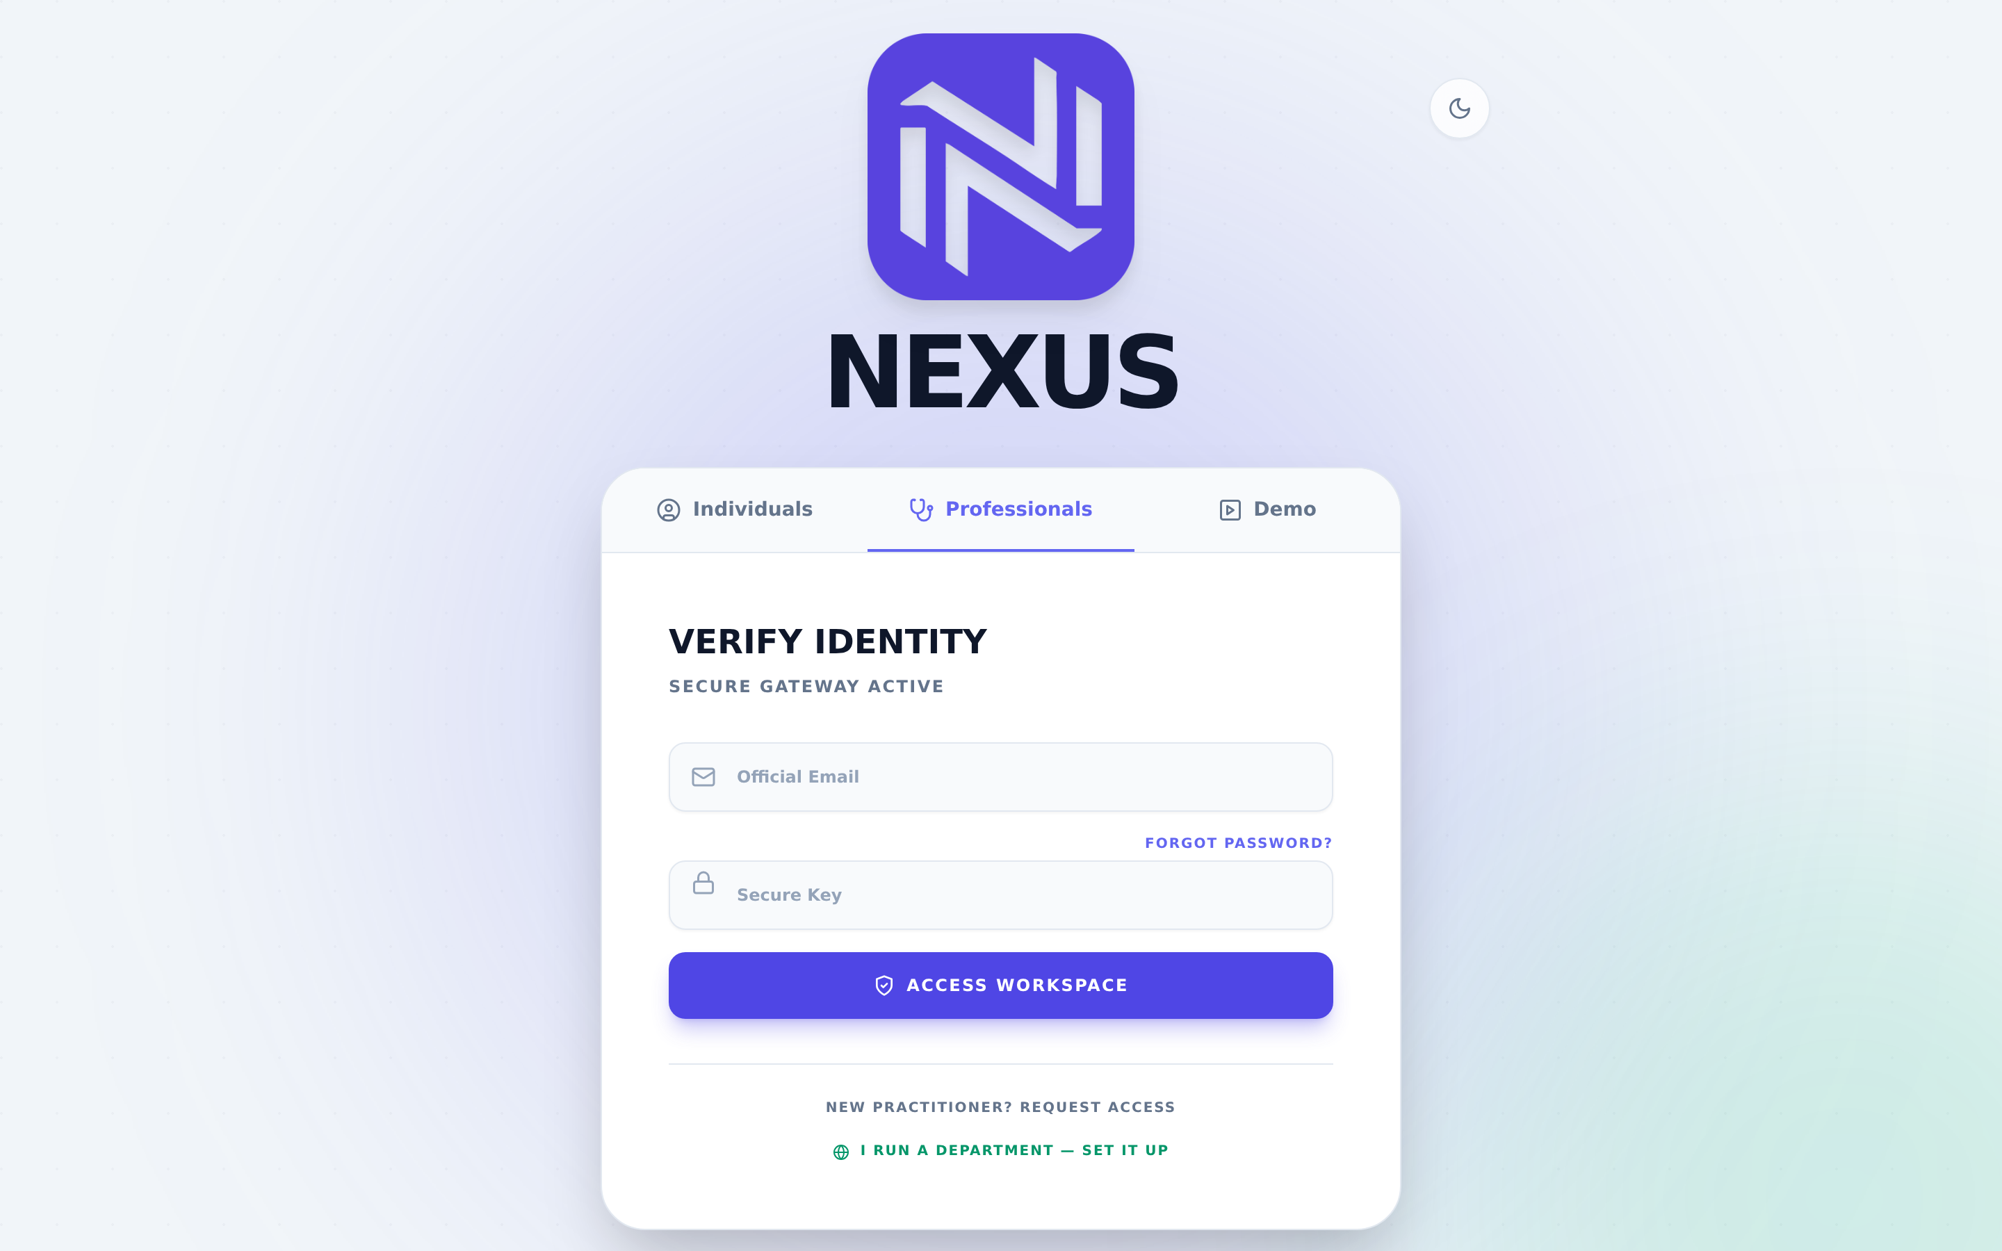
Ready to try it with your real team?
1
Register on the Professionals tab and declare your team — department, institution, profession.
2
The declaration is approved once, centrally. You are then the team’s lead.
3
Invite your own staff — no administrator needed after day one.
4
Your team’s data is scoped to your team. No other department can read it.
Sandbox first, always: the Demo door stays open, and nothing you tried today touched live data.

