Slide 1
Computer Architectures Session 1
Single cycle RISC-V processor
TAs :
Jun Yin (jun.yin@kuleuven.be)
Yuanyang Guo (yuanyang.guo@imec.be)
Linyan Mei (linyan.mei@kuleuven.be)
Nathan Laubeuf (nathan.laubeuf@gmail.com)

Slide 2
Course material
Provided material
CA_session_guide.docx
Project guide
CA_report.docx
Project report
CA_Exercise
Project directory
Slides
Sessions slides
Support documents
Ssh instructions
Git instructions
Debugging instructions
Extra resources
Computer organization and design. RISC-V edition.
https://owncloud.esat.kuleuven.be/index.php/s/HPc2rfQ5LaYfqZm
RISC-V specification
https://riscv.org/wp-content/uploads/2017/05/riscv-spec-v2.2.pdf
RISC-V green card
https://inst.eecs.berkeley.edu/~cs61c/fa17/img/riscvcard.pdf
Verilog tutorial
https://www.asic-world.com/verilog/veritut.html
RISC-V machine code generator *
https://github.com/Kritagya-Agarwal/Assembly-To-Machine-Code-RISC-V
Discord server
Ask invite link to one of the TA’s
* assembles RV64 but only simulates RV32, only use it for assembly to machine code translation

Slide 3

Objective
Chapter 4
RTL design of a RISC-V microprocessor
Simple Implementation
Pipelined implementation
Data Hazard resolution
Advanced Acceleration
Branch prediction
SIMD
...
https://owncloud.esat.kuleuven.be/index.php/s/HPc2rfQ5LaYfqZm
Notes:
Objective is to implement a RISC-V processors based on Chapter 4 for the Pat& Hen.

Slide 4

Objective
Session 1
Session 2
Session 3
Single cycle processor skeleton
Functional single cycle processor
Single cycle processor with multiplication
Pipelined processor
Pipelined processor with data hazard resolution
Advanced acceleration
Simulation
Synthesis

Slide 5
Project structure
RTL
RTL sources
tools_script
Scripts used to source the simulation and synthesis tools
incisiv_15.20.058.rc
nc_sim requirements
synopsys_2017.09rc
synopsys requirements
SYNTHESIS
Synthesis related resources
synthesis.sh
Synthesis script
designlist.tcl
Update if you add a new RTL source !
Script pointing towards the RTL
rep
Reporting folder
SIM
Simulation related resources
data
Instruction and data memory sources
testcode_m
Imem and dmem contents used for different exercises
dmem_content.txt
Data memory content
Imem_content.txt
Instruction memory content
files_verilog.f
List of RTL sources
Update if you add a new RTL source !
Makefile
Makefile with simulation related commands

Slide 6
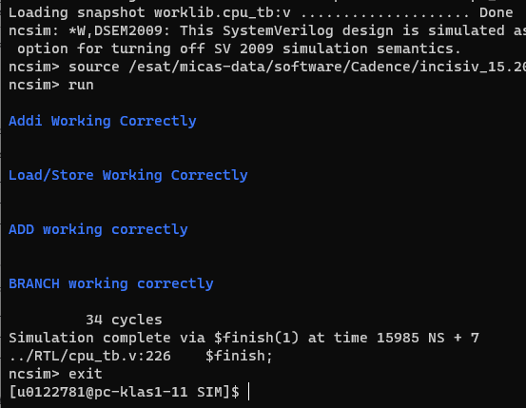
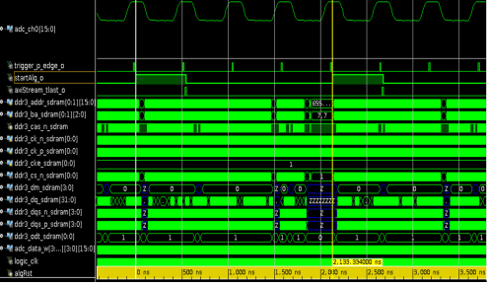
Tools
HDL files (RTL/*)
Testbench (RTL/cpu_tb.v)
Simulation (nc Verilog)
Tool to simulate the behavior of the RTL
Tool sourced using
source ./tools_script/incisiv_15.20.058.rc
In the ./SIM folder
make nc
uses cpu_tb.v, the content of ./SIM/data/imem_content and ./SIM/data/dmem_content to verify that the current RTL is able to run the considered program.
make nc_gui
same but provides traces for debugging (See next slide)
Nc verilog
make nc
make nc_gui
Test if program runs properly
Provide traces for debugging

Slide 7
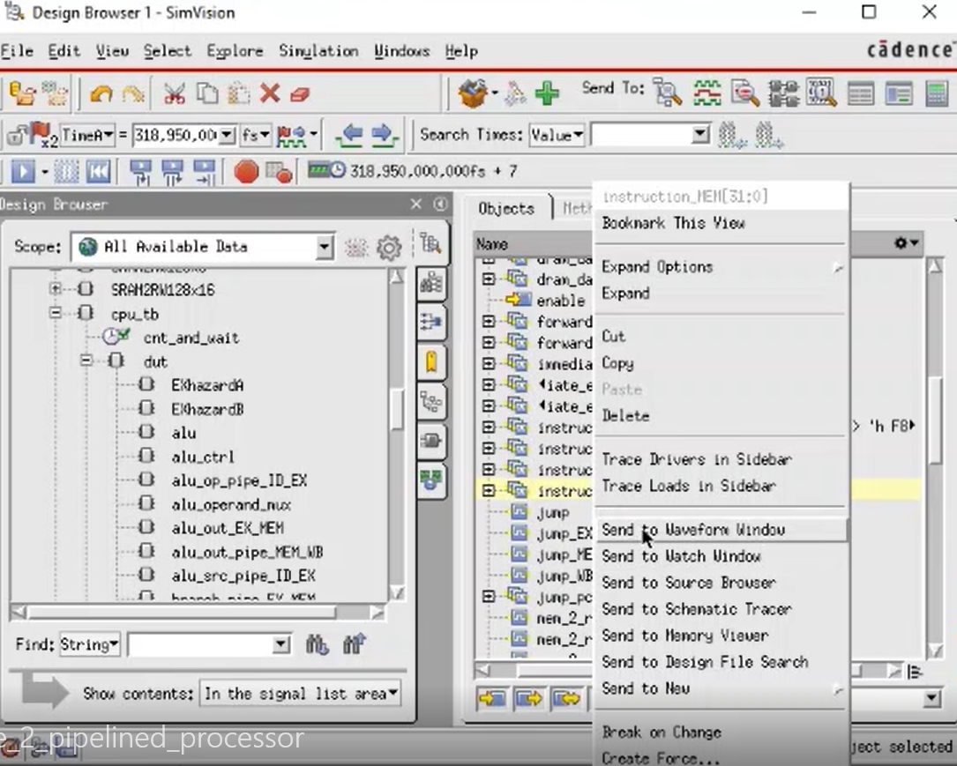
Design under test

Slide 8
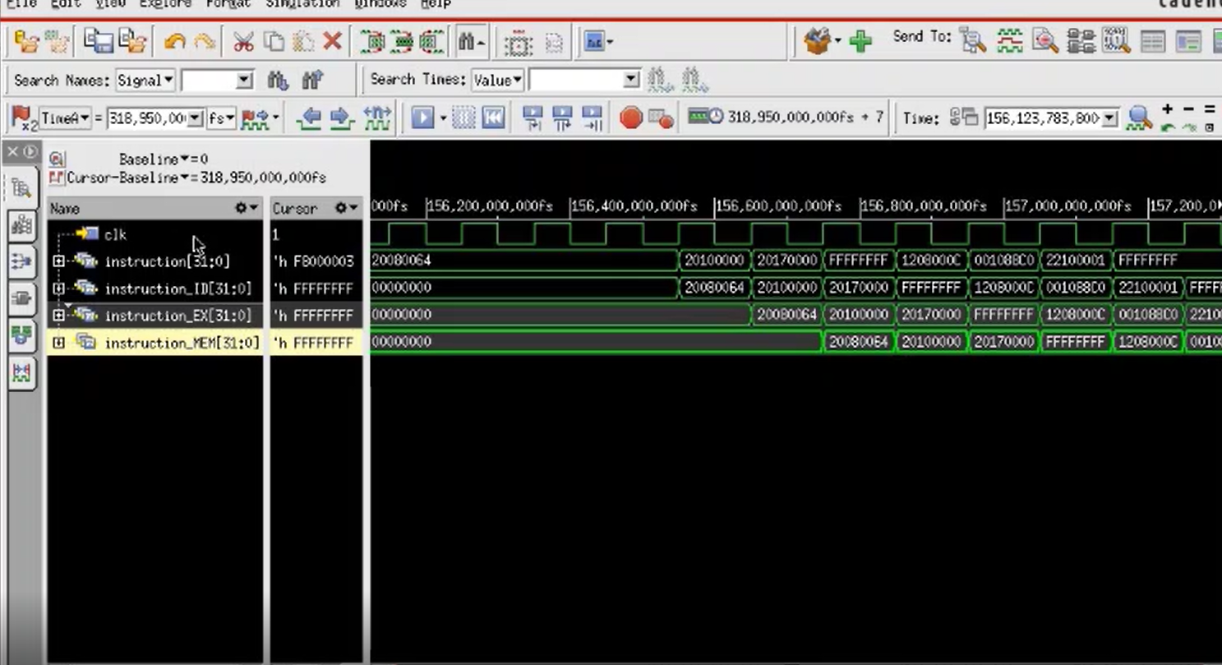

Slide 9
Tools
Constraints
(./SYNTHESIS/design_constraints.sdc)
Synthesis (design vision)
Tool to synthesize the integrated circuit and evaluate its major characteristics
Tool sourced using
source ./tools_script/synopsys_2017.09.rc
In the ./SYNTHESIS folder
source synthesis.sh
Will run the synthesis and generate the appropriate reports in ./SYNTHESIS/rep/
Libraries
(./SYNTHESIS/alib-52/)
RTL
(./RTL/)
Design vision
source synthesis.sh
Area, timing, power reports
./SYNTHESIS/rep/cpu.area
./SYNTHESIS/rep/cpu.power
./SYNTHESIS/rep/cpu.tim
netlist

Slide 10
**************************************** Report : area Design : cpu Version: N-2017.09-SP3 Date : Tue Mar 1 23:35:12 2022 **************************************** Information: Updating design information... (UID-85) Warning: Design 'cpu' contains 1 high-fanout nets. A fanout number of 1000 will be used for delay calculations involving these nets. (TIM-134) Library(s) Used: saed32rvt_tt1p05v25c (File: /users/micas/micas/design/generic/synopsys_32nm/SAED32_EDK/lib/stdcell_rvt/db_ccs/saed32rvt_tt1p05v25c.db) saed32sram_tt1p05v25c (File: /users/micas/micas/design/generic/synopsys_32nm/SAED32_EDK/lib/sram/db_ccs/saed32sram_tt1p05v25c.db)
Number of ports: 3057 Number of nets: 11493 Number of cells: 8556 Number of combinational cells: 5712 Number of sequential cells: 2778 Number of macros/black boxes: 20 Number of buf/inv: 300 Number of references: 12
Combinational area: 14144.892647 Buf/Inv area: 386.044737 Noncombinational area: 14383.534074 Macro/Black Box area: 379865.820312 Net Interconnect area: 27114.416993 Total cell area: 408394.247034 Total area: 435508.664027
Hierarchical area distribution ------------------------------ Global cell area Local cell area -------------------- ----------------------------------- Hierarchical cell Absolute Percent Combi- Noncombi- Black- Total Total national national boxes Design -------------------------------- ----------- ------- ---------- ---------- ----------- ---------------------------------------------- cpu 408394.2470 100.0 6.0995 0.0000 0.0000 cpu alu 3924.7458 1.0 3924.7458 0.0000 0.0000 alu_DATA_W64 alu_ctrl 35.3260 0.0 35.3260 0.0000 0.0000 alu_control alu_operand_mux 163.9229 0.0 163.9229 0.0000 0.0000 mux_2_DATA_W64_3 branch_unit 95.5581 0.0 95.5581 0.0000 0.0000 branch_unit_DATA_W64 control_unit 39.3923 0.0 39.3923 0.0000 0.0000 control_unit data_memory 305708.2610 74.9 1815.6047 0.0000 303892.6562 sram_BW64_ADDR_W10_DATA_W64 immediate_extend_u 55.4034 0.0 55.4034 0.0000 0.0000 immediate_extend_unit instruction_memory 76463.6620 18.7 490.4979 0.0000 75973.1641 sram_BW32_ADDR_W9_DATA_W32 program_counter 187.0500 0.0 44.4752 0.0000 0.0000 pc_DATA_W64 program_counter/mux_branch 29.2266 0.0 29.2266 0.0000 0.0000 mux_2_DATA_W64_1 program_counter/mux_jump 29.2266 0.0 29.2266 0.0000 0.0000 mux_2_DATA_W64_0 program_counter/pc_register 84.1217 0.0 0.0000 78.2764 0.0000 reg_arstn_en_64_s00000000 program_counter/pc_register/clk_gate_r_reg . . . register_file/clk_gate_reg_array_reg_8_ 5.8453 0.0 0.0000 5.8453 0.0000 SNPS_CLOCK_GATE_HIGH_register_file_DATA_W64_24 register_file/clk_gate_reg_array_reg_9_ 5.8453 0.0 0.0000 5.8453 0.0000 SNPS_CLOCK_GATE_HIGH_register_file_DATA_W64_23 -------------------------------- ----------- ------- ---------- ---------- ----------- ---------------------------------------------- Total 14144.8926 14383.5341 379865.8203
cpu.area
summary
Total cpu area (in square micrometers)
breakdown
Combinational: area for logic
Non-combinational: area for memory (registers)
Black-boxes: Macros

Slide 11
Information: Propagating switching activity (high effort zero delay simulation). (PWR-6) Warning: Design has unannotated primary inputs. (PWR-414) Warning: Design has unannotated sequential cell outputs. (PWR-415) Warning: Design has unannotated black box outputs. (PWR-428)
**************************************** Report : power -net -cell -hier -analysis_effort high -verbose -sort_mode dynamic_power Design : cpuVersion: N-2017.09-SP3 Date : Tue Mar 1 23:35:15 2022 **************************************** Library(s) Used:
saed32rvt_tt1p05v25c (File: /users/micas/micas/design/generic/synopsys_32nm/SAED32_EDK/lib/stdcell_rvt/db_ccs/saed32rvt_tt1p05v25c.db) saed32sram_tt1p05v25c (File: /users/micas/micas/design/generic/synopsys_32nm/SAED32_EDK/lib/sram/db_ccs/saed32sram_tt1p05v25c.db)
Information: The library cell 'SRAM2RW128x32' in the library 'saed32sram_tt1p05v25c' is not characterized for internal power. (PWR-227) Information: The design contains cells, other than constants and black boxes, that are not characterized for internal power. (PWR-228)
. . .
-------------------------------------------------------------------------------- Switch Int Leak Total Hierarchy Power Power Power Power % -------------------------------------------------------------------------------- cpu 8.395 0.000 7.62e+08 770.532 100.0 branch_unit (branch_unit_DATA_W64) 0.209 0.000 3.56e+06 3.767 0.5 regfile_data_mux (mux_2_DATA_W64_2) 0.431 0.000 4.10e+06 4.527 0.6 alu (alu_DATA_W64) 1.124 0.000 1.34e+08 134.681 17.5 alu_operand_mux (mux_2_DATA_W64_3) 0.144 0.000 4.10e+06 4.240 0.6 alu_ctrl (alu_control) 6.78e-02 0.000 1.09e+06 1.157 0.2 register_file (register_file_DATA_W64) 1.816 0.000 5.51e+08 552.837 71.7 control_unit (control_unit) 6.67e-02 0.000 1.51e+06 1.573 0.2 data_memory (sram_BW64_ADDR_W10_DATA_W64) 2.498 0.000 4.36e+07 46.057 6.0 instruction_memory (sram_BW32_ADDR_W9_DATA_W32) 1.039 0.000 1.29e+07 13.985 1.8 program_counter (pc_DATA_W64) 0.316 0.000 5.11e+06 5.424 0.7 pc_register (reg_arstn_en_64_s00000000) 0.253 0.000 2.00e+06 2.249 0.3 mux_jump (mux_2_DATA_W64_0) 1.13e-02 0.000 7.47e+05 0.759 0.1 mux_branch (mux_2_DATA_W64_1) 1.30e-02 0.000 7.47e+05 0.760 0.1 immediate_extend_u (immediate_extend_unit) 0.106 0.000 1.52e+06 1.625 0.2
cpu.power
Last table of the report
Total power (uW)

Slide 12
. . .
Point Incr Path -------------------------------------------------------------------------- clock clk (rise edge) 0.00 0.00 clock network delay (ideal) 0.00 0.00 program_counter/pc_register/r_reg_9_/CLK (DFFARX1_RVT) 0.00 0.00 r program_counter/pc_register/r_reg_9_/Q (DFFARX1_RVT) 0.15 0.15 f program_counter/pc_register/dout[9] (reg_arstn_en_64_s00000000) 0.00 0.15 f program_counter/current_pc[9] (pc_DATA_W64) 0.00 0.15 f instruction_memory/addr[9] (sram_BW32_ADDR_W9_DATA_W32) 0.00 0.15 f instruction_memory/U40/Y (NAND2X0_RVT) 1.14 1.29 r instruction_memory/U39/Y (INVX0_RVT) 0.62 1.92 f instruction_memory/U18/Y (AO22X1_RVT) 3.63 5.55 f instruction_memory/U103/Y (OR2X1_RVT) 0.71 6.26 f instruction_memory/rdata[0] (sram_BW32_ADDR_W9_DATA_W32) 0.00 6.26 f control_unit/opcode[0] (control_unit) 0.00 6.26 f control_unit/U10/Y (NAND2X0_RVT) 0.75 7.01 r control_unit/U14/Y (NOR2X0_RVT) 0.10 7.11 f control_unit/U4/Y (AND2X1_RVT) 0.67 7.78 f control_unit/alu_src (control_unit) 0.00 7.78 f alu_operand_mux/select_a (mux_2_DATA_W64_3) 0.00 7.78 f alu_operand_mux/U53/Y (AO22X1_RVT) 8.11 15.89 f alu_operand_mux/mux_out[2] (mux_2_DATA_W64_3) 0.00 15.89 f alu/alu_in_1[2] (alu_DATA_W64) 0.00 15.89 f alu/U112/Y (MUX41X1_RVT) 40.50 56.39 r alu/U70/Y (AO22X1_RVT) 0.06 56.45 r alu/U1173/Y (OA22X1_RVT) 0.05 56.50 r alu/U1183/Y (NAND4X0_RVT) 0.11 56.60 f alu/alu_out[3] (alu_DATA_W64) 0.00 56.60 f regfile_data_mux/input_b[3] (mux_2_DATA_W64_2) 0.00 56.60 f regfile_data_mux/U61/Y (AO22X1_RVT) 3.64 60.25 f regfile_data_mux/mux_out[3] (mux_2_DATA_W64_2) 0.00 60.25 f register_file/wdata[3] (register_file_DATA_W64) 0.00 60.25 f register_file/reg_array_reg_1__3_/D (DFFARX1_RVT) 5.41 65.65 f data arrival time 65.65 clock clk (rise edge) 100.00 100.00 clock network delay (ideal) 0.00 100.00 clock uncertainty -0.10 99.90 register_file/reg_array_reg_1__3_/CLK (DFFARX1_RVT) 0.00 99.90 r library setup time -0.10 99.80 data required time 99.80 -------------------------------------------------------------------------- data required time 99.80 data arrival time -65.65 -------------------------------------------------------------------------- slack (MET) 34.15
cpu.tim
Critical path (ns)
Clock margin (ns)

Slide 13

Objective
Session 1
Session 2
Session 3
Single cycle processor skeleton
Functional single cycle processor
Single cycle processor with multiplication
Pipelined processor
Pipelined processor with data hazard resolution
Advanced acceleration
Simulation
Synthesis

Slide 14
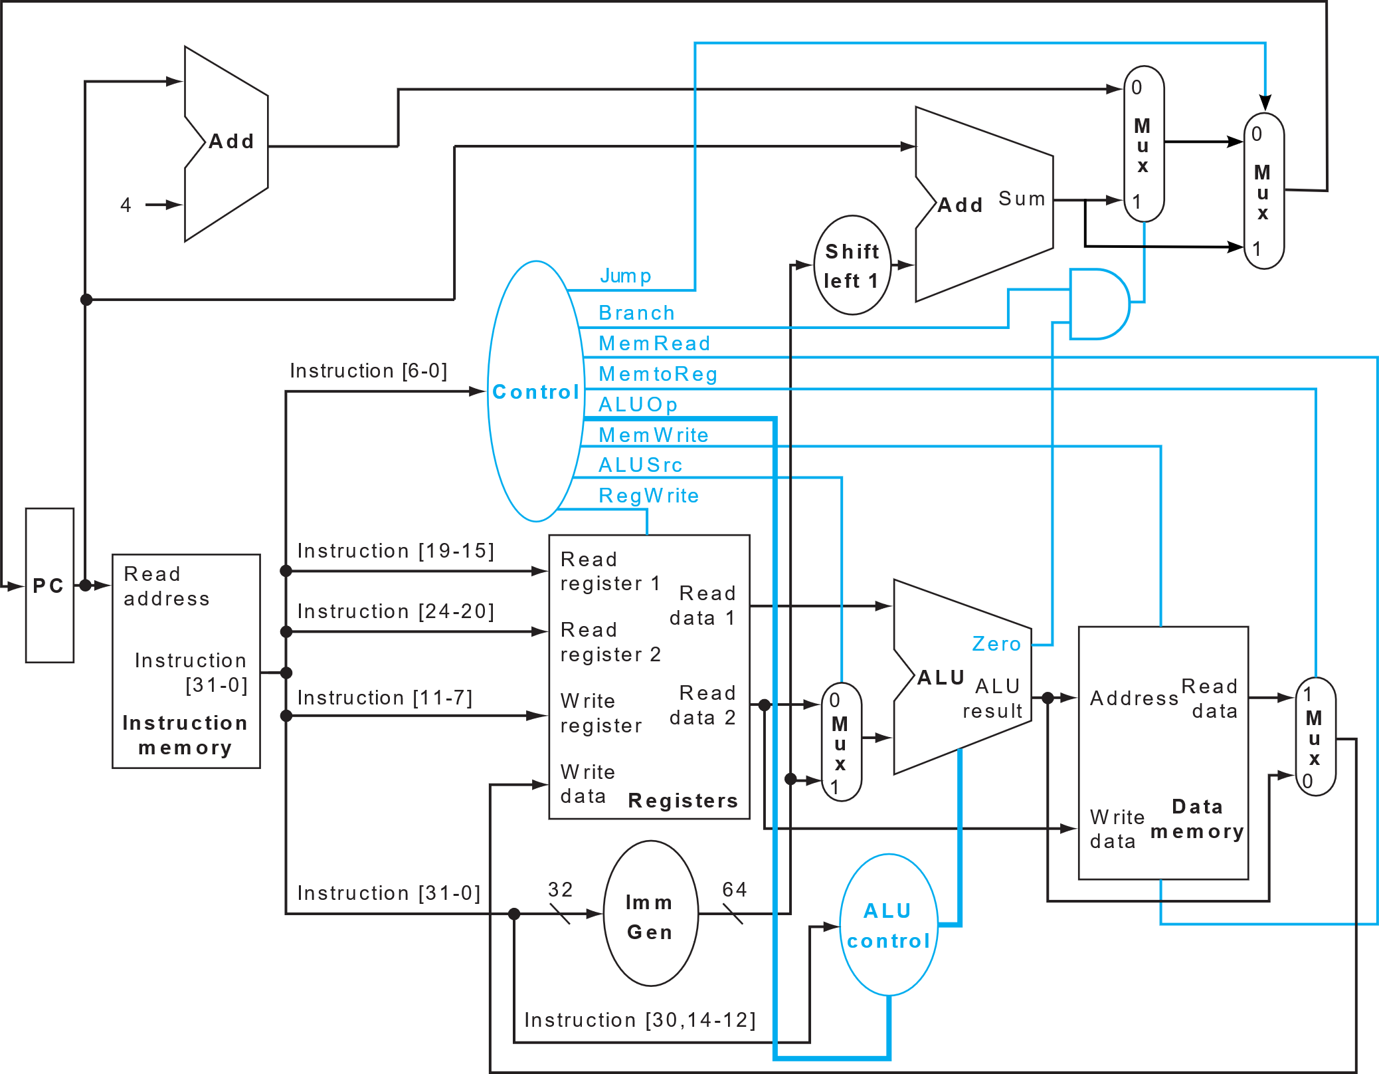
Base architecture
cpu.v
pc.v
RTL
alu_control.v
alu.v
branch_unit.v
control_unit.v
cpu_tb.v
cpu.v
immediate_extend_unit.v
mux_2.v
pc.v
register_file.v
sram.v
control_unit.v
branch_unit.v
alu.v
register_file.v
immediate_extend_unit.v
alu_control.v
Patterson-Hennessy Section 4.1 to 4.4

Slide 15
Session Objectives
Single cycle processor skeleton
Functional single cycle processor
Functional single cycle processor
Modify the control_unit.v to support BEQ, JUMP, LD, SD, ADDI and R-type ALU instructions (ALU_R)
Run SIMPLE_PROGRAM
Copy the instruction and data memory for simple program to imem and dmem
cat ./data/testcode_m/simpleprogram_imem_content.txt > .data/imem_content.txt
cat ./data/testcode_m/simpleprogram_dmem_content.txt > ./data/dmem_content.txt
Run simulation with make nc
Run MULT1
See above with mult1 instead of simpleprogram
Synthesize
source synthesis.sh
Simple Program
addi x8, x0, 7
addi x9, x8, 2
sd x9, 0(x0)
ld x17, 0(x0)
ld x18, 8(x0)
add x19, x17, x18
beq x9, x17, FINAL
add x20, x8, x9
FINAL: add x20, x18, x19
sll x21, x18, x8
STOP
STOP is a "fake" instruction used for the cpu_tb to recognize the end of the program (See line 304-306 of cpu_tb.v)

Slide 16
Session Objectives
Single cycle processor skeleton
Functional single cycle processor
Multiplication algorithm
# init
addi x16, x0, 80
addi x8, x0, 0
addi x9, x0, 0
addi x10, x0, 1
# Looping over operands
M1:ld x17, 0(x8)
ld x18, 8(x8)
addi x23, x0, 64
addi x19, x0, 1
addi x20, x0, 0
add x22, x0, x17
# Multiplication
LOOP_0: and x21, x18, x19
beq x21, x0, SHIFTING_0
add x20, x20, x22
SHIFTING_0: sll x22, x22, x10
sll x19, x19, x10
addi x23, x23, -1
beq x23, x0, M2
jal LOOP_0
# Summing results
M2: add x9, x9, x20
addi x16, x16, -16
addi x8, x8, 16
beq x16, x0, FINISH
jal M1
FINISH:
x16: Total size of data memory
x8: Data Memory Pointer
x23: Iteration over the number of bits
x20: Accumulated result of each multiplication
x9: Final result
Algorithm 1:
Acc = 0
N = operand1
Traverse each bit of operand2 (LSB -> MSB)
If the bit of operand2 is 1, accumulate. Acc = Acc + N.
If the bit is 0, Acc = Acc.
Left shift N by 1 position.
 |  |  | 1 | 1 | 0
 |  |  | 1 | 0 | 1
 |  |  | 1 | 1 | 0
 |  | 0 | 0 | 0
 | 1 | 1 | 0
 | 1 | 1 | 1 | 1 | 0
MULT1
Multiply adjacent operand in pairs (5 multiplications) using Algorithm 1
Sums results together

Slide 17
Session Objectives
Functional single cycle processor
Single cycle processor with multiplication
MULT2
Single cycle processor with multiplication
Modify the control_unit.v, alu_control.v and alu.v to support the MULT instruction
Run MULT2
Synthesize
# load operands
ld x8, 0(x0)
ld x9, 8(x0)
ld x10, 16(x0)
ld x11, 24(x0)
ld x12, 32(x0)
ld x13, 40(x0)
ld x14, 48(x0)
ld x15, 56(x0)
ld x16, 64(x0)
ld x17, 72(x0)
# multiplication
mul x18, x8, x9
mul x19, x10, x11
mul x20, x12, x13
mul x21, x14, x15
mul x22, x16, x17
#sums
addi x23, x0, 0
nop
nop
nop
add x23, x23, x18
nop
nop
nop
add x23, x23, x19
nop
nop
nop
add x23, x23, x20
nop
nop
nop
add x23, x23, x21
nop
nop
nop
add x23, x23, x22
nop
nop
nop
nop

Slide 18
REMARKS
The assignments should be completed in groups of 2 people.
After completing each one of the exercises, the results must be shown to the TAs for its correspondent evaluation.
For each exercise session, the corresponding design version need to be archived. The design versions of session 2 and 3 (the RTL folder of each) need to be submitted in the end.
Also, you will hand in a small report based on the template that you find in the folder. Together with the performance of your processor, this counts for 4 points in the final H05d3A grade.
This report and designs should be handed in through Toledo. The deadline will be set later.

Slide 19

Keep your project safe!
We highly suggest you to use git as a versioning tool.
It helps you to:
keep track of modifications
automatically sync the project between group members
allow TAs to support you more easily
Please have a look at the dedicated guide.

