Slide 1
Fashion dataset from diverse culture
BLIP Model
Image to Text
Raw Label
Manual
label editing
Label with cultural information
Cultural Image text pairs
Finetuned Cultural CLIP
User Outfit Request
Cultural Filter
Text Embedding
or
Pretrained General Fashion CLIP
The outfit combination that is closest to the outfit request
User Closet Dataset
Enumeration
All outfit combination image
Images Embedding
Calculate cosine similarity for image search

Slide 2
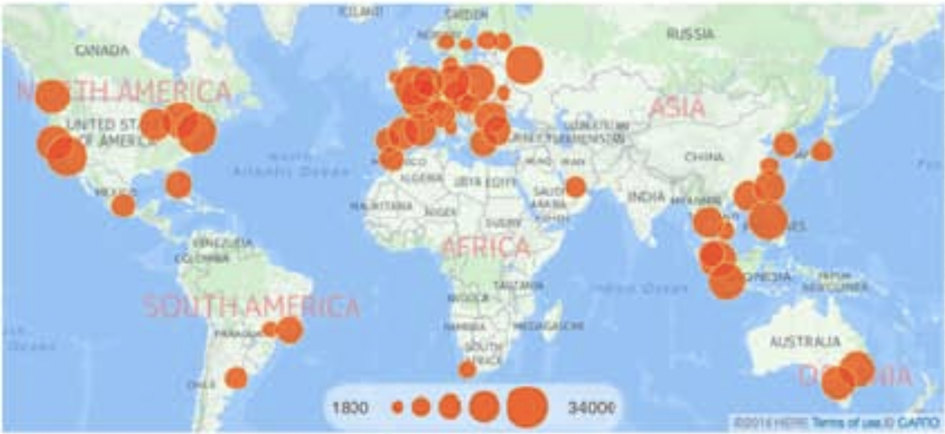
Background
A main fashion dataset, The GSFashion (Global Street Fashion) image dataset, has a total number of 400822 local street fashion pictures from 45 global major cities. In this dataset, African and Indian fashion are underrepresented, and therefore models trained on these datasets could be bias towards western fashion and fail to learn the representation of african and indian ethnic fashion. Then, minority users could not find outfits that fit their identify when using those customized fashion products with AI models train on these datasets.

Slide 3
Dataset

Slide 4
Methods

Slide 5
Model Used

