Slide 1
Gitflow Workflow
Max Kenobi

Slide 2
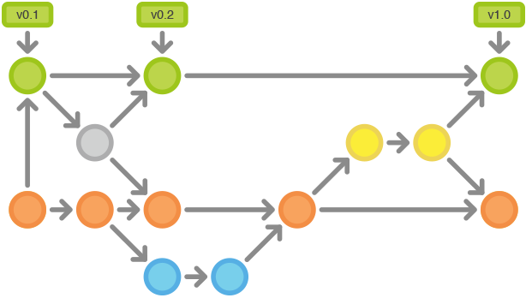
Gitflow workflow
https://leanpub.com/git-flow/read

Slide 3
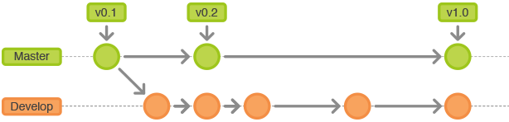
Main branches
master branch
- contains production-ready code that can be released
- stores the official release history
- tag all commits with a version number
develop branch
- contains pre-production code with newly developed features
- integration branch for new features
https://leanpub.com/git-flow/read

Slide 4
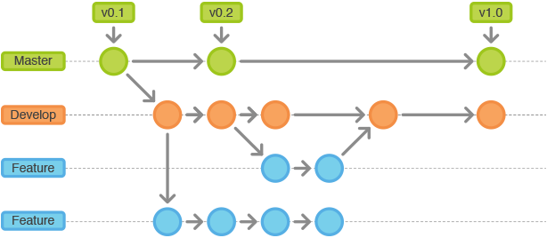
Feature branches
feature branch
- used when adding new features to your code
- the most common type of branch
https://leanpub.com/git-flow/read

Slide 5
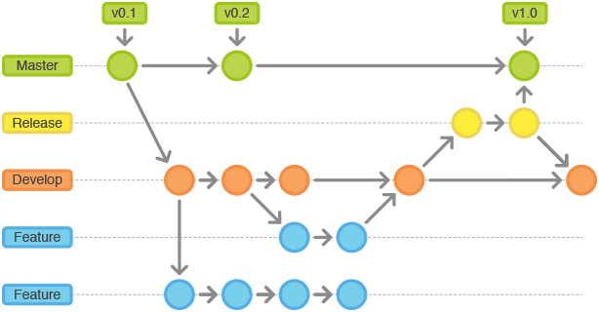
Release branches
release branch
- preparing new production releases
- no new features, just finishing touches and minor bugs
- polish the release and work on the new features at the same time
https://leanpub.com/git-flow/read

Slide 6
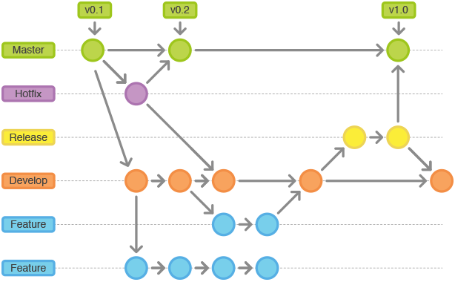
Hotfix branches
hotfix branch
- quickly patch production releases (ad hoc release branches)
- address issues without waiting for the next release cycle
https://leanpub.com/git-flow/read

Slide 7
Gitflow extension
No need to be a git master!
Initialise gitflow and set default branch names:
> git flow init
Start/finish feature branches:
> git flow feature start <name>
> git flow feature finish <name>
Push/pull a feature branch:
> git flow feature publish <name>
> git flow feature pull <name>
Start/finish release branches:
> git flow release start <release>
> git flow release finish <release>
Start/finish hotfix branches:
> git flow hotfix start <release>
> git flow hotfix finish <release>
gitflow extension repohow to install (easy)

Slide 8
Extra rules
1. Feature branches naming convention
feature/<youtrack_task_id>/<short_meaningful_description>
ex. feature/ML-9999/add_new_awesome_feature
2. Tags naming convention
<huge_changes_num>.<new_feats_num>.<hotfix_num>
ex. 1.10.2, 2.0.0, etc.
- huge_changes_num: changes that affect the whole repo code
- new_feats_num: the most commonly changed num, new features
- hotfix_num: hotfixes; really hot; in the evenings or on weekends
3. Code review in GitLab UI
- before “git flow feature finish”
- make merge requests into the develop branch
4. Delete old branches

Slide 9
Pros and Cons
Pros
- releases
- support multiple versions
- production-ready code in master
- improved collaboration
- built-in code quality reviews
- clean git history
Cons
- complexity
- slows down the deployment

Slide 10
Additional links
Post by the author: https://nvie.com/posts/a-successful-git-branching-model/
https://www.atlassian.com/git/tutorials/comparing-workflows/gitflow-workflow
https://github.com/nvie/gitflow
https://leanpub.com/git-flow/read

Slide 11

https://nvie.com/posts/a-successful-git-branching-model/

