Slide 1
RWF Economic Impact Model
Lifetime Economic Benefits Analysis • Updated February 2026

Slide 2
Executive Summary: What We Found
Metric | RTE | Apprenticeship
Average LNPV | Rs 14.0 Lakhs | Rs 34.4 Lakhs
Program Cost | Rs 1.04 Lakhs | Rs 1.58 Lakhs
Average BCR | 13.5 : 1 | 21.7 : 1
BCR Range | 5.0 - 27.6 : 1 | 11.8 - 33.1 : 1
All 32 scenarios positive? | Yes ✓ | Yes ✓
💡 BCR = Benefit-Cost Ratio. A BCR of 13.5:1 means every Rs 1 invested generates Rs 13.5 in lifetime benefits.

Slide 3
The Investment Multiplier: Three Legs of Value
Stage | RTE | Apprenticeship
Leg 1: RWF Direct Spend | Rs 4,000 | Rs 6,000
Leg 2: Unlocked Funds | Rs 1,04,000 (govt) | Rs 1,58,460 (govt+private)
Leg 3: Lifetime Value | ~Rs 14 Lakhs | ~Rs 34.4 Lakhs
Ratio | 1 : 26 : 350 | 1 : 26 : 567
💡 Every Rs 1 RWF spends unlocks Rs 26 in government/private funds, which generates Rs 350-567 in lifetime value.

Slide 4
The Challenge: India's Bifurcated Labor Market
Formal Sector (~10%)
Informal Sector (~90%)
• Entry wage: Rs 32,800/month
• Annual growth: +1.5%/year
• Contracts, PF, ESI, job security
• By Year 40: 4× informal wages
• Entry wage: Rs 13,425/month
• Annual growth: -0.2%/year
• No contracts, no benefits
• Wage stagnation over career
💡 This is why P(Formal) is our #1 NPV driver — shifting someone to formal employment has larger lifetime effects than any initial wage premium.

Slide 5
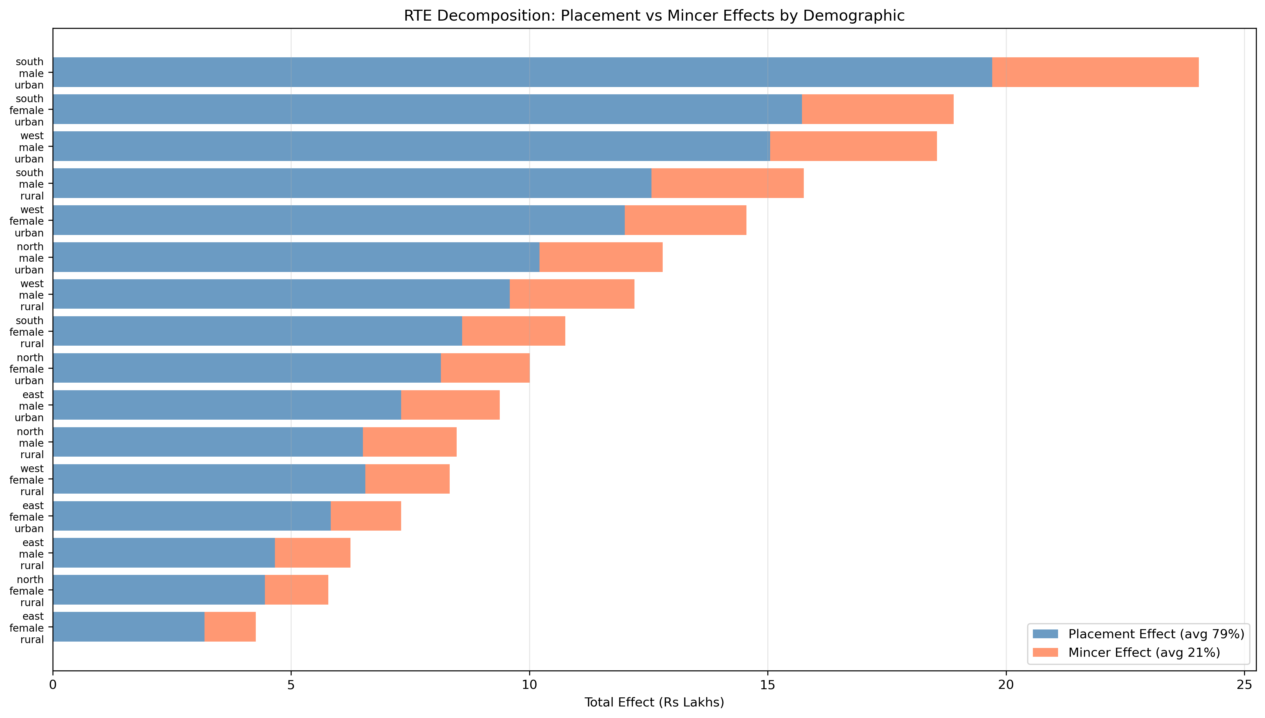
How RTE Creates Value
• Private School → +0.137 SD test score gains
• Educational credentials → signaling to employers
• Formal sector entry: 30% vs 9.1% baseline (3.3× improvement)
• Mincer wage premium: 5.8% per year of quality education
•
• Key Finding: 79% of value comes from formal sector access,
• only 21% from improved learning outcomes
💡 The primary value of RTE is as a pathway to formal employment, not just better learning. Career guidance can maximize this effect.

Slide 6
RTE Results by Scenario
Scenario | LNPV | BCR
South Male Urban (highest) | Rs 28.7L | 27.6 : 1
West Male Urban | Rs 22.2L | 21.4 : 1
North Female Urban | Rs 11.4L | 11.0 : 1
East Female Rural (lowest) | Rs 5.2L | 5.0 : 1
Average (all 16) | Rs 14.0L | 13.5 : 1
💡 Even in the most pessimistic scenario (East Female Rural), RTE delivers a 5:1 return — well above the 3:1 threshold for development programs.

Slide 7
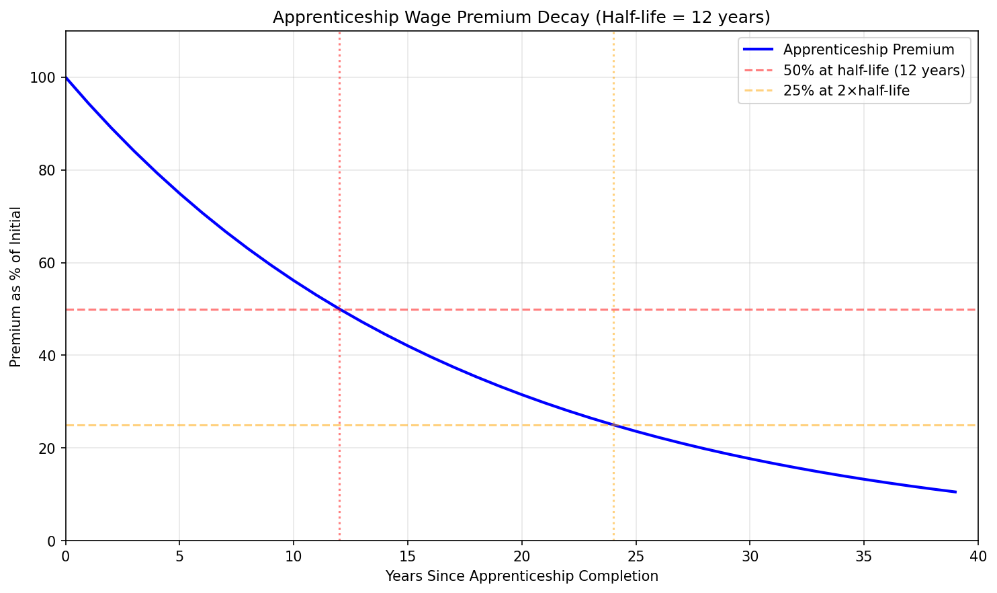
How Apprenticeship Creates Value
• Program → NAC Certification (85% completion)
• Employer Absorption: 68% formal placement (vs 9% baseline)
• Initial premium: Rs 78,000/year above counterfactual
• Premium decays with 12-year half-life
•
• Key Finding: The 68% placement rate creates a 59 p.p.
• advantage that dominates the calculation, even with decay
💡 Skill premiums fade over time, but formal sector entry is permanent. That's why Apprenticeship NPV remains high despite decay.

Slide 8
Apprenticeship Results by Scenario
Scenario | LNPV | BCR
South Male Urban (highest) | Rs 52.3L | 33.1 : 1
West Male Urban | Rs 50.4L | 31.9 : 1
North Female Urban | Rs 36.0L | 22.8 : 1
East Female Rural (lowest) | Rs 18.6L | 11.8 : 1
Average (all 16) | Rs 34.4L | 21.7 : 1
💡 Apprenticeship assumptions are conservative: premium is 33% of theoretical value, half-life is below international benchmarks (15-20 years).

Slide 9
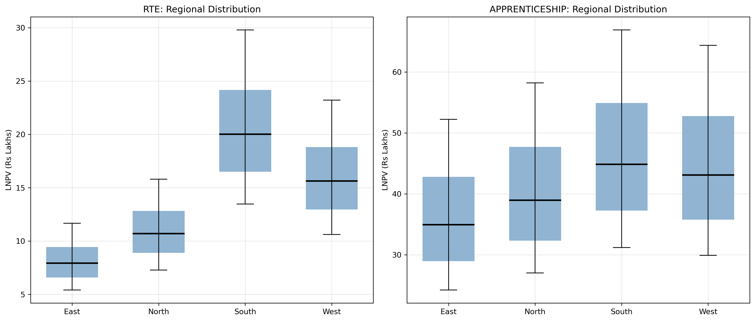
Regional Analysis: Where Returns Are Highest
South/West regions show 20-50% higher returns than North/East
💡 Geographic targeting can significantly improve cost-effectiveness. Urban beneficiaries show 30-50% higher LNPV than rural.

Slide 10
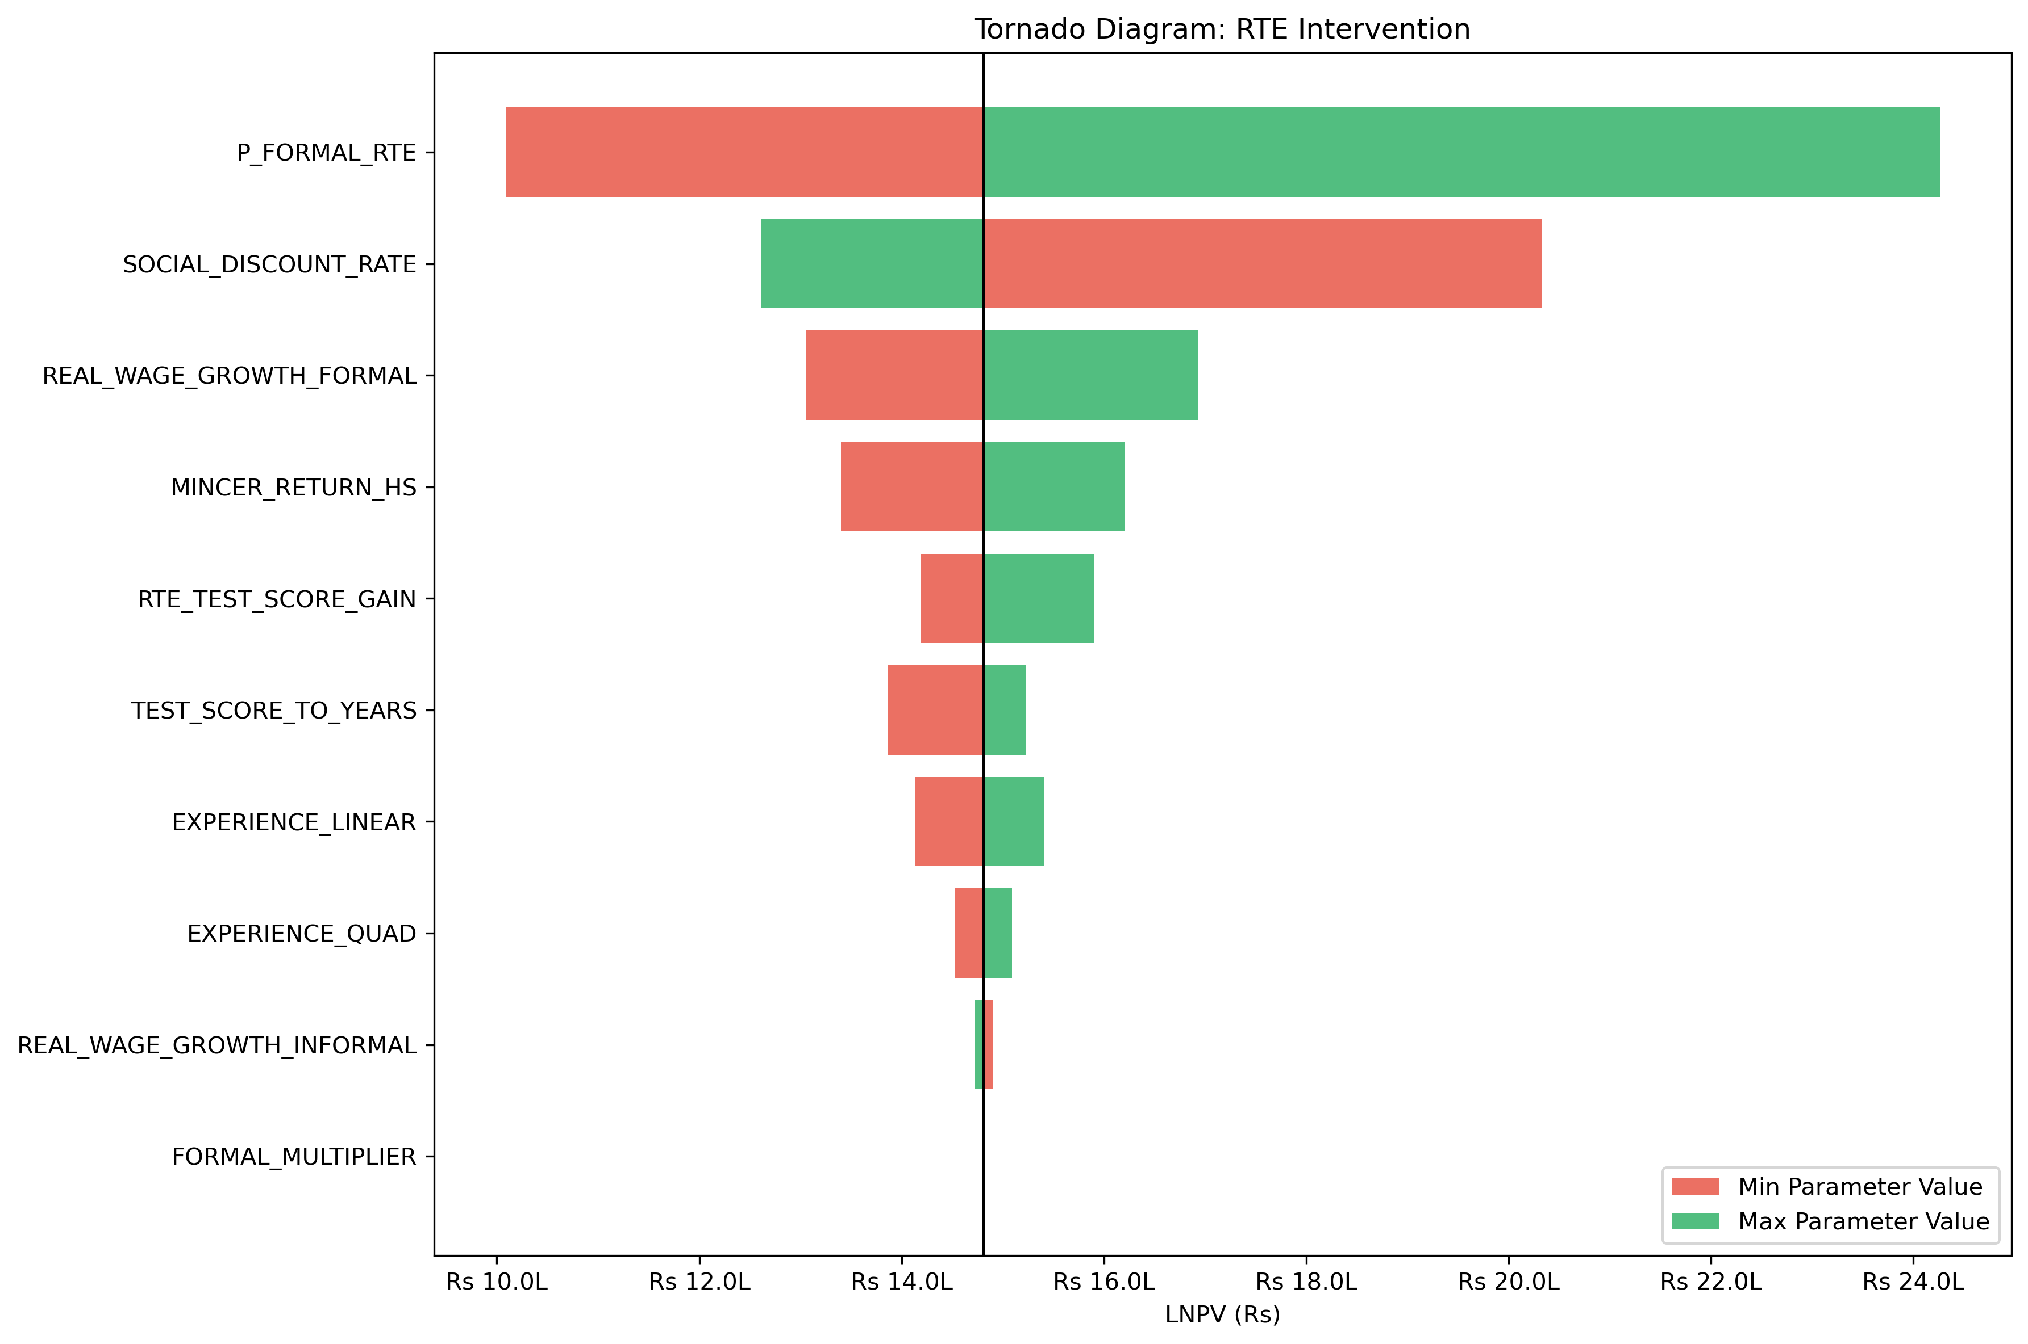
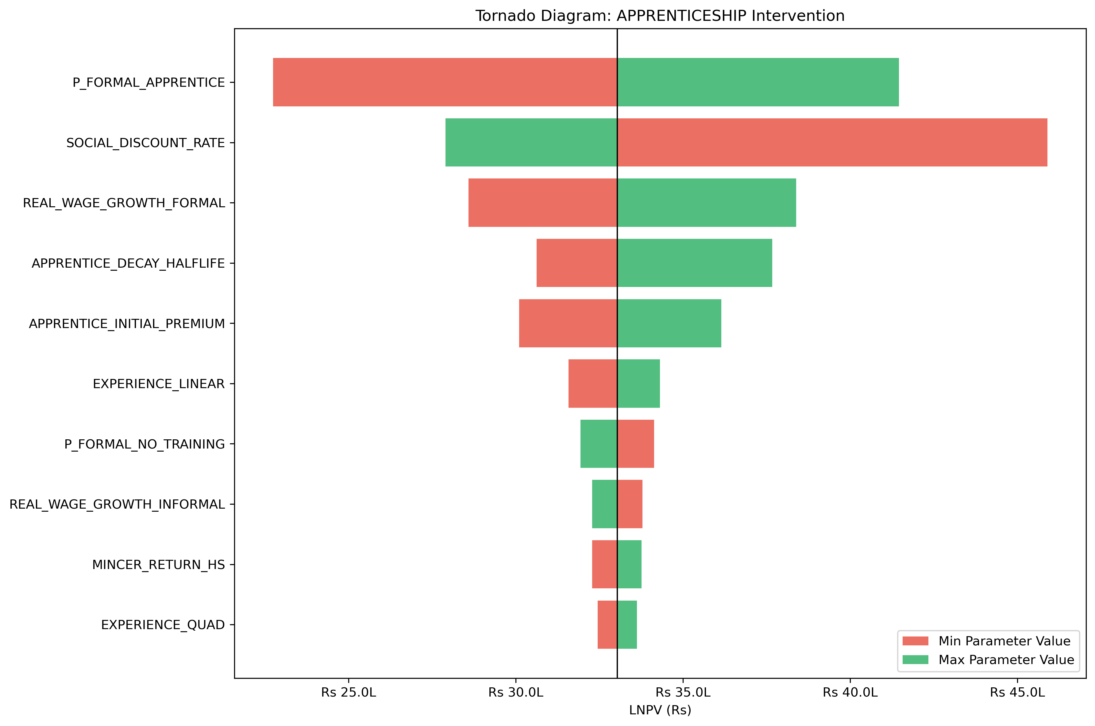
Sensitivity Analysis: What Parameters Matter Most?
RTE: P(Formal) is the top driver
Apprenticeship: Placement rate dominates
💡 Tornado diagrams show how LNPV changes when each parameter varies across its uncertainty range. Wider bars = more influential parameters.

Slide 11
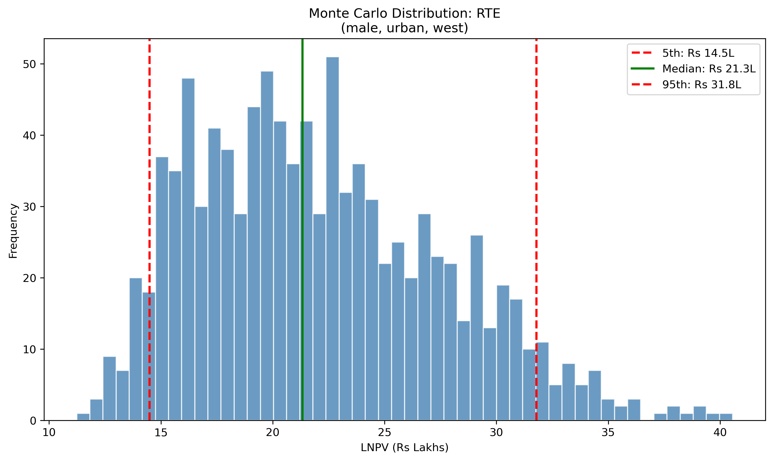
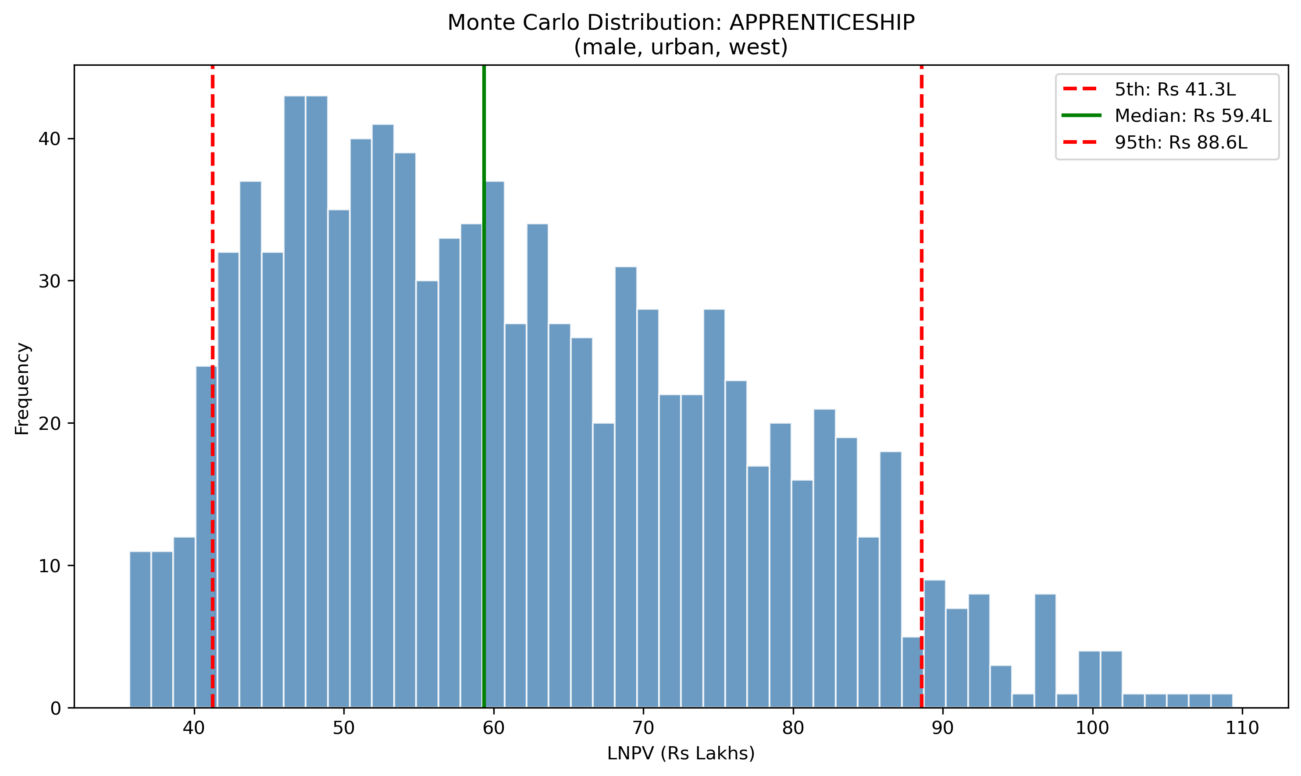
Uncertainty Quantification: 1,000 Monte Carlo Simulations
RTE: Median Rs 13.6L, 90% CI Rs 5.2-27.5L
Apprenticeship: Median Rs 40.5L, 90% CI Rs 22-62L
💡 Monte Carlo draws random parameter values 1,000 times to show the distribution of possible outcomes. P(positive) = 100% for both interventions.

Slide 12
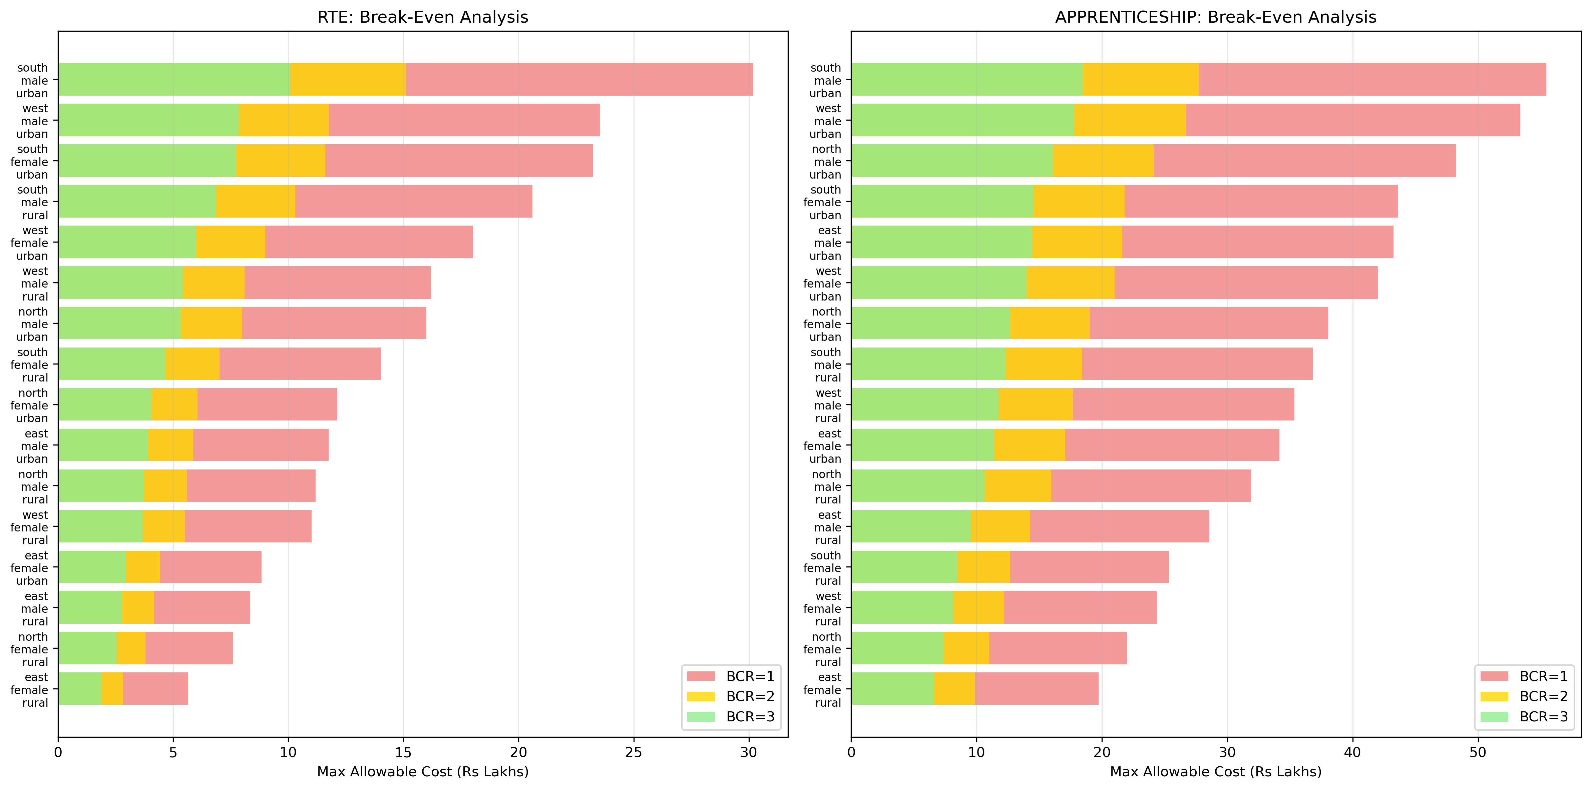
Cost-Benefit Positioning: Massive Safety Margin
Both interventions operate far below break-even thresholds
💡 Actual costs are 5× below RTE's break-even and 8× below Apprenticeship's break-even at BCR=3:1. Strong investment case.

Slide 13
Dual BCR Analysis: Two Perspectives on ROI
Metric | RTE | Apprenticeship
Average LNPV | Rs 14.9 Lakhs | Rs 36.4 Lakhs
Full BCR (Total Investment) | 14.3:1 (5.4-29.0) | 23.0:1 (12.5-35.0)
RWF-only BCR (Direct Spend) | 372:1 (141-755) | 606:1 (329-924)
RWF Direct Cost | Rs 4,000 | Rs 6,000
Total Investment | Rs 1.04 Lakhs | Rs 1.58 Lakhs
Unlock Multiplier | 26× | 39.6×
💡 Full BCR: Total benefits / total costs (RWF + govt + private). RWF-only BCR: Total benefits / RWF direct spend only.

Slide 14
BCR Sensitivity: Discount Rates
Discount Rate | RTE LNPV | RTE BCR (Full) | App LNPV | App BCR (Full)
3% (low) | Rs 32.8L | 31.5:1 | Rs 74.9L | 47.2:1
5% (central) | Rs 23.5L | 22.6:1 | Rs 53.4L | 33.7:1
8% (high) | Rs 15.7L | 15.1:1 | Rs 35.1L | 22.2:1
💡 Even at 8% discount rate (conservative), BCRs remain highly positive. All scenarios exceed the 3:1 development program threshold.

Slide 15
Gender Funnel: Current Data & Key Gaps
Apprenticeship Funnel
RTE Funnel
• Mobilized > Registered > Enrolled > Completed > Certified > Placed > Formal > Retained
• P(Formal|Apprentice) = 68% (blended)
• Gender breakdown: NOT YET AVAILABLE
• Female share est. ~30-40% of enrollees
• If female P(Formal) is 55% vs 68%, model overstates female NPV by ~24%
• Mobilized > Enrolled > Completed Gr 8 > Completed Gr 12 > Labor Market > Formal
• P(Formal|RTE) = 30% (expert assumption)
• Gender breakdown: NOT YET AVAILABLE
• Female LFPR = 37% vs 78% male (PLFS)
• Gender wage gap: 24% formal, 32% informal (urban)
💡 Immediate action: re-query RWF's 68% placement data by gender. This single data point would improve the model at near-zero cost.

Slide 16
Trade Mix & Skill Half-Life: NPV by Trade Category
Category | Example Trades | Half-Life | NPV vs Baseline
A: Rapid Obsolescence | IT/ITES, Digital Marketing | 5-8 yrs | 57-84%
B: Moderate Decay | Auto Mechanic, CNC, COPA | 8-12 yrs | 92-114%
C: Durable Skills | Electrician, Plumber, Welder | 12-18 yrs | 114-145%
D: Long-Term Persistent | Health Asst, Draughtsman | 18-25 yrs | 145-170%
💡 National NATS trade mix is dominated by Category C (43% share), suggesting the model baseline (h=10) may be slightly conservative. Weighted avg h ~ 11.4 years.

Slide 17
Trade Mix Scenarios: BCR Impact
Scenario | Weighted h | NPV (approx.) | Full BCR | vs Baseline
IT-Heavy (pessimistic) | 9.2 yrs | Rs 7.5L | 4.7:1 | -6%
Balanced National | 11.4 yrs | Rs 8.8L | 5.6:1 | +10%
Manufacturing-Heavy | 15.1 yrs | Rs 10.5L | 6.7:1 | +32%
Model baseline | 10 yrs | Rs 8.0L | 5.1:1 | --
💡 Steering youth toward durable trades (electrician, plumber, welder) could increase apprenticeship NPV by ~31%.

Slide 18
Top 5 Evidence Sources
# | Source | Used For | Sample | Confidence
1 | PLFS 2023-24 | Baseline wages, employment | ~433K individuals | HIGH
2 | ILO India Employment 2024 | Formal entry rates, youth | PLFS microdata | HIGH
3 | Chen et al. (2022) | Mincer returns (5.8%/yr) | ~100K households | MODERATE
4 | Muralidharan (2013) | RTE test score gain (0.137 SD) | 18,926 obs (RCT) | MODERATE
5 | RWF Data (Nov 2025) | Placement rate (68%) | RWF participants | HIGH
💡 Of 12 high-impact parameters, only 1 has HIGH confidence (P_FORMAL_APPRENTICE). The tracer study targets the 3 LOW-confidence parameters.

Slide 19
Tracer Study: Closing the Evidence Gaps
• Sample: 1,200-1,600 (300-400 RTE + 300-400 Apprentice + comparison group)
• Cohorts: 2015-2024 (expanded vintage for cross-cohort decay estimation)
•
• Priority research questions:
• 1. P_FORMAL_RTE validation (currently 30%, zero empirical data)
• 2. External validation of P_FORMAL_APPRENTICE (currently 68%)
• 3. Trade-specific decay estimation (IT vs electrician vs health)
• 4. Gender-disaggregated outcomes (placement, wages, retention)
•
• Timeline: 18 months core | Budget: Rs 45-55 lakhs
• Expected: reduce parameter uncertainty from +/-50% to +/-15-20%
💡 One investment (Rs 45-55L) closes 7 of 8 evidence gaps simultaneously. This is the single most cost-effective next step.

Slide 20
Policy Persistence: Multi-Cohort Impact (Illustrative)
Scenario | Years Post-Exit | Attribution | Multiplier | Effective BCR (RTE)
Conservative | 5 yrs | 20% | 1.86x | 10.2x
Moderate | 10 yrs | 40% | 4.40x | 62.9x
Optimistic | 15 yrs | 60% | 9.31x | 395.0x
💡 ILLUSTRATIVE ONLY: Attribution fractions have no empirical basis. Shows how persistence compounds value — single-cohort BCR is a conservative floor.

Slide 21
Ask & Next Steps
• 1. Approve tracer study launch (Rs 45-55L, 18 months)
• -> Validates the 3 LOW-confidence parameters that drive BCR
•
• 2. Request actual cost data (RWF direct spend per beneficiary)
• -> Enables precise RWF-only BCR calculation
•
• 3. Re-query 68% placement rate by gender (1-2 weeks, near-zero cost)
• -> Immediate model improvement
•
• 4. Microdata access: PLFS unit records + RWF beneficiary contact database
• -> Needed for tracer sampling frame and enhanced calibration
•
• 5. Pilot lightweight exit survey for next 2-3 completing cohorts
• -> Generates gender-disaggregated data before tracer results arrive

Slide 22
Decision Framework: Which Intervention When?
If your priority is... | Consider... | Because...
Max per-beneficiary impact | Apprenticeship | 2.5× higher LNPV
Max reach with limited budget | RTE | Lower cost, simpler delivery
Serve underserved regions | Targeted Apprenticeship | Higher marginal returns
Long-term systemic change | RTE | Generational education shift
Quick wins / demonstrable outcomes | Apprenticeship | Faster employment results

Slide 23
Appendix

Slide 24
Key Assumptions & Confidence Levels
Parameter | Value | Range | Confidence | Tracer?
P(Formal|RTE) | 30% | 20-50% | LOW | Yes
P(Formal|Apprentice) | 68% | 50-90% | HIGH | Yes
Decay Half-Life | 10 yrs | 5-50 yrs | LOW | Partial
RTE Retention | 60% | 50-75% | LOW | Yes
Completion Rate | 85% | 75-95% | LOW | Yes
Mincer Return | 5.8%/yr | 5-8% | MODERATE | No
Discount Rate | 5% | 3-8% | MODERATE | No
Wage Growth (Formal) | 1.5%/yr | 0.5-2.5% | MODERATE | No
💡 Of 12 high-impact parameters, only 1 has HIGH confidence. The tracer study (Rs 45-55L) would validate the 4 most uncertain parameters.

Slide 25
Thank You
Both interventions generate positive returns in ALL 32 scenarios tested. The key question is how to optimize delivery for maximum impact. RWF Economic Impact Model • February 2026

