Slide 1
SMARTBIN CONNECT
CONNECTED WASTE OPERATIONS
A smarter way to
monitor and collect
Ultrasonic fill sensing • ESP32 control • AI-assisted dispatch
Hardware Design and Implementation
Max Kabechani | Prof. J. Phiri | 15 October 2026
SMARTBIN CONNECT • HARDWARE DESIGN & IMPLEMENTATION
01

Slide 2
01 / PROJECT IDEA
From fixed collection to fill-aware operations
THE PROBLEM
THE SMARTBIN RESPONSE
Blind collection
Sense
Share
A schedule cannot tell whether a bin is nearly empty or overflowing.
Ultrasonic distance estimates available capacity.
Wi-Fi sends readings to a role-based web portal.
→
Slow response
Prioritize
Collect
Staff may only learn about a full bin after someone reports it.
AI service estimates time to capacity and priority.
Dispatch queue and routes turn alerts into work.
Design choice: one simple compartment, with smart sensing and collection coordination as the innovation.
SMARTBIN CONNECT • HARDWARE DESIGN & IMPLEMENTATION
02

Slide 3
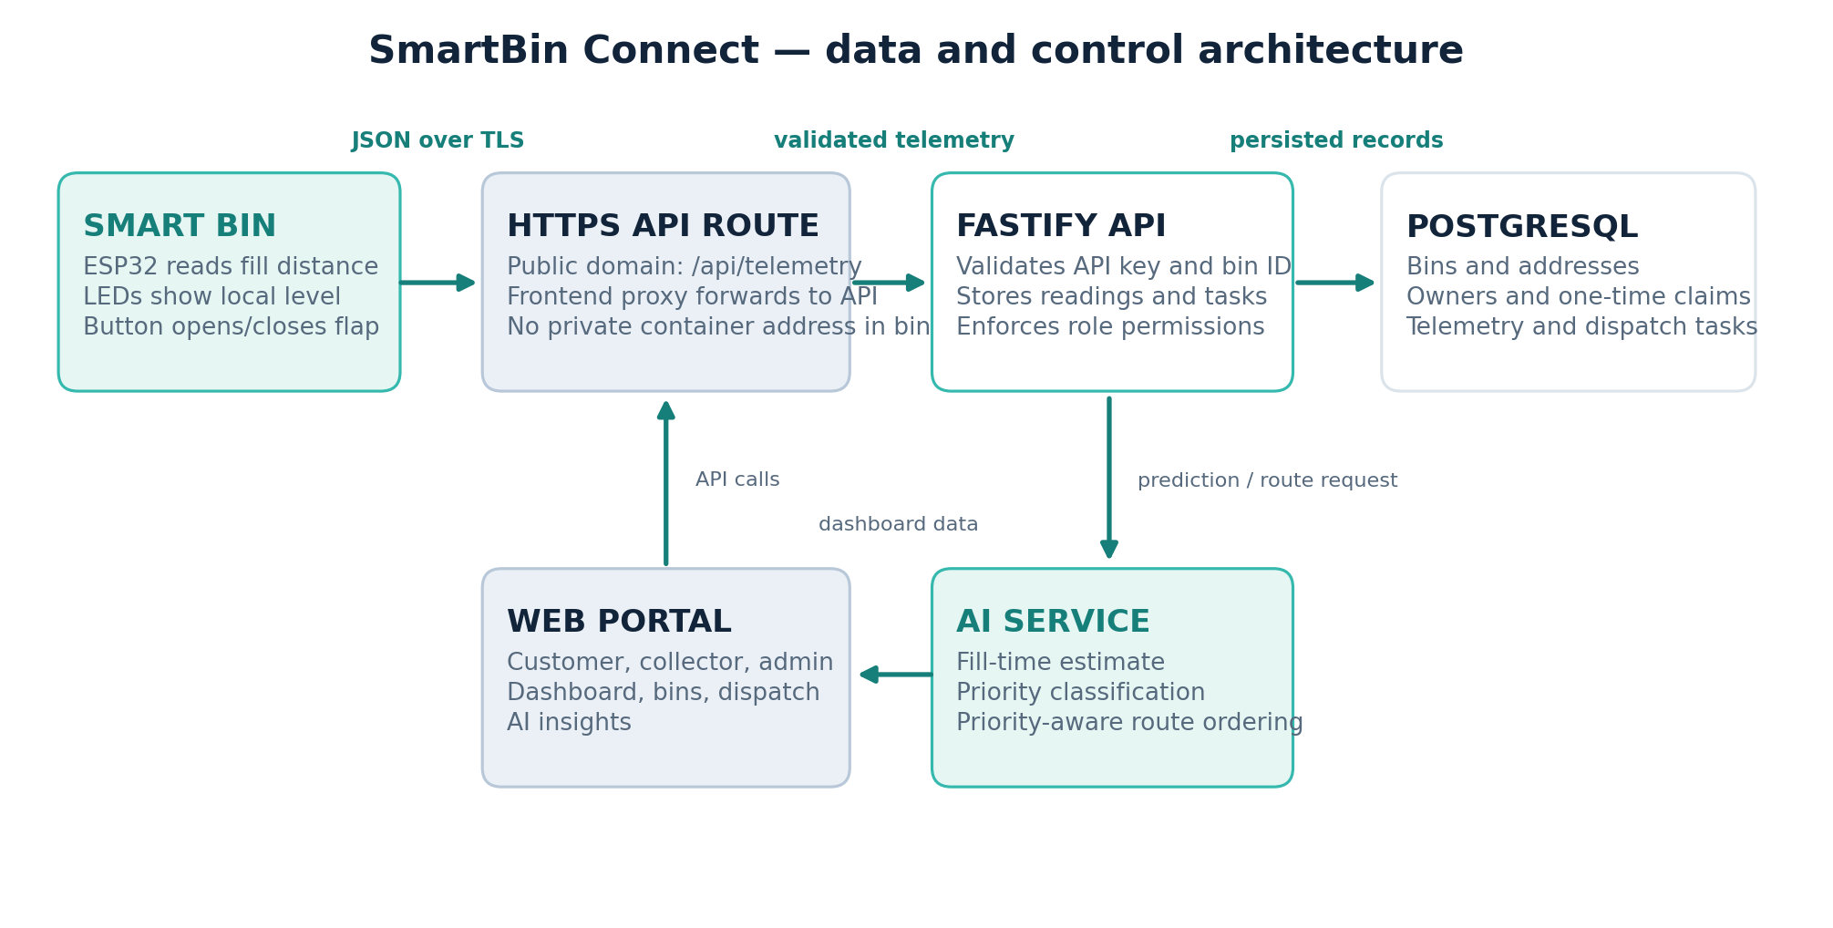
02 / SYSTEM ARCHITECTURE
One connected loop from bin to collection
The device calls the public HTTPS domain; the site forwards /api traffic to the private backend service.
SMARTBIN CONNECT • HARDWARE DESIGN & IMPLEMENTATION
03

Slide 4
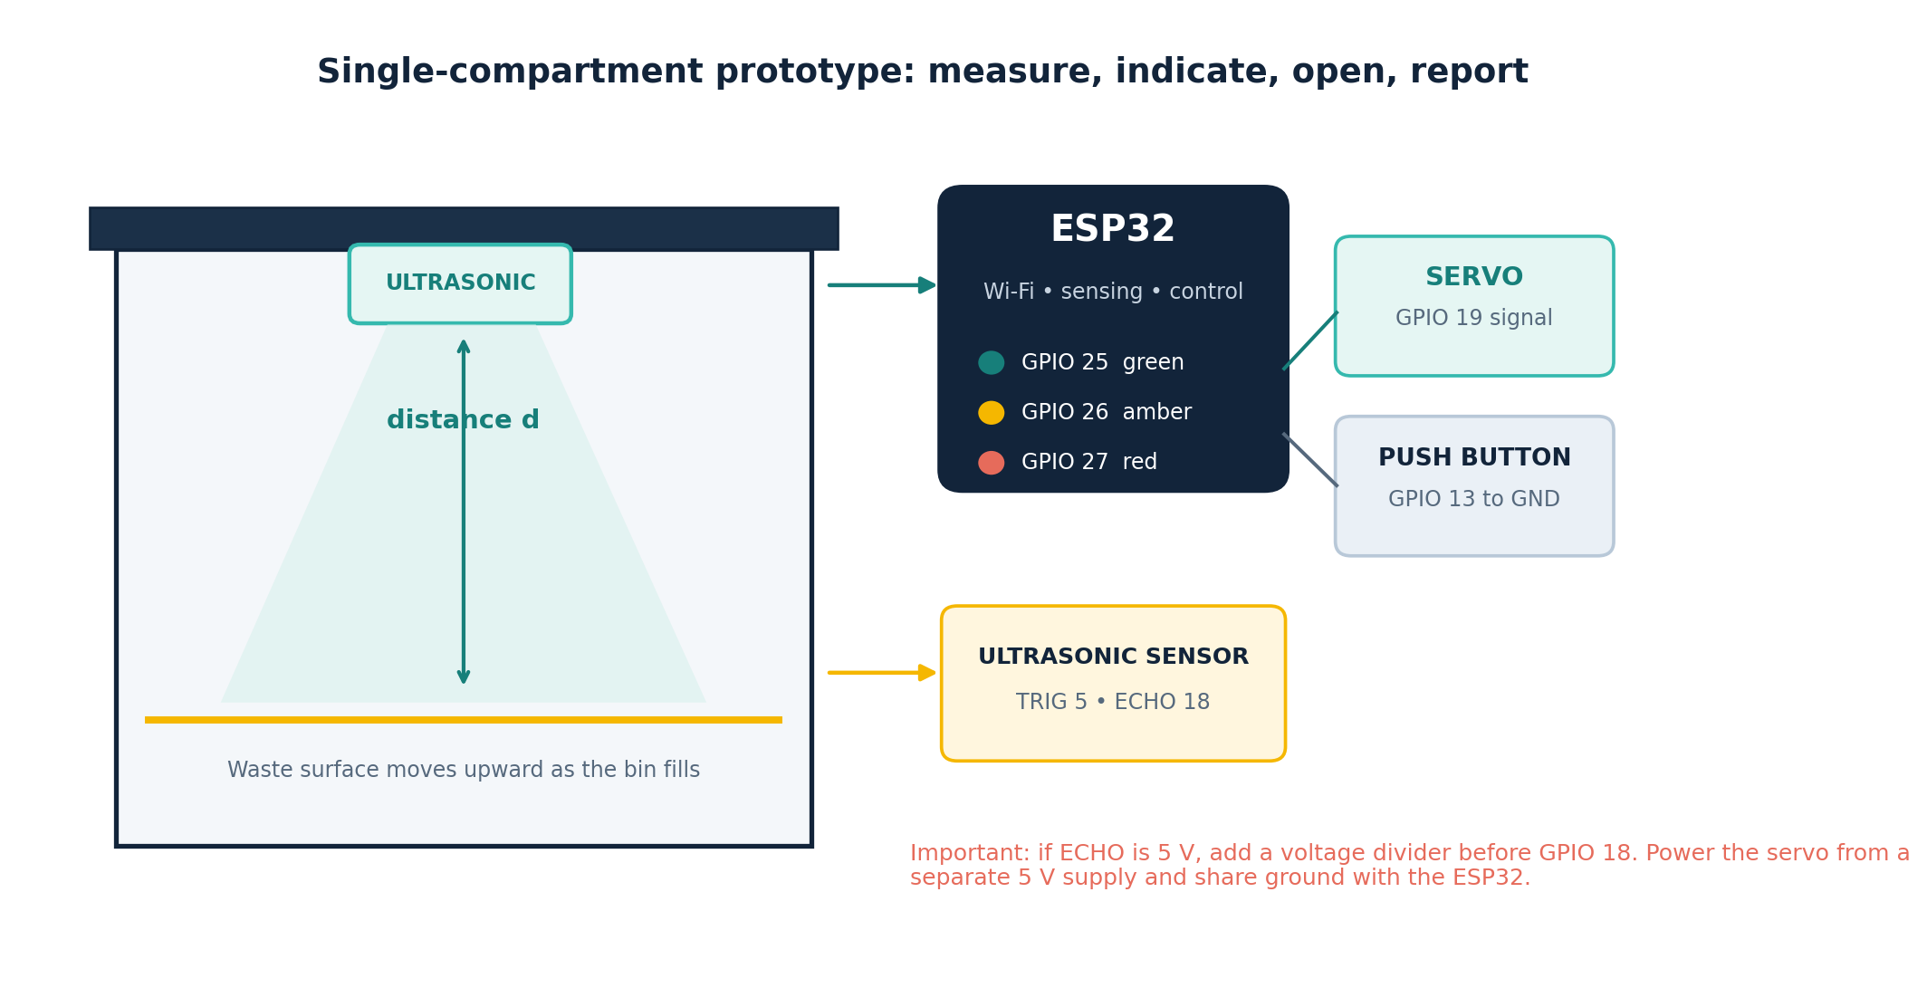
03 / HARDWARE DESIGN
Hardware: simple parts, clear signals
ESP32
Sensor read • Wi-Fi • LEDs • servo
Ultrasonic sensor
TRIG GPIO 5 • ECHO GPIO 18
Indicators + input
LEDs 25/26/27 • button 13
Servo flap
Signal GPIO 19 • separate 5 V supply
Safety: divide a 5 V ECHO signal to 3.3 V; share ground with the separately powered servo.
SMARTBIN CONNECT • HARDWARE DESIGN & IMPLEMENTATION
04

Slide 5
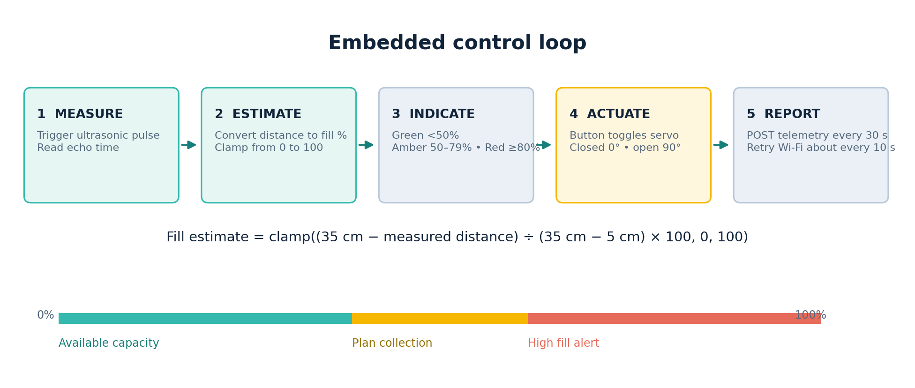
04 / EMBEDDED CONTROL
Firmware turns distance into a useful action
Reference range
Reporting
Network recovery
35 cm empty • 5 cm full
Every 30 s + on flap toggle
Wi-Fi retry about every 10 s
SMARTBIN CONNECT • HARDWARE DESIGN & IMPLEMENTATION
05

Slide 6
05 / OPERATIONS PORTAL
The portal gives each role the right actions
ADMINISTRATOR
CUSTOMER
COLLECTOR
Register bins, add addresses and coordinates, create collectors, and manage roles.
Claim a registered bin with its one-time code, view readings, and request collection.
Review prioritized open tasks, follow the route order, and close each task after pickup.
REGISTER → CLAIM → MONITOR → REQUEST / ALERT → ROUTE → COLLECT
The API enforces permissions server-side; hiding a button is not the security boundary.
SMARTBIN CONNECT • HARDWARE DESIGN & IMPLEMENTATION
06

Slide 7
06 / PREDICTION + ROUTING
AI turns readings into collection priorities
FILL-TIME MODEL
PRIORITY LABEL
ROUTE HEURISTIC
Random Forest estimates hours to capacity from fill and time features.
Urgent ≥90% or ≤4 h • High ≥80% or ≤12 h • Medium ≥60%.
Priority-weighted nearest neighbour orders located stops using distance.
HONEST STATUS • Training data is synthetic (1,600 generated examples). Live prediction currently supplies fill level; fill rate and time since collection are defaulted. Accuracy is not yet measured.
AI is the decision workflow: estimate → prioritize → suggest stops. Real collection history is the next step.
SMARTBIN CONNECT • HARDWARE DESIGN & IMPLEMENTATION
07

Slide 8
07 / DEMONSTRATION
Prototype evidence and live demo path
1
Show hardware
Sensor above waste, LED bands, button and open flap.
2
Show live data
Move a target; verify fill update reaches the portal.
3
Show the workflow
Request collection, open dispatch, follow route, close task.
4
Explain the AI
Priority estimate plus route heuristic; explain synthetic-data limit.
Verification: stub-based C++ syntax check passed; ESP32 compile and physical bench tests still need confirmation.
SMARTBIN CONNECT • HARDWARE DESIGN & IMPLEMENTATION
08

Slide 9
SMARTER COLLECTION STARTS WITH BETTER SIGNALS
Measure what is inside.
Move collection when it matters.
SmartBin Connect joins a real-world sensor, a simple actuator, and an operations portal.
NEXT 1
NEXT 2
NEXT 3
Bench-test the sensor and servo.
Validate a full telemetry cycle.
Train with real collection history.
SMARTBIN CONNECT • HARDWARE DESIGN & IMPLEMENTATION
09

