Slide 1
Notes on Two Concepts of Causation by Ned Hall with some links to econometrics
Jeremy Large
19 November 2024

Slide 2
Backdrop
Ned Hall's essay, "Two Concepts of Causation“, was published in 2004
A chapter in Causation and Counterfactuals, edited by him, Collins, and Paul.
At that point, dependence analyses of cause were popular
counterfactuals : “If A hadn’t occurred, B wouldn’t have occurred”
eg David Lewis’s work
I understand this paper as introspecting about what we mean/are doing when we say “causation”, “cause” etc. in various cases.
So, it has an ordinary language philosophy element

Slide 3
Dependence v Production
Dependence theories of causation
Counterfactual dependence between distinct events.
Event c causes distinct event e only if, had c not occurred, e would not have occurred.
Nb this just one of several counterfactual-based accounts put forward at the time
Production view of causation
Generation or bringing-about of one event with another.
You see a direct, often physical, connection between cause and effect.
“Event c helps to generate or bring about, or produce, another event e”
Nb it only helps
Also, who does it help?

Slide 4
Dependence + ? = causation
What do we add to ‘dependence’ to get the concept of causation?
Candidates:
Locality: Causes are connected to their effects via spaciotemporally continuous sequences of causal intermediates.
Intrinsicness: The causal structure of a process is determined by its intrinsic character and the laws.
Transitivity: If c causes d, and d causes e, then c causes e.

Slide 5
Two stones and a bottle
Overdetermination
Both Suzy and Billy throw rocks at a bottle. Suzy's rock hits first and shatters the bottle. Even if Suzy hadn't thrown, Billy's rock would have shattered it soon after.
Did Susy’s throw cause the bottle to break?
Didn’t Billy’s throw have an effect as well?

Slide 6
Failing to foil a bomber
Double-prevention
In a World War, Suzy is piloting a bomber on a mission, and Billy is her escort in a fighter jet. Enemy takes-off in pursuit.
Enemy is about to shoot down Suzy. But Billy shoots down Enemy first. If Billy had not shot Enemy, the bombing would have failed.
One event prevents another event from preventing a third event.
Was Billy’s shot a cause of the bombing?
Was Enemy’s failure to shoot (omission) a cause of the bombing?
Was Enemy’s 6am alarm that morning a cause the bombing?

Slide 7
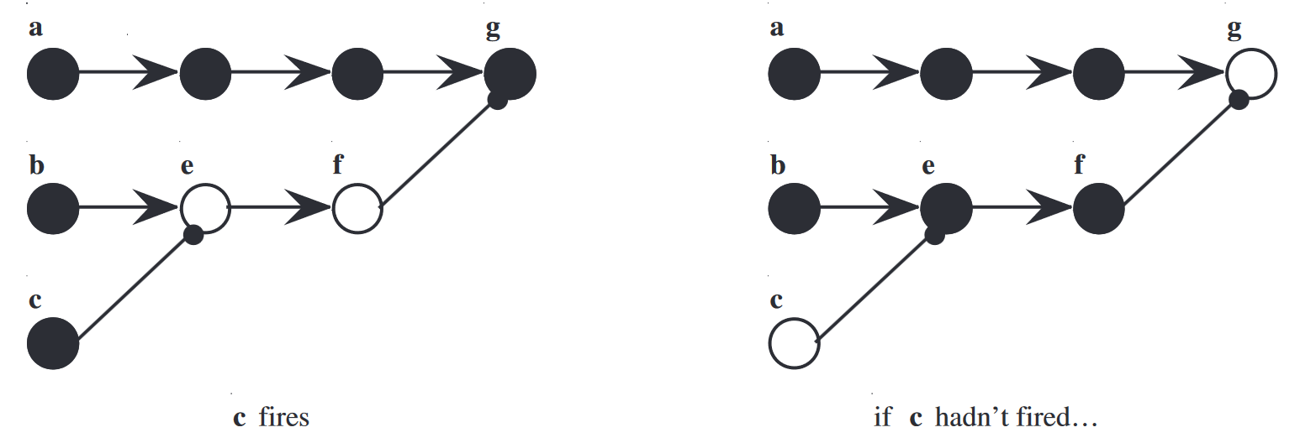
DAGs of war
Double-prevention

Slide 8
Tensions Between Theses
In our thought experiments, conflicts arise between:
- Dependence and Transitivity
- Dependence and Locality
- Dependence and Intrinsicness
But, Ned Hall suggests, they are all true theses!
Hall’s resolution: multiple concepts of causation, including production.

Slide 9
Hall’s two categories
Dependence causation
Production causation
Handles cases involving omission
Handles causation at a distance
Does not respect transitivity
Billy’s intercept
Respects locality
Respects intrinsicness
Often respects transitivity
Suzy’s throw
Precise analysis of this is more challenging.
One for future work 😊

Slide 10
Protecting a window from a ball
Double-prevention
McDermott (1995)
Catcher catches a cricket ball flying towards a fragile window.
Does Catcher prevent the window being shattered?
If the window is protected by a brick wall anyway, does Catcher prevent it being shattered?
If the window is protected by a world-class wicket-keeper, does Catcher prevent it being shattered?

Slide 11
Production causation & agency
Recall Ned Hall’s account:
A cause helps to generate, or bring about, or produce an effect
Physics:
Aristotle elaborates on four causes: material, formal, efficient, and final.
Efficient cause as the agent that actively brings about an effect.
Intention (1957):
Anscombe argues that causation is intimately tied to human agency and intentionality.
Philosophical Investigations (1953):
Wittgenstein reviews how people express causation in language and practice.
Suggests causal explanations are often contextual and tied to everyday life.

Slide 12
Statistical dependence? (1/2)
Hall’s dependence causation, as related here, is deterministic:
If c had not occurred, then e would (definitely) not have occurred
c and e are events
However, it would be good to carry his ideas over to statistical dependence.
So now let's think of events in a probability model: let’s capitalize C and E
For Hall’s dependence thesis, one might say, E is a subset of C

Slide 13
Statistical dependence (2/2)
C causally influences E if it raises the probability of E :
P(E | C) > P(E | ¬C).
And you can include a noise (confounder) term N:
P(E | C, N) > P(E | ¬C, N).
Using random variables X (for C) and Y (for E):
E[Y | X = 1] > E[Y | X = 0].
NB the conceptual symmetry between X=1 (action) and X=0 (omission).

Slide 14
Suspending X’s status as a RV
Recall, for causal influence we might require:
E[Y | X = 1] > E[Y | X = 0],
using X (for C) and Y (for E). But:
Pearl DAGs:
E[Y | do(X = 1)] > E[Y | do(X = 0)].
Ruben/Imbens Treatment Effects:
E[ Y(1) ] − E[ Y(0) ]
This reminds of production causation

Slide 15
Hall and causal inference
Framework | Dependence (Hall) | Production (Hall)
Potential Outcomes (Rubin / Inbens) | - If Treatment ↔ If No Treatment - intervention ↔ omission - RCT as the ‘ideal’ evidence | - physical or mechanistic continuity might be discussed in the theory section - but, often pessimistic about grasping the full rich DAG of a society - preference for ‘manipulable’ C
DAG / do-calculus (Pearl) | - dependence passes down the graph - a rich DAG can incorporate preemption and double prevention - how do we put free will into a DAG? | - you do(C) but you don’t do E. - quite ambitious about which causes it can handle
Granger | - statistical dependence | - add temporal ordering

