Slide 1
Sameness, Difference, and the Problem of Variable Construction
Lily Hu
Philosophy, Yale University
Overview Audit Studies: Canons of Interpretation Interpretation 1 Interpretation 2 Interpretation 3 Implications

Slide 2
Recap of Tuesday
The problem of sameness and difference
No two actually existing things are identical in all respects
X_{i} = X_{j} capture sameness and difference in only some respects, captured by features or variable representations in data
The problem of variable construction
How should we construct variables to appropriately capture what is significant in a given system, state of affairs, etc. in order to do science and pursue our normative aims?
Notes:
We need to define the thing that we are seeking to detect with our empirical methods. What is IT?

Slide 3
Today
1. What are the variables? 2. Are those variables apt to the task?

Slide 4
This is work with the incomparable Issa Kohler-Hausmann
Notes:
We need to define the thing that we are seeking to detect with our empirical methods. What is IT?

Slide 5
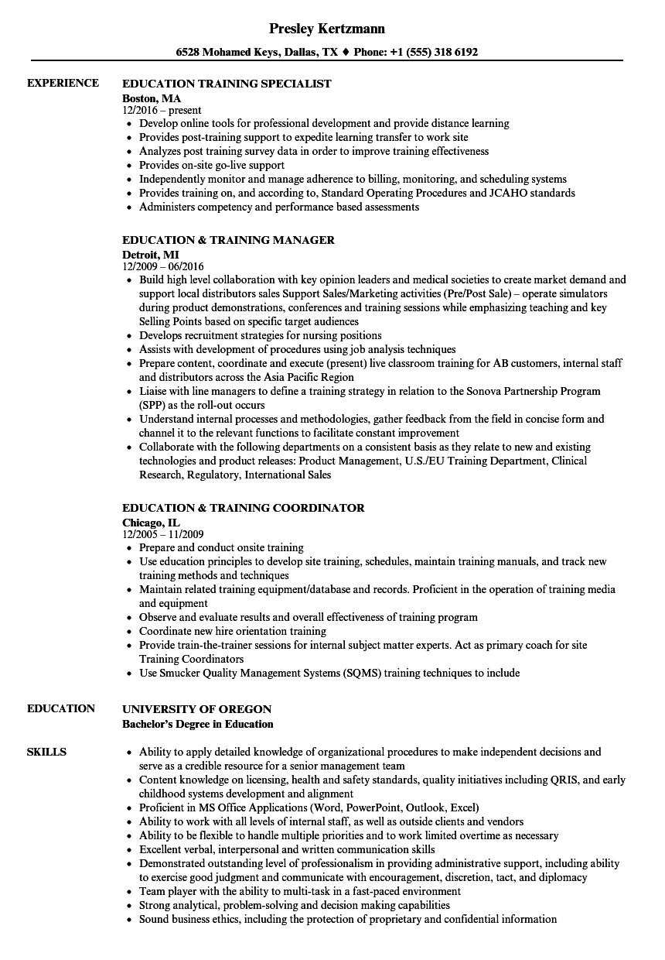
Audit Studies
Greg Baker
Jamal Jones
Bertrand and Mullainathan 2004, “Are Emily and Greg more employable than Lakisha and Jamal? A field experiment on labor market discrimination”

Slide 6

…and per many leading social scientists
“[W]e define discrimination throughout this chapter [as]: members of a minority group (women, Blacks, Muslims, immigrants, etc.) are treated differentially (less favorably) than members of a majority group with otherwise identical characteristics in similar circumstances.”
Marianne Bertrand & Esther Duflo, Field Experiments on Discrimination in Handbook of Economic Field Experiments (2017).

Slide 7
Some take audit or correspondence studies as the “gold standard” for identifying this counterfactual notion of discrimination
“[C]orrespondence audits remain the gold standard for documenting discrimination (Gaddis 2019b; Pedulla 2018; Quillian 2006).”
S. Michael Gaddis & Raj Ghoshal, Searching for a Roommate: A Correspondence Audit Examining Racial/Ethnic and Immigrant Discrimination among Millennials, Socius (Vol. 6, 2020).
“Auditing has not been tried or even discussed in the law enforcement field, which is surprising because for decades it has been a central tool in antidiscrimination research and civil rights enforcement more generally…auditing could provide something observational research usually cannot: causally rigorous analysis of police discrimination in a real-world setting.”
Sonja B. Starr, Testing Racial Profiling: Empirical Assessment of Disparate Treatment by Police, 2016 U. Chi. Legal F. 485, 487 (2016)
“Studies of behavior in a simulated laboratory environment[] offer the benefit of studying how people make decisions in situations where, by construction, the only variable that differs across encounters is the race of the subject.”
National Academies of Sciences, Proactive Policing: Effects on Crimes and Communities 256 (2018)
Overview Audit Studies: Canons of Interpretation Interpretation 1 Interpretation 2 Interpretation 3 Implications
Notes:
The claim seems to be that such studies detect this conception of discrimination BECAUSE they are able to methodologically achieve isolation of race from other causal variables…
What does “unobserved individual heterogeneity” mean - what is the fear there? That something OTHER THAN the causal effect of race is confounding the estimand.
“The advocates of correspondence studies argue that the method provides the most clear and convincing evidence of discrimination. Their main argument is that a carefully designed correspondence study can identify discriminatory treatment by employers since the signal of group belonging is randomized. This circumvents the problem with unobserved individual heterogeneity – a common problem in studies using administrative data.”
Carlsson, M., Fumarco, L. & Rooth, DO. Does the design of correspondence studies influence the measurement of discrimination?. IZA J Migration 3, 11 (2014). https://doi.org/10.1186/2193-9039-3-11
We can also include:
““Racial discrimination is defined with reference to counterfactual notions of causality developed in statistics: racial discrimination for an individual is the difference in an outcome if an individual were of one race contrasted to another race…we must use indirect techniques to estimate the magnitude of racial discrimination.””
Lincoln Quillian, Book Review,
35 CONTEMP. SOC. 88, 89 (2006)

Slide 8

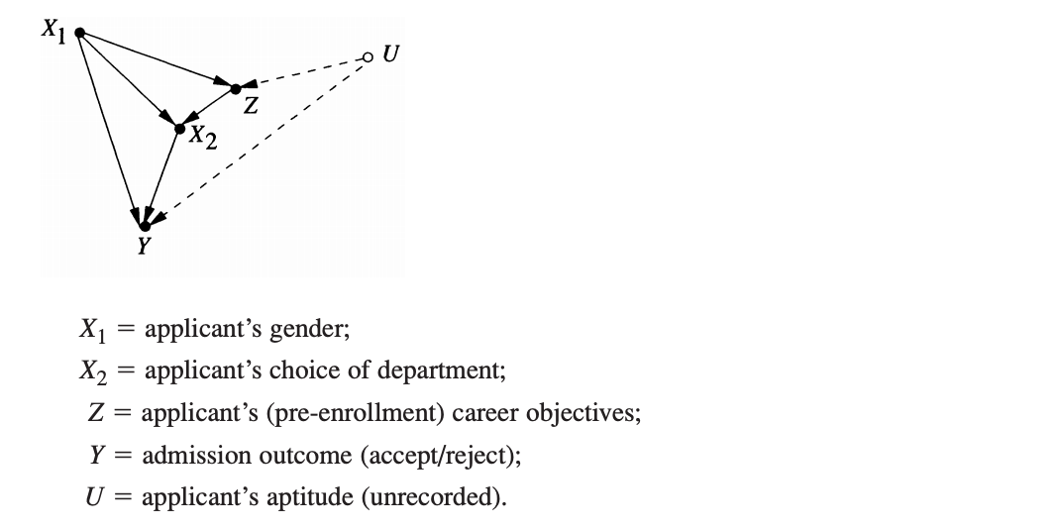
Counterfactual definition of discrimination
“U.S. courts have issued clear directives as to what constitutes employment discrimination. According to law makers, ‘The central question in any employment-discrimination case is whether the employer would have taken the same action had the employee been of a different race (age, sex, religion, national origin etc.) and everything else had been the same.’”
Judea Pearl, Madelyn Glymour, and Nicholas P. Jewell. Causal Inference in Statistics: A Primer. Wiley, 2016 (citing Carson vs Bethlehem Steel Corp., 70 FEP Cases 921, 7th Cir. (1996).)
Overview Audit Studies: Canons of Interpretation Interpretation 1 Interpretation 2 Interpretation 3 Implications

Slide 9
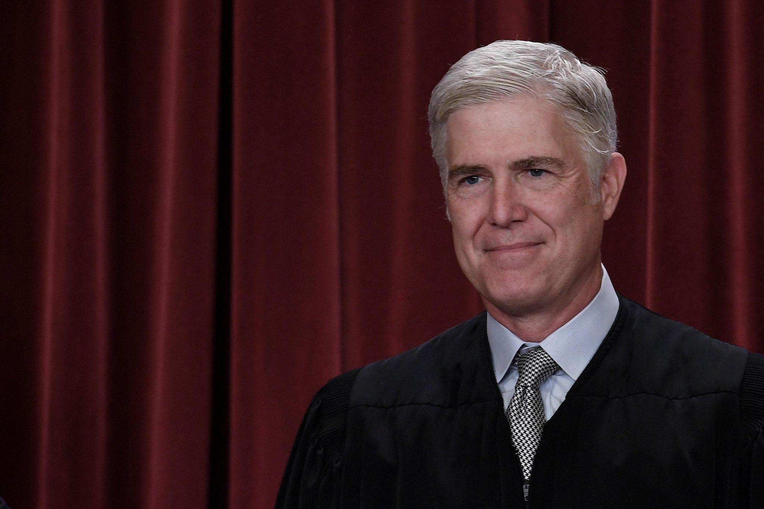
In the Supreme Court and domestic legal system…
In the National Research Council’s definition of measuring discrimination…
“To prevail, a plaintiff must initially plead and ultimately prove that, but for race, it would not have suffered the loss of a legally protected right.”
Comcast Corp. v. Nat’l Ass’n of African Am.-Owned Media, 140 S. Ct. 1009, 1019 (2020) (Gorsuch, J., majority opinion.)
The National Research Council’s report entitled Measuring Racial Discrimination says, “to measure discrimination researchers must answer the counterfactual question: What would have happened to a nonwhite individual if he or she had been white?”
National Research Council et al., Measuring Racial Discrimination 77 (National Academies Press 2004).
Overview Audit Studies: Canons of Interpretation Interpretation 1 Interpretation 2 Interpretation 3 Implications

Slide 10

Whether a manipulation constitutes an intervention depends on:
what the operation does to its target variable X, and
what it doesn’t do to the other causal factors that link up to Y.
changes only its target, leaves everything else “as is”
need a theory of what it is for everything else (that is causally relevant) to be “the same”

Slide 11
Audit Studies
Greg Baker
Jamal Jones
Bertrand and Mullainathan 2004, “Are Emily and Greg more employable than Lakisha and Jamal? A field experiment on labor market discrimination”

Slide 12
Audit Studies
Z
Greg Baker
Jamal Jones
X₁
X₂
X₃
Bertrand and Mullainathan 2004, “Are Emily and Greg more employable than Lakisha and Jamal? A field experiment on labor market discrimination”

Slide 13
Audit Studies
“different!”
Z
Greg Baker
Jamal Jones
“same”
X₁
“same”
X₂
“same”
X₃
Bertrand and Mullainathan 2004, “Are Emily and Greg more employable than Lakisha and Jamal? A field experiment on labor market discrimination”

Slide 14
Audit Studies
“race”
Z
Greg Baker
Jamal Jones
“non-race”
X₁
X₂
X₃
Bertrand and Mullainathan 2004, “Are Emily and Greg more employable than Lakisha and Jamal? A field experiment on labor market discrimination”

Slide 15
An example of a notable audit study…
Greg Baker
Jamal Jones
Marianne Bertrand & Sendhil Mullainathan, Are Emily and Greg more employable than Lakisha and Jamal? A field experiment on labor market discrimination, 94, Am. Econ. Rev., 991, 991-1013 (2004). (Artistic license on resume content).
Overview Audit Studies: Canons of Interpretation Interpretation 1 Interpretation 2 Interpretation 3 Implications
Notes:
Possibility of manipulation

Slide 16
Audit studies: What is the treatment vs. confounders?
Every version makes some assumptions. The question is what assumptions are apt to make for the question at hand:
1
The study reveals the causal effect of presenting Blob 1 Stimulus vs. Blob 2 Stimulus on callbacks.
Interpretation 1
2
The study reveals the causal effect of perceiving different race but perceiving the ‘same’* job experience, education, etc. on callbacks.
Interpretation 2
3
The study reveals the causal effect of perceiving different race AND perceiving the “same”* job experience, education pertaining to different racialized candidates on callbacks
Interpretation 3
*where ‘same’ vs. “same” have different meanings
Overview Audit Studies: Canons of Interpretation Interpretation 1 Interpretation 2 Interpretation 3 Implications

Slide 17
Audit studies: What is the treatment vs. confounders?
Every version makes some assumptions. The question is what assumptions are apt to make for the question at hand:
1
The study reveals the causal effect of presenting Blob 1 Stimulus vs. Blob 2 Stimulus on callbacks.
Interpretation 1 “The Retreat”
2
The study reveals the causal effect of perceiving different race but perceiving the ‘same’* job experience, education, etc. on callbacks.
Interpretation 2 “The Mixed Treatment”
3
The study reveals the causal effect of perceiving different race AND perceiving the “same”* job experience, education pertaining to different racialized candidates on callbacks
Interpretation 3
“The Becker"
*where ‘same’ vs. “same” have different meanings
Overview Audit Studies: Canons of Interpretation Interpretation 1 Interpretation 2 Interpretation 3 Implications

Slide 18
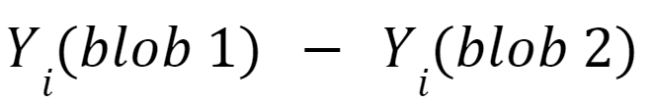
The Retreat: Treatment is Blob 1 vs. Blob 2
This version takes the treatment to be exposing a person to some stimuli, and the only assumption is that the two treatments are different insofar as the two stimuli differ in some respects.
It makes no assumption about the meanings (if any) perceived by decision makers when they see, e.g., Blob 1.
It’s just a “blob,” because no assumptions are made at all about the contents of the résumés, so no grounds to distinguish between the résumé’s “work experience” text vs. the “name” text, or even to call any part of the blob “text”!
Blob 1
Greg Baker
Overview Audit Studies: Canons of Interpretation Interpretation 1 Interpretation 2 Interpretation 3 Implications

Slide 19
The Retreat: Blob 1 vs. Blob 2
Some problems:
It’s no longer about race: Because no assumptions are made about the meanings perceived, there is no ground to call it a study of the causal effects of perceiving race
Lack of connection between stimuli: Because no assumptions are made about the meanings perceived by the other text, what was the point of creating résumés with the “same” text?
Lack of similarity between stimuli: Can’t assume the résumés are “the same” in any respect. In fact, no grounds to even call it a résumé! It is just a blob stimulus. Or the treatment is just “doing [action A] vs. [action B].”
Overview Audit Studies: Canons of Interpretation Interpretation 1 Interpretation 2 Interpretation 3 Implications

Slide 20
The Retreat: Blob 1 vs. Blob 2
The implication is that any way that the outcomes vary across the two treatments counts as an effect of interest.
E.g., if the decisionmaker takes the stimulus to be a sign from the dieties that he must crumple and eat the résumé, that counts as an effect of the treatment as opposed to non-compliance with the treatment
Overview Audit Studies: Canons of Interpretation Interpretation 1 Interpretation 2 Interpretation 3 Implications

Slide 21
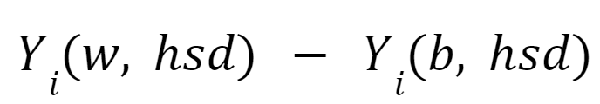
The Mixed Treatment: Different perceptions of race but perception of the ‘same’ formal résumé credentials
This is how a lot of folks interpret the results of audit studies. It appears that they are after the following causal contrast:
b indicates perception of Black w indicates perception of white hsd indicates perception that the candidate has met the formal requirements of obtaining a high school diploma
Overview Audit Studies: Canons of Interpretation Interpretation 1 Interpretation 2 Interpretation 3 Implications

Slide 22
The Mixed Treatment: Different perceptions of race but perception of the ‘same’ formal résumé credentials
ASSUMPTIONS - INTERPRETATION #2
Read “Greg”
→ Assume decisionmaker perceives the candidate to be racialized white
Read “Education: High school diploma from Berkeley High School”
→ Assume decisionmaker perceives a candidate they believe to have met the formal requirements of getting a HSD from Berkeley High
Read “Jamal”
→ Assume decisionmaker perceives the candidate to be racialized Black
Read “Education: High school diploma from Berkeley High School”
→ Assume decisionmaker perceives a candidate they believe to have met the formal requirements of getting a HSD from Berkeley High
Overview Audit Studies: Canons of Interpretation Interpretation 1 Interpretation 2 Interpretation 3 Implications

Slide 23
The Mixed Treatment: Different perceptions of race but perception of the ‘same’ formal résumé credentials
Not Assuming:
Not assuming that when the decisionmaker perceives a candidate they believe to have met the formal requirements of getting a HSD from Berkeley High, such a perception produces any specific impression regarding that candidate’s productivity, level of human capital, or other indicia of merit
This is why researchers often say that part of the “effect” audit studies are testing for is whether the decision maker devalues (e.g.) educational credentials “because of race”
Overview Audit Studies: Canons of Interpretation Interpretation 1 Interpretation 2 Interpretation 3 Implications

Slide 24
The Mixed Treatment: Different perceptions of race but perception of the ‘same’ formal, résumé credentials
For instance…
"Whites with higher-quality resumes receive nearly 30-percent more callbacks than Whites with lower-quality resumes. On the other hand, having a higher-quality resume has a smaller effect for African-Americans…In other words, the gap between White and African-Americans widens with resume quality. While one may have expected improved credentials to alleviate employers’ fear that African-American applicants are deficient in some unobservable skills, this is not the case in our data."
Marianne Bertrand & Sendhil Mullainathan, Are Emily and Greg more employable than Lakisha and Jamal? A field experiment on labor market discrimination, 94, Am. Econ. Rev., 991, 992 (2004).
Overview Audit Studies: Canons of Interpretation Interpretation 1 Interpretation 2 Interpretation 3 Implications
Notes:
Seem to be saying that part of the causal mechanism that they intent to sweep IN with the study design is assigning dissimilar value to the same formal credentials

Slide 25
Researchers often seem to imply they are pursuing Interpretation #2
“Much of the economics literature has focused on separating the contributions of taste-based and statistical discrimination to observed disparities, an exercise that requires inferring the extent to which employer conduct is motivated by beliefs regarding the productivity of different groups of workers.”
Patrick Kline, Evan K Rose, Christopher R Walters, Systemic Discrimination Among Large U.S. Employers, 137 The Quarterly Journal of Econ., 1963, 1963–2036 (2022).
“It is hard to rule out entirely the possibility that behavior or demeanor that might be correlated with race is the true cause of any observed differential treatment of members of different races. Even in a tester study in which racialized names rather than live individuals are used…it has proven to be difficult to disentangle race and other factors. [However,] our eBay study, by varying racial appearance in an internet auction in which there is simply no behavior, demeanor, or other features (apart from racial appearance) to distinguish one sale from another, seeks to isolate the role of race to the greatest degree possible.
Ayres, Ian and Banaji, Mahzarin R. and Jolls, Christine and Jolls, Christine, Race Effects on Ebay, 46 The RAND Journal of Econ., 891, 892-94 (2015).
Overview Audit Studies: Canons of Interpretation Interpretation 1 Interpretation 2 Interpretation 3 Implications
Notes:
Seem to want to isolate race effect from “effect of perceiving different productivity” so you want to equalize productivity interpretation

Slide 26
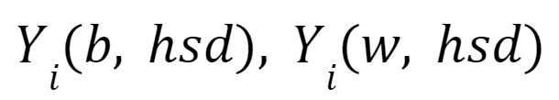
The Mixed Treatment: Questions
Notice, the following notation indicates that the two versions of unit i differ only in “perceived race”:
However, if you are not assuming that the decisionmaker perceives the same substantive meaning regarding that candidate’s merit when he reads the text “Education: High school diploma from Berkeley High School” under Greg and Jamal’s name, then the notation is “not justified.”¹
Insofar as people respond to meaning, and we are not assuming same meaning, then can’t denote both Greg’s and Jamal’s “Berkeley High School” line as hsd.
1 VanderWeele 2009, 881.
Overview Audit Studies: Canons of Interpretation Interpretation 1 Interpretation 2 Interpretation 3 Implications
Notes:
They are going to say this IS part of the “direct effect of b or w” - just question begging. Sweep in or out the effect if want it to count as bad, but what is the principled definition of the variable?

Slide 27
The Mixed Treatment: Assumptions Revisited
ASSUMPTIONS REVISITED - INTERPRETATION #2
Read “Greg”
→ Assume decisionmaker perceives the candidate to be racialized white
Read “Education: High school diploma from Berkeley High School”
→ assume decisionmaker perceives candidate who is racialized white to have met the formal requirements of getting a HSD from Berkeley High
Read “Jamal”
→ Assume decisionmaker perceives the candidate to be racialized Black
Read “Education: High school diploma from Berkeley High School”
→ assume decisionmaker perceives candidate who is racialized Black to have met the formal requirements of getting a HSD from Berkeley High
Overview Audit Studies: Canons of Interpretation Interpretation 1 Interpretation 2 Interpretation 3 Implications
Notes:
Why?
The name atop of the résumé indicates that the credentials, educational background, etc. belong to that person
While the candidates may meet the same formal requirements for HSD, if you are not making any assumptions that the decisionmaker takes those formal requirements to mean the same thing when possessed by differently racialized candidates, then you cannot assume that hsd = b-hsd = w-hsd

Slide 28
The Mixed Treatment: Assumptions Revisited
ASSUMPTIONS REVISITED - INTERPRETATION #2
Read “Greg”
→ Assume decisionmaker perceives the candidate to be racialized white
Read “Education: High school diploma from Berkeley High School”
→ assume decisionmaker perceives candidate who is racialized white to have met the formal requirements of getting a HSD from Berkeley High
Read “Jamal”
→ Assume decisionmaker perceives the candidate to be racialized Black
Read “Education: High school diploma from Berkeley High School”
→ assume decisionmaker perceives candidate who is racialized Black to have met the formal requirements of getting a HSD from Berkeley High
Need this assumption to be able to account for devaluing of credential by race
Overview Audit Studies: Canons of Interpretation Interpretation 1 Interpretation 2 Interpretation 3 Implications
Notes:
Why?
The name atop of the résumé indicates that the credentials, educational background, etc. belong to that person
While the candidates may meet the same formal requirements for HSD, if you are not making any assumptions that the decisionmaker takes those formal requirements to mean the same thing when possessed by differently racialized candidates, then you cannot assume that hsd = b-hsd = w-hsd

Slide 29
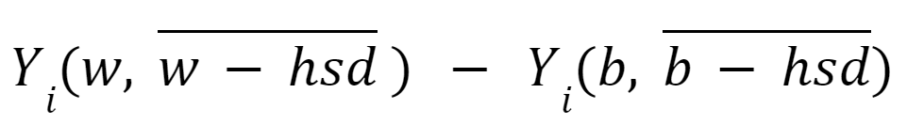
The Mixed Treatment: Notation Revised
Let:
b-hsd denote: perception of a candidate who is racialized Black to have met the formal requirements of getting a HSD from Berkeley High; and
w-hsd denote: perception of a candidate who is racialized white to have met the formal requirements of getting a HSD from Berkeley High
If you are not assuming that similarity in formal credentials on the page implies similarity in corresponding perception of substantive qualifications/productivity (w-hsd= w-hsd), then why write “w-hsd” and “b-hsd” as if a single, identical variable “hsd”?
So the audit study’s target estimand looks like it should written as follows:
Pick your assumptions and then pick your notation. Your notation must be consistent with your assumptions
Overview Audit Studies: Canons of Interpretation Interpretation 1 Interpretation 2 Interpretation 3 Implications
Notes:
We are not assuming that w-hsd≠ w-hsd, just not assuming that w-hsd= w-hsd
The point here is that you INTEND to measure how they respond when they think that a person w that racial status has that degree, so what you want them to perceive is really not “the same” in all respects

Slide 30
The Becker: Different perceptions of race but perception of the “same” substantive credentials
But sometimes it seems like researchers are making the additional assumption that the two candidates are perceived identically in terms of substantive qualifications/productivity, or that the study should be aiming to trigger in decisionmakers perceptions of the same substantive merit:
“[T]he auditor pair [] identical in all dimensions that might affect productivity in employers’ eyes, except for race.”
Bertrand and Mullainathan 2004, 994, emph. added
“One set of difficulties arise, however, because there are sure to be many unobserved variables… it is unlikely that all characteristics that might affect productivity will be perfectly matched… Both are determinants of perceived (by the firm) productivity.”
Heckman 1998, 108, 109, emph. added
Overview Audit Studies: Canons of Interpretation Interpretation 1 Interpretation 2 Interpretation 3 Implications

Slide 31
The Becker: Different perceptions of race but perception of the ‘same’ substantive credentials
ASSUMPTIONS - INTERPRETATION #3
Read “Greg”
→ Assume decisionmaker perceives the candidate to be racialized white
Read “Education: High school diploma from Berkeley High School”
→ Assume decisionmaker perceives that the candidate has some specific level of qualification or merit irrespective of racialized status
Read “Jamal”
→ Assume decisionmaker perceives the candidate to be racialized Black
Read “Education: High school diploma from Berkeley High School”
→ assume decisionmaker perceives that the candidate has some specific level of qualification or merit irrespective of racialized status
Overview Audit Studies: Canons of Interpretation Interpretation 1 Interpretation 2 Interpretation 3 Implications

Slide 32
The Becker: Treatment is different perceptions of race and different racialized credentials
If one makes the addition supposition that
similarity in formal credentials on the page
=
similarity in corresponding perception of substantive qualifications/productivity
then (w-hsd= b-hsd) writing “hsd” as single variable seems justified.
Overview Audit Studies: Canons of Interpretation Interpretation 1 Interpretation 2 Interpretation 3 Implications

Slide 33
The Becker: Different perceptions of race but perception of the “same” substantive credentials
Sometimes it seems like #3 is the causal contrast folks are after, but it is ambiguous…
E.g. of ambiguity:
“In particular, conditional independence requires that the only thing that changes in an observer’s mind upon examining a resume with a distinctively black-sounding name is the belief that the person to whom the résumé refers is black.”
Kerwin Kofi Charles & Jonathan Guryan, Studying Discrimination: Fundamental Challenges and Recent Progress, 3 Annual Rev. of Econ., 479, 490 (2011).
Overview Audit Studies: Canons of Interpretation Interpretation 1 Interpretation 2 Interpretation 3 Implications
Notes:
It could be that they think it ought not to be called discrimination so are looking to take the effect out of the race variable and put it into a non-race variable, again just drawing normative lines

Slide 34
The Becker: Different perceptions of race but perception of the ‘same’ substantive credentials
E.g. of ambiguity:
“The quality of the experiment depends to a large extent on the quality of the match between testers. An effective test requires that testers are extremely similar on characteristics other than the one being tested that may influence the decisions of hiring persons or rental agents (e.g., testers must be similar in height, weight, style of dress, speech pattern/accent, presence of facial hair, and so forth so that researchers can rule out discrimination on the basis of one of these characteristics rather than the characteristic of interest)”
Melissa Favreault, “Discrimination and economic mobility” The Urban Institute
Similar in what regard?
Similar in terms of formal credentials as stated on the résumé page?
Similar in terms of corresponding perceived level of qualifications/productivity?
Overview Audit Studies: Canons of Interpretation Interpretation 1 Interpretation 2 Interpretation 3 Implications
Notes:
A few other quotes (bold emphases added), if you want them:
From List (2004)’s The Nature and Extent of Discrimination in the Marketplace:
“the differences in the empirical distribution of prices could be due to at least three sources: i) animus-based or taste-based discrimination, whereby dealers are willing to incur a cost to avoid transacting with a minority; ii) differences in bargaining ability—i.e., majorities are superior bargainers and obtain better outcomes in the marketplace; and iii) statistical discrimination, where minorities have a different distribution of reservation values and in their pursuit of profits dealers use observable variables to make inferences about a relevant but unobservable variable (reservation values).” (p. 50-51)
From Marianne Bertrand & Esther Duflo, Field Experiments on Discrimination IN Handbook of Economic Field Experiments (2017):
“Attributes beyond those intended by the researcher may be inferred by the recipient. For example, Fryer and Levitt (2004) suggest that black names may “provide a useful signal to employers about labor market productivity after controlling for information on the resume.” This is clearly true for age, as we noted, but this may also be true for race if the choice of a black name is a political statement by the parent, accompanied by a different attitude toward schooling and obedience.” (p. 334)
“Audit and correspondence methodologies were developed to address these core limitations of the regression approach [the case that race or gender is correlated with other proxies for productivity that are unobservable to the researcher but observed by the employer] to measure discrimination.” (p 315-16)
“Bertrand and Mullainathan (2004) experimentally varied the quality of the resume used in response to a given ad. Higher quality applicants had on average a little more labor market experience and fewer holes in their employment history; they were also more likely to have an email address, have completed some certification degree, possess foreign language skills, or have been awarded some honors. The authors sent four resumes in response to each ad: two higher quality and two lower quality ones. They randomly assigned an African-American-sounding name to one of the higher and one of the lower quality resumes. They find that whites with higher quality resumes receive nearly 30 percent more call backs than whites with lower quality resumes. On the other hand, having a higher quality resume has a smaller effect for African-Americans. In other words, the gap between whites and African-Americans widens with resume quality. While one may have expected improved credentials to alleviate employers’ fear that African-American applicants are deficient in some unobservable skills under a statistical discrimination explanation for the overall discrimination, this was not the case in their data. Bertrand and Mullainathan argue that one simple alternative model that may best explain the patterns in their data is some form of lexicographic search by employers:
Employers receive so many resumes that they may use quick heuristics in reading these resumes. One such heuristic could be to simply read no further when they see an African-American name. Thus, they may never see the skills of African-American candidates and this could explain why these skills are not rewarded.”
(p. 324)
“A subtler criticism of the correspondence and audit methods by Heckman and Siegelman (1993) has been recently revisited by Neumark (2012). Heckman and Siegelman (1993) show that a troubling result emerges in audit or correspondence studies because the outcome of interest is not linear in productivity (as it might be for a wage offer) but instead is nonlinear. That is, we think that in the hiring process firms evaluate a job applicant’s productivity relative to a standard and offer the applicant a job (or a call- back) if the standard is met. This nonlinear relationship can raise issues for any inferences of discrimination based on call backs if employers believe that blacks and whites differ in the variance of their unobserved productivity.
Consider, for example, the case where employers believe that the variance of unobserved productivity is higher for whites than for blacks. The correspondence and audit methods make black and white applicants equal on observable productivity characteristic X1. However, no information is conveyed on a second, unobservable productivity- related characteristic, X2. Because an employer will offer a job interview only if it perceives or expects the sum b1X1 + X2 to be sufficiently high, when X1 is set at a low level the employer has to believe that X2 is high (or likely to be high) in order to offer an interview. Even though the employer does not observe X2, if the employer knows that the variance of X2 is higher for whites, the employer correctly concludes that whites are more likely than blacks to have a sufficiently high sum of b1X1 + X2, by virtue of the simple fact that fewer blacks have very high values of X2. Employers will therefore be less likely to offer jobs to blacks than to whites, even though the observed average of X1 is the same for blacks and whites, as is the unobserved average of X2. The opposite holds if X1 is set at a high value: in this case, the employer only needs to avoid very low values of X2, which will be more common for the higher variance whites. In other words, Heckman and Siegelman (1993) show that, even when there are equal group averages of both observed and unobserved variables, an audit or correspondence study can generate biased estimates, with spurious evidence of discrimination in either direction or spurious evidence of its absence.” (p. 333-34)
-----------------------------------------
From Ayres and Siegelman’s Race and Gender Discrimination in Bargaining for a New Car (1995), The American Economic Review, Vol. 85, No. 3. (Jun., 1995), pp. 304-321.
“"Statistical discrimination" is based not on a psychological distaste for associating with blacks or women, but rather on sellers' use of observable variables (such as race or gender) to make inferences about a relevant but unobservable variable (Edmund Phelps, 1972). In the labor market, productivity is the relevant unobservable variable. In car negotiations, dealers might use a customer's race or gender to make inferences about a buyer's knowledge, search and bargaining costs, or, more generally, her reservation price at the specific dealership. If sellers believe, for example, that women are on average more averse to bargaining than men, it may be profitable to quote higher prices to women customers.
Dealers might also make racial or gender inferences about the expected costs of contracting-including, for example, the expected costs of default on car loans. The script attempted to eliminate cost-based statistical discrimination by having all testers volunteer early in the negotiations that they were providing their own financing. This disclosure indicated that the dealer should not have to bear a risk of buyer default.” (p. 317)
“Even though all testers volunteered that they did not need financing, dealers might disparately assess the credibility of this information depending on the gender and race of the tester. If statistically valid, this inference could form the basis for cost-based statistical discrimination.” (p. 317)
“The evidence that dealers occasionally used racist or sexist language, combined with the large (but statistically insignificant) savings that black testers encountered in black neighborhoods, justify lingering concerns about the possibility of animus or stereotypic discrimination. However, dealership conduct may be better explained as a form of statistical discrimination in which dealers use race and gender as a proxy for the customer's reservation price.” (p. 319)

Slide 35
Implications
If this is the estimand (Interpretation 2/The Mixed Treatment):
then audit studies do not measure an effect that disentangles perception of race from perception of educational credentials. Candidates are not perceived to be only different in race and not different in qualifications. They may be different in both!
So, if audit studies are taken to substantiate claims of racial discrimination, they do not do so on an “all-but-race-equal” causal interpretation.
Instead, deviations from equal treatment constitute discrimination because of a background normative presupposition that these two differently racialized candidates ought to be treated the same, even if they are perceived to differ in respects other than race.
Overview Audit Studies: Canons of Interpretation Interpretation 1 Interpretation 2 Interpretation 3 Implications
Notes:
When someone says under version 2 that the “effect” of downgrading the credential is part of the effect of is that b/c it is “bad” or b/c they start with a principled commitment to the boundaries of the variable race.
It is not even clear WHAT IT MEANS to “differ only in race”

Slide 36
Implications
The two differently racialized candidates are “the same” in a normative sense, in the sense of warranting equal treatment, not in the sense of in fact perceived to be identical in all respects “but for” race.
This means that methodological critiques and concerns that a study fails to “deconfound” the “direct” race effect from the “indirect” effect of the substantive meaning of credentials in light of race are inapposite.
We should be clear about our normative assumptions, so that we do not confuse methodological and normative disagreements.
Y_{i} (w, hsd_{norm}) – Y_{i} (b, hsd_{norm})
Overview Audit Studies: Canons of Interpretation Interpretation 1 Interpretation 2 Interpretation 3 Implications
Notes:
Example: let’s say Trump says “I have paid the same taxes as you” he might mean that he has complied with the legal duties as applied to him, not that he has paid the same $ amount or even %.

Slide 37
Thank you

Slide 38
Social statuses causes & discrimination:
Causal mediators and misdefined causal quantities
Lily Hu
Philosophy, Yale University
Issa Kohler-Hausmann
Law & Sociology, Yale University
Recap Mediation Model of Discrimination Examples & Responses Assumptions

Slide 39
Review from last week
Counterfactual theory of discrimination defines as discriminatory those outcomes that are counterfactually dependent on social status
That is, the normative determination that the outcome counts as discriminatory is grounded in the (direct)* causal dependence—i.e. obtains in virtue of the fact that it was caused by race, sex, religion, etc.
*But see “discriminatory intent” in law and scholars’ opinions vary on what counts as “direct”
Recap Mediation Model of Discrimination Examples & Responses Assumptions

Slide 40
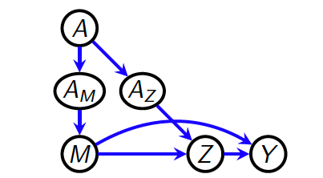
The mediation model of discrimination
A is sex
A_{M} = f(A) is “components of (applicant’s) gender that influence resume content”
A_{Z} = g(A) is “components of (applicant’s) gender that influence interviewer opinion”
M = h(A_{M}, A_{Z}) is content of (applicant’s) resume
Z = q(A_{Z}, M) is interviewer opinion of applicant
Y = r(M, Z) is hiring decision
Recap Mediation Model of Discrimination Examples & Responses Assumptions

Slide 41
Revision: mediation model of discrimination
Defines discrimination as outcomes counterfactually dependent on a particular subset of causal pathways from the social status
Stipulate that the causal pathway that proceeds from A_{Z} (components of (applicant’s) gender that influence interviewer opinion) is “unfair”
Define the indirect “unfair” effect of sex on Y via this pathway:
Y_{i}(a_{M}, a_{Z}) – Y_{i}(a_{M}, a’_{Z}) where a’_{Z} = g(a’)

Slide 42
The mediation model of discrimination
The variables A_{M} and A_{Z} pick out descriptive, non-normative features of the world.
Two step:
Draw a model of causal factors and causal connections
Call in an “expert” to come in to make normative valuations, designating fair/unfair pathways
“Context and background ethical considerations pick out some path-specific effect of the sensitive feature A on the outcome Y as unfair” (Nabi, Malinsky, and Shpitser 2022, 4).
Recap Mediation Model of Discrimination Examples & Responses Assumptions

Slide 43
Let’s take an example….
The variables A_{M} and A_{Z} pick out specific entities in the world
A is sex {f, m}
Switching from {a, a’} to {f, m}
A_{M} = k(A) is “take time off to care for young children vs. have consistent employment history” {0, 1}
A_{Z} = g(A) is “apologize before speaking vs. not apologize before speaking” {0,1}
M = h(A_{M}, A_{Z}) is content of (applicant’s) résumé
Z = q(A_{Z}, M) is interviewer opinion of applicant
Y = r(M, Z) is hiring decision {0,1}
Recap Mediation Model of Discrimination Examples & Responses Assumptions

Slide 44
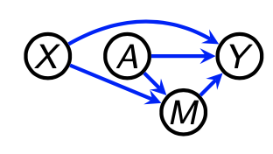
Nested counterfactuals
Central to the mediation definition of discrimination is notion that we can pull out of the portion of the causal effect that due to one of the indirect pathways of sex, while leaving the other pathways unaffected.
Can decompose total causal effect into = total indirect effect (TIE) + pure direct effect (PDE)
Total Indirect Effect (TIE) = Y(a, M(a)) - Y(a, M(a’)) Fix A=a. In the first term, let mediator M take its “natural” value: M = M(a); in the second term, “force” M = M(a’)
What is the meaning of this Y(a, M(a’)) term?
The “outcome Y would have, had A been assigned to a and M been assigned to whatever values it would have had under a’ ”
Ilya S. slides at 7
Recap Mediation Model of Discrimination Examples & Responses Assumptions

Slide 45
The variables A_{M} and A_{Z} pick out specific entities in the world…
What counterfactual state of affairs does Y_{i}(a_{M}, a’_{Z}) designate in this model?
The hiring decision that would have happened if the candidate were female, and because she was female she took a 5-year leave from paid work to care for her young children (and recorded said fact on her resume), but–instead of apologizing when she speaks as most persons who were gendered female at birth do – she does NOT apologize.
Recap Mediation Model of Discrimination Examples & Responses Assumptions

Slide 46
The variables A_{M} and A_{Z} pick out specific entities in the world…
The causal model is encoding the fact that “apologizing before speaking” is a feminized trait with the A → A_{Z} variable.
But, this nested counterfactual asks what would happen if a candidate who we expect to apologize (because she is female!), does not apologize when she speaks.

Slide 47
The variables A_{M} and A_{Z} pick out specific entities in the world…
Issue: Non-causal dependencies
“Y_{i}(a_{M}, a’_{Z})” raises the same issues as last week:
The natural reading of the counterfactual either entails backtracking or it designates a state of affairs that is non-normative with respect to gendered expectations as expressed in this model
Y_{i}(a_{M}, a’_{Z}) → Y_{i}(a_{M}, a’_{Z}, non-normative)
Recap Mediation Model of Discrimination Examples & Responses Assumptions

Slide 48
The variables A_{M} and A_{Z} pick out specific entities in the world…
Given this model in our example:
Y_{i}(a_{M}, a_{Z}, conforming) - Y_{i}(a_{M}, a’_{Z}, non-conforming)
Whenever someone perceived female apologizes before speaking she is acting in a manner that conforms to the gender stereotypes of her perceived sex status, and when she fails to apologize before speaking she is acting in a manner that is non-conforming to the gender stereotypes of her perceived sex status.
The variable {conforming, non-conforming} is relationally defined and not independently intervenable.
Recap Mediation Model of Discrimination Examples & Responses Assumptions

Slide 49
The variables A_{M} and A_{Z} pick out specific entities in the world…
Possible objection:
“In the relevant counterfactual, there is no need to specify that the person is perceived as female (A = f). After all, once we intervene to set A_{Z} to “not apologizing,” Y is sensitive to only that fact. It is not sensitive to “sex” in any extra distinct manner that cannot be decomposed into A_{Z} and A_{M}.”
E.g., The “non-conforming” part comes from the mismatch of female + not apologizing. But we don’t write: Y_{i}(f, a_{M}, a’_{Z}).
We write Y_{i}(a_{M}, a’_{Z}).
Recap Mediation Model of Discrimination Examples & Responses Assumptions

Slide 50
The variables A_{M} and A_{Z} pick out specific entities in the world…
The “what exactly are you modeling?” response:
That’s fair enough as you’ve drawn your model. But models are just representations that help us formally define counterfactuals. What we actually care about what the actual CF state of affairs is. What are we exactly to imagine is the case in the specified CF? A disembodied voice devoid of any gendered markers apologizing vs. not apologizing?
If your model cannot specify the *truth conditions* of the counterfactuals, then it is a deficiency of your model to provide a reasonable model for question being asked.
Recap Mediation Model of Discrimination Examples & Responses Assumptions

Slide 51
The variables A_{M} and A_{Z} pick out specific entities in the world…
The consistency assumption objection:
The consistency assumption holds that the potential outcome is invariant to the means/method of setting the treatment or ‘version’ of treatment
This is expressed as Y(A) = Y . Here Y(A) reads “the random variable Y, had A been intervened on to whatever value A would have naturally attained” (Nabi and Shpitser, 2017).
Translation in this context: Whether we intervene to set A_{Z} = “not apologize” vs. letting A_{Z} take its natural state be “not apologize” has no bearing on the causal behavior of A_{Z}.
Recap Mediation Model of Discrimination Examples & Responses Assumptions

Slide 52
Is consistency violated?
If Y_{i}(a_{M}, a’_{Z}, non-conforming) ≠ Y_{i}(a_{M}, a’_{Z}, conforming), then the notation
Y_{i}(a_{M}, a_{Z}) – Y_{i}(a_{M}, a’_{Z},)
is “not justified”.
If this features is relationally defined and not independently intervenable, then can’t get “same” version of treatment for f and m candidates.
Recap Mediation Model of Discrimination Examples & Responses Assumptions

Slide 53
The variables A_{M} and A_{Z} pick out specific entities in the world…
The consistency violation response:
It is justified to assume that A_{Z}’s effect on downstream variables is independent of how it’s set, how it relates to its parent A, or its “sibling” variable A_{M}?
We might just disagree on the empirics that would falsify the assumption.
Consistency might be violated if:
The other facts entailed in the intervention (because of non-causal dependencies between relata) has an effect on Y
The intervention stipulated requires backtracking or moving to a very far away world
Recap Mediation Model of Discrimination Examples & Responses Assumptions

Slide 54
Assumption behind mediation approach
Recall that the 2-step approach to mediation analysis & discrimination is:
1. Identify all of the causal factors of Y and carve up the various causal pathways from from A to Y.
2. Call in lawyer or philosopher (or both! Lily & Issa @ $645/hour) and the put normative post-it notes on these pathways, designating some as “fair” and others as “unfair”
Assumption: How things in the world stand in causal relations are sufficiently divisible, independently manipulable, and can be neatly labeled with “good” and “bad” post-it notes, so that we can turn off some effects and leave on other effects.
Recap Mediation Model of Discrimination Examples & Responses Assumptions
Notes:
Notice, this is just another way of saying it is not discrimination because, if I considered you to have a DIFFERENT setting of “impermissible consideration” (but, per assumption it is still an impermissible consideration) I still would have treated you the same.

Slide 55
Assumption behind mediation approach
Questions about that assumption:
Can we always unbundle the relevant features of the world into causal factors and pathways that are independently manipulable?
Sometimes how we carve up the world reflects our normative priors.
Majority
Dissent
[1] P’s Sex [M]
[1] P’s Sex [M]
Outcome
Outcome
[2] Male sex of sexual partner
Has same-sex attractions
Recap Mediation Model of Discrimination Examples & Responses Assumptions

