Slide 1
Mapping Access to Mobile and Fixed Broadband Sources at the Census Block Level in Onondaga County, NY
PAI 789
Max Kent

Slide 2
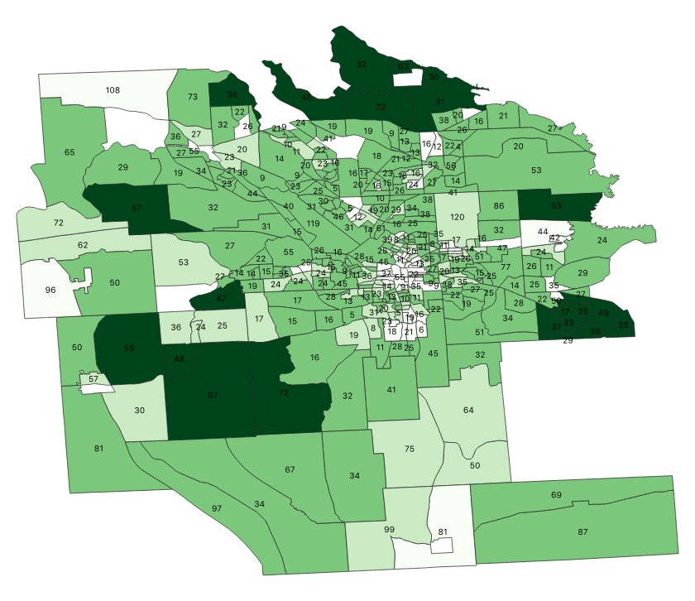
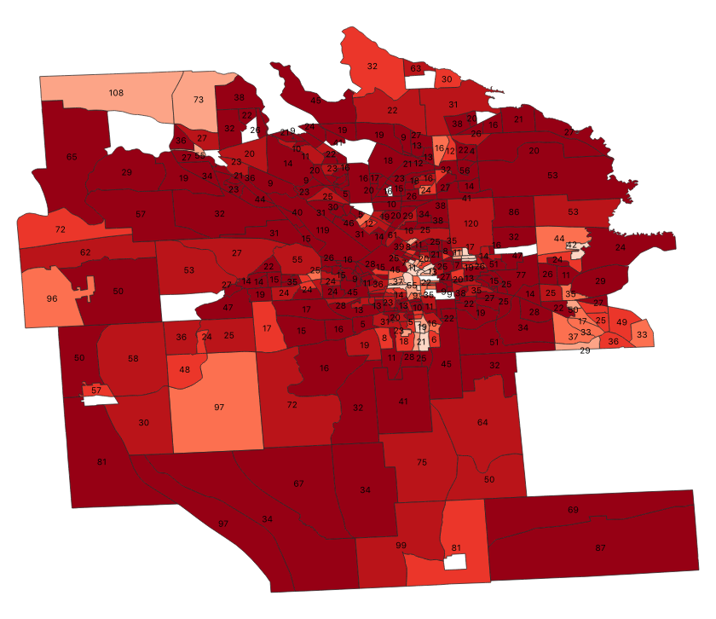
Understanding Gaps in Broadband Access and Availability
Average upload speed=
Number of providers= #
Average upload speed=
Number of providers= #

Slide 3
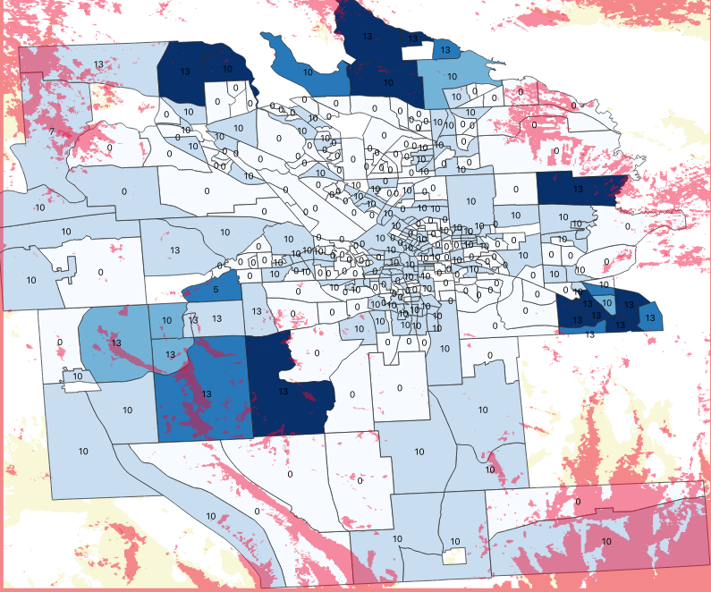
Mobile and Fixed Broadband Variability
Gaps in mobile broadband coverage = (Verizon and Sprint only)
Range of upload speeds for fixed broadband =

Slide 4
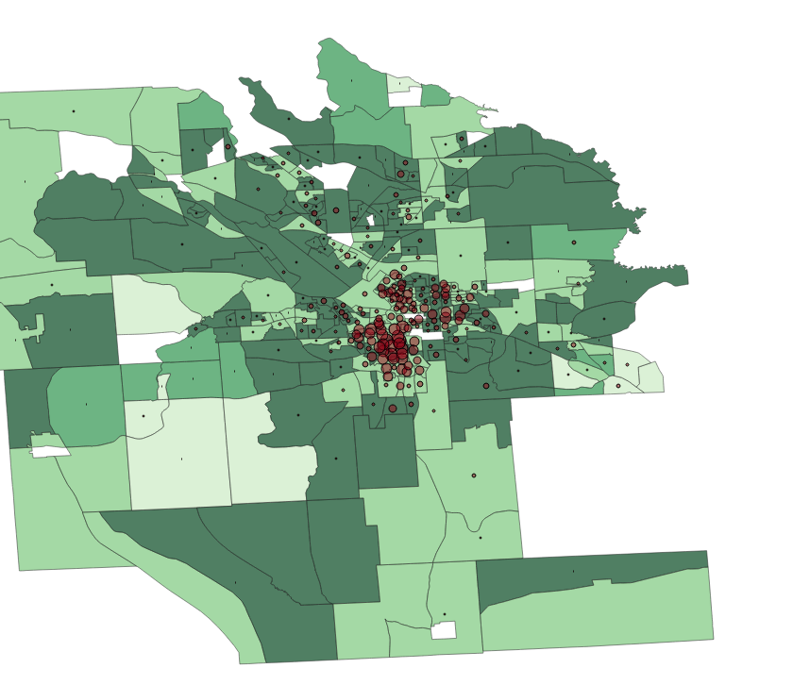
Demographic Considerations
Minimum Upload Speeds (min.= 3 mbps) =
Percent of Pop. Black in Block=

Slide 5
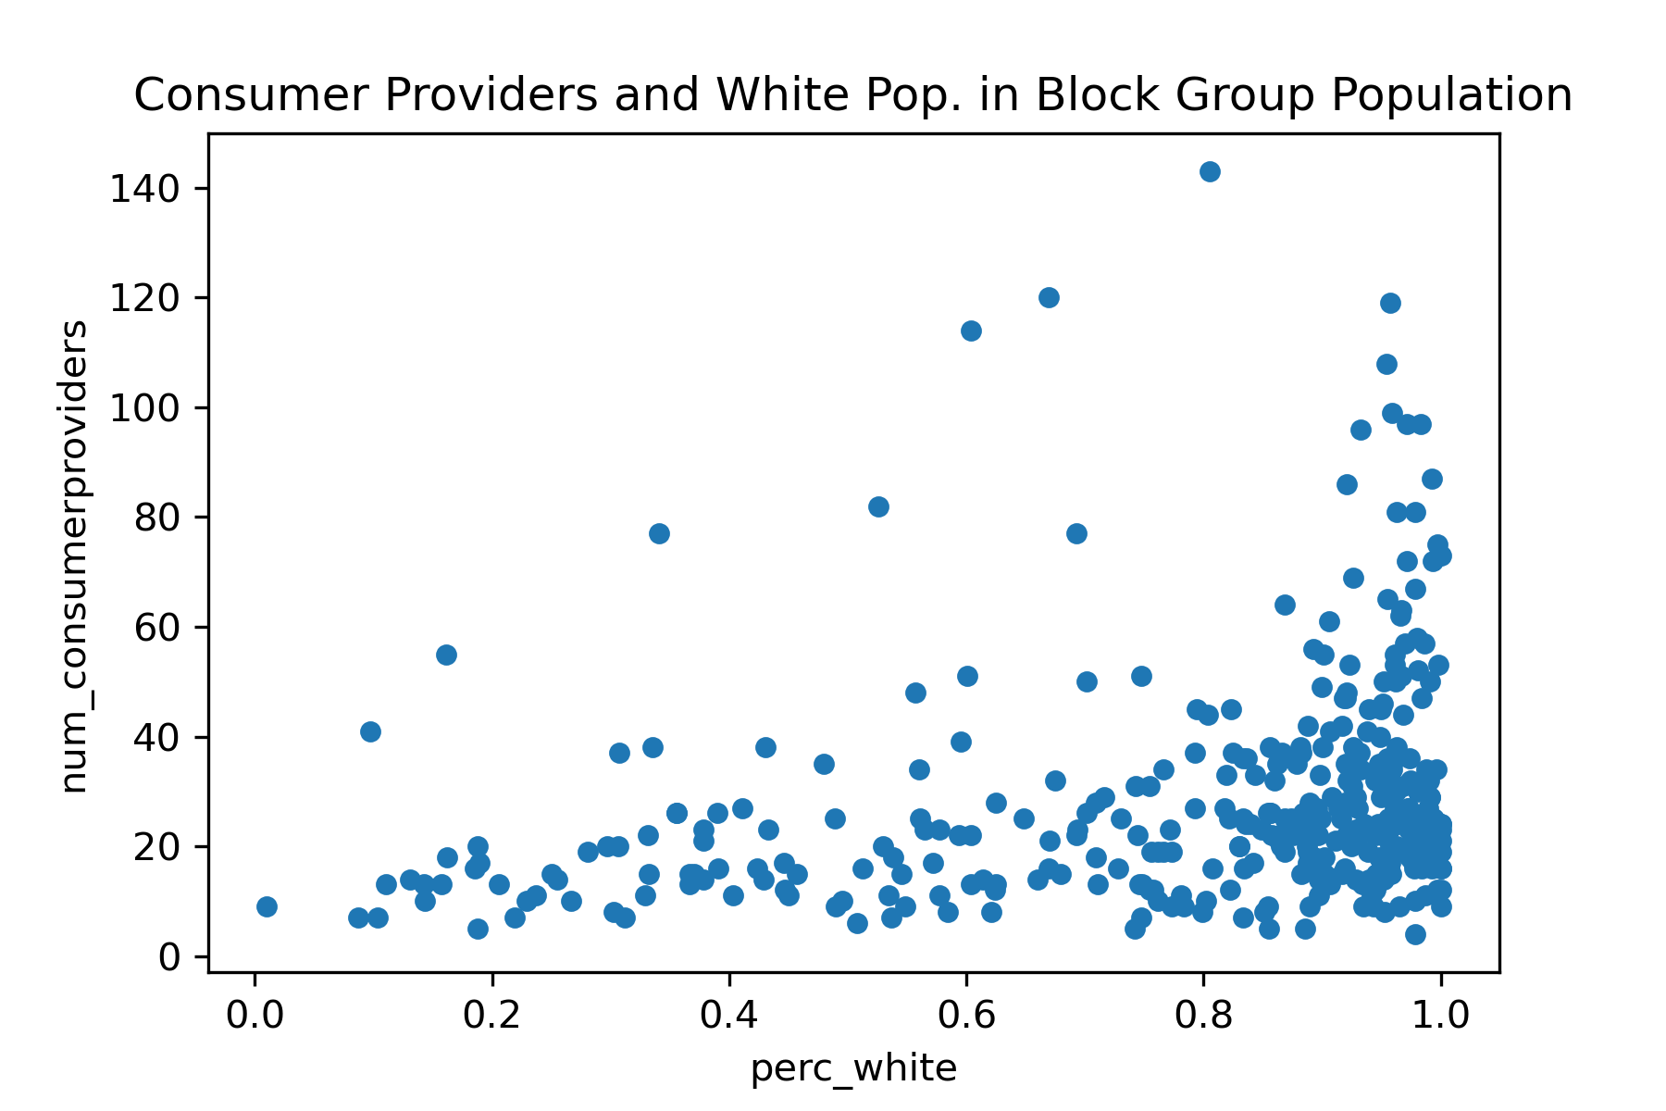
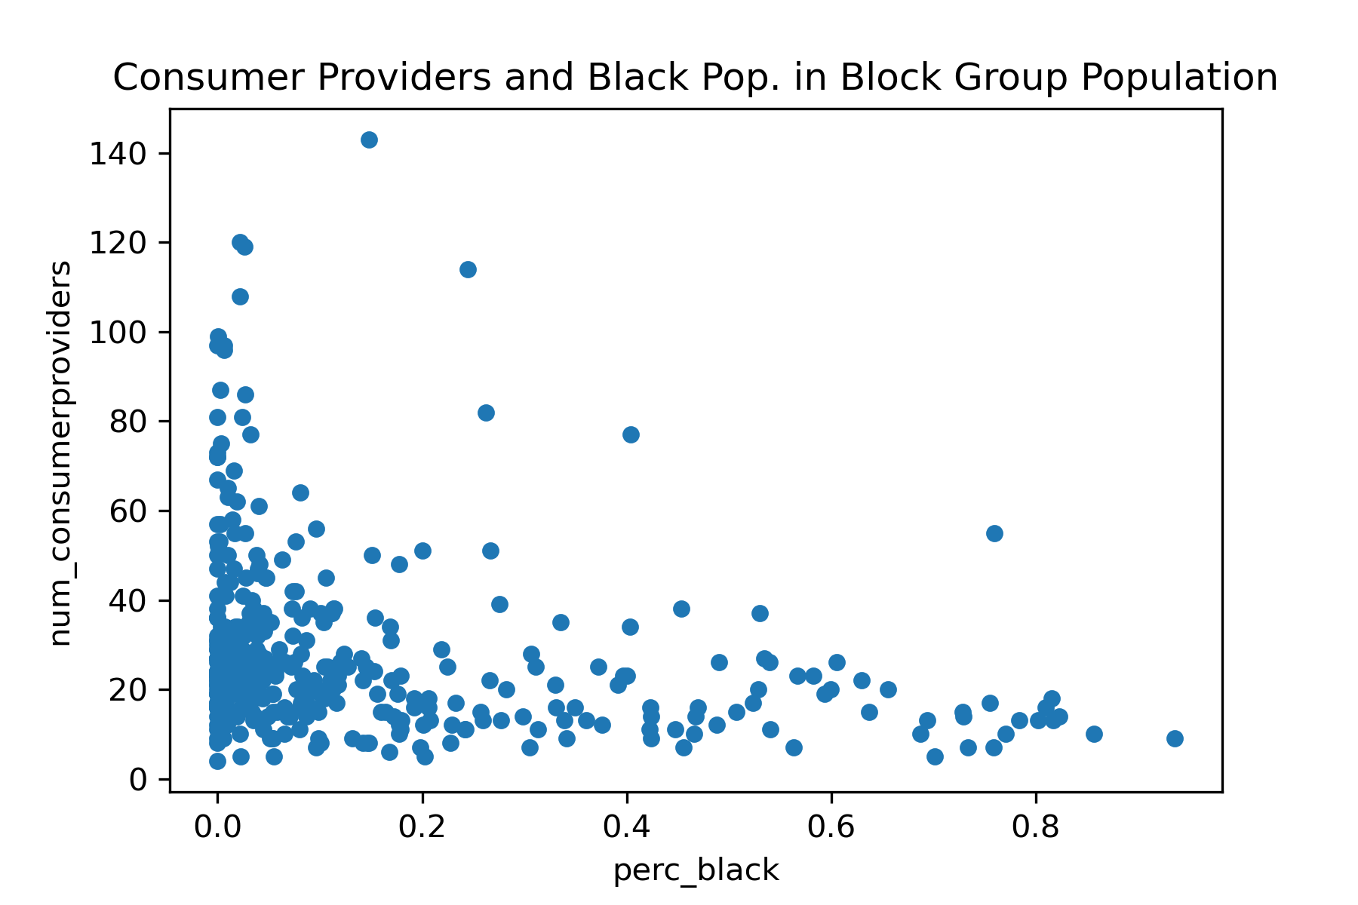
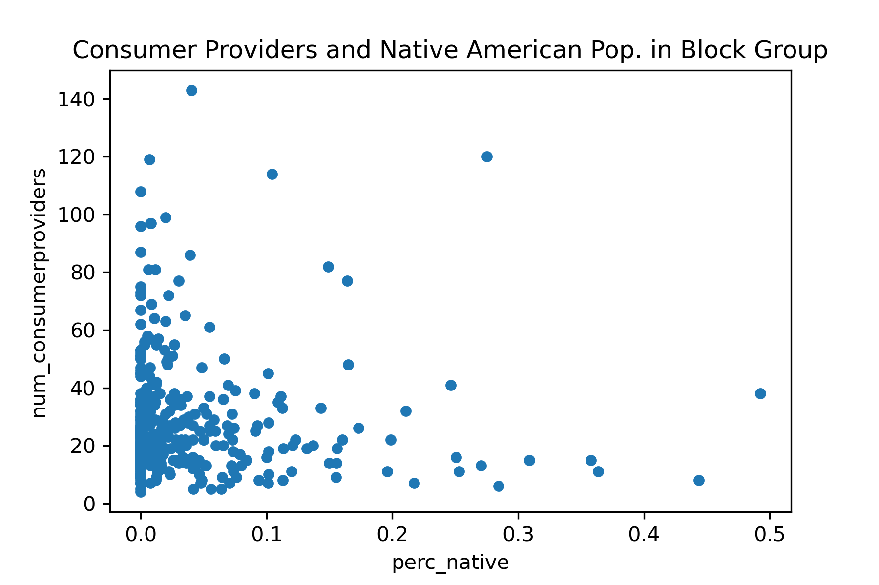
Demographic makeup and Fixed broadband providers

Slide 6
Questions?

