Slide 1
ERTC-LAB
ERTC-LAB
2023

Slide 2
LAB 4 - goal
Goal: Line following robot

Slide 3
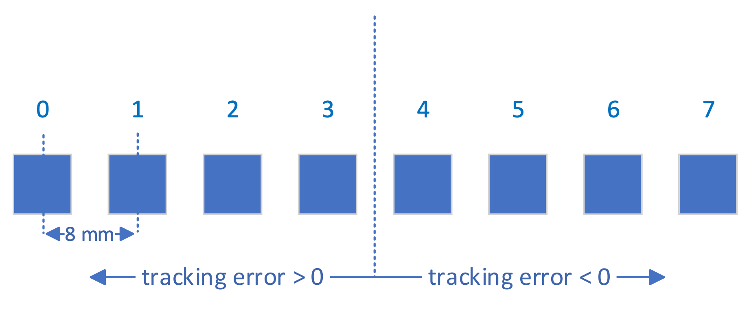
LAB 4 – line sensor
Properties of the infrared sensor
[0 0 0 0 0 0 0 0]
Notes:
Line sensor consists of 8 infrared diodes
8 mm apart
Goal is to keep the line in the middle
Introduced tracking error:

Slide 4
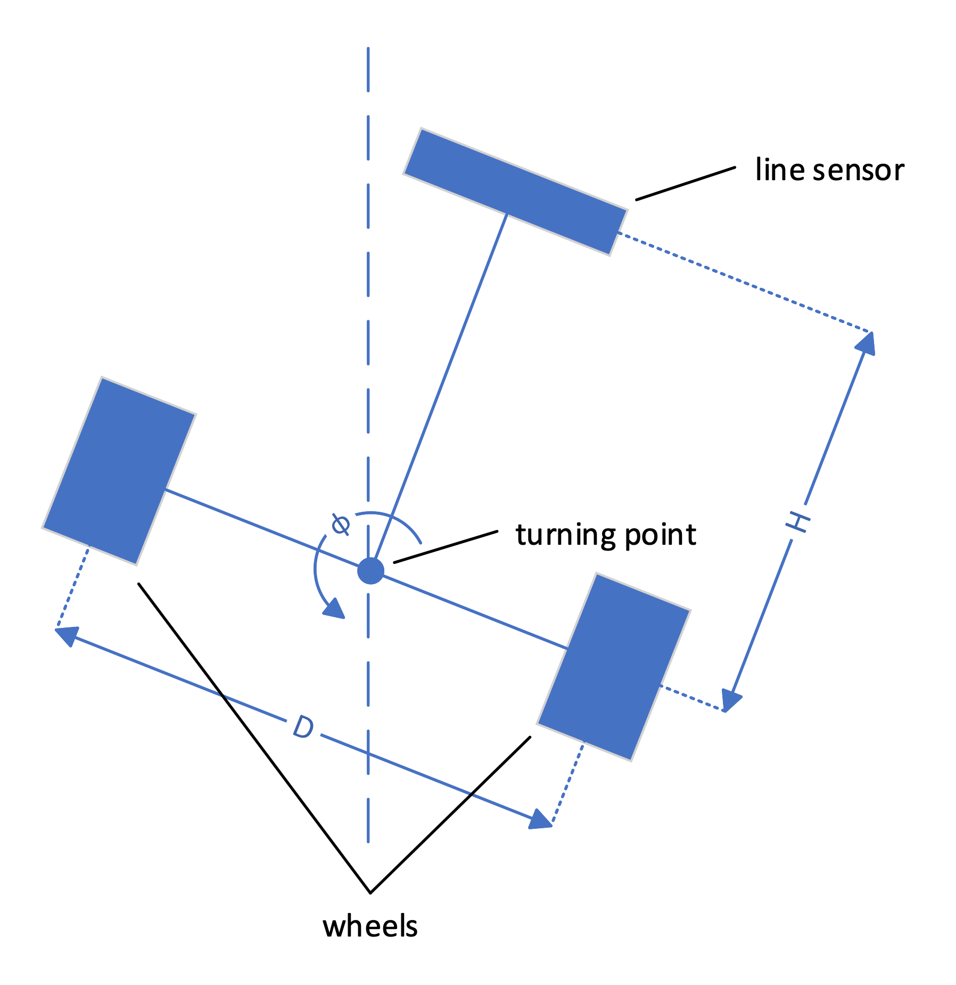
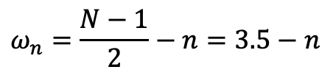
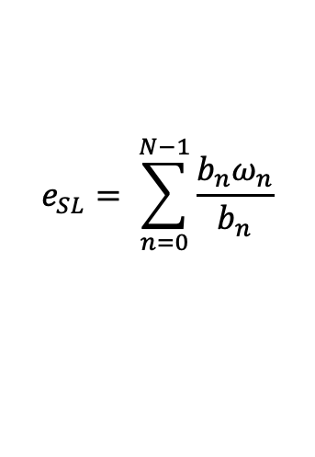
LAB 4 - tracking error
$$e_{SL}= \sum_{n=0}^{N−1}{\frac{b_{n}ω_{n}}{b_{n}}}$$
$$ω_{n}=\frac{N−1}{2}−n=3.5−n$$

