Slide 1
Object Removal by Exemplar-Based Inpainting
Ye Hong
CS766
Fall 2004

Slide 2
Introduction
Object Removal
  Idea: Remove object(s) from digital photographs, and then fill the hole with information extracted from the surrounding area.
  Filled region should look “reasonable” to the human eyes.

Slide 3

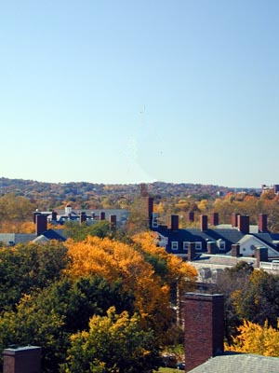
An Example
Before After

Slide 4
Approaches
Texture Synthesis
  Idea
    Sample color values of the surrounding area
    Generate textures with sampling result to fill the hole
  Advantage
    Cheap and effective
    No blur or other degradation
  Disadvantage
    May lose linear structure and composite textures

Slide 5
Approaches(cont.)
Inpainting
  Fill holes by propagating linear structures into the target region via diffusion
  Advantage
    Preserves the linear structures
  Disadvantage
    Diffusion will cause blurs, which are usually noticeable

Slide 6
Criminisi’s approach
Combine the strengths of two approaches
  Use a texture synthesis algorithm
  Give higher priority to linear structures
Result
  Linear Structures are preserved
  No blurs introduced

Slide 7
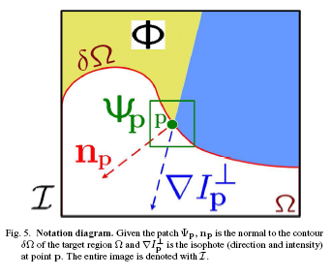


Criminisi’s Algorithm
Assign each pixel with a priority value
Give linear structures higher priorities

Slide 8
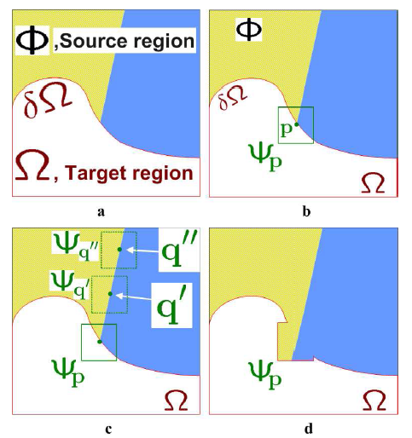
Criminisi’s Algorithm(cont.)
Structure Propagation by exemplar-based texture synthesis

Slide 9
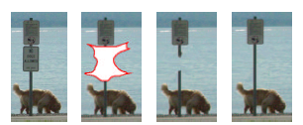
Expected Results
Criminisi’s Algorithm vs. Texture Synthesis
Original Object Cut Tex. Syn. Criminisi

Slide 10
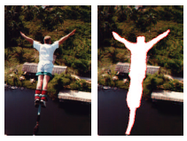
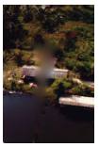
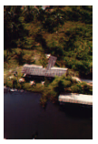
Expected Results
Criminisi’s Algorithm vs. Inpainting
Original Object Cut
Inpainting Criminisi

Slide 11
Future Works
More accurate propagation of curved structures
Object removal from videos

Slide 12
References
A. Criminisi, P. Perez, K. Toyama.
Region filling and object removal by exemplar-based inpainting.
In 2004 IEEE Transactions on Image Processing 9 1200-1212.
M. Bertalmio, G. Sapiro, V. Caselles, and C. Ballester.
Image inpainting. In Proc. ACM Conf. Comp. Graphics
(SIGGRAPH), pp. 417–424, New Orleans, LU, Jul 2000.
A. Efros and T. Leung.
Texture synthesis by non-parametric sampling.
In Proc. ICCV, pp. 1033–1038, Kerkyra, Greece, Sep 1999.

