Slide 1

Google Maps API
Nov. 2024 \./ Max Kleiner
Maps with out of the box demos
Google Directions / Shell / Scripts
OpenStreetMap OSM mapbox
https://github.com/maxkleiner/restcountries
JSON, EdgeView2 and Geocoding
This session shows you various ways of using Maps and directions in your application.

Slide 2
TDirections
We use a simple class TDirections with 4 events.
Component for Delphi, Python and Lazarus.
I use an URI, a struct Tlatlong, a JSON and a HTTPGet object
In the archive 1274_GoogleDirForm2GeocodeWeather_General2request2.pas
you find the script, model and data you need, which works with Lazarus, Delphi, Jupyter and maXbox.
type TTlatlong = record
lat, long: double;
descript: string;
end;

Slide 3
Google Maps Directions
You can get directions for driving, public transit, walking, ride sharing, cycling, flight, or motorcycle on Google Maps. If there are multiple routes, the best route to your destination is blue, all other routes are gray.
Some directions in Google Maps are in development and may have limited availability.
Script Ref: http://www.softwareschule.ch/examples/directions3.htm
https://sourceforge.net/projects/maxbox/files/Examples/EKON/EKON28/1274_GoogleDirForm2GeocodeWeather_General2request2.pas/download

Slide 4
Cross-platform component
TestUnit From Cologne to Graz
get geocoords: lat: 50.9473 – lon: 6.9503 Cologne
get geocoords: lat: 47.0739 – lon: 15.4168 Graz
latlong:= TAddressGeoCodeOSM(‘Gereonswall 66, Cologne, Germany’);
latlong:= TAddressGeoCodeOSM(‘Hauptbahnhof, Graz, Austria’);
UnitTest GeoCode
https://www.google.com/maps/dir/050.94730,006.95031/047.07389,015.41674/@050.94730,006.95031,9z
https://www.google.com/maps/dir/046.94724,007.45158/046.55764,015.64559/@046.94724,007.45158,9z

Slide 5
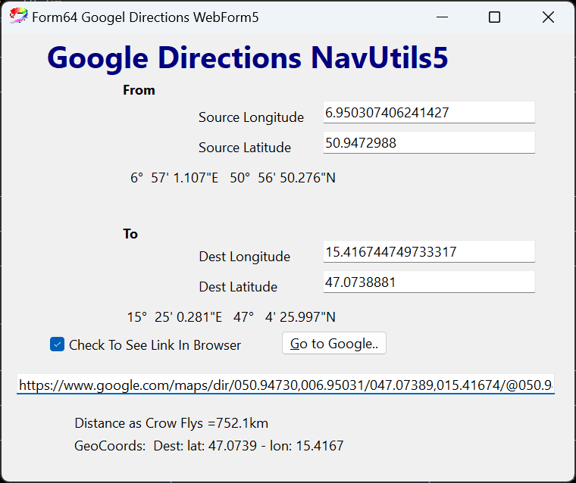

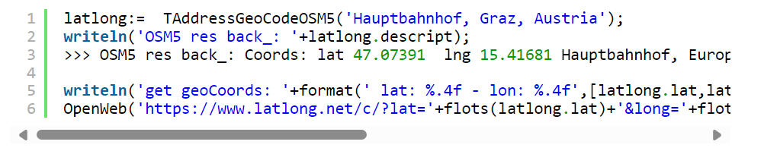
GUI or Console

Slide 6
Be aware of
You should in particular verify that you have set a custom HTTP referrer or HTTP user agent ( windown.useragent:=) that identifies your application, and that you are not overusing the service with massive bulk requests. Otherwise you get following message:
<p>You have been blocked because you have violated the<a href=”https://operations.osmfoundation.org/policies/nominatim/”>usage policy</a>of OSM’s Nominatim geocoding service. Please be aware that OSM’s resources are limited and shared between many users. The usage policy is there to ensure that the service remains usable for everybody.</p>
Important: Stay alert when you use directions on Google Maps. Always be aware of your surroundings to ensure the safety of yourself and others. When in doubt, follow actual traffic regulations and confirm signage from the road or path that you’re on.
Demo: https://jasontpenny.com/blog/2009/01/11/google-maps-in-a-twebbrowser-from-delphi-directions/

Slide 7
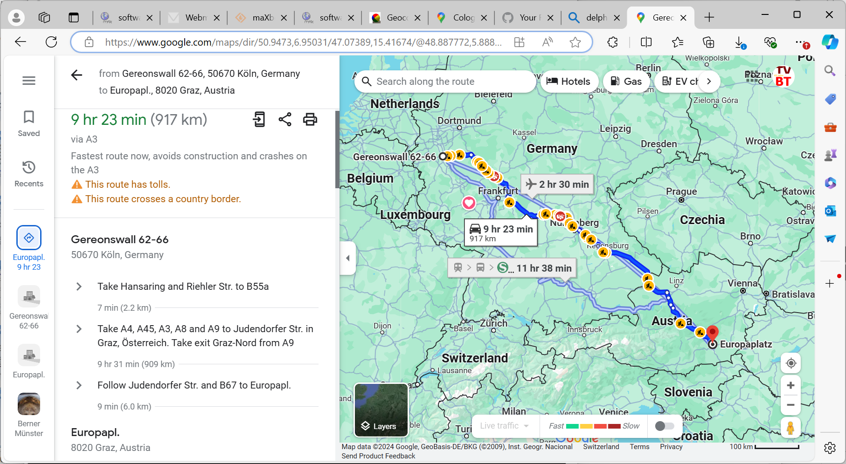
Graph Control

Slide 8
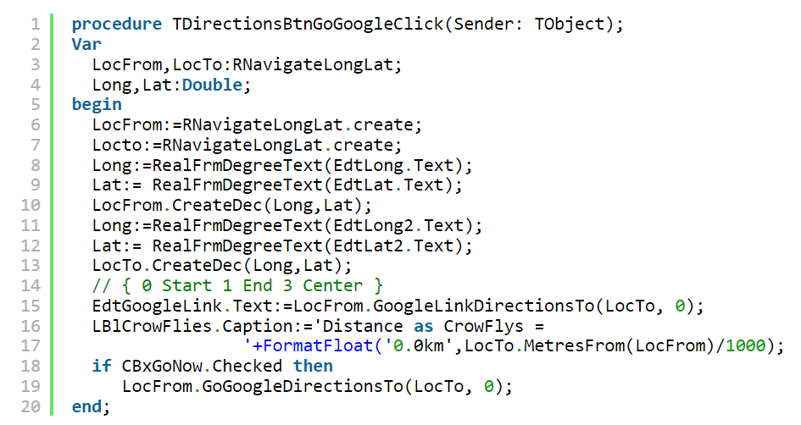
Code Control II
Demo: 1234_NeuralNetwork2_XOR_sampleEU_EKON27.pas

Slide 9
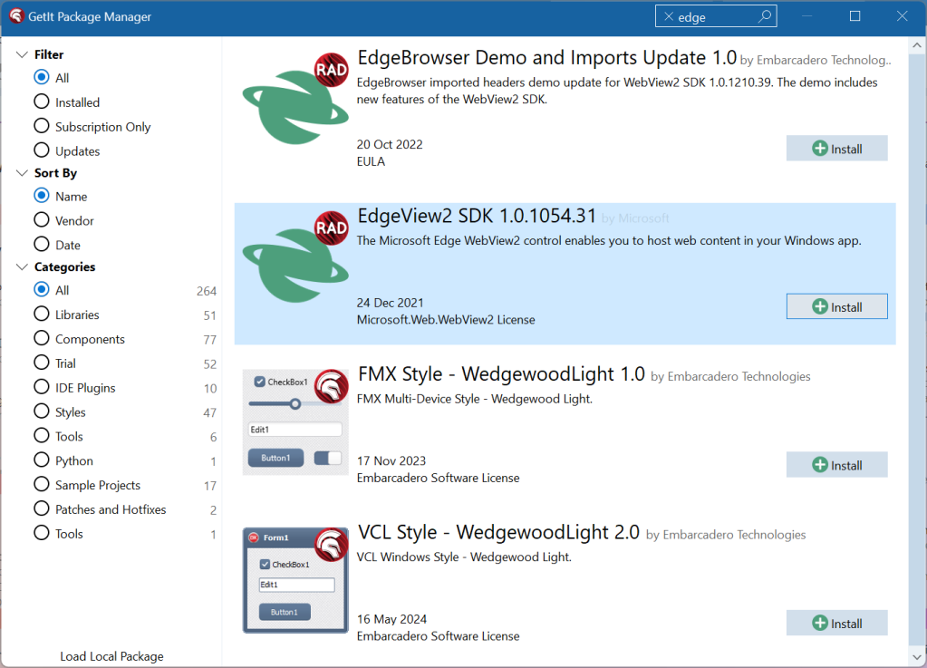
Other Packages
IDE for Console or Terminal
TGoMaps (Komponente, kommerziell, 599 € + MwSt.)
TGoMaps Lite (Komponente, kostenlos, stark eingeschränkte Version von TGoMaps, dient
als "Testversion" von TgoMaps)
TGAgisGoogleMap und TGAgisGoogleGeo (Komponenten, kommerziell, 799 USD + MwSt.)
TECMap (Komponente, kommerziell, 500 € + MwSt., Testkomponente auf Anfrage)
TMS WebGMaps (Komponenten, kommerziell, 95 € + MwSt.)
https://www.tmssoftware.com/site/tmsfncmaps.asp?r=vcl
DelphiMaps (Komponenten, MPL 1.1)
GMLib (Komponenten, LGPL 3.0)
Google Maps Library v1 (closed)

Slide 10
RestClient Lib
The REST library is available for all platforms that are supported by Delphi. The REST Library framework focuses on JSON as the representation format. XML is not explicitly supported.
Use “TRESTClient“, “TRESTRequest” and “TRESTResponse” components.
Notice that they are automatically connected together (RESTRequest has “Client” and “Response” properties).f
Rest for API-s of GEO services. speech recognition, image classification, OpenCL, big data, data science, sentiment-analysis, computer vision2 with more or less SVG.
https://github.com/maxkleiner/neural-api/

Slide 11
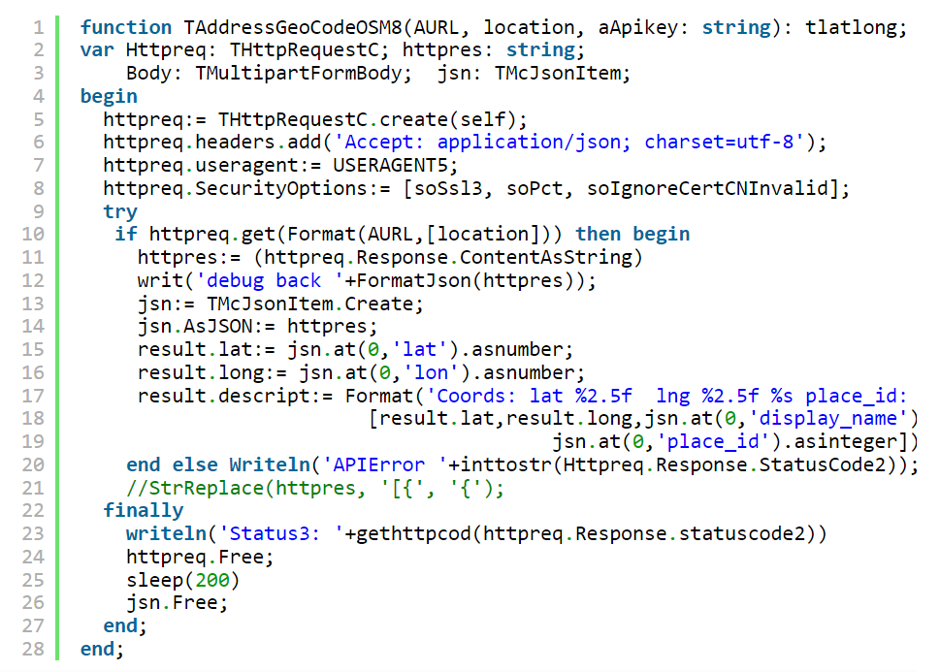
Behind the Scene...
RestClient: URL, cookies, auth, security – RestRequest: resources, params - RestResponse: JSON or UTF8 parsing, binding

Slide 12
Maps and API Keys
{$I .\NINJAAPIKEY.INC}
const
N_APIKEY = NINJA_APIKEY;
L_APIKEY = LAYER_APIKEY;
File NINJAAPIKEY.INC
Const
NINJA_APIKEY = 'gwM+25ePKBKfgnz40Q+s+w==sFaryouAPIKey;
// insert your private ChatGTP API key here
LAYER_APIKEY = 'DNwCF9Rf6y1AmSSednjn8ZyourAPIKey';
Call:
t_latlong:= TAddressGeoCodeOSM8(URL_APILAY_GEO,
'Athen', L_APIKEY);

Slide 13
Traps by Agent or Limits
First we need to set the TIdHTTP property UserAgent (the UserAgent is what a browser uses to identify itself to the HTTP server) to an valid Agent, if you use the default value Mozilla/3.0 (compatible; Indy Library) you will get a awful message like this HTTP 1.1/ 403 Forbidden. so we can change this value to Mozilla/3.0 or to another valid agent.
Then we need build the url to request the image from an location. a valid URL look like this
http://maps.google.com/maps/api/staticmap?center=40.714728,-73.998672&zoom=12&size=400x400&sensor=false.
A limit is enforced to prevent abuse and/or repurposing of the Static Maps API, and this limit may be changed in the future without notice. If you exceed the 24-hour limit or otherwise abuse the service, the Static Maps API may stop working for you temporarily. If you continue to exceed this limit, your access to the Static Maps API may be blocked.

Slide 14

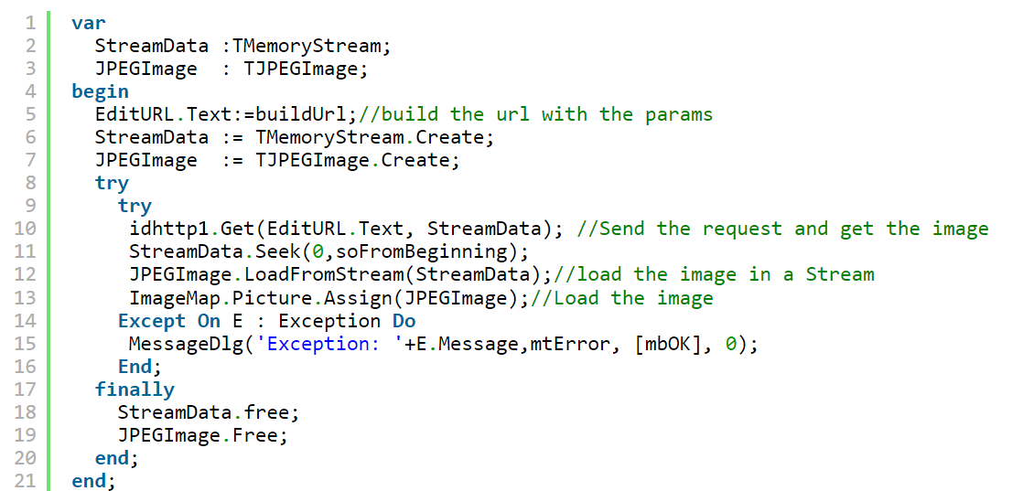
Static Maps
Use of the Google Static Maps API is subject to a query limit of 1000 unique (different) image requests per viewer per day. Since this restriction is a quota per viewer, most developers should not need to worry about exceeding their quota.
https://developers.google.com/maps/documentation/maps-static/overview?hl=en
https://wiki.freepascal.org/pas2js_Electron_Web_Application

Slide 15
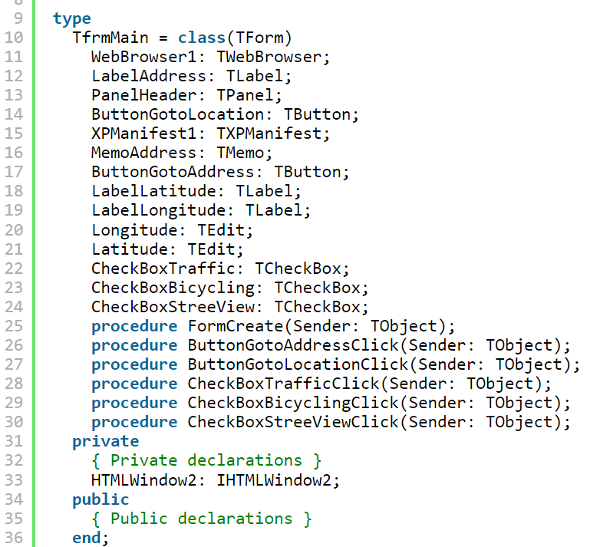
Form Create

Slide 16
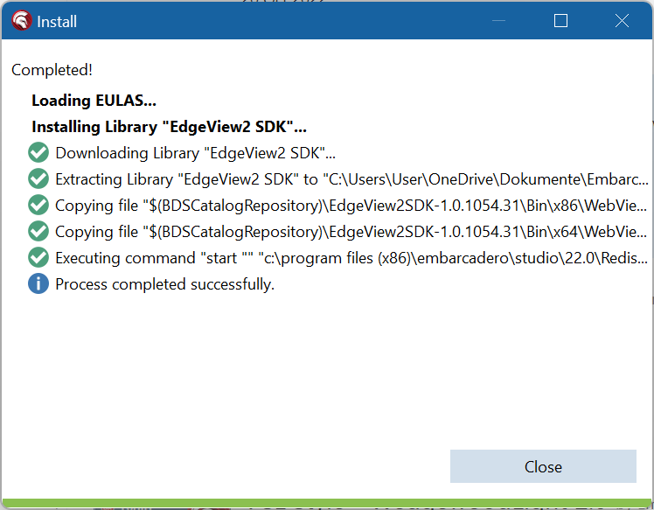
EdgeView2 SDK
McJson use a Simple Object-Pascal native code using TList as internal data structure with a Single-pass string parser and is just one unit (McJSON) and just one class(TMcJsonItem) integrated in maXbox or Lazarus.
RAD Studio 10.4 Sydney brings support for working with web content through the Chromium-based Edge WebView2 browser control in VCL applications via the new TEdgeBrowser component.
Demo: 1312_API_Demo64_5_javascript_maps2edge.txt

Slide 17
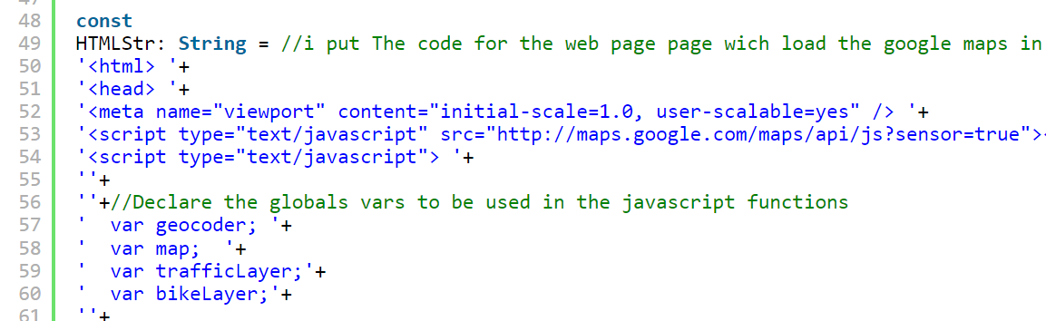
JS-Solution
in this sample application you can use the traffic layer, Bicycling layer and the street View Control to activate a panorama view.
Integrate dynamic, interactive, custom maps, location data and geospatial data into your apps by embedding JS:
1312_API_Demo64_5_javascript_maps.txt

Slide 18
Web Platforms
As a Delphi GUI/Console (with or without JS or EdgeView):
TMS FNC Maps
Universal Delphi & C++ Builder components for mapping, geographical data, timezone visualization, routes and directions calculation. Use your mapping service of choice like Google Maps, OpenStreetMap, Leaflet, Azure Maps, Here Maps in VCL, FMX and WEB core apps
PositionStack API
https://colab.research.google.com/github/maxkleiner/maXbox/blob/master/EKON24_SimpleImageClassificationCPU.ipynb
As static maps:
You can use online map services (e.g. Google Map or Microsoft Bing); they both provide static map services alongside their default dynamic map interfaces which work inside a web browser.
They also support geo-location queries; that is, you can send an address to their server, and retrieve a coordinate.
https://github.com/maxkleiner/maXbox/blob/master/objectdetector3.ipynb
https://blogs.embarcadero.com/this-is-how-to-make-a-geocoding-app-in-5-minutes/

Slide 19
Conclusion
Integrate a component like TDirections class or a service (API) like OSM on a Form
Integrate a component like TDirections on a Form and open external Browser
Integrate a component like TDirections in a Shell, CLI and embed or open internal Browser like EdgeView
Different Map Solutions (static or dynamic):
Google Maps
Maps, Directions, Geocoding, Static Maps, TimeZone, Elevation, Location, Places
Microsoft Azure Maps
Maps, Geocoding, Directions, Static Maps, TimeZone, Places
MapBox
Maps, Geocoding, Directions, Static Maps
OpenLayers (OpenStreetMap, Nominatim)
Maps, TileServers, Geocoding
Method: Compnent or API
Maps: Offline or Online
View: Form or Browser
https://raw.githack.com/breitsch2/maXbox4/master/assets/graph3.html

Slide 20

Geo Cod
Thanks for coming!
Materials:
http://www.softwareschule.ch/download/maxbox_starter105.pdf
https://maxbox4.wordpress.com/2024/03/06/geocoding-iv/
https://maxbox5.wordpress.com/2024/07/22/ekon-28/

