Slide 1

Statistic Packages Overview
2025
Regression & Correlation box script demos
7 Statistic Methods & 5 Diagramtypes
Stats Package TeeChart & mrMath, Delphi AI
Sklearn & Statsmodels (P4D)
AGSI, JSON, EdgeView2 and Weather Reports
Alternate Packages, Top & Flops Statistic
This session shows various ways of using statistic and plots in your apps.
📊
https://blogs.embarcadero.com/why-a-data-scientist-chooses-delphi-for-powerful-real-world-visualizations/

Slide 2
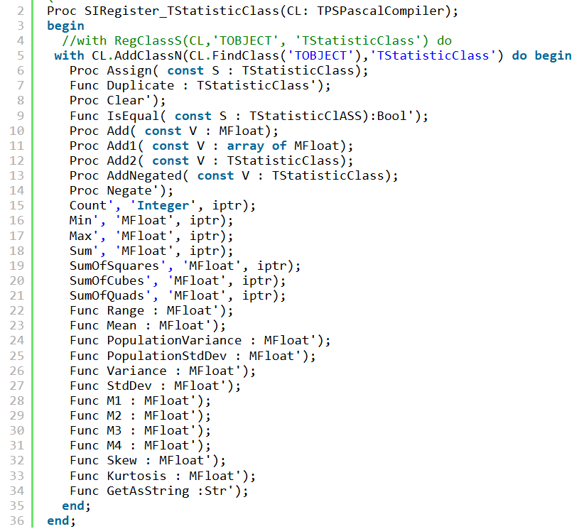
A Base Class

Slide 3

A Brain Class

Slide 4
7 Statistical Methods Criteria
1. Bayesian Inference (p(A))
2. Hypothesis Testing (t-test)
3. Factor Analysis (Loading Analysis)
4. Cluster Analysis (K-means)
5. Logistic Regression Classifier
6. Monte Carlo Simulation (Rnd)
7. Time Series Analysis (ARIMA)
Data science is a multidisciplinary field that combines math, statistics, computer science, machine learning, and domain expertise to extract insights from data. While data science algorithms often put the spotlight, a solid foundation in statistical methods can be just as pivotal.
https://softwareschule.code.blog/2025/02/20/7-data-science-statistical-methods/

Slide 5
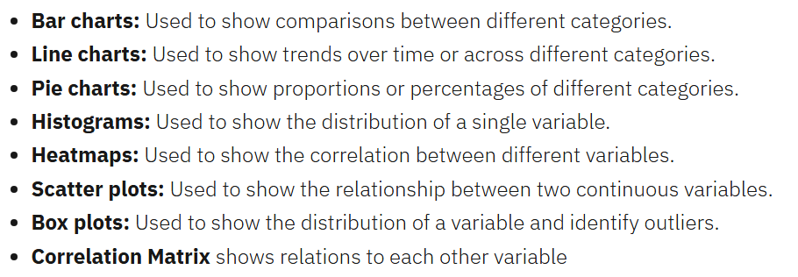
5 Important Diagram Types
Here, I’ll show you how to analyze a runtime script created dataset and extract meaningful insights with 5 diagram types:
Bar Chart
Scatter Plot
Histogram
Box Plot
Correlation Matrix
https://softwareschule.code.blog/2025/02/20/7-data-science-statistical-methods/

Slide 6
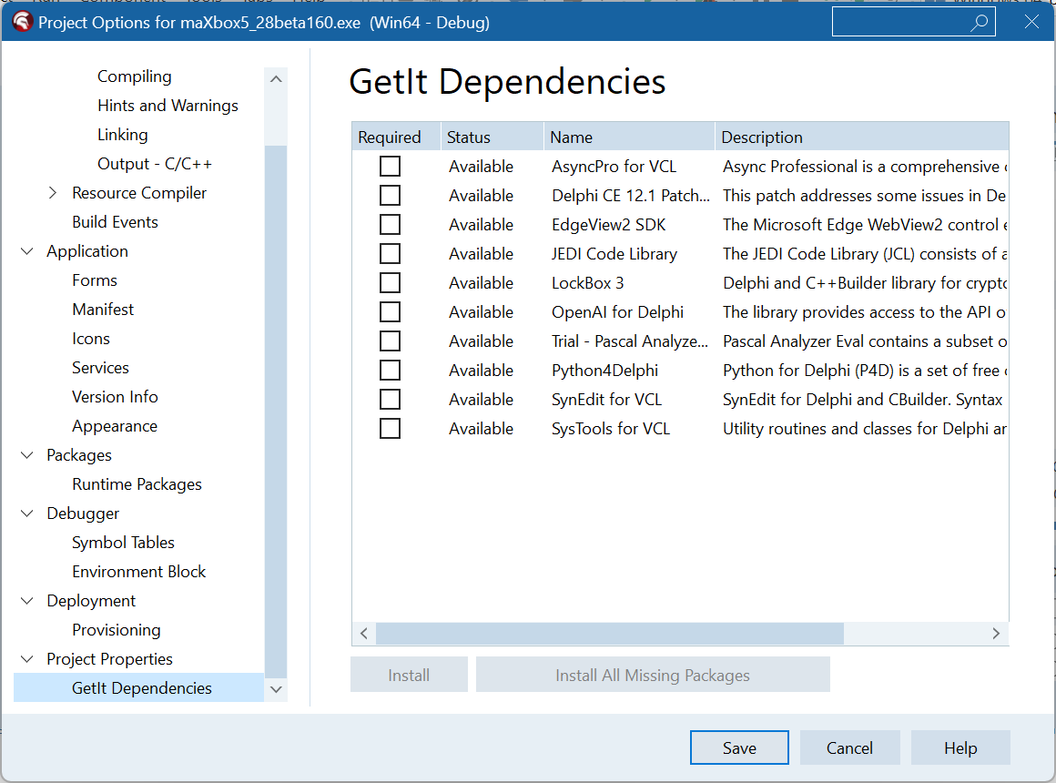
Stats Dependencies
https://sourceforge.net/projects/maxbox/files/Examples/EKON/EKON28/1274_GoogleDirForm2GeocodeWeather_General2request2.pas/download

Slide 7
Cross-platform class TChart
TeeChart is a powerful charting component developed by Steema Software, widely used in Delphi and C++Builder environments. It provides a comprehensive set of tools for creating various types of charts, including line, bar, area, pie, point, and horizontal bar charts, which can be viewed in both 2D and 3D formats.
Key Features
Versatility: TeeChart supports a wide range of chart types and can be used for business, real-time, financial, and scientific applications. It is included in most Delphi and C++Builder products and supports both VCL and FM.
Cross-Platform Support: TeeChart can be used to create applications for Windows (x32/x64) and macOS. For Apple iOS support, TeeChart Pro.
Interactivity: TeeChart allows users to interact with charts by zooming, panning, and exporting to various file types. This makes it suitable for applications that require real-time data visualization and user interaction.
https://blogs.embarcadero.com/why-a-data-scientist-chooses-delphi-for-powerful-real-world-visualizations/
Demo: 820_U_ProbabilityDist2ekon29_1_64.pas

Slide 8
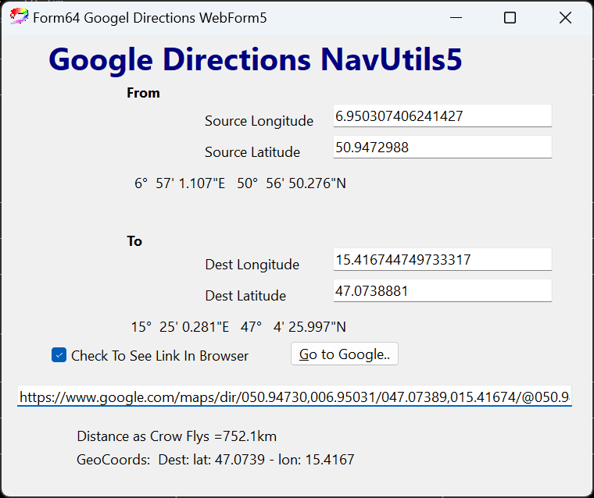
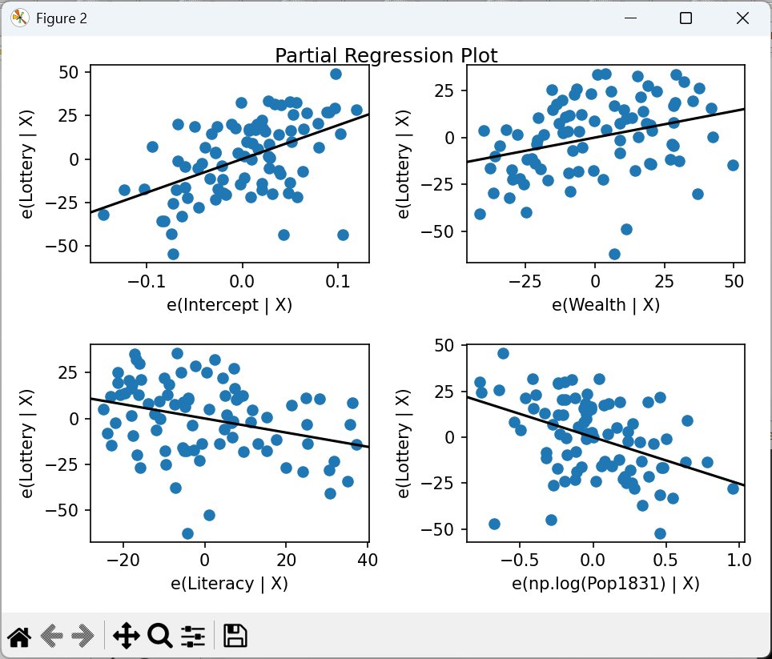
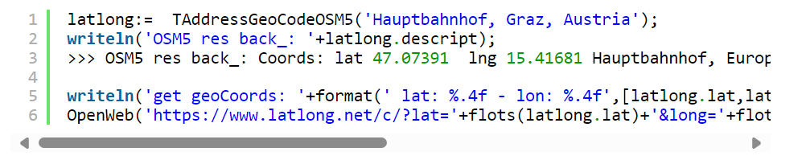
GUI or Console?

Slide 9
Mr Math Package
The mrMath, mrStats, mrMatrix, mrImgUtils package includes:
Standard Fisher LDA classifier
Robust (and Fast Robust) version of this classifier
Incremental (and Robust) Fisher LDA classifier learning.
Support Vector Machines (least squares and lagrangian learning)
Naive Bayes
Simple Decission stumps
Radial basis function
C4.5 Decission trees.
K-means
Ensemble classifiers: AdaBoost, Gentle Boost, Bagging
Simple feed forward Neural Nets
Important: On top of these classifiers there exists a few image database handling routines
and an 1D, 2D Haar Feature extractor which is based on an integral image approach.
Demo: TestdemoStatisticClassifier64bit.exe

Slide 10
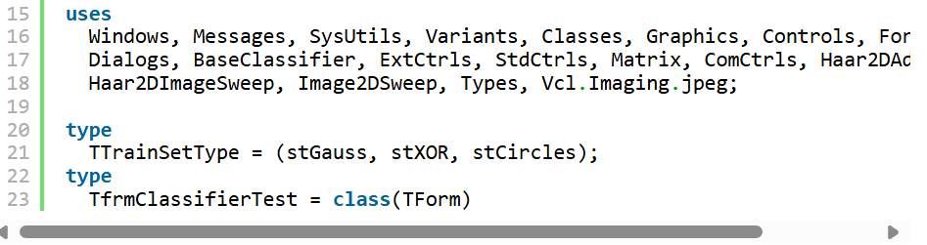
Mr Math II Test
A testing app TestClassifier.dpr which shows the usage and performance of these classifiers on various tasks (e.g. face recognition) which we slightly improved, compiled and signed can be found on git or sourceforge:
https://github.com/maxkleiner/mrai_mx5/tree/master/TestApp
https://sourceforge.net/projects/maxbox5/files/binaries/TestClassifier64bit.exe/download

Slide 11
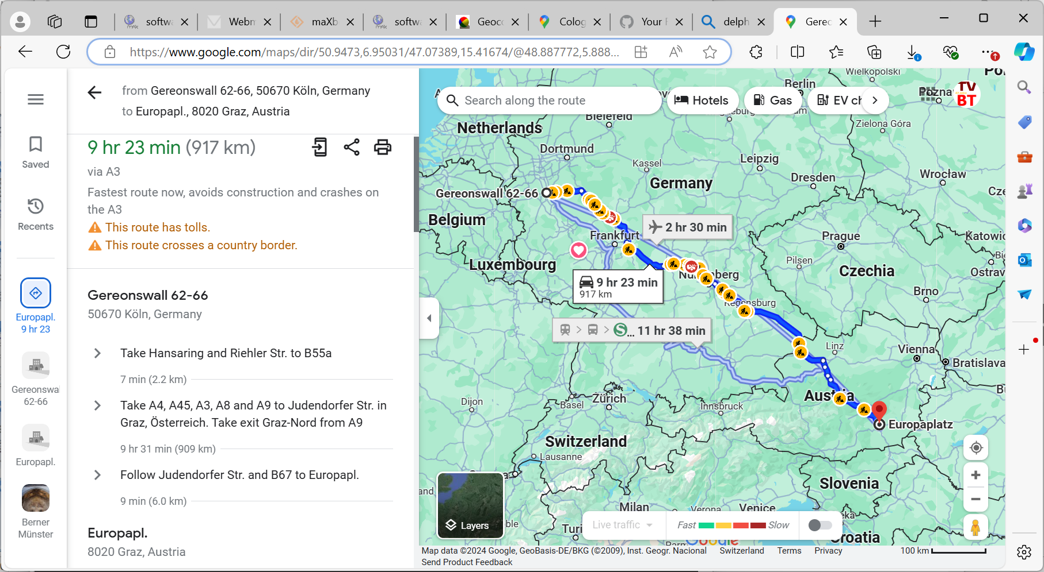
Stat Control
https://maxbox4.wordpress.com/2024/12/14/test-classifier-app/

Slide 12
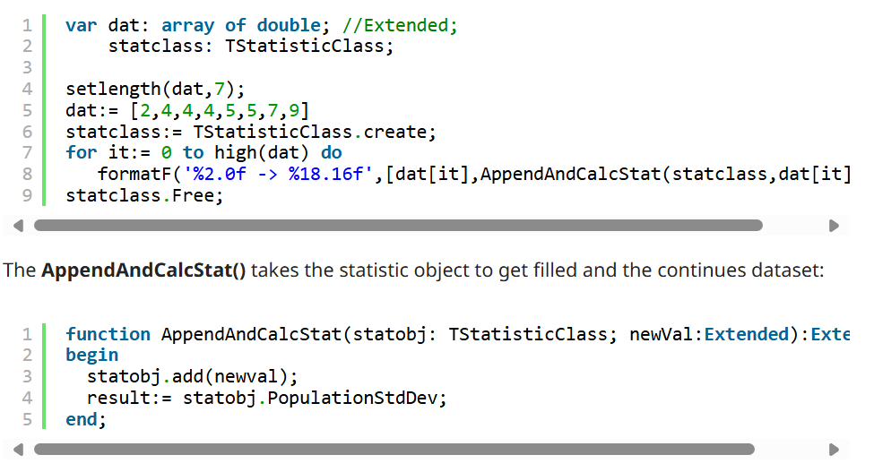
Code Control II
Write a stateful function, class, generator or co-routine that takes a series of floating point numbers, one at a time, and returns the running standard deviation of the series.
Use this to compute the standard deviation of this demonstration set, {2,4,4,4,5,5,7,9} which is 2. {\displaystyle \{2,4,4,4,5,5,7,9\}}

Slide 13
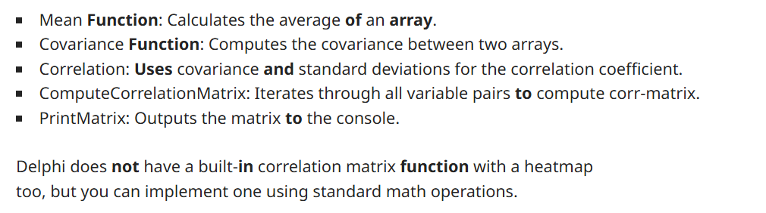
Gas storage timeline AGSI dataset
The data science tutorial explains the so called AGSI data storage and his visualization of the timeline. AGSI is the Aggregated Gas Storage Inventory and offers you the possibility to be kept up to date whenever a new service announcement or update from one of our data providers is posted on the website.
https://blogs.embarcadero.com/why-a-data-scientist-chooses-delphi-for-powerful-real-world-visualizations/
https://wiki.freepascal.org/pas2js_Electron_Web_Application

Slide 14
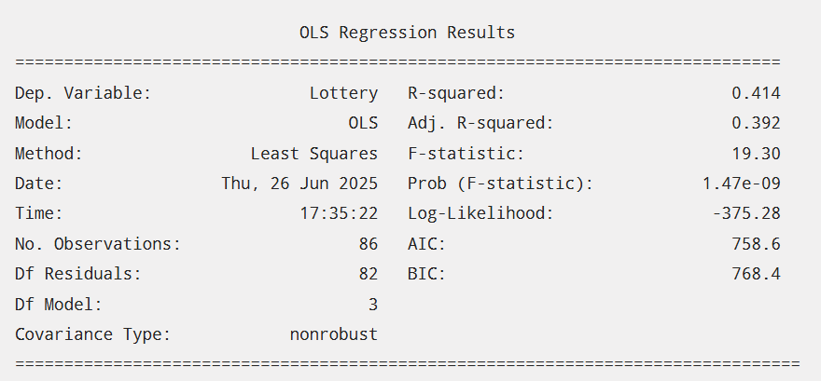
Statsmodels
Statsmodels is a Python library designed for statistical modeling, hypothesis testing, and data exploration with high reference.
It provides a wide range of statistical models, including linear regression, time series analysis, and generalized linear models.
The library supports both formula-based modeling (similar to R) and direct use of NumPy arrays.
Demo: 1417_statsmodels_64_delphi_python3.12.4debug130_EKON29.txt

Slide 15
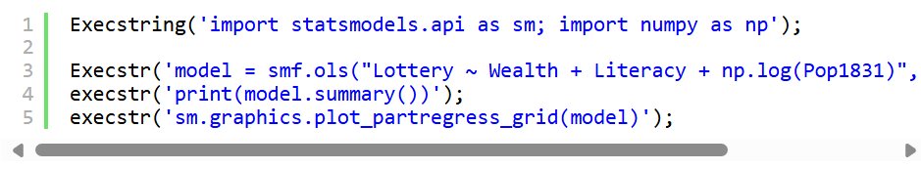
Statsmodels Code
We download the Guerry dataset, a collection of historical data used in support of Andre-Michel Guerry’s 1833 Essay on the Moral Statistics of France. The data set is hosted
online in comma-separated values format (CSV) by the Rdatasets repository. We could download the file locally and then load it using read_csv, but pandas takes care of all of this automatically for us:
Execstr('model = smf.ols("Lottery ~ Wealth + Literacy + np.log(Pop1831)", data=df).fit()');

Slide 16
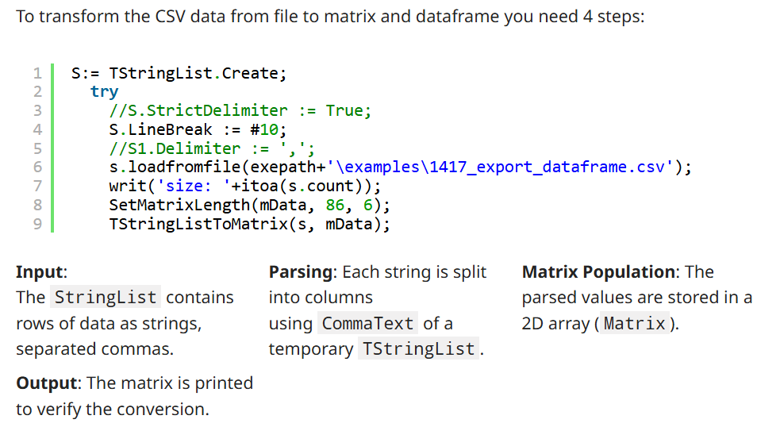
Code Behind Dataframe

Slide 17
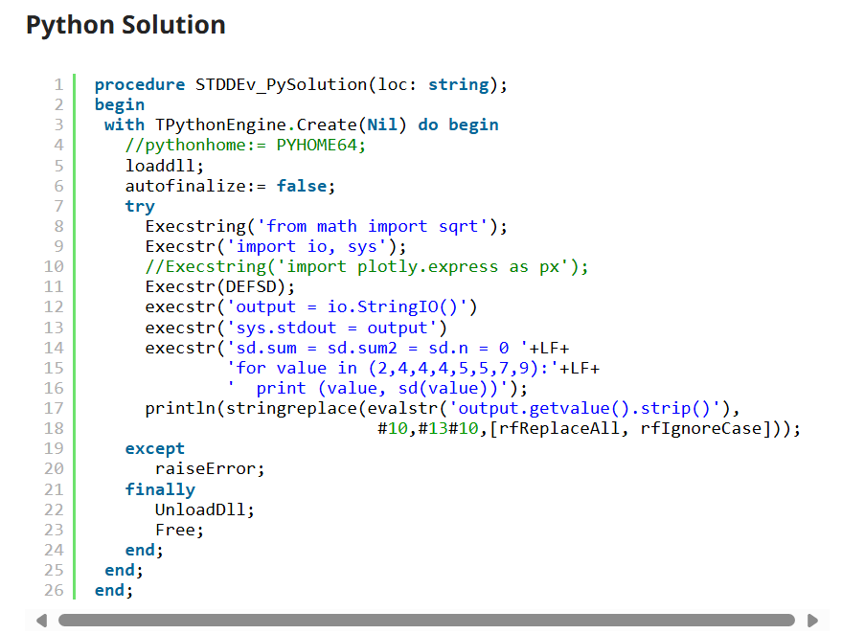
P4D Primer

Slide 18
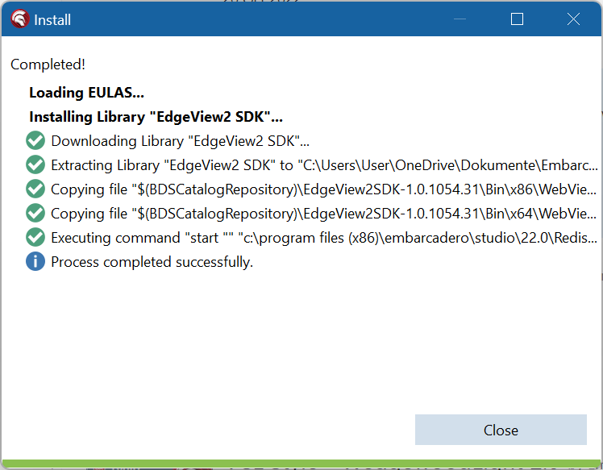
EdgeView2 SDK for Stats
McJson use a Simple Object-Pascal native code using TList as internal data structure with a Single-pass string parser and is just one unit (McJSON) and just one class(TMcJsonItem) integrated in maXbox or Lazarus.
RAD Studio 10.4 Sydney brings support for working with web content through the Chromium-based Edge WebView2 browser control in VCL applications via the new TEdgeBrowser component.
Demo: 1324_weatherbox_regex_64_maincities.txt
https://sourceforge.net/projects/maxbox5/files/binaries/WebView2Loader_2739.dll/download

Slide 19

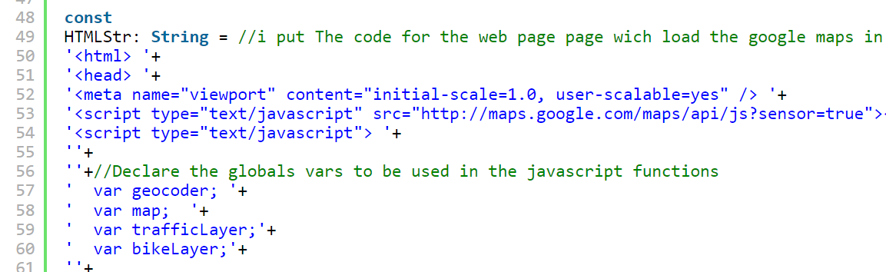
JS-Pas-Solution
These projects have been selected based on their popularity, technical significance, and impact on the Delphi development community. They represent a mix of developer tools, frameworks, and components.
Integrate dynamic, interactive, custom maps, statistic data and geospatial data into your apps by embedding JS:
Weather, Navigation or Trafic Data uses huge statistical data with representation
1312_API_Demo64_5_javascript_maps.txt

Slide 20
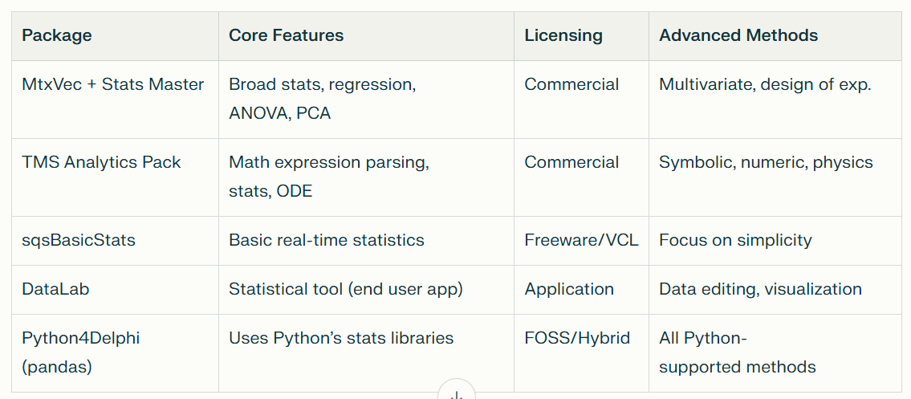
Other Packages
Several statistical packages and libraries are available for Delphi, ranging from commercial solutions to open-source and freeware options.
These packages support a wide range of statistical computations, from basic descriptive statistics to advanced multivariate analysis.

Slide 21
Tops & Flops Stats
**1. Awesome Delphi***
**2. Delphi IDE Theme Editor**
**3. DelphiMVCFramework (DMVCFramework)**
**4. Delphi REST Client API***
**5. Virtual-TreeView**
**6. Delphi-OpenCV***
**7. DUnitX**
**8. Delphi IDE Colorizer**
**9. CEF4Delphi***
**10. OmniThreadLibrary**
These projects have been selected based on their popularity, technical significance, and impact on the Delphi development community. They represent a mix of developer tools, frameworks, and components (perplexity,chatgpt,gemini prompts).
https://github.com/maxkleiner/maXbox/blob/master/objectdetector3.ipynb

Slide 22
Tops & Flops Explain
**1. Virtual-TreeView**
A highly flexible and powerful tree view control, Virtual-TreeView has become a staple in both open-source and commercial Delphi applications.
Its performance and extensibility have set the standard for advanced UI components in Delphi, making it one of the most influential libraries
in the ecosystem[1].
**2. OmniThreadLibrary**
This threading library greatly simplified the development of multi-threaded applications in Delphi. Its ease of use and robust feature
set have made it the go-to solution for Delphi developers needing parallelism and concurrency, ensuring Delphi apps remain competitive
on modern multi-core hardware[1].
**3. DelphiMVCFramework (DMVCFramework)**
As web development became critical, DMVCFramework provided Delphi developers with a modern, powerful framework for building
RESTful web applications and APIs. Its adoption has helped keep Delphi relevant in server-side and web API development[1].
**4. CEF4Delphi**
By enabling the embedding of Chromium-based browsers in Delphi applications, CEF4Delphi has allowed developers to
integrate modern web technologies and content directly into native apps, bridging the gap between desktop and web[1].
**5. DUnitX**
Unit testing is essential for modern software development, and DUnitX brought advanced, NUnit-inspired testing
capabilities to Delphi. Its adoption has fostered better software quality and test-driven development practices in the Delphi community[1].
**6. Delphi-OpenCV**
This project brought the power of the OpenCV computer vision library to Delphi developers, opening up new
possibilities in image processing and AI within the Delphi ecosystem[1].
**7. Delphi REST Client API**
As RESTful APIs became the backbone of modern applications, this library enabled Delphi developers to
easily consume web services, ensuring Delphi’s continued viability for connected applications[1].
**8. Awesome Delphi**
While not a library or component, this curated list of high-quality Delphi resources has become an essential
starting point for developers, helping to foster community and knowledge sharing[1].
**9. Delphi IDE Theme Editor & Delphi IDE Colorizer**
These tools have modernized the developer experience, allowing for extensive customization
and theming of the Delphi IDE, which has contributed to the productivity and satisfaction of Delphi programmers[1].
https://github.com/maxkleiner/maXbox/blob/master/objectdetector3.ipynb

Slide 23
Flops
**1. Delphi 8 and Delphi 2005 Releases**
**2. Dreaded Sorts (THSorts) Demo**
**3. Component Colossus Projects**
**4. Projects Stuck on Old Delphi Versions**
**5. Projects Dependent on Discontinued Technologies**
**6. DLL Hell Projects**
**7. Over-Componentized “Flavor of the Month” Projects**
**8. Projects Broken by Unicode Transition**
**9. Projects with Inflexible Architectures**
**10. “Reinventing the Wheel” Projects**

Slide 24
Conclusion
https://softwareschule.code.blog/2025/02/20/7-data-science-statistical-methods/
Config and spec features of DMath, SKLearn, Statsmodels, mrMath library
Troubleshooting: Typical miscalculations and their solutions with cleaned data
Typical Features of These Packages
Descriptive stats: mean, median, mode, variance, percentiles
Probability distributions (PDF, CDF, inverse CDF)
Random number generation
Hypothesis testing (t-tests, chi-squared, ANOVA)
Regression (linear, logistic, ridge, Poisson, non-linear)
Multivariate techniques (PCA, factor analysis)
Data visualization, function approximation
Check the statistic package like TEE in feature-matrix
https://www.embarcadero.com/docs/rad-studio-feature-matrix.pdf
Method: Correlation
Plot: List or Matrix
View: Form or Browser
https://raw.githack.com/breitsch2/maXbox4/master/assets/graph3.html

Slide 25


Many Thanks for coming!
Materials:
http://www.softwareschule.ch/download/maxbox_starter140.pdf
http://www.softwareschule.ch/download/maxbox_starter149.pdf
https://blogs.embarcadero.com/why-a-data-scientist-chooses-delphi-for-powerful-real-world-visualizations/
Dienstag, 28. Oktober 2025
11:45 – 12:45, Max Kleiner
https://sourceforge.net/projects/maxbox5/files/EKON29/
https://maxbox4.wordpress.com/2025/07/01/ekon-29

