Slide 1

The Machine Learning Package
Nov. 2023, Max Kleiner
MLP as Package with out of the box demos
IDE / RAD / CLI / Shell / Scripts
CIFAR-10 Image Classifier
https://github.com/maxkleiner/neural-api
This session shows you various ways of using the MLP in your application.

Slide 2
Agenda
Artificial Neural Networks (ANNs) in a Delphi Form as a Component.
ML Package for Delphi and Lazarus.
CIFAR-10 Image Classifier
Loading and testing a pre-trained model
In the archive MachineLearningPackage.zip you find the script, model and data you need, which works with Lazarus, Delphi, Jupyter and maXbox.

Slide 3
NN Research
Neural networks are composed of a large number of interconnected units divided into input, output, and hidden nodes. A single processing unit merely sums up the weighted activation on its inputs, transforms this sum according to an activation function, and passes the resulting function to its output.
https://www.kau.edu.sa/Files/320/Researches/52692_22998.pdf
https://entwickler-konferenz.de/blog/machine-learning-mit-cai/

Slide 4
Cross-platform ANN component
Defining the Network Structure.
Initialization (structure).
Specifying minimum and maximum values for inputs and outputs.
Training data (with loss function).
After Training testing.
Using the Trained Network
https://github.com/maxkleiner/maXbox/blob/master/logisticregression2.ipynb

Slide 5
Defining NN Structure
To define structure of a network run-time, just add following lines:
nn1.Network.clear;
nn1.Network.Add('2'); // Number of inputs
nn1.Network.Add('3'); // Number of hidden neurons
nn1.Network.Add('2');
nn1.Network.Add('1'); // Num. of outputs
Nn1.Initialize(true); // Initialize neural network

Slide 6
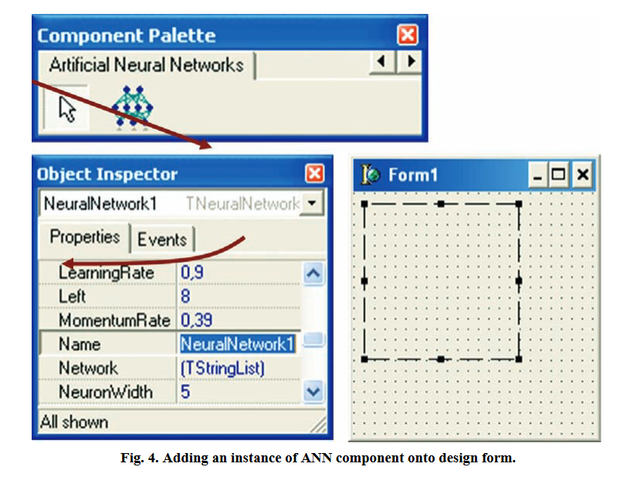
Be aware of
Demo: 1234_NeuralNetwork2_XOR_test12_EKON27.pas

Slide 7
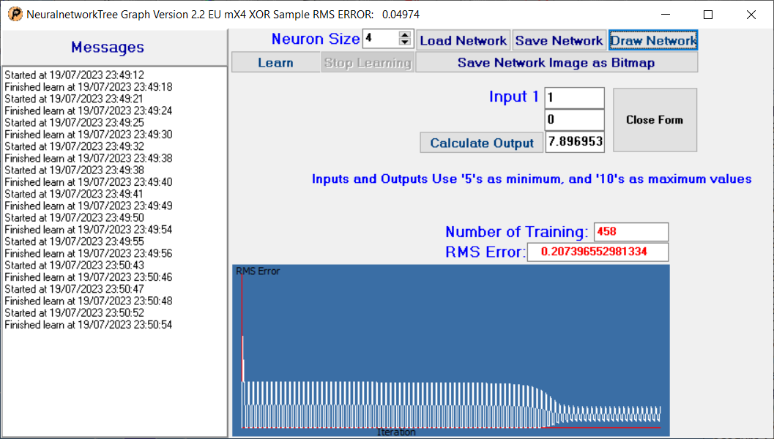
Graph Control

Slide 8
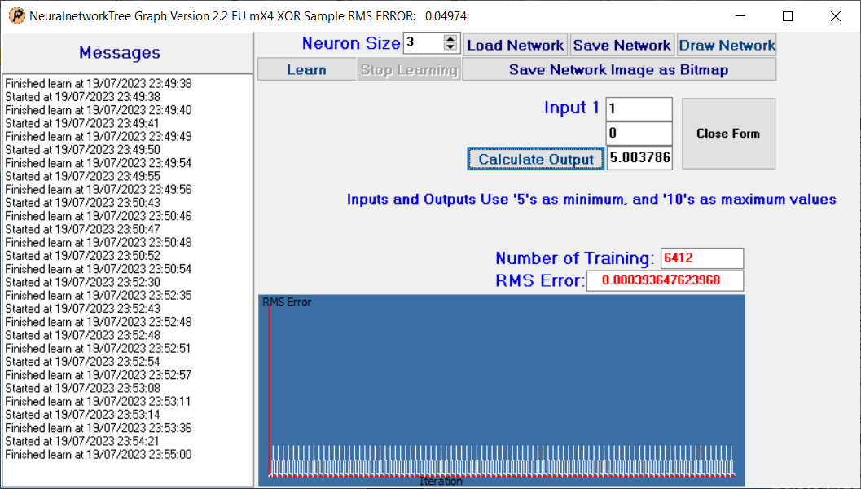
Flow & Graph Control II
Demo: 1234_NeuralNetwork2_XOR_sampleEU_EKON27.pas

Slide 9
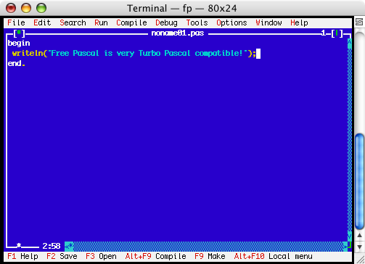
ML Package
IDE for Console or Terminal

Slide 10
MLP
The neural-api or CAI API (Conscious Artificial Intelligence) is
something like TensorFlow for Pascal and is platform-independent open source
library for artificial intelligence or machine learning in the field of
speech recognition, image classification, OpenCL, big data, data science, sentiment-analysis
and computer vision2 with more or less SVG.
https://github.com/maxkleiner/neural-api/

Slide 11
Using MLP
To be able to run this example, you'll need to load an already trained neural network file and then select the image you intend to classify.
TRAINPATH = '.\model\ClassifyCNNResize40_84.nn'
CAI stores both architecture and weights into the same *.nn file!
Dropout is a simple and powerful regularization technique for neural networks and deep learning models.
Download the package:
https://github.com/maxkleiner/neural-api/blob/master/examples/SimpleImageClassifier/MachineLearningPackage.zip
Just unpack the zip and start exe

Slide 12
Let's compile
As the name implies, it is a CNN-model. A Convolutional1 Neural Network (CNN) is a type of deep learning algorithm that is particularly for image recognition and object-detection tasks. It is made up of multiple layers, including convolution layers, pooling layers, and fully connected layers.
Const PICPATH = '.\data\';
TRAINPATH = '.\model\ClassifyCNNModel_70.nn';
The main procedure to classify incoming images loads the model, decides dropout or not (later more) and creates input- and output-volumes with a shape of 32;32;3 or a 32x32x3 volume:
Demo: 1135_classify_cifar10images1_5.pas

Slide 13
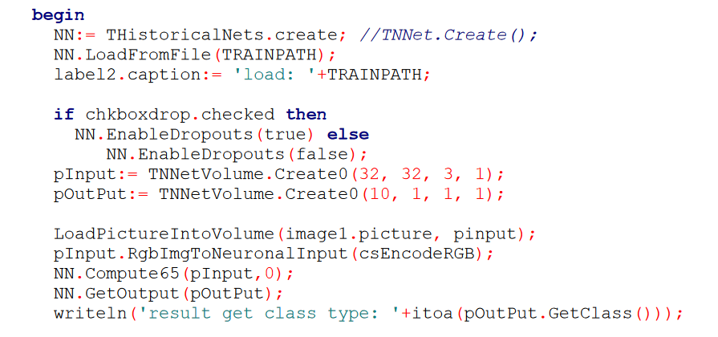
The Main
Loading 10K images from file "C:\Program Files\Streaming\maxbox4\maxbox47590\maxbox4\cifar-10-batches-bin\test_batch.bin" ...
GLOBAL MIN MAX -2 1.984375
Testbatch size: 48000000
dbug volumescount: 10000
Ver: 4.7.6.50 (476). Workdir: C:\Program Files\Streaming\maxbox4\maxbox47590\maxbox4\resized\MLPackage
Testbatch score: Rate:0.8000, Loss:-0.0639, ErrorSum:467.7171

Slide 14
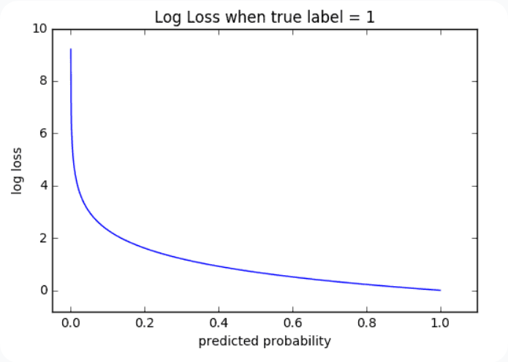
Pretrained
The *.nn file in TRAINPATH serves as a pre-trained file (FAvgWeight) to classify/predict images we trained on. Also the CIFAR-10 with experiments/testcnnalgo/testcnnalgo.lpr and a number of CIFAR-10 classification examples are available on /experiments.
Imagine the accuracy goes up and the loss-function (error-rate) goes down. The loss function is the bread & butter of modern machine learning; it takes your algorithm from theoretical to practical and transforms matrix multiplication into deep learning.

Slide 15

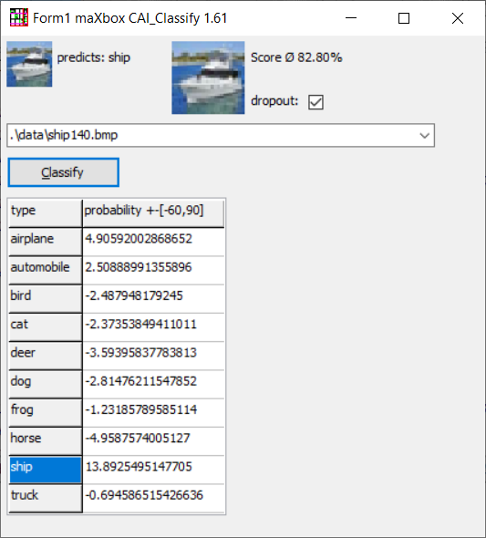
Electron Web App
Unit classify_cifar10_images2lazTutor42_1_61;
https://wiki.freepascal.org/pas2js_Electron_Web_Application

Slide 16
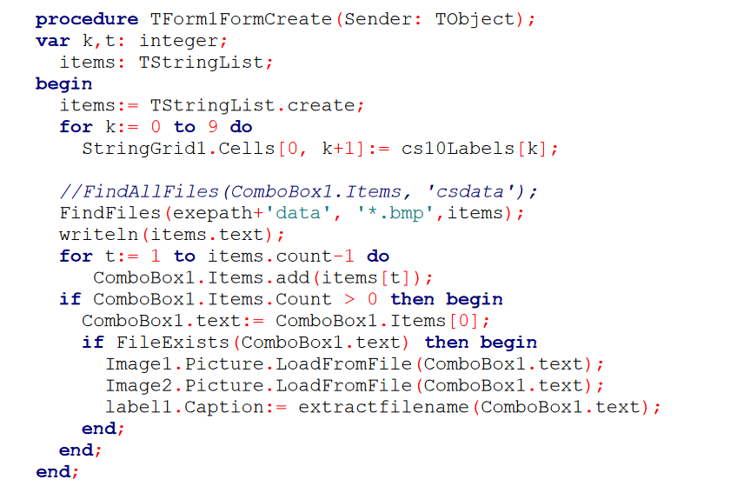
Form Create

Slide 17
Performance
Loss functions are different based on a problem statement to which deep learning is being applied. The cost function is another term used interchangeably for the loss function, but it holds a more different meaning.
A loss function is for a single training example, while a cost function is an average loss over a complete train dataset.
train neural network start..:15000 iterators, train neural network finished:
RMS ERROR: 0.004679808474835: evaluate neural network..
i:0 j:0 0.095534542493845
i:0 j:1 0.931946667637693
i:1 j:0 0.914564807733864
i:1 j:1 0.005510785410457
debug inf nncount:3 mX4 executed: 14/08/2023 09:33:01 Runtime: 0:0:6.1 Memload: 54% use

Slide 18
Web Platforms
As a Jupyter Notebook:
https://github.com/maxkleiner/maXbox/blob/master/EKON24_SimpleImageClassificationCPU.ipynb
and the same in Colab.research:
https://colab.research.google.com/github/maxkleiner/maXbox/blob/master/EKON24_SimpleImageClassificationCPU.ipynb
The whole package with app, script, tutorial, data and model:
https://github.com/maxkleiner/neural-
api/blob/master/examples/SimpleImageClassifier/MachineLearningPackage.zip
https://github.com/maxkleiner/maXbox/blob/master/objectdetector3.ipynb

Slide 19
Conclusion
Only CNN is available but diff. structures possible, implement some of these well known architectures with CAI:
For example Yann LeCun LeNet-5:
NN := TNNet.Create();
NN.AddLayer( TNNetInput.Create(28, 28, 1) );
NN.AddLayer( TNNetConvolution.Create(6, 5, 0, 1) );
NN.AddLayer( TNNetMaxPool.Create(2) );
NN.AddLayer( TNNetConvolution.Create(16, 5, 0, 1) );
NN.AddLayer( TNNetMaxPool.Create(2) );
NN.AddLayer( TNNetFullConnect.Create(120) );
NN.AddLayer( TNNetFullConnect.Create(84) );
NN.AddLayer( TNNetFullConnectLinear.Create(10) );
NN.AddLayer( TNNetSoftMax.Create() );
Method: Classification
Model: CNN + CIFAR-10
Metric: RMS
https://raw.githack.com/breitsch2/maXbox4/master/assets/graph3.html

Slide 20

MLP
Thanks for coming!
Materials:
http://www.softwareschule.ch/download/maxbox_starter105.pdf
https://github.com/breitsch2/maXbox4/tree/master/assets

