Slide 1
Project-one
Seara Clayborn
Max Krueger
Max Thachet
Zibo Zhao

Slide 2
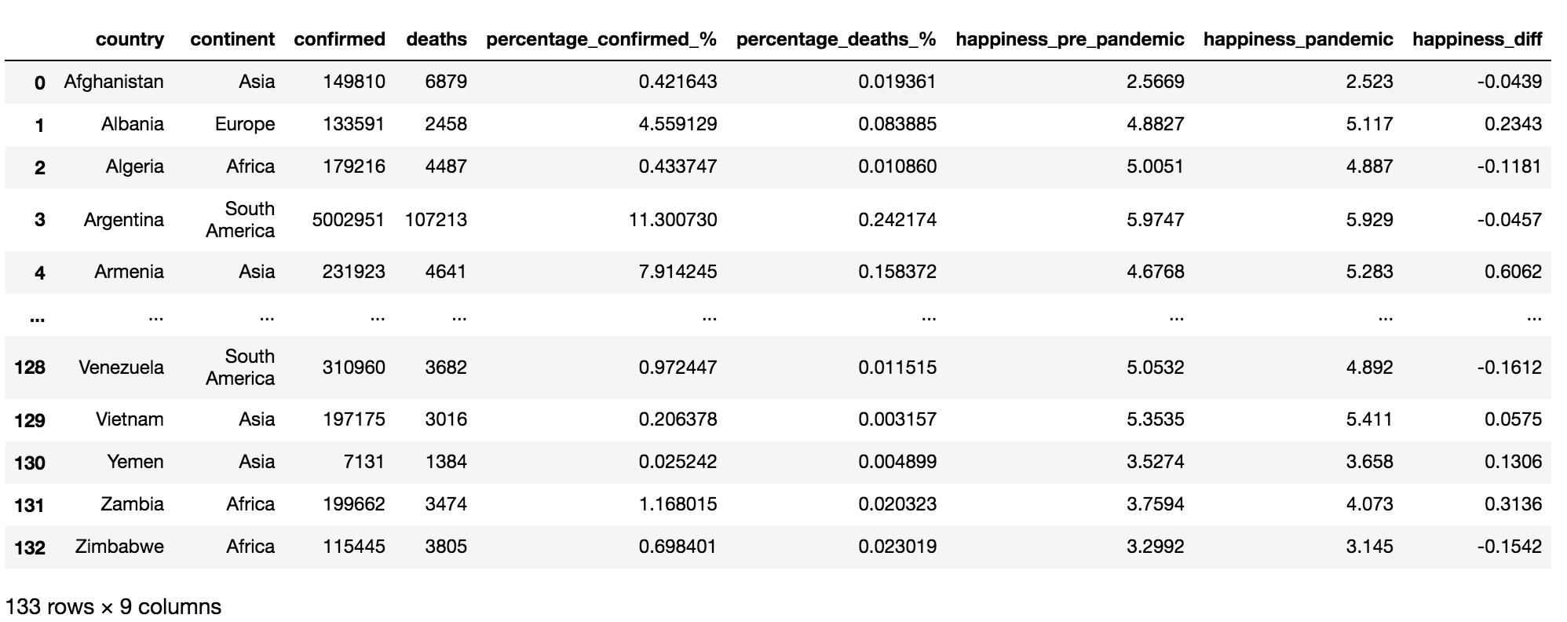
Relationship between covid cases and happiness score pre- and during pandemic
Happiness_2020 (n=153)
n=148
Normalization by total population
Score difference (2021 – 2020)
Relationship by scatter plot
Linear regression
Happiness_2021 (n=149)
Drop na for case number
Merge on country name
all_df (n=133)
Visualization
Covid_API_df (n= 180)

Slide 3
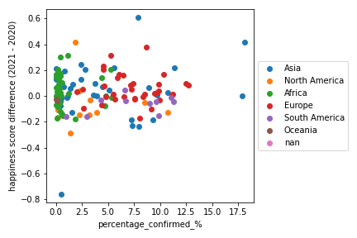
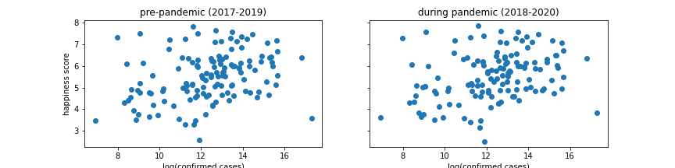
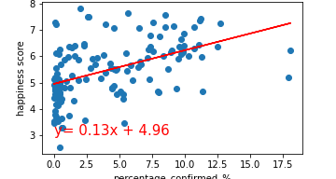
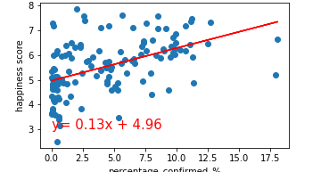
Relationship between covid cases and happiness score pre- and during pandemic
log(confirmed cases)
log(confirmed cases)
There is a weak positive relationship between happiness score and confirmed case number/percentage among all the countries around the world.
There is no correlation between difference of happiness (2021-2020) and percentage of confirmed/total population.
Confirmed/total population (%)
Confirmed/total population (%)
r²: 0.22
r²: 0.24

