Slide 1
World Happiness pre- and during pandemic - Project-one
Seara Clayborn
Junaid Dawood
Max Krueger
Max Thachet
Zibo Zhao

Slide 2
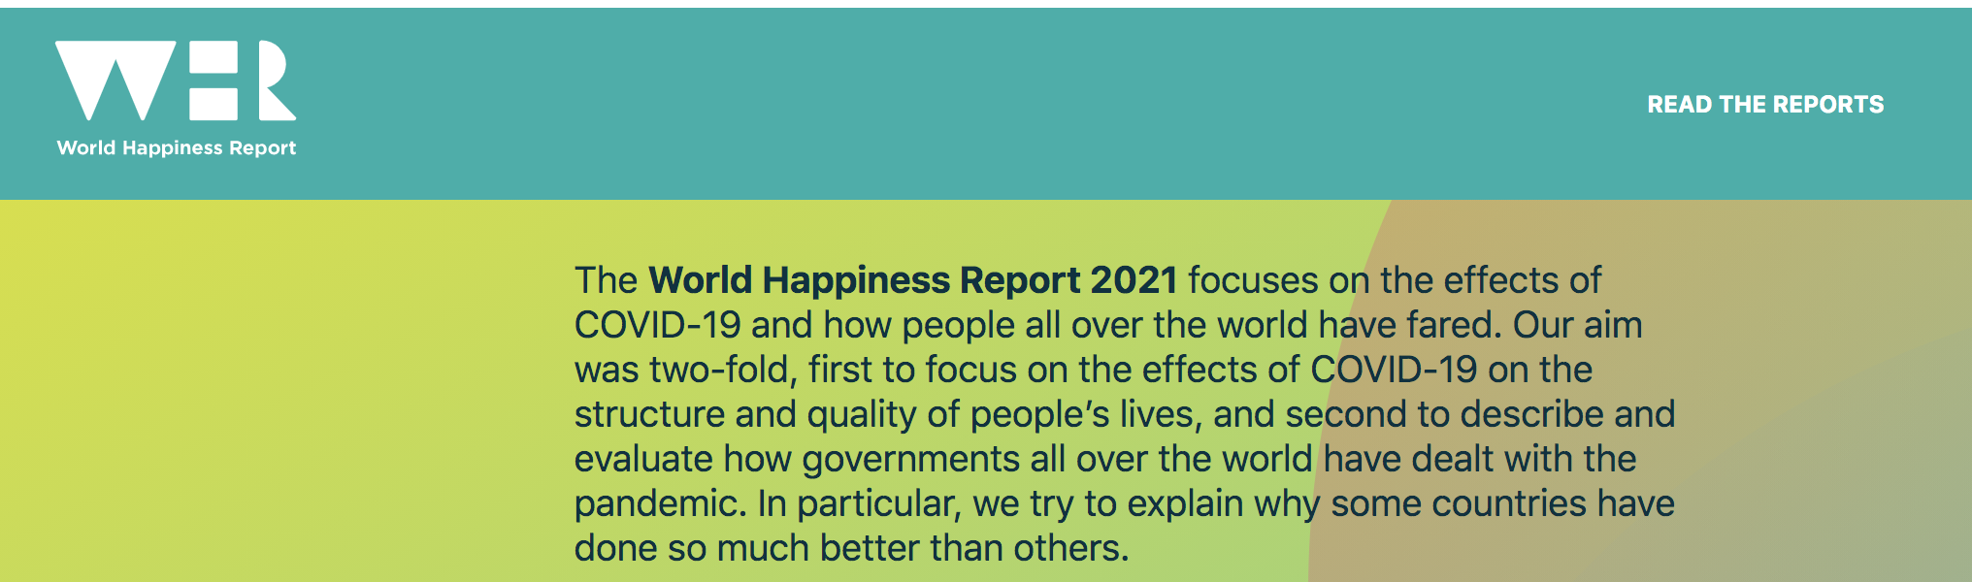
In this project, we are diving into the World Happiness Report (2020 and 2021) and Covid-19-API.
Data Source:
https://worldhappiness.report/
https://github.com/M-Media-Group/Covid-19-API
Datasets:
Part I: The world happiness report in year 2020 and 2021
https://worldhappiness.report/ed/2021/ https://worldhappiness.report/ed/2020/
World Happiness Report 2021 use data that come from the Gallup World Poll surveys from 2018 to 2020.
Cantril ladder – the measurement of happiness:
the best possible life for them being a 10
the worst possible life being a 0
Rating of their own current lives on that 0 to 10 scale.

Slide 3
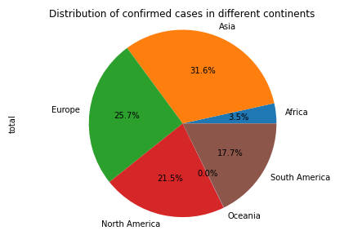
In this project, we are diving into the World Happiness Report (2020 and 2021) and Covid-19-API.
Data Source:
https://worldhappiness.report/
https://github.com/M-Media-Group/Covid-19-API
Datasets:
Part II: Live cases data from Covid-19-API (updated once every hour)
https://covid-api.mmediagroup.fr/v1/cases
Population data:
https://github.com/M-Media-Group/country-json/blob/master/src/countries-master.json
Request: GET /cases
GET /history
GET /vaccines
For cases data: Optional query parameters, country/ab/continent

Slide 4
Analysis Goals
What are the top 10 happiest countries pre-pandemic?
What are the top 10 least happiest countries pre- and during pandemic?
What is the relationship between covid cases and happiness?
What is the relationship between life expectancy and confirmed covid deaths?
What is the relationship between GDP per capita and confirmed covid deaths?

Slide 5
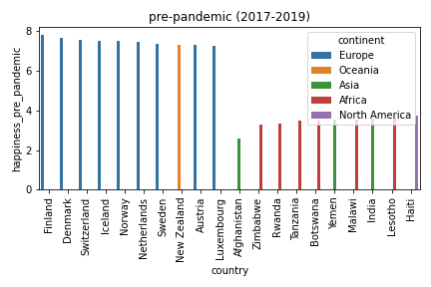
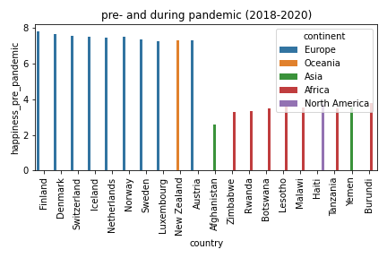
The top 10 happiest and least happiest countries pre- and during pandemic

Slide 6
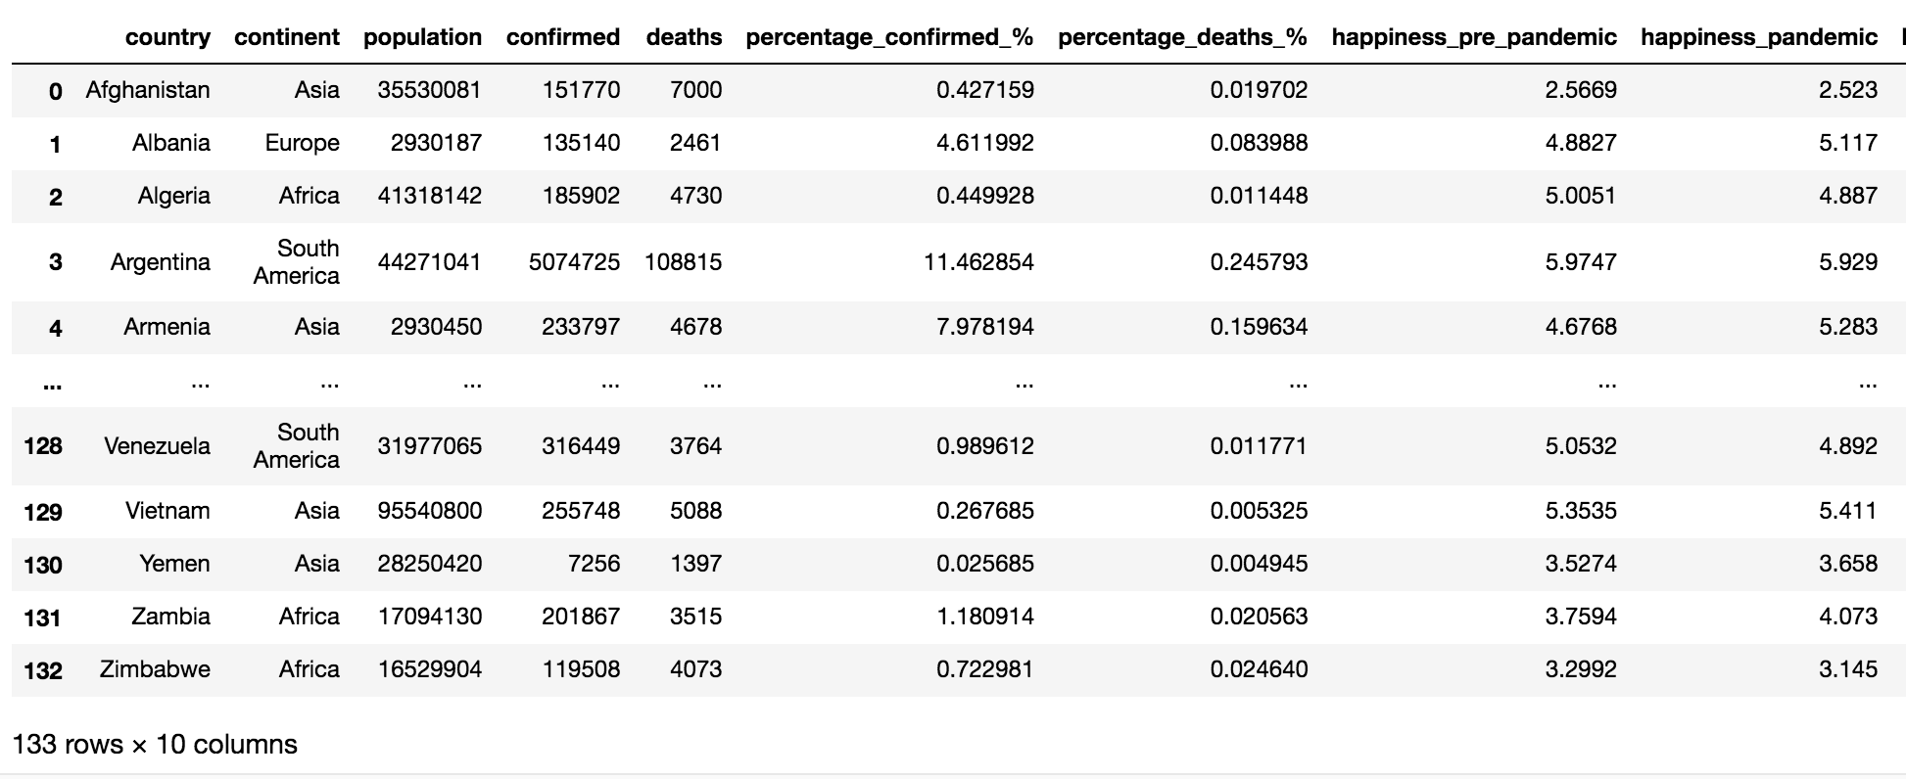
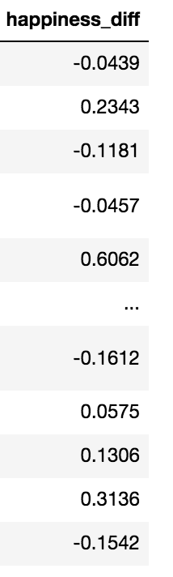
Relationship between covid confirmed cases and happiness score pre- and during pandemic
Happiness_2020 (n=153)
n=148
Normalization by total population
Score difference (2021 – 2020)
Relationship by scatter plot
Linear regression
Happiness_2021 (n=149)
Drop na for case number
Merge on country name
all_df (n=133)
Visualization
Covid_API_df (n= 180)

Slide 7
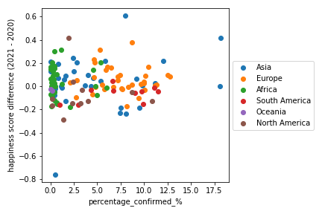
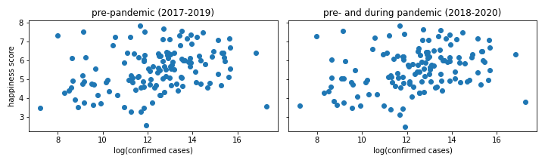
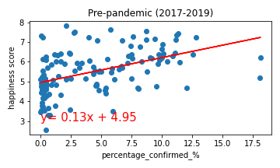
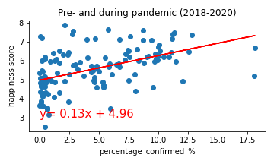
Relationship between covid confirmed cases and happiness score pre- and during pandemic
Conclusion:
There is a weak positive relationship between happiness score and confirmed case number/percentage among all the countries around the world.
There is no correlation between difference of happiness (2021-2020) and percentage of confirmed/total population.
r²: 0.22
r²: 0.24
Notes:
Pakistan; Armenia, Bahrain

Slide 8
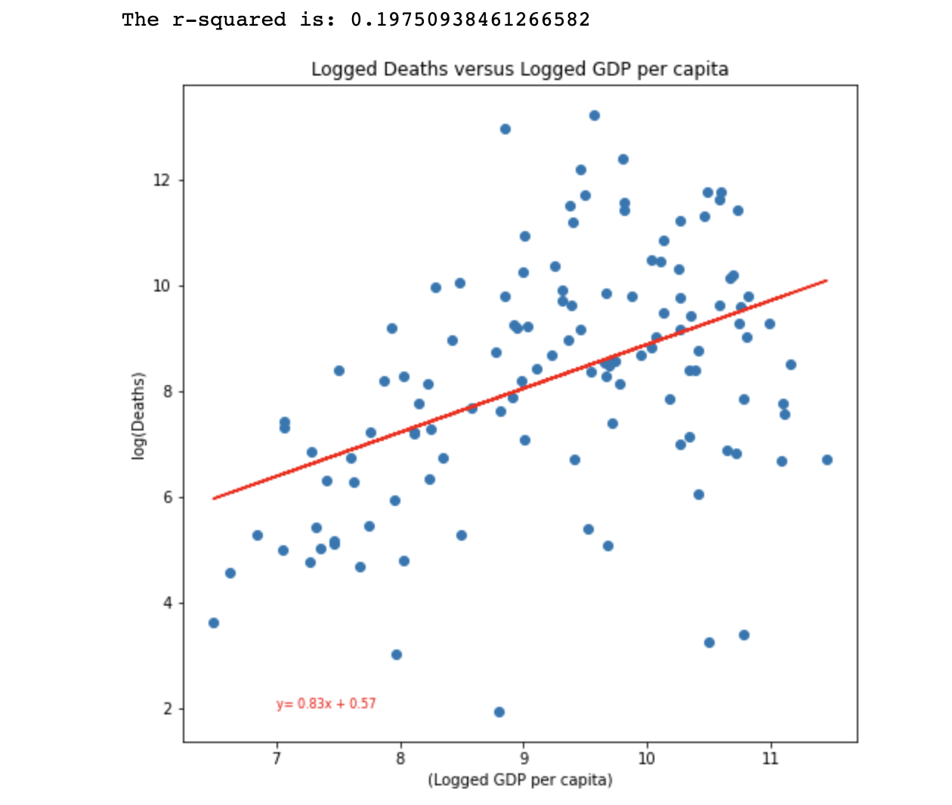
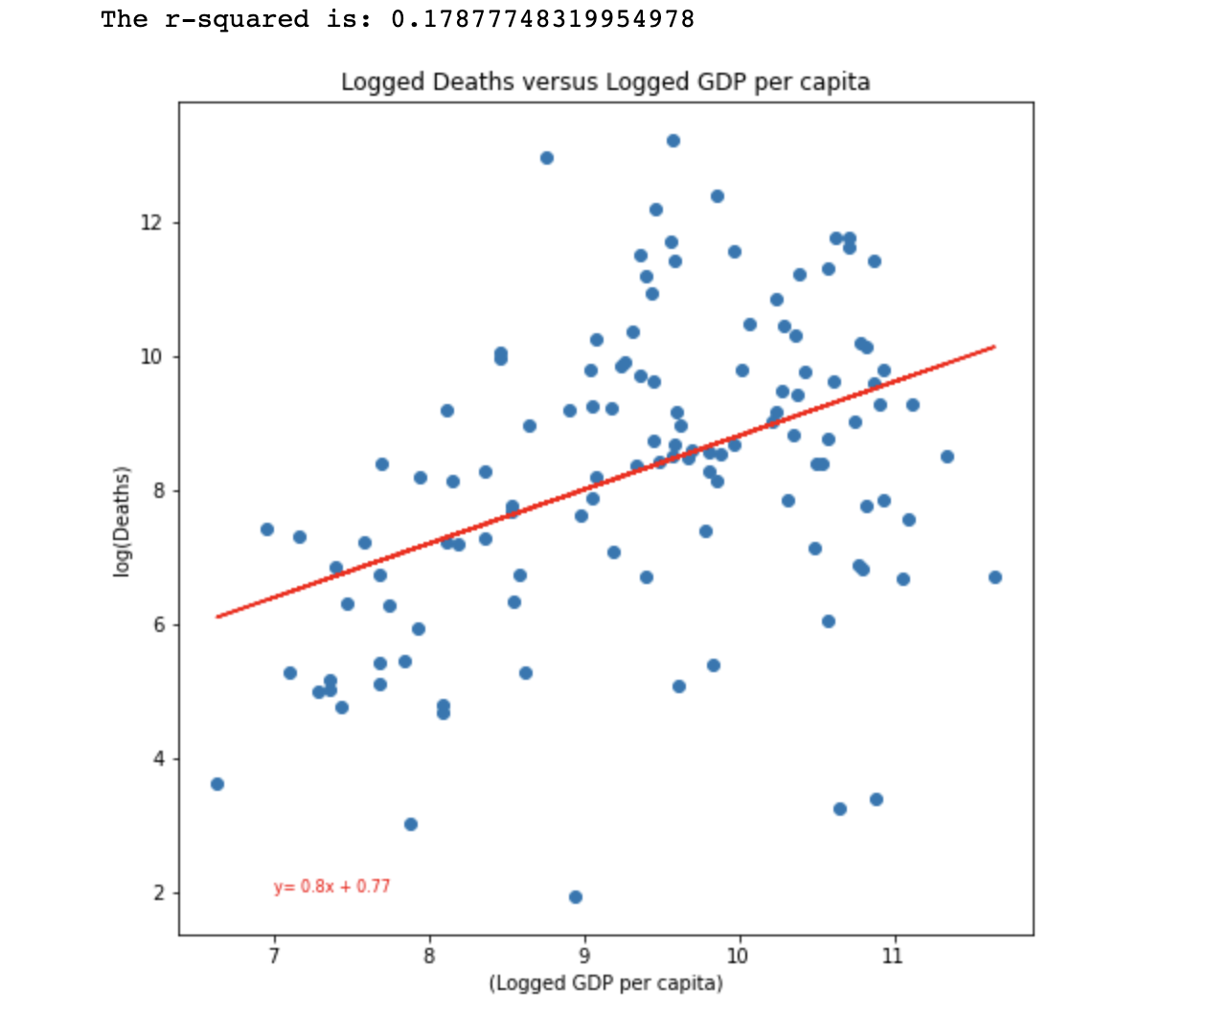
Relationship between covid deaths and GDP per capita
2020 report
2021 report
Conclusion: There is a weak positive relationship between covid deaths and GDP per capita.

Slide 9
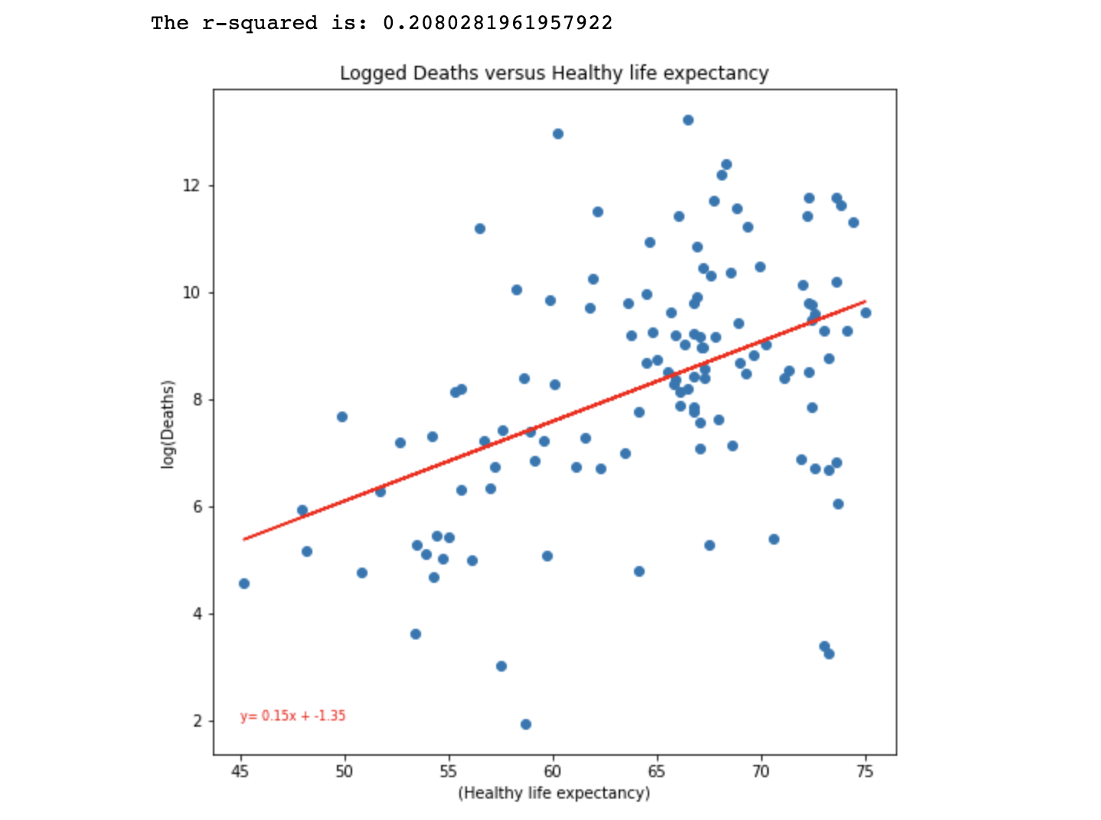
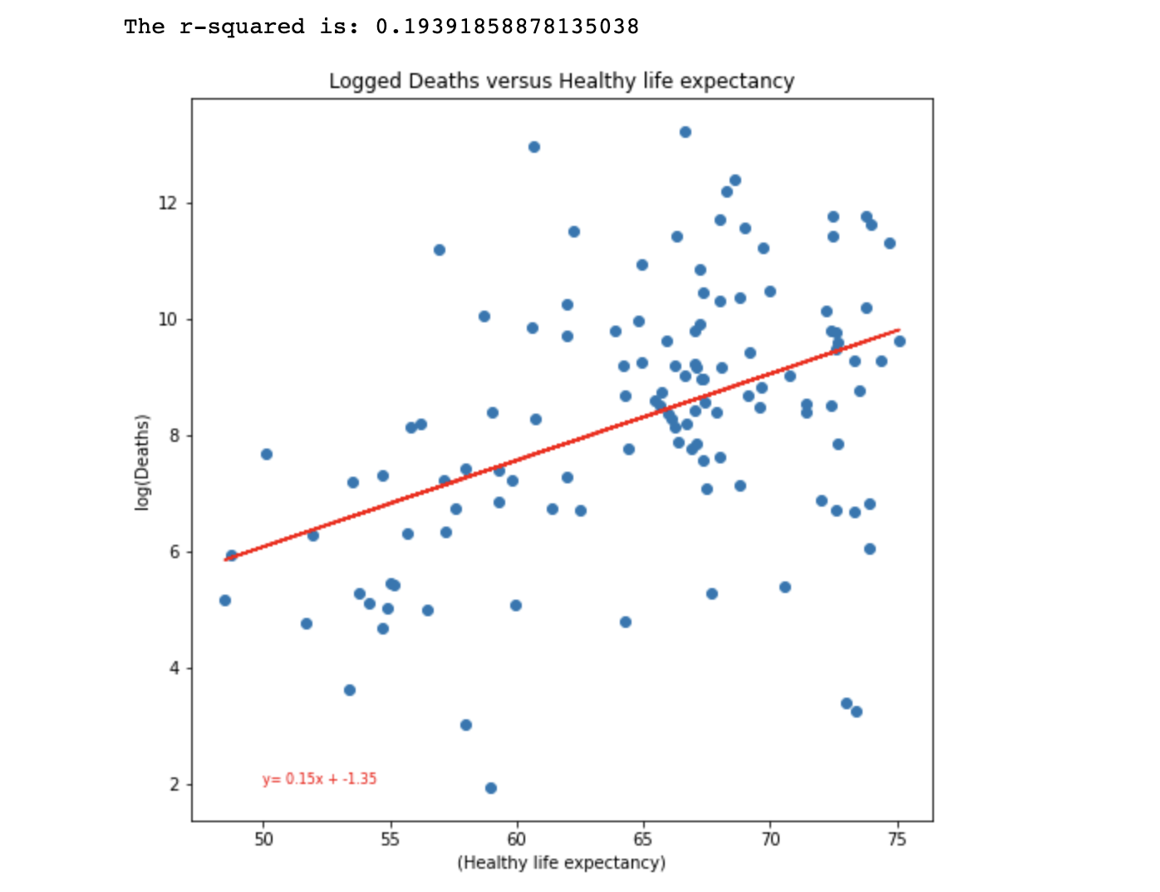
Relationship between covid deaths and healthy life expectancy
2020 report
2021 report
Conclusion: There is a weak positive relationship between covid deaths and healthy life expectancy.

