Slide 1
Web Development
Introduction to the world of JavaScript

Slide 2
Introductions
Hi everyone,
My name is Ildar, and I’ll be leading you through this project
A bit of info about me:
just finished my 3B term in Computer Science
this is my first time teaching at Coffee ‘N Code
did 4 coop terms in web development
and thank you very much for coming!

Slide 3
Course Goals
In this series of workshops you will learn the following:
JavaScript
modern database structure (NoSQL)
user authentication with JWT
Vue.js
deployment of the application (if time permits)
Assumptions made by me in this course:
You don’t need any knowledge of JavaScript, or programming, this is a beginner-friendly course

Slide 4
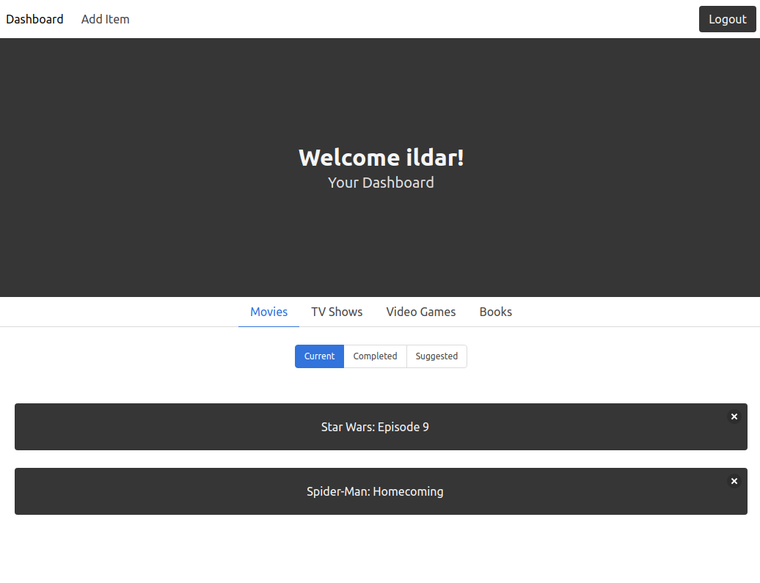
The Project:
A “Backlogger Application”:
you can check out a live example at
https://www.entertainment-backlogger.herokuapp.com

Slide 5
A Preamble
If you are having trouble with anything (regardless how small, or big), please do not hesitate to raise your hand or contact me privately or at #webdev channel on Slack.
If you feel that I made a mistake, don’t hesitate to say something

Slide 6
A Preamble
I will post the code and the progress we made each day by the end of the week of each workshop.
fully documented, with steps that you could follow if you miss a class
Join our Slack Channel:
Slack: https://bit.ly/uwcoffeencodeslack
Channel: #webdev

Slide 7
Before we get started:
Some important questions:
Which year are you in?
How much programming experience do you have ?
Anyone not in math or engineering?

Slide 8
Getting Started
In duration of this course, we will need the following:
Node.js
Visual Studio Code
Postman
RoboMongo

Slide 9
Let’s get started!

Slide 10
Setting Up
Please navigate to: github.com/UWCoffeeNCode/W20-Lessons/tree/master/webdev/lesson-1
2. Please follow the instructions in: setup.md
Please don’t hesitate to ask for help

Slide 11
That’s all for the installations for today

Slide 12
JavaScript
Introduction

Slide 13
Review
We have learned about:
operators
variables
data types
arrays
objects
functions
loops

Slide 14
See you next week!

