Slide 1
Web Development
Introduction to the world of JavaScript

Slide 2
Introductions
Hi everyone,
My name is Ildar, and I’ll be leading you through this project
A bit of info about me:
just finished my 3B term in Computer Science
this is my first time teaching at Coffee ‘N Code
did 4 coop terms in web development
and thank you very much for coming!

Slide 3
Course Goals
In this series of workshops you will learn the following:
JavaScript
modern database structure (NoSQL)
user authentication with JWT
Vue.js
deployment of the application (if time permits)
Assumptions made by me in this course:
You don’t need any knowledge of JavaScript, or programming, this is a beginner-friendly course

Slide 4
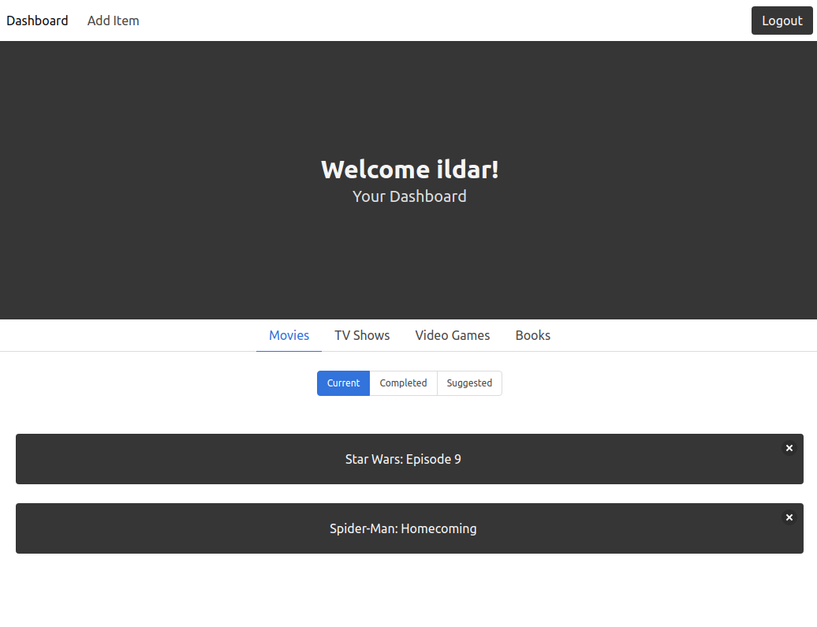
The Project:
A “Backlogger Application”:
you can check out a live example at
https://www.entertainment-backlogger.herokuapp.com

Slide 5
A Preamble
If you are having trouble with anything (regardless how small, or big), please do not hesitate to raise your hand or contact me privately or at #webdev channel on Slack.
If you feel that I made a mistake, don’t hesitate to say something

Slide 6
A Preamble
I will post the code and the progress we made each day by the end of the week of each workshop.
fully documented, with steps that you could follow if you miss a class
Join our Slack Channel:
Slack: https://bit.ly/uwcoffeencodeslack
Channel: #webdev

Slide 7
Before we get started:
Some important questions:
Which Year are you in?
How much programming experience do you have ?
Anyone not in math or engineering?

Slide 8
Getting Started
In duration of this course, we will need the following:
Node.js
Visual Studio Code
Postman
RoboMongo

Slide 9
Let’s get started!

Slide 10
Setting Up
Please navigate to: github.com/UWCoffeeNCode/W20-Lessons/webdev/lesson-1
2. Please follow the instructions in: setup.md
Please don’t hesitate to ask for help

Slide 11
That’s all for the installations for today

Slide 12
JavaScript
Introduction

Slide 13
Review
We have learned about:
operators
variables
data types
arrays
objects
functions
loops

Slide 14
Express.js
Introduction to REST API

Slide 15
REST API
REST stands for REpresentational State Transfer
REST is an architectural style, or design pattern, for APIs (API: Application Programming Interface)

Slide 16
Important Definitions
Server: a computer or computer program which manages access to a centralized resource or service in a network.
Client: a person or software who uses the API.
Resource: can be any object the API can provide information about.
HTTP (Hypertext Transfer Protocol): Protocol for communication between servers

Slide 17
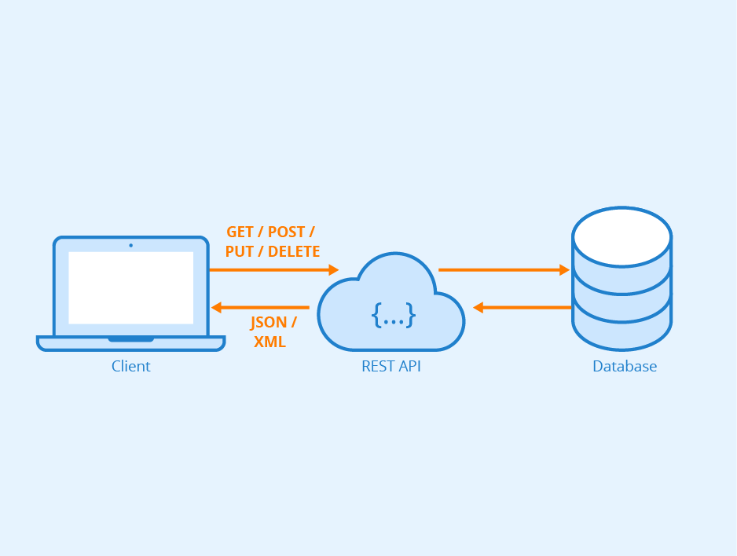
Key Idea
when a REST API is called, the server will transfer to the client a representation of the state of the requested resource.

Slide 18
Types of HTTP methods
GET - Retrieves resource from the server (should only retrieve resource and should have no other effect).
POST - This HTTP request type is usually used for creating an entity i.e. a resource without an id. Once the request is successfully created, an id of the newly created resource is returned as part of the response to this HTTP request.
PUT - Similar to POST, but used to update an existing resource. You pass the id of existing resource along with the request.
PATCH - Applies partial modifications to a resource.
DELETE - Removes the resource from the server. You need to pass the id of the resource to be deleted.

Slide 19
Let’s implement our first RESTful API endpoints

Slide 20
Review
We have learned about:
REST architecture
initialized our project
setup express.js
made our first REST API calls

Slide 21
See you next week!

Slide 22
Sources
https://medium.com/extend/what-is-rest-a-simple-explanation-for-beginners-part-1-introduction-b4a072f8740f
https://medium.com/@kumaraksi/using-http-methods-for-restful-services-e6671cf70d4d
https://expressjs.com/

