Slide 1


Molecular Dynamics
for biological systems
Cédric Gageat Maximilien Levesque
prénom.nom@ens.fr

Slide 2
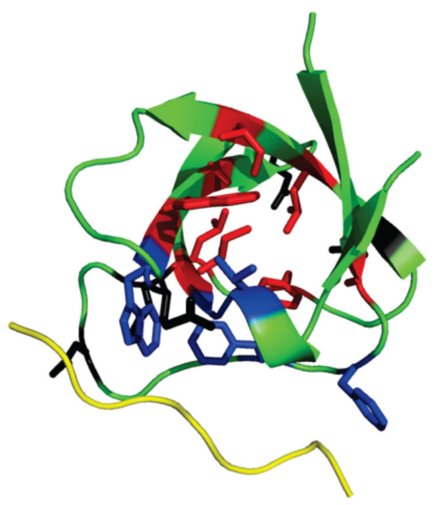
What for ?
Understanding a biological macromolecule
Karplus, Acc. Chem. Res., 2002, 35 (6), pp 321–323,
doi: 10.1021/ar020082r
Describing living systems in terms of physics and chemistry
Can we predict
- Structural and functional changes
- Solvation free energies
- The microscopic solvation profile
Courtesy of Dominik Domin, ENS

Slide 3
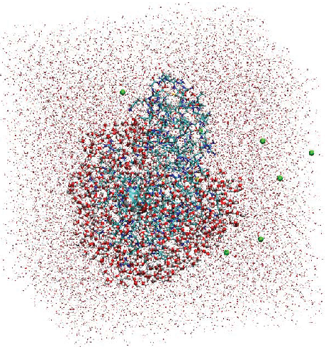
What for ?
Understanding a biological macromolecule
Karplus, Acc. Chem. Res., 2002, 35 (6), pp 321–323,
doi: 10.1021/ar020082r
Describing living systems in terms of physics and chemistry
Can we predict
- Structural and functional changes
- Solvation free energies
- The microscopic solvation profile
Courtesy of J. Dziedzic, S. J. Fox,T. Fox, C. S.Tautermann and C.-K. Skylaris

Slide 4
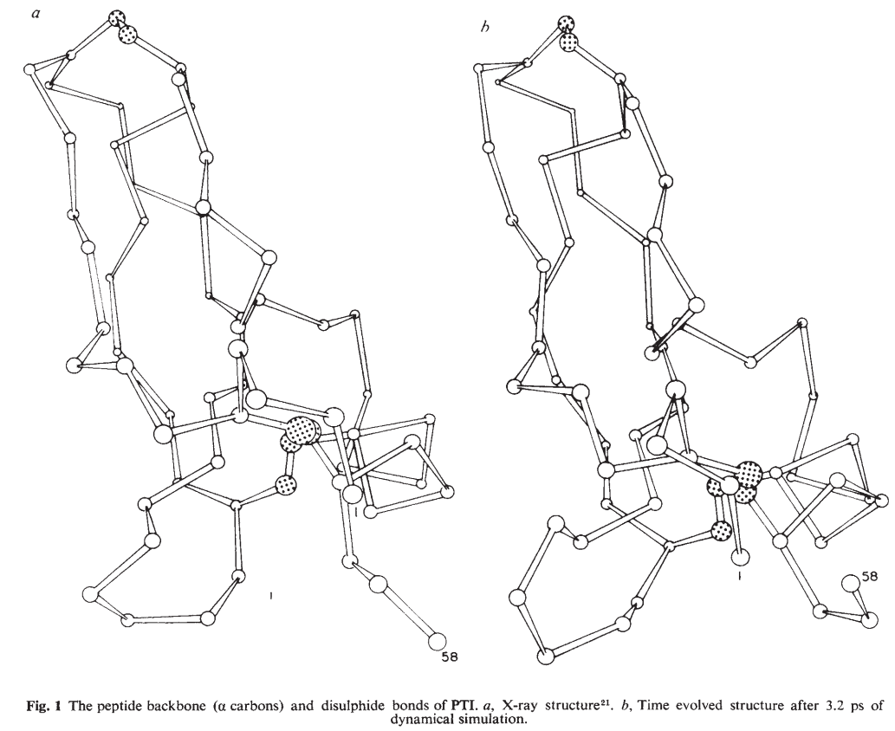
Since when ?
In the 70’ : McCammon, Gelin and Karplus, Dynamics of folded proteins
Nature 1977, 267, 585-590
MD 50’s
MD for liquid Ar 60’s
accurate X-rays ~ 70’s
8.8 ps by steps of 1 fs

Slide 5
So late !?
In the 70’ : McCammon, Gelin and Karplus, Dynamics of folded proteins
Nature 1977, 267, 585-590
- Time-averaged structure and fluctuations

Slide 6
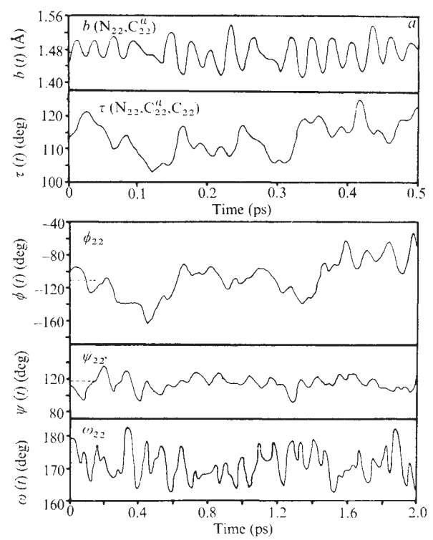
So late !?
In the 70’ : McCammon, Gelin and Karplus, Dynamics of folded proteins
Nature 1977, 267, 585-590
- Time-averaged structure and fluctuations
- Time-dependence of motions

Slide 7
So late !?
In the 70’ : McCammon, Gelin and Karplus, Dynamics of folded proteins
Nature 1977, 267, 585-590
- Time-averaged structure and fluctuations
- Time-dependence of motions
- Concerted fluctuations
- Concerted motions

Slide 8
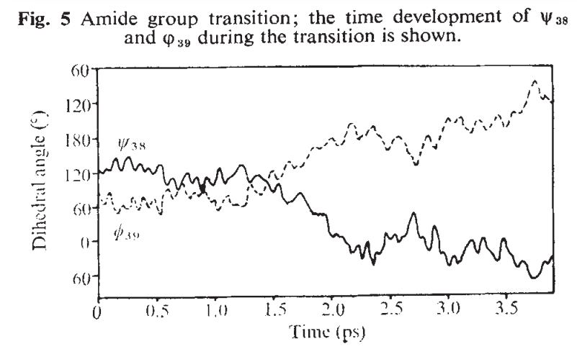
So late !?
In the 70’ : McCammon, Gelin and Karplus, Dynamics of folded proteins
Nature 1977, 267, 585-590
« It is clear […] the protein […] samples highly anharmonic regions of the potential surface […] confined multidimensional space […] »

Slide 9

So late !?
In the 70’ : McCammon, Gelin and Karplus, Dynamics of folded proteins
Nature 1977, 267, 585-590
« It is clear […] the protein […] samples highly anharmonic regions of the potential surface […] confined multidimensional space […] »
Still, we understood proteins are not rigid.

Slide 10
So late !?

Slide 11
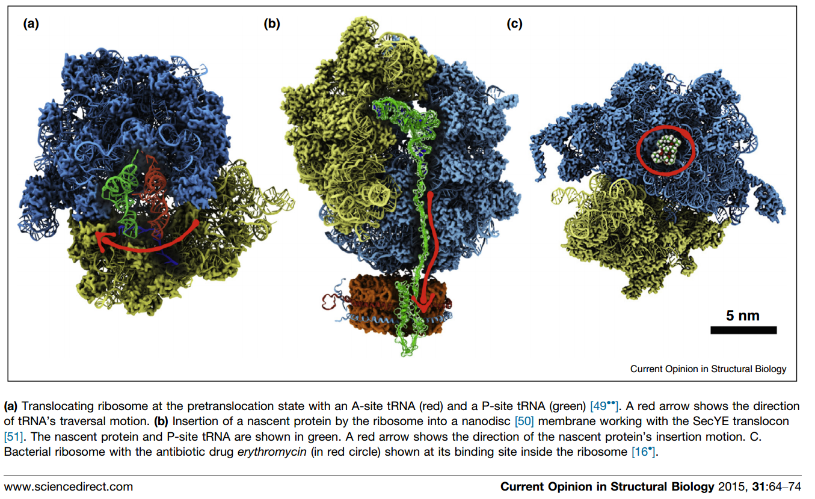
Biological systems studied today

Slide 12

Biological systems studied today

Slide 13

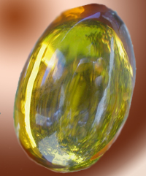


Code names to keep in mind
AMBER

Slide 14
Petascale, exascale, Xtreme-scale, Xxtreme, XXX…
From laptops to Tianhe-2 (heterogeneous architecture, 3 120 000 cores)
55 PFLOP/S
… to propagate sum of forces = mass × acceleration

Slide 15
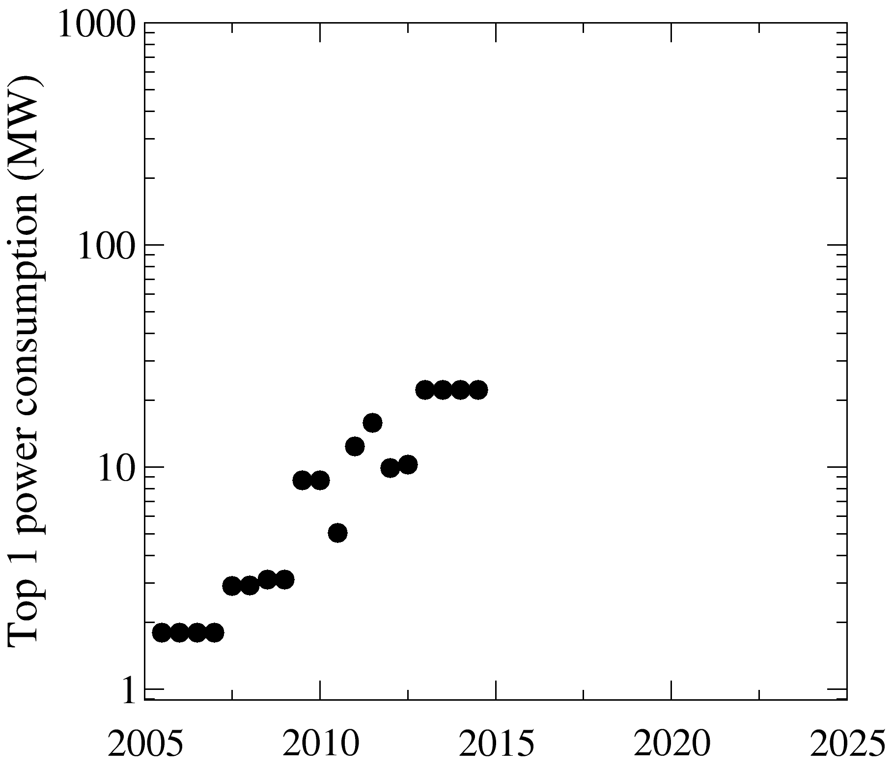
Petascale, exascale, Xtreme-scale, Xxtreme, XXX…
From laptops to Tianhe-2 (heterogeneous architecture, 3 120 000 cores)
55 PFLOP/S 18 MW
… to propagate sum of forces = mass × acceleration
Fessenheim (reactor 1)
Fukushima Daiichi (reactor 1)
Tianhe-2, nov. 2014

Slide 16
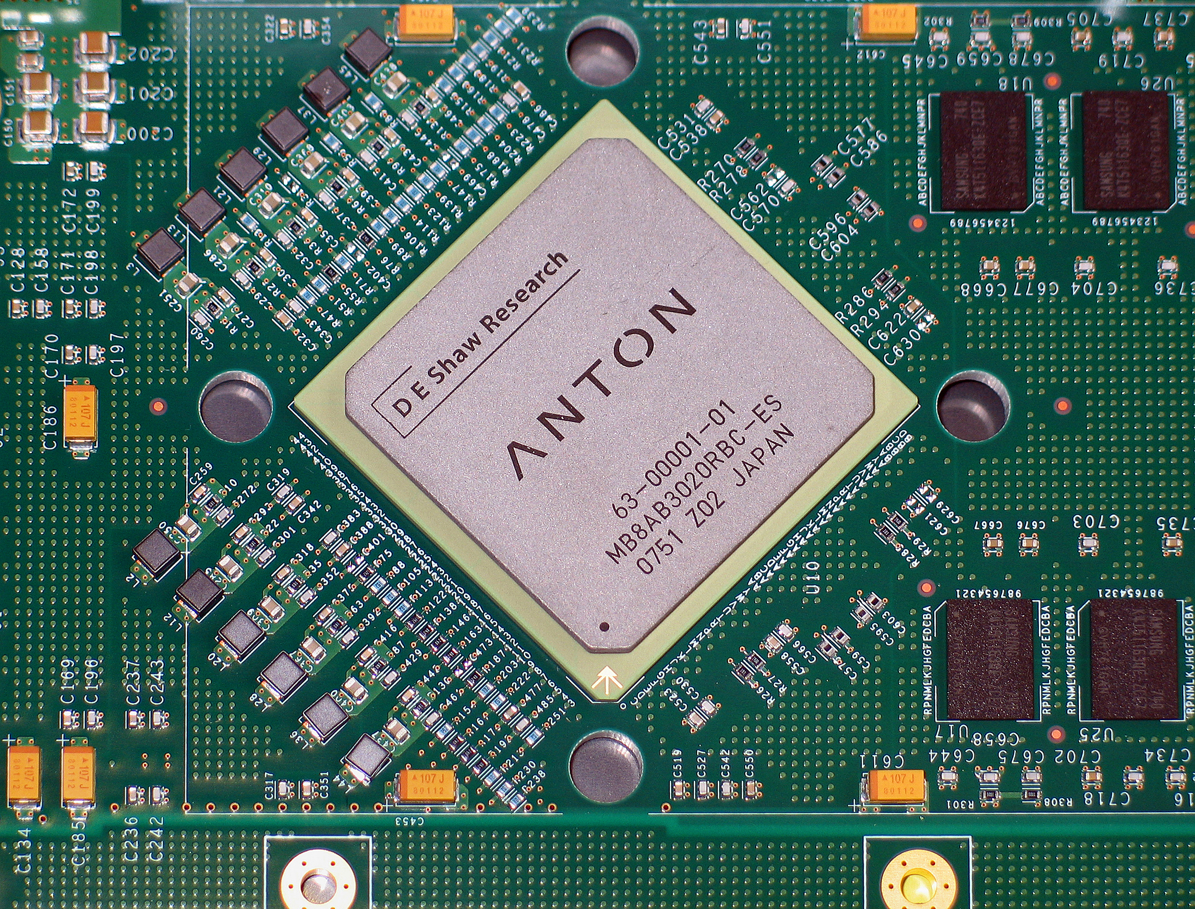
Petascale, exascale, Xtreme-scale, …, ASICS
A short story for the coffee time !
David E. Shaw Research
$$$script
hedge fund < parallel computing > billions | bioMDresearch > milliseconds
$$$
Application Specific
Integrated Circuits (ASICs)
designed for MD of proteins
ANTON

Slide 17

Protein Data Bank
Centralised repository for experimentals structures :
http://www.wwpdb.org/
Three portails :
- Europe : http://www.ebi.ac.uk/pdbe
- Japan : http://pdbj.org
- United-States : http://www.rcsb.org
May 2016 : 119137 Biological Macromolecular Structures
Berman, Nucl. Acids Res. (2000) 28 (1): 235-242,
doi: 10.1093/nar/28.1.235

Slide 18
A short tutorial
This tutorial is a shortened and discussed version of GROMACS tutorial
« Lysozyme in water » by Justin A. Lemkul, University of Maryland
We recommend you do the whole tuto online once back home
Plus you could drop Justin Lemkul an email to thank him !
(jalemkul@outerbanks.umaryland.edu)
http://www.bevanlab.biochem.vt.edu/Pages/Personal/justin/gmx-tutorials/lysozyme/
Our target protein (egg lysozyme) in a target solvent (water)
1/ Chose a model and generate input files
2/ Define a simulation box
3/ Solvate
4/ Add ions
5/ Energy minimization
6/ Equilibration NVT / NPT
7/ Production
8/ Analysis

Slide 19
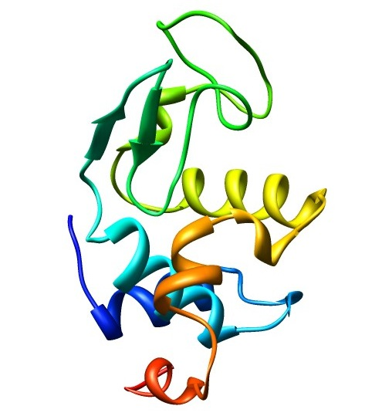
1/ Chose a model and generate input files
Our target protein (egg lysozyme) in a target solvent (water)
1/ get the structure from the Protein Data Bank
wget http://files.rcsb.org/download/1AKI.pdb

Slide 20
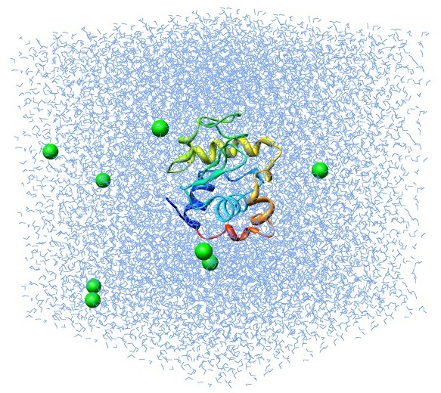
Follow the online tutorial ! This is just a summary
2/ remove water molecules
grep ^ATOM 1AKI.pdb > 1AKI_noWater.pdb
3/ put the protein in the simulation box
gmx pdb2gmx -f 1AKI_noWater.pdb -o 1AKI_processed.gro -water spce
gmx editconf -f 1AKI_processed.gro -o 1AKI_newbox.gro -c -d 1.0 -bt cubic
4/ solvate the protein (put water molecules inside the box)
gmx solvate -cp 1AKI_newbox.gro -cs spc216.gro -o 1AKI_solv.gro -p topol.top
5/ make the system neutral by adding ions
gmx grompp -f ions.mdp -c 1AKI_solv.gro -p topol.top -o ions.tpr
gmx genion -s ions.tpr -o 1AKI_solv_ions.gro -p topol.top -pname NA -nname CL -nn 8

Slide 21
Follow the online tutorial ! This is just a summary
6/ stabilize the generated system
gmx grompp -f minim.mdp -c 1AKI_solv_ions.gro -p topol.top -o em.tpr
gmx mdrun -v -deffnm em -ntmpi 8 -ntomp 1 -pin on
Plot the evolution of the energy to convince yourself it diminished
gmx energy -f em.edr -o potential.xvg
7/ stabilize the temperature to 300 K (takes few minutes)
gmx grompp -f nvt.mdp -c em.gro -p topol.top -o nvt.tpr
gmx mdrun -v -deffnm nvt -ntmpi 8 -ntomp 1 -pin on
Plot the evolution of the temperature to convince yourself it is fluctuating around 300K
gmx energy -f nvt.edr -o temperature.xvg
8/ Stabilize also the pressure to 1 atmosphere (takes few minutes)
gmx grompp -f npt.mdp -c nvt.gro -t nvt.cpt -p topol.top -o npt.tpr
gmx mdrun -v -deffnm npt -ntmpi 8 -ntomp 1 -pin on
Plot both pressure and density to convince yourself
gmx energy -f npt.edr -o pressure.xvg
gmx energy -f npt.edr -o density.xvg

Slide 22
Follow the online tutorial ! This is just a summary
9/ Production run ! The one you will extract something about your protein (takes few hours)
gmx grompp -f md.mdp -c npt.gro -t npt.cpt -p topol.top -o md_0_1.tpr
gmx mdrun -v -deffnm md_0_1 -ntmpi 8 -ntomp 1 -pin on
10/ Some examples of analysis
gmx trjconv -s md_0_1.tpr -f md_0_1.xtc -o md_0_1_noPBC.xtc -pbc mol -ur compact
gmx rms -s md_0_1.tpr -f md_0_1_noPBC.xtc -o rmsd.xvg -tu ns
gmx rms -s em.tpr -f md_0_1_noPBC.xtc -o rmsd_xtal.xvg -tu ns
gmx gyrate -s md_0_1.tpr -f md_0_1_noPBC.xtc -o gyrate.xvg

