Slide 1
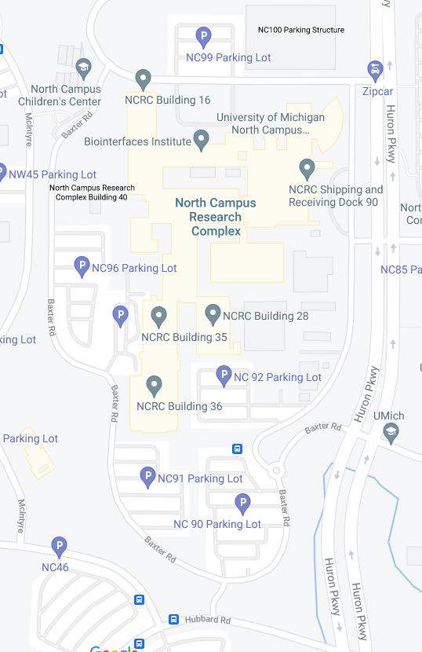
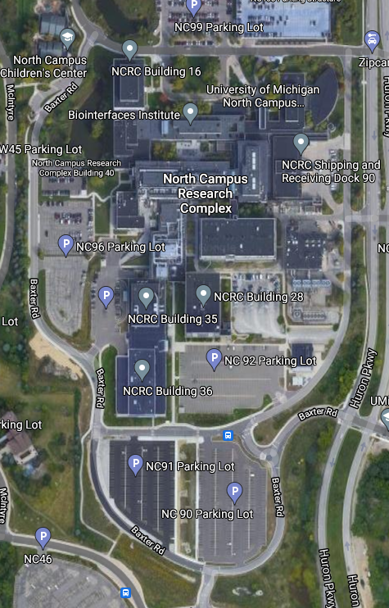
7
2
7
1
1
2
Intersection-1
1884 events
Intersection-2
1476 events
Intersection-3
336 events
Intersection-4
151 events
Intersection-5
237 events
Intersection-6
351 events
Intersection-7
2077 events
3
3
6
4
6
4
5
5

Slide 2

7
Totally 6512 intersection events
Very few cases when GPS initiates at the required intersection but immediately shift to the true(?) location
Need to check video but in general there will still be 6000+ events

