Slide 1


Diet indicies
Beta regression of Levins diversity index & Schoener overlap index with rectangle as random effect, year and density as covariates
0-1 bounded

Slide 2
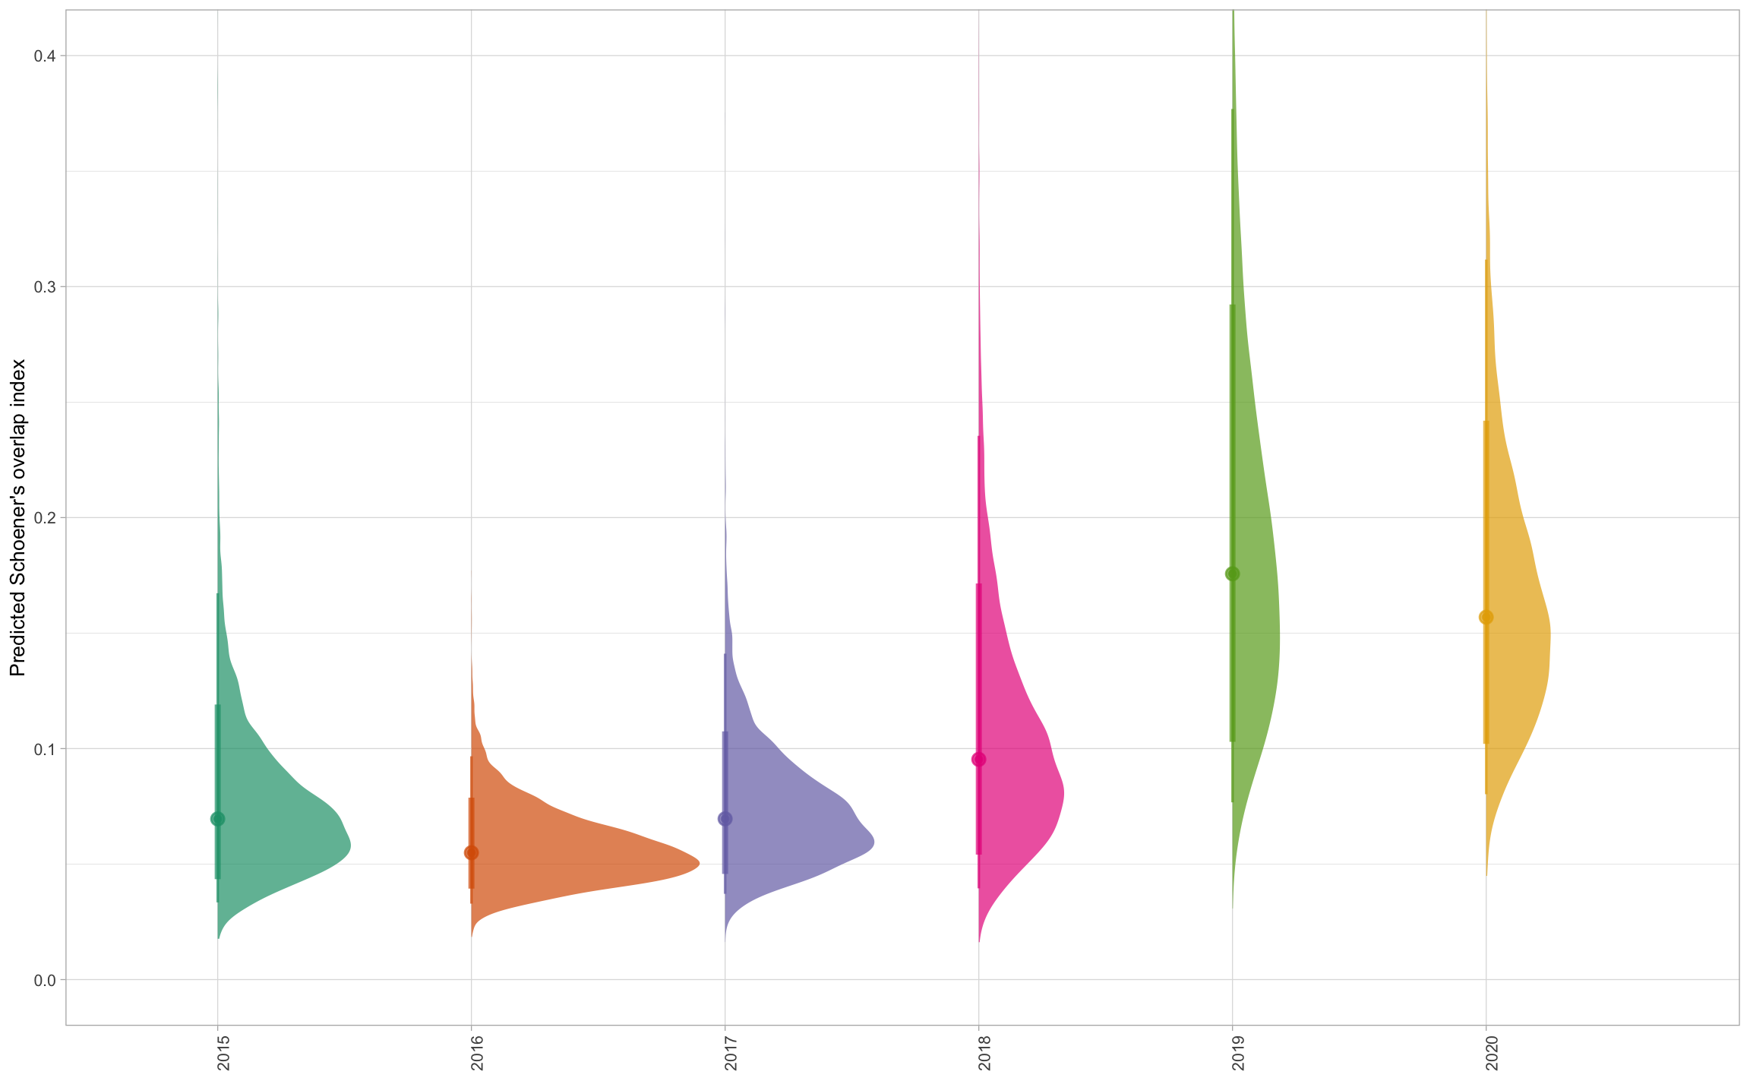
Quite low dietary overlap!
No size-effect yet though
Small effects of density covariates
loo selected the simplest model

Slide 3
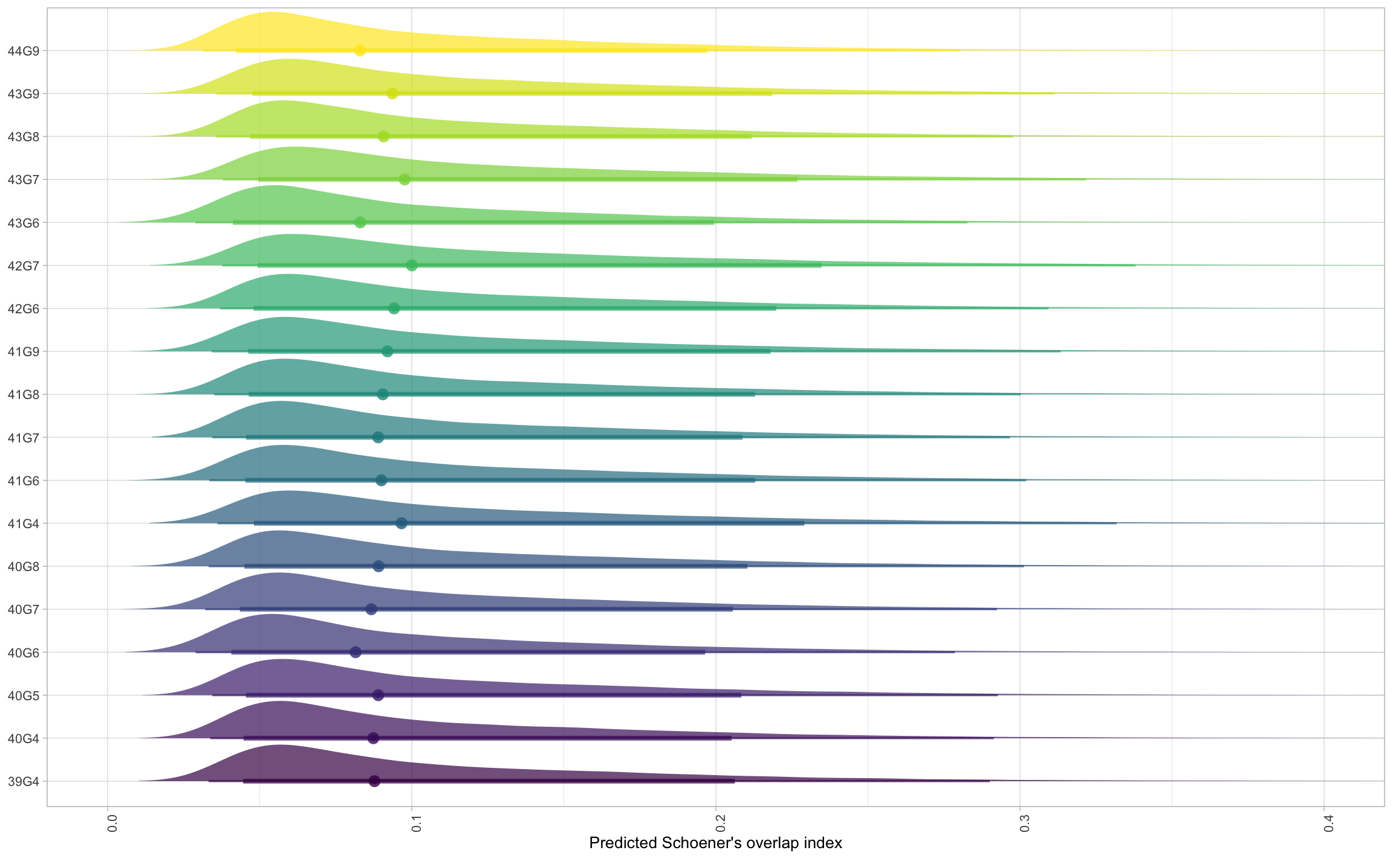
Little variation among rectangles

Slide 4
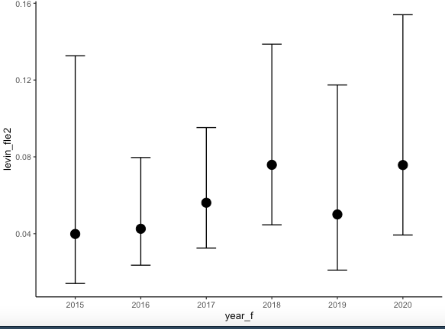
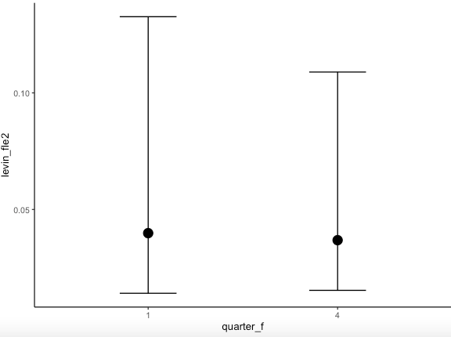
Levin index for flounder
Very specialist feeders
Small effect of year and quarter

Slide 5
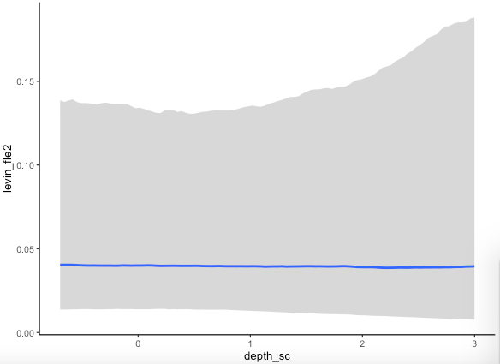
Levin index for flounder
Specialization does not change with depth

Slide 6
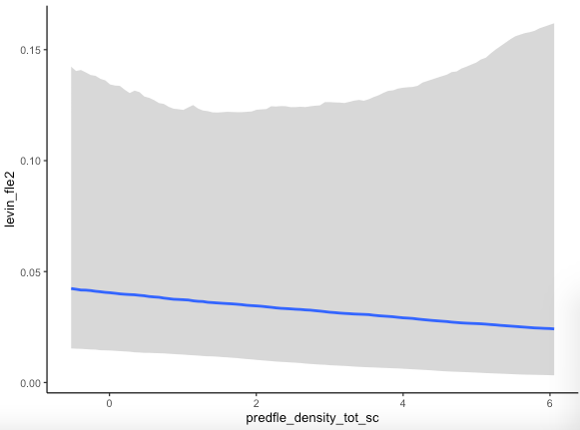
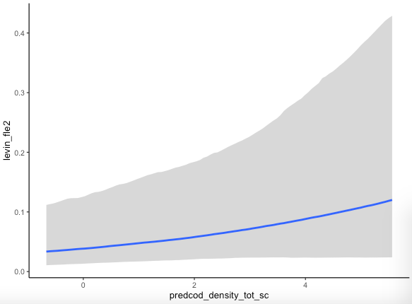
Levin index for flounder
Very minor effects of densities

Slide 7
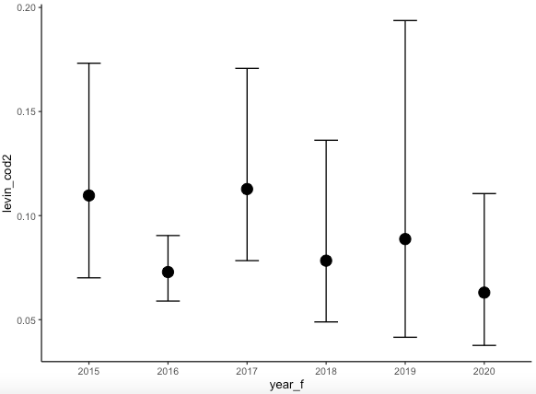
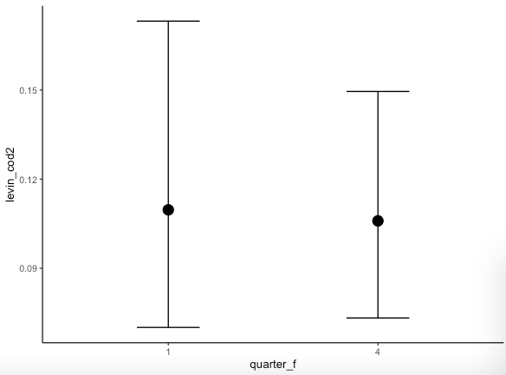
Levin index for cod
Slightly more diverse diets in cod, still quite specialized
No difference between years and quarters

Slide 8
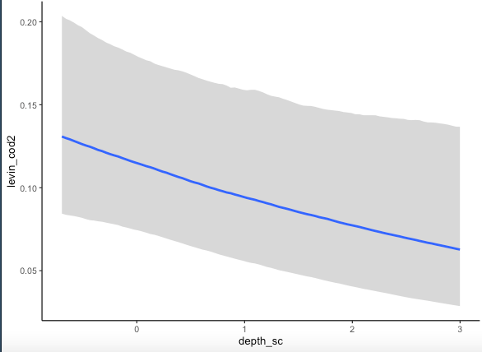
Levin index for cod
More specialized in deeper areas (fewer prey likely)

Slide 9
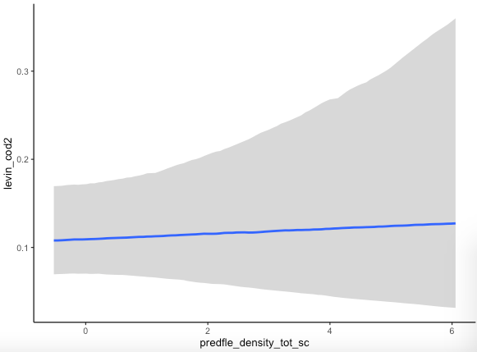
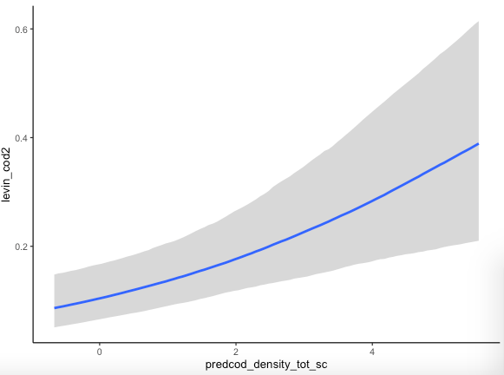
Levin index for cod
No effect of flounder, but looks like bigger effect of cod.
More diverse diets in high density cod rectangles

Slide 10
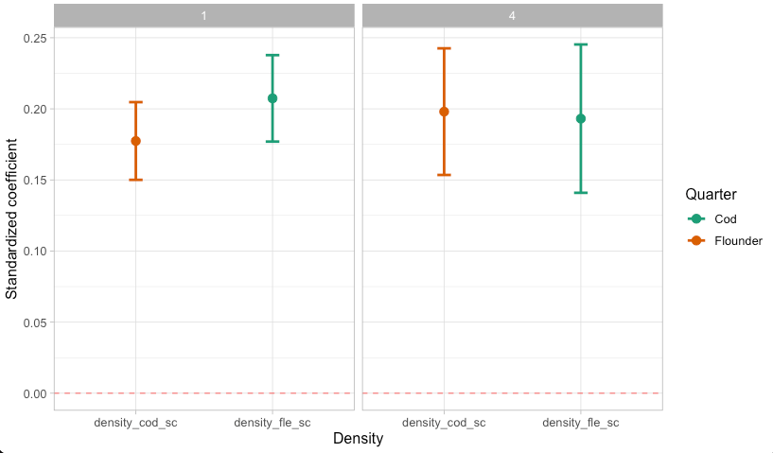
Density models: covariates
Positive association!

Slide 11
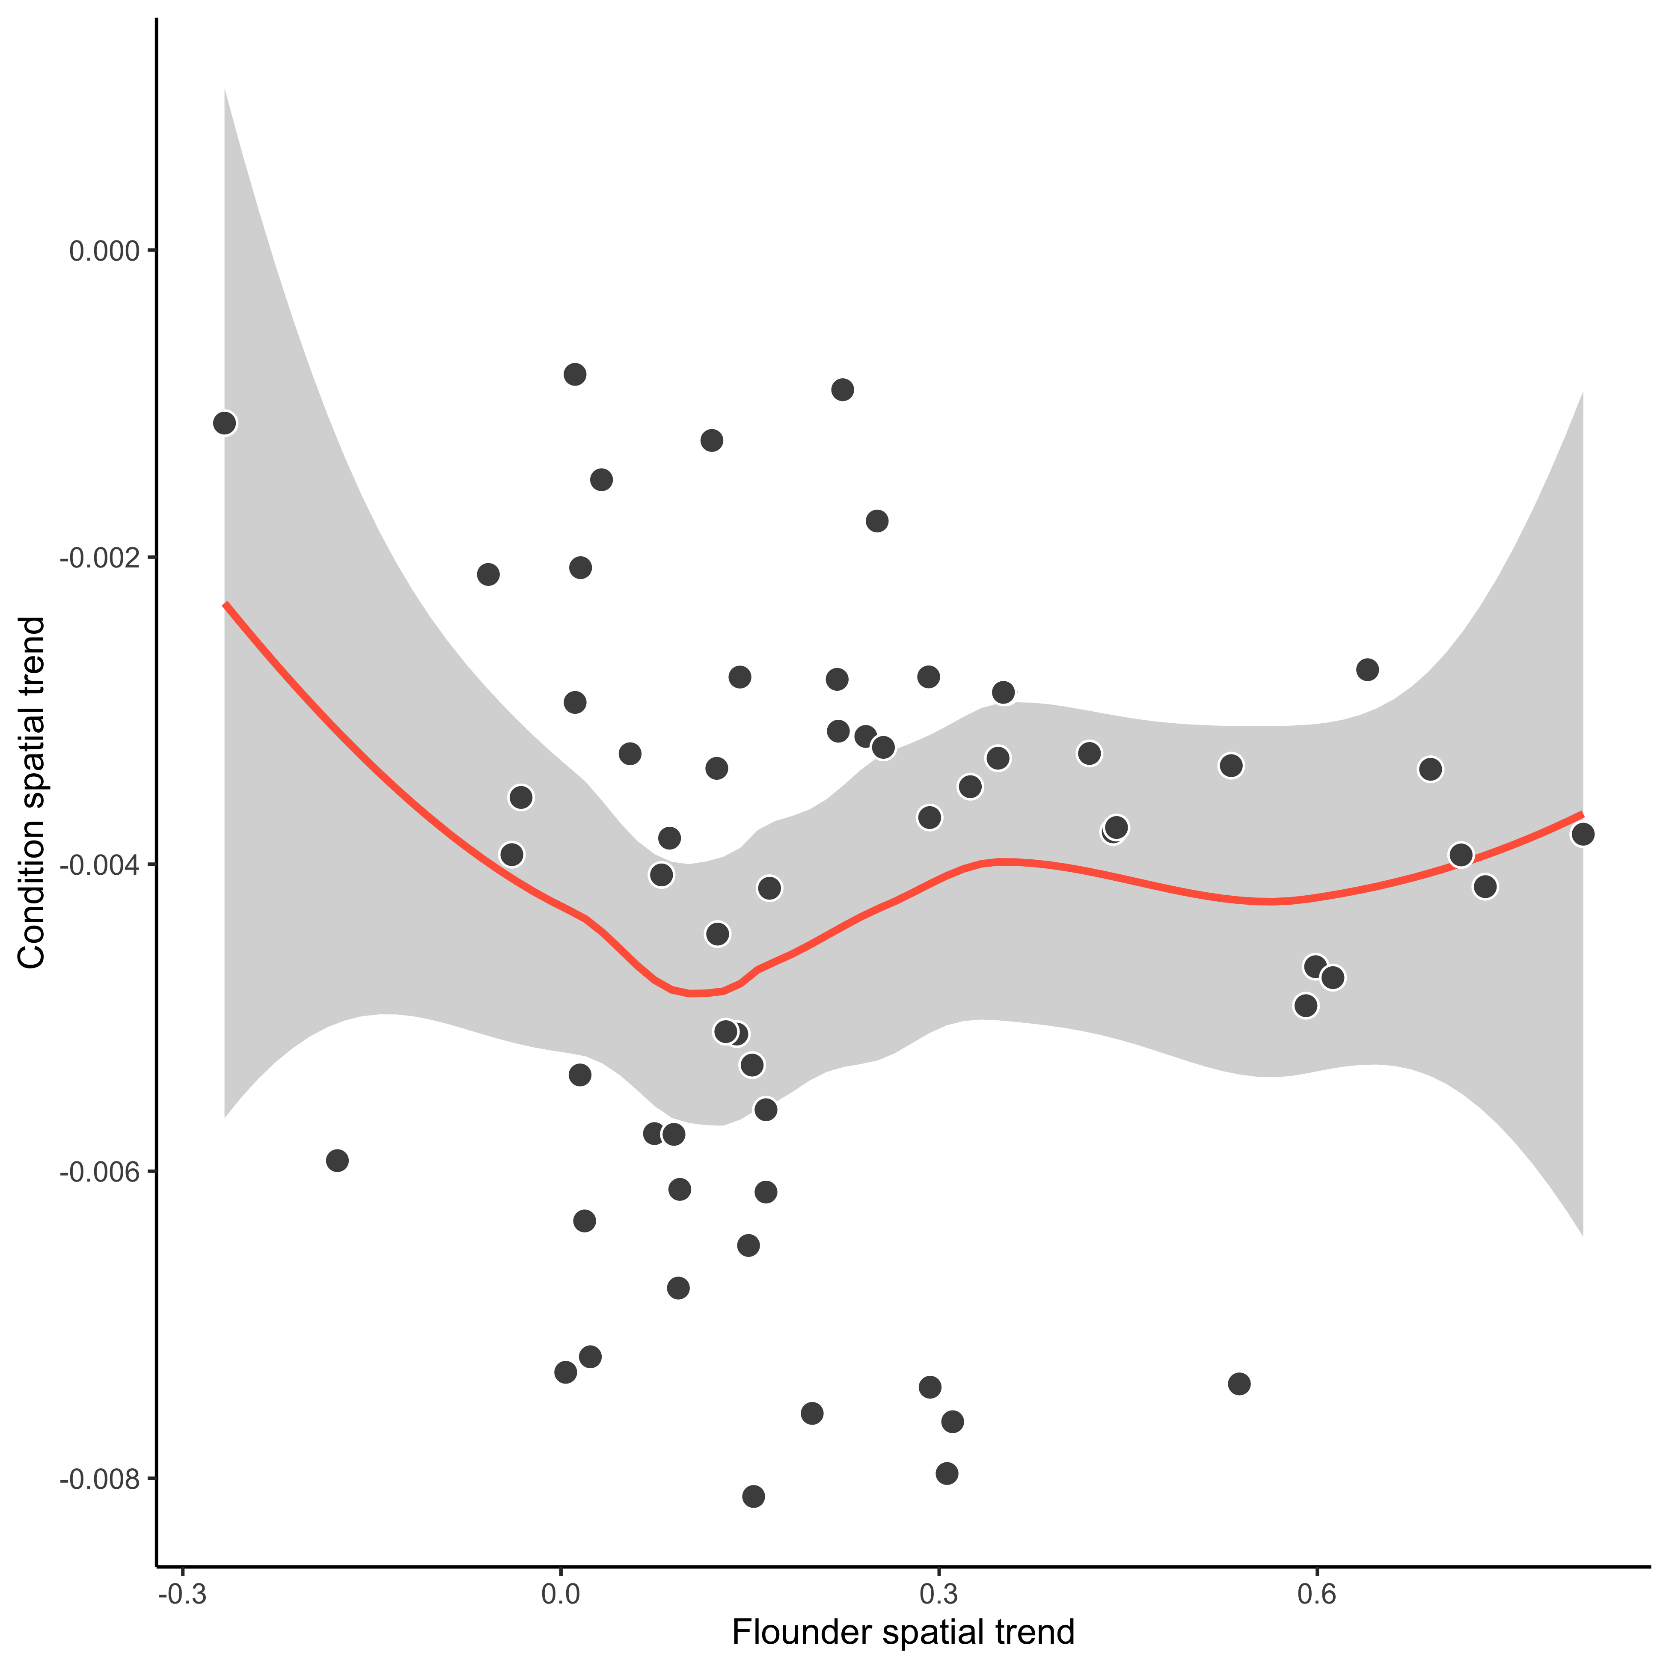
Density models: covariates
(No relationship between rate of change in flounder density and cod condition (rectangle level))

Slide 12
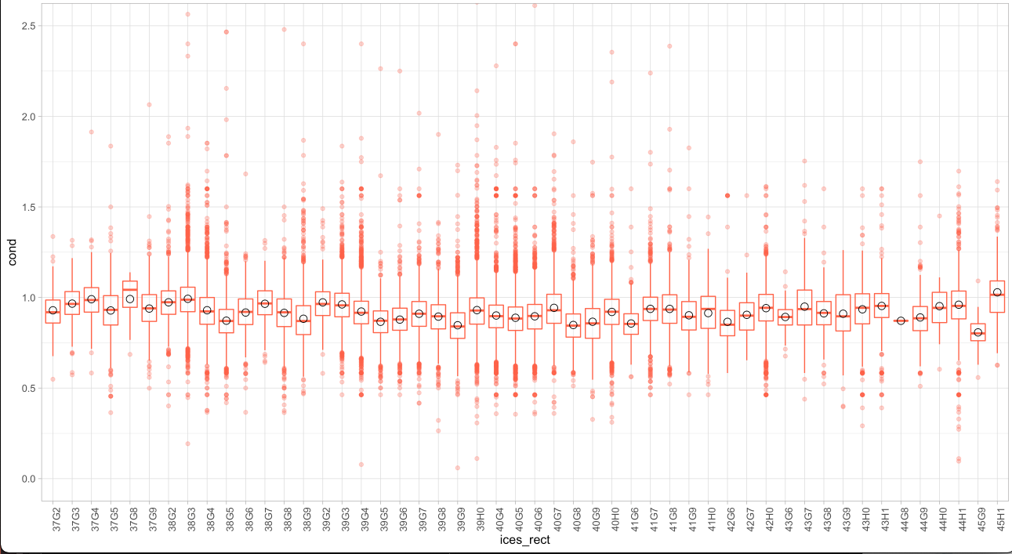
Scale for condition model

