Slide 1
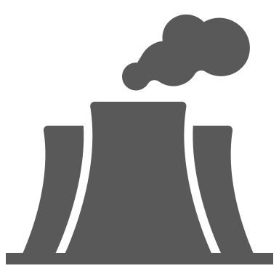
1 km
Heated lake
Warm
water outlet
Reference area
Nuclear reactors
Cooling water intake

